Slide 1
Lesson 10 American Government
State and Local Government
Questions: 41, 4, 5, 42, 2, 13, 45, 43, 44
1
Notes:
Lesson 10. American Government: State and Local Government.
This lesson explains the structure and function of state and local government in the United States.

Slide 2
A Federal System
Separate and Shared Powers
Federal State
Shared
print money
declare war
create an army
make treaties
establish post offices
regulate trade between
states and countries
establish rules for
naturalization
issue patents
provide schooling and education
provide protection
provide safety
give a driver’s license
approve zoning & land use
conduct elections
establish local governments
regulate trade within a state
collect taxes
borrow money
build roads
establish courts
provide for the general welfare
charter banks and corporations
make and enforce laws
2
Notes:
The U.S. Constitution sets up a federal system of government. This type of government has a central government at the top and state governments below. This creates a broader government, encourages experimentation and keeps the government close to the people. Federal and state governments share some powers such as establishing courts, making laws and collecting taxes. Other powers though belong to only one government or the other. Under the Constitution, some powers granted to the federal government are the ability to print money, create an army, declare war, and make treaties with other countries.

Slide 3
3
Notes:
Question 41. Under our Constitution, some powers belong to the federal government. What is one power of the federal government?

Slide 4
Question #41
4
Notes:
Some powers that belong to the federal government are the powers to
print money
declare war
create an army
and make treaties

Slide 5
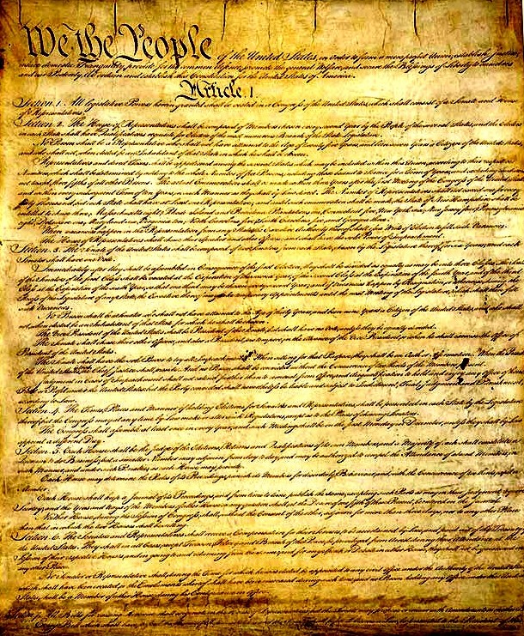
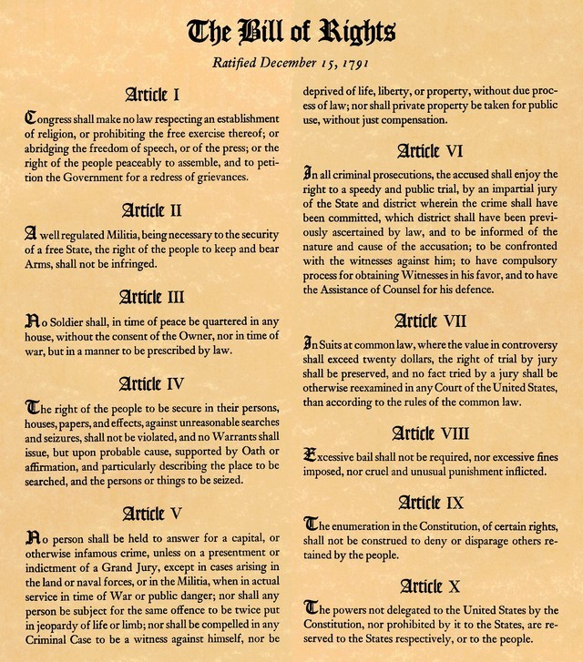
The Constitution and Bill of Rights
5
Notes:
The Founding Fathers included procedures to allow changes or additions to be made to the Constitution. These changes are called amendments. Because the original Constitution did not guarantee certain rights, including states' rights, Thomas Jefferson convinced James Madison to add a series of amendments to limit government power and guarantee certain individual rights. These first ten amendments to the Constitution are called the Bill of Rights.

Slide 6
6
Notes:
Question 4. What is an amendment?

Slide 7
Question #4
Notes:
An amendment is a change or addition to the Constitution.

Slide 8
8
Notes:
Question 5. What do we call the first ten amendments to the Constitution?

Slide 9
Question #5
Notes:
The Bill of Rights.

Slide 10
A Federal System
Separate and Shared Powers
Federal State
Shared
print money
declare war
create an army
make treaties
establish post offices
regulate trade between
states and countries
establish rules for
naturalization
issue patents
provide schooling and education
provide protection
provide safety
give a driver’s license
approve zoning & land use
conduct elections
establish local governments
regulate trade within a state
collect taxes
borrow money
build roads
establish courts
provide for the general welfare
charter banks and corporations
make and enforce laws
10
Notes:
While the Constitution gives the federal government certain definite powers, to protect states' rights and individual rights, the 10th Amendment says that any powers not given to the federal government belong to the states. Some state powers include providing schooling, education, protection and safety. Protection is police departments, and safety means fire departments. States also give driver’s licenses, and approve zoning and land use. Zoning and land use determines how land is used. This includes whether buildings can be built, what types of buildings can be built, and how they are used.

Slide 11
11
Notes:
Question 42. Under our Constitution, some powers belong to the states. What is one power of the states?

Slide 12
Question #42
12
Notes:
According to the Constitution, some of the powers that belong to states are providing schooling, education, protection and safety, giving driver’s licenses, and approving zoning and land use.

Slide 13
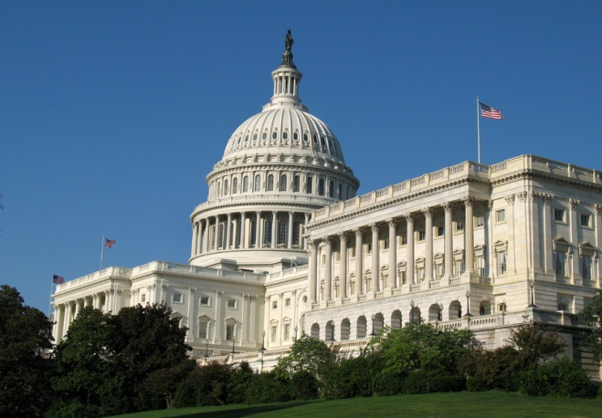
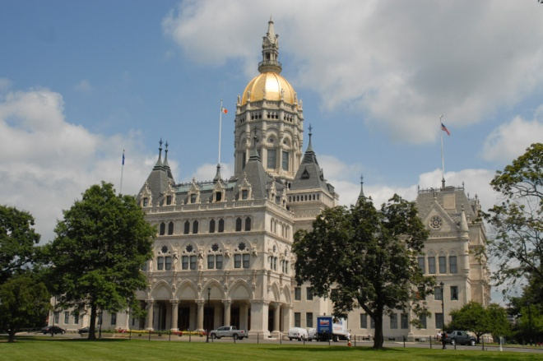
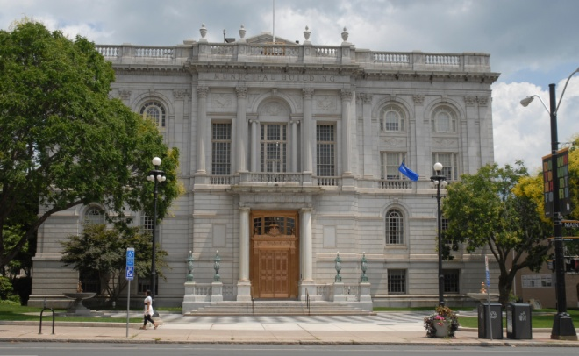
The Three Levels of Government
Federal Government
State Government
Local Government
(County, City, Town, Borough)
13
Notes:
The United States has three levels of government - federal, state and local. The federal government is the government in Washington D.C. It deals with foreign governments and national issues, creates all federal laws, and upholds the Constitution. In this way, what the federal government does affects all 50 states.

Slide 14
The Three Levels of Government
Federal
State (50)
Local (89,000⁺)
14
Notes:
The United States has three levels of government - federal, state and local. The federal government is the government in Washington D.C. It deals with foreign governments and national issues, creates all federal laws, and upholds the Constitution. In this way, what the federal government does affects all 50 states. Below the federal government are the 50 individual state governments. State governments have many of the same powers and responsibilities as the federal government, except their power is limited to the state. Below the 50 state governments are more than 89,000 local governments.

Slide 15
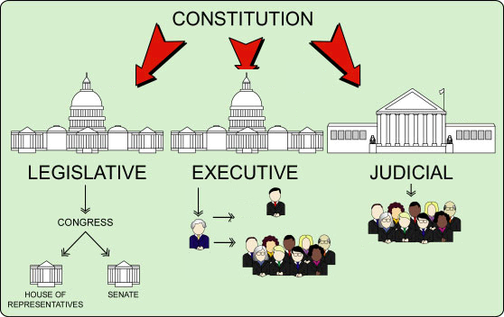
The Three Branches of State Government
State Constitution
GENERAL ASSEMBLY
LIEUTENANT GOVERNOR
STATE SUPREME COURT
|
COURTS OF APPEAL
|
SUPERIOR COURTS
GOVERNOR
EXECUTIVE OFFICERS
*
*Except Nebraska
15
Notes:
The U.S. Constitution sets up the federal government and protects the basic rights of all Americans. Every state also has their own constitution that does similar things. While there are many differences between state constitutions and governments, every state government has the same three branches as the federal government: a legislative, executive, and judicial.

Slide 16
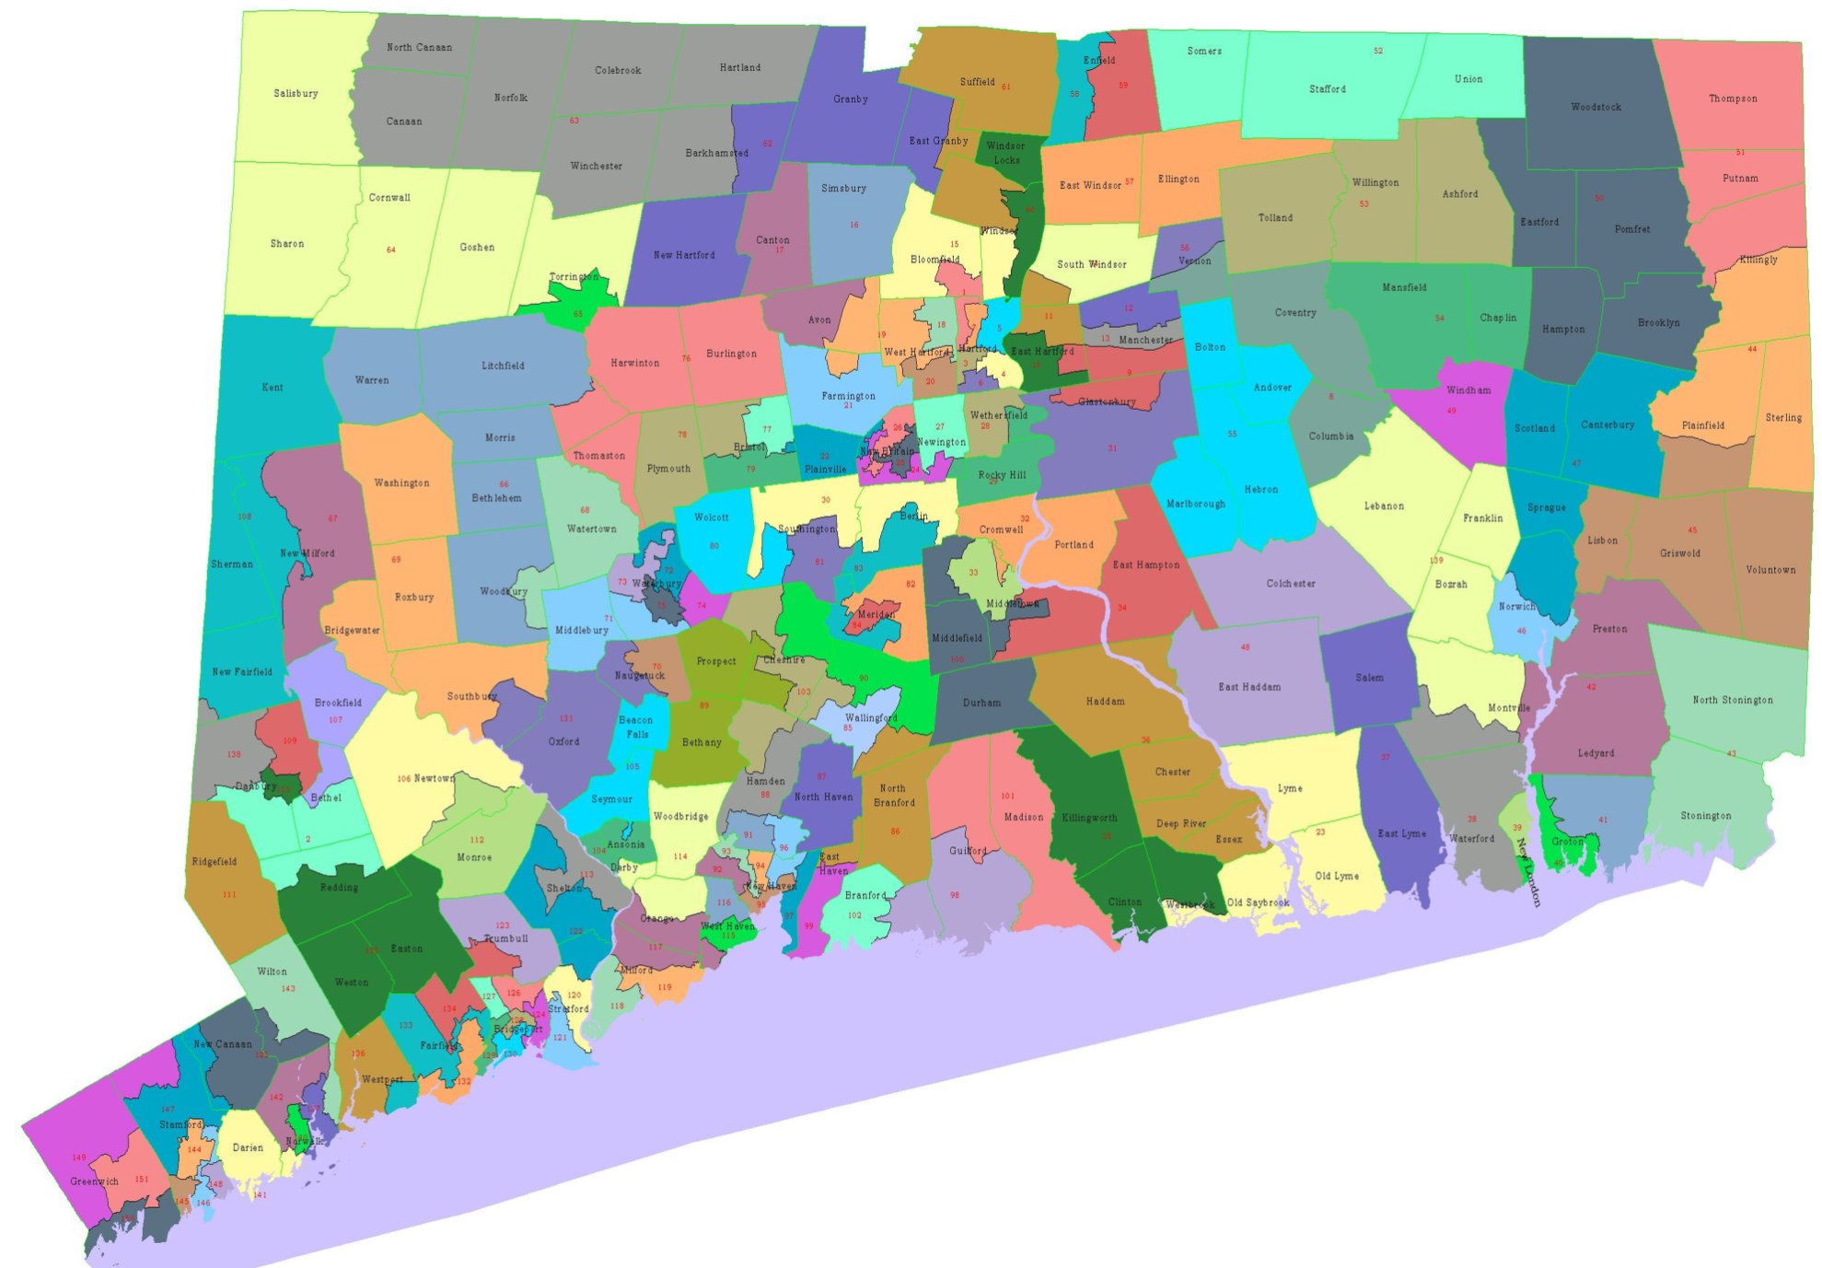
Representative Districts
16
Notes:
In every state except Nebraska, the legislative branch consists of a House of Representatives and Senate. In contrast, Nebraska only has one house of Congress. In Connecticut, the legislature is called the General Assembly and its job is to make state laws. Connecticut's General Assembly has 36 Senators and 151 Representatives. Both Senators and Representatives represent districts containing an equal number of citizens. All Connecticut Senators and Representatives serve 2-year terms and have no term limits.

Slide 17
17
Notes:
Question 2. What does the Constitution do?

Slide 18
Question #2
Notes:
The Constitution
sets up the government
defines the government
protects the basic rights of Americans

Slide 19
19
Notes:
Question 13. Name one branch or part of the government.

Slide 20
Question #13
20
Notes:
The three parts of the U.S. government are:
Congress, also called the legislative
the President, also known as the executive
and the courts, or the judicial branch

Slide 21
Connecticut State Capital, Hartford
21
Notes:
In addition to the governor, the executive branch in Connecticut includes a Lieutenant Governor, Treasurer, Secretary of State, Comptroller, and Attorney General. The Lieutenant Governor is like the Vice President. He or she is president of the senate, and becomes Governor should the Governor be no longer able to serve. The Treasurer is like a banker and manages all the money the state receives. The Comptroller /con-trol-ler/ is like an accountant and writes financial reports and manages the state's budget. The Secretary of State is responsible for state elections and all public records. The Attorney General is the state's chief legal advisor and chief law enforcement officer. Like the President and Vice President, the Governor and Lieutenant Governor are elected together. However, in Connecticut, members of the executive are not appointed, but elected separately. All members of the executive serve four-year terms, like the governor.

Slide 22
What Does a Governor Do?
A Governor
leads the state’s executive branch
proposes legislation
signs bills into law
enforces state laws
commands the state’s National Guard
can veto bills
serves 4 years with no term limit
22
Notes:
A governor has similar powers to the president. As head of the state executive, a governor leads the state’s executive branch, proposes legislation, signs bills into law, enforces state laws, and commands the state’s National Guard. Like a President, governors can also veto bills. However, the Connecticut governor can also use a line-item veto. A line-item veto allows the governor to reject parts of a bill without vetoing the whole bill. In 48 states, including Connecticut, governors serve four-year terms. In Vermont and New Hampshire, they serve two-year terms. Connecticut is also one of 14 states that have no term limit for governors.

Slide 23
Connecticut’s Executive Branch
Lieutenant Governor
President of the state senate
Treasurer
In charge of the state treasury
Secretary of State
In charge of all public records and elections
Comptroller
Oversees the state’s accounting
Attorney General
Chief legal advisor and law enforcement officer
23
Notes:
In addition to the governor, the executive branch in Connecticut includes a Lieutenant Governor, Treasurer, Secretary of State, Comptroller /con-trol-ler/, and Attorney General. The Lieutenant Governor is like the Vice President. He or she is president of the senate, and becomes Governor should the Governor no longer be able to serve. The Treasurer is like a banker and manages all the money the state receives. The Secretary of State is responsible for state elections and all public records. The Comptroller /con-trol-ler/ is like an accountant and writes financial reports and manages the state's budget. The Attorney General is the state's chief legal advisor and chief law enforcement officer. Like the President and Vice President, the Governor and Lieutenant Governor are elected together. However, in Connecticut, members of the executive are not appointed, but elected separately. All members of the executive serve four-year terms, like the governor.

Slide 24
The State Court System
State Supreme Court
Hears appeals from Appellate Court
Appellate Court
Hears appeals from lower courts
Superior Court
Hears serious cases and most trial cases
Special Courts (Probate, Family, Juvenile, Traffic, Small Claims, Municipal)
Hear special cases and minor cases
24
Notes:
The judicial branch is the state court system. State courts are independent from federal courts, although the two systems sometimes interact. Like the federal court system, each state court system has a highest court. In every state except New York and Maryland, this is the State Supreme Court. If serious enough, a case may move from the state's highest court to the U.S. Supreme Court. Below the top court are a series of lower courts. Appellate Courts are courts of Appeal and Superior Courts hear most serious and trial cases. In addition to the Superior Courts, there are several special courts that deal with minor cases and more specific areas such as juvenile crime, family matters, and traffic violations.

Slide 25
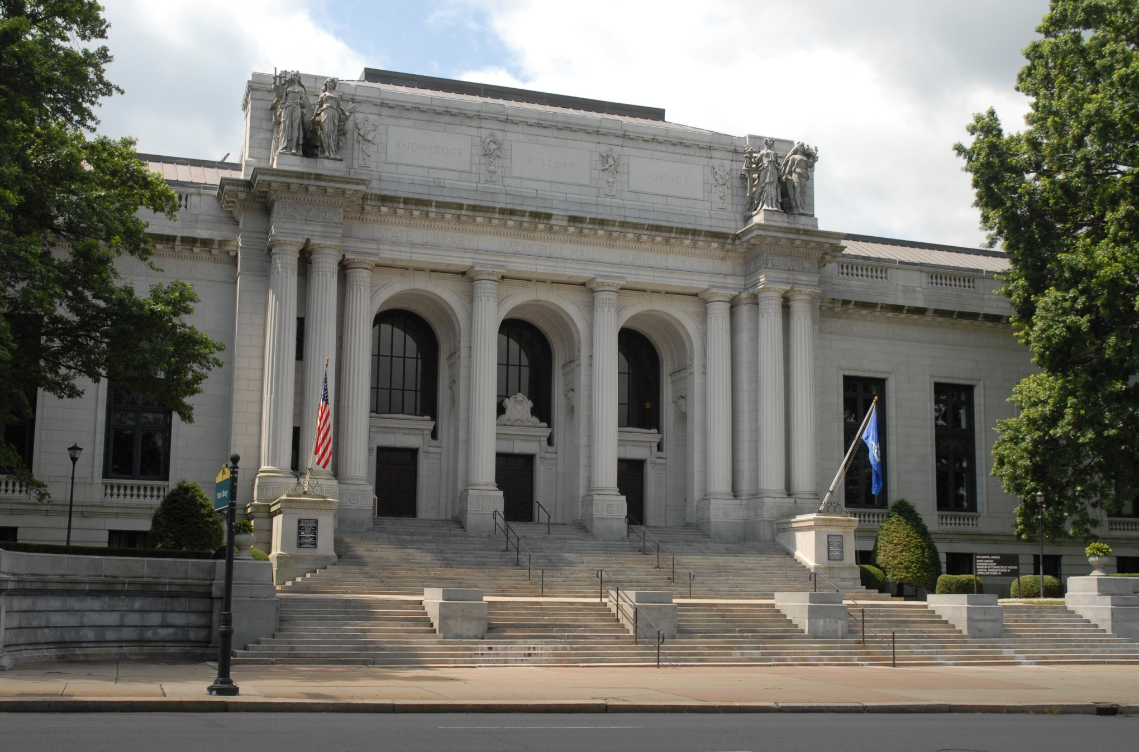
Connecticut Supreme Court
25
Notes:
Connecticut's highest court is the Connecticut Supreme Court. The court has seven justices, including one Chief Justice. Justices are appointed by the governor and approved by the General Assembly. There is no term limit, but Justices must retire when they turn 70.

Slide 26
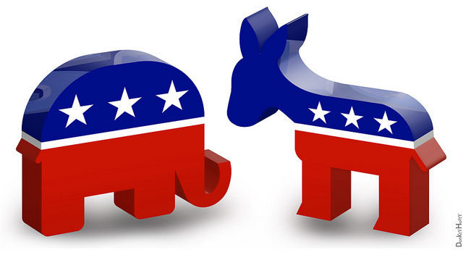
The Two Major Political Parties
Republican Democratic
26
Notes:
The two major political parties in the United States are the Democratic party and the Republican party. The elephant is the symbol of the Republican Party and the donkey represents the Democratic Party. While less common, a politician may also be an independent, which means he or she doesn't belong to a political party. Currently, there are two independent senators and several independent representatives in Congress. Both of Connecticut's senators and all five representatives are Democrats.

Slide 27
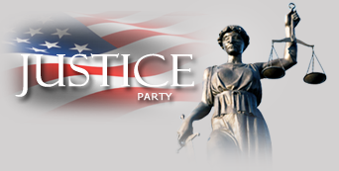
Third Parties Bring New Ideas
27
Notes:
For most of its history, the United States has had two major political parties, although the parties and policies have differed over time. Third parties are usually more successful in local elections, but very important in bringing new ideas into national politics. Women's voting rights, child labor laws, the 40-hour work week, and Social Security are all ideas originally promoted by third parties. Currently, the largest third parties in the U.S. are the Libertarian Party, Green Party, and Constitution Party. The Libertarian Party believes in very limited federal government. The most radical form would be a government that only provides police, prisons, courts, and a military. The Green Party promotes grass roots democracy, social justice, non-violence, and environmentalism. The Constitution Party wants greater power given to the states and a federal government guided by a strict interpretation of the Constitution.

Slide 28
28
Notes:
Question 45. What are the two major political parties in the United States?

Slide 29
Question #45
29
Notes:
The two major political parties in the United States are the Democratic and Republican parties. The elephant is the symbol of the Republican Party and the donkey represents the Democratic Party.

Slide 30
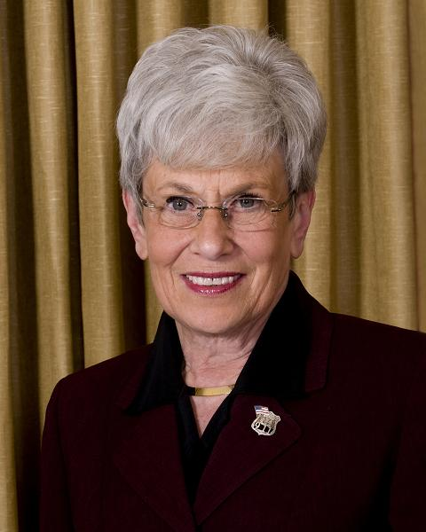
Connecticut’s Governors
Governor
(Dannel P.) Malloy
Lieutenant Governor
(Nancy) Wyman
30
Notes:
In 2010, Dannel Malloy was elected Connecticut's new governor. He is Connecticut's first Democratic governor in 20 years. Before he was governor, Malloy was the mayor of Stamford. The Lieutenant Governor is Nancy Wyman. She is also a Democrat and was Comptroller for 16 years before being elected Lieutenant Governor.

Slide 31
31
Notes:
Question 43. Who is the Governor of your state now?

Slide 32
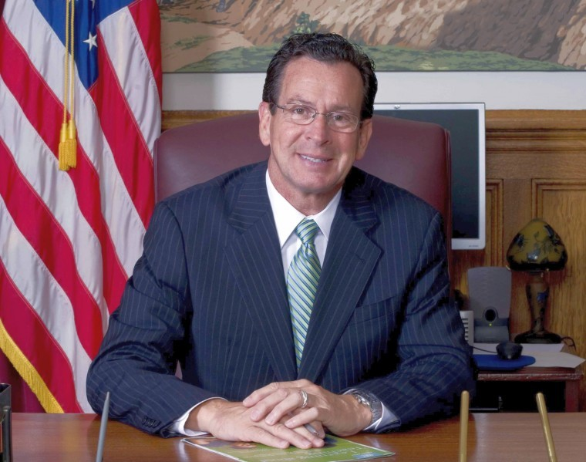
Question #43
(Dannel P.) Malloy
32
Notes:
Dannel Malloy. The Governor of Connecticut is Dannel Malloy.

Slide 33
Hartford
33
Notes:
Hartford is the capital of Connecticut, but Connecticut originally had two capitals, Hartford and New Haven. Every two years, the government moved from one city to the other. As Connecticut and its government grew, however, this arrangement became too inefficient. In 1873, a referendum was held to choose which city would become the state's only capital. Hartford won and, in 1879, a new state capital building was completed.

Slide 34
34
Notes:
Question 44. What is the capital of your state?

Slide 35
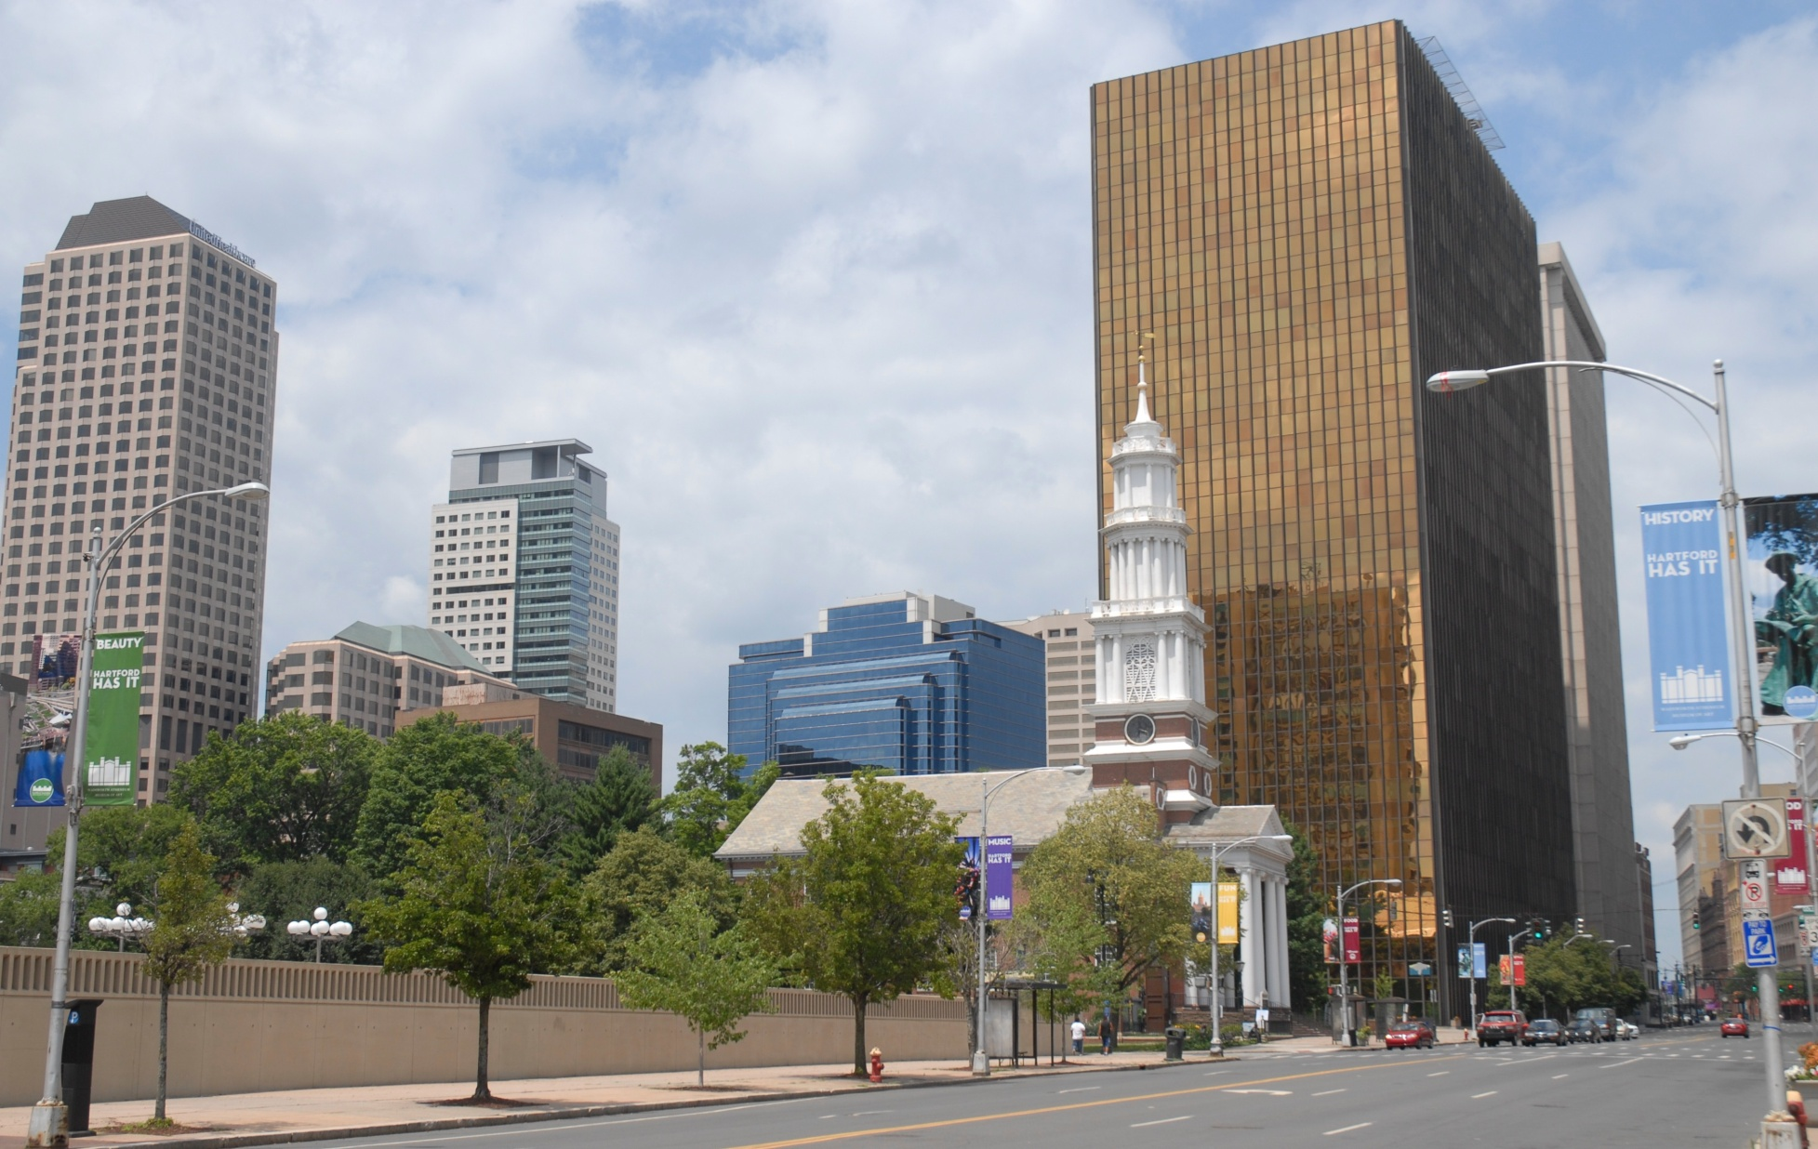
Question #44
Hartford
35
Notes:
The capital of Connecticut is Hartford. This is a picture of Main Street in downtown Hartford.

Slide 36
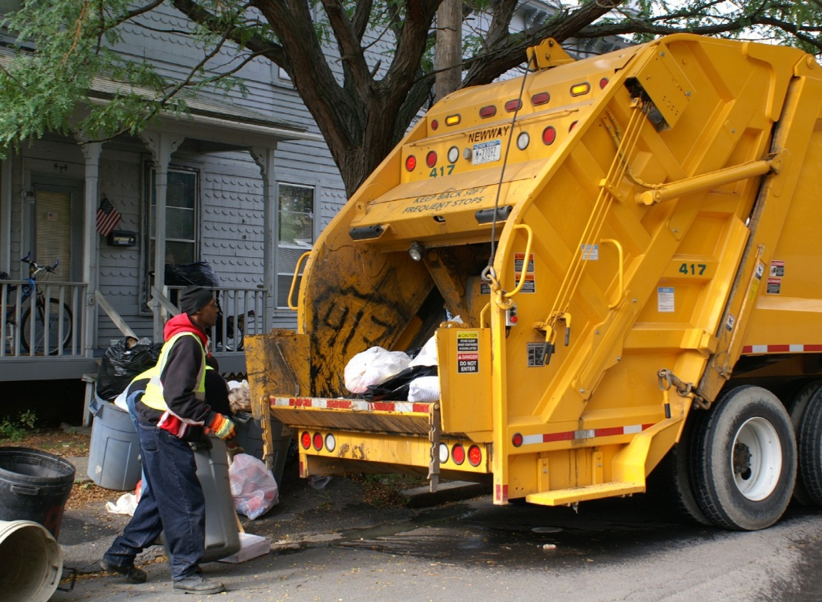
Local Government Services
Birth and Death Certificates
Housing Assistance
Leaf Collection and Snow Removal
Maintenance of Roads and Sidewalks
Marriage Licenses
Municipal Courts
Police and Fire Protection
Public Schools, Libraries, and Parks
Public Transportation
Street Lighting and Street Signs
Trash Collection
Voter Registration
36
Notes:
Under each state government are numerous local governments. The structure and function of local government varies depending upon the state. However, local governments have many of the same powers as federal and state government such as the power to make laws and to collect taxes. More importantly, they also provide services like police and fire departments, trash collection, street lighting, road maintenance, and voter registration.

Slide 37
Hartford City Hall
37
Notes:
Connecticut, like other states in New England, does not have county governments. Instead, local government is based on cities, towns, and boroughs. Cities and towns are equal under state law, while a borough is part of a town and therefore not fully independent. In Connecticut, cities are governed by a mayor and city council. Towns are run by either a mayor, first selectman, or town manager plus some form of council. In most Connecticut towns, legislative work is conducted through a town meeting. This is a form of direct democracy which allows citizens to directly express their views and vote on proposals. Most town governments have 4-year terms.

Slide 38
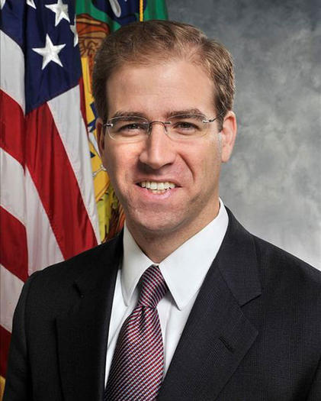
Hartford Mayor Luke Bronin
38
Notes:
The Mayor of Hartford is Luke Bronin. He is a Democrat and was elected in 2016.

