Slide 1
American History
Lesson 1A: The Colonial Period
Questions: 59, 58, 60, 87, 64
1
Notes:
1
Lesson 1A. The Colonial Period.
The Colonial Period is the time from the first European settlements in the early 1600s until 1776, when the 13 original states declared their independence from Great Britain.

Slide 2
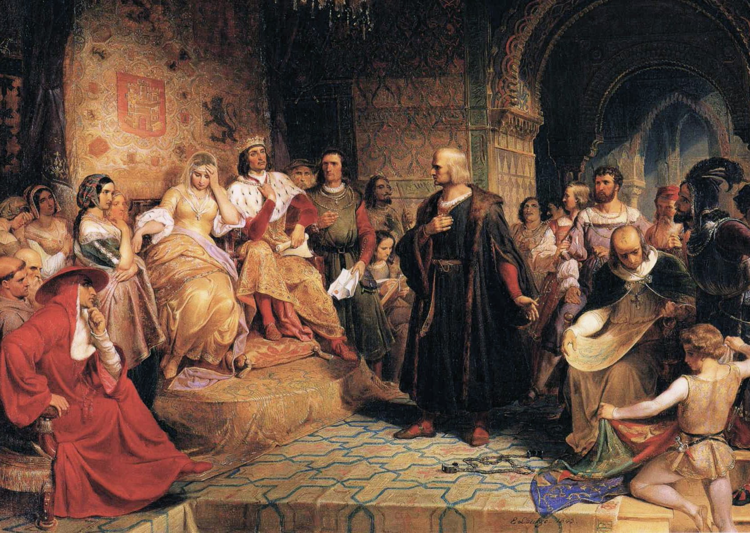
Christopher Columbus
2
Notes:
Christopher Columbus was an Italian navigator and explorer. For centuries, Europe bought spices and beautiful fabrics from Asia. However, the eastern trade route was very long and Columbus believed if he sailed west he could reach China and India more quickly. In 1492, the King of Spain gave Columbus three ships to sail west.

Slide 3
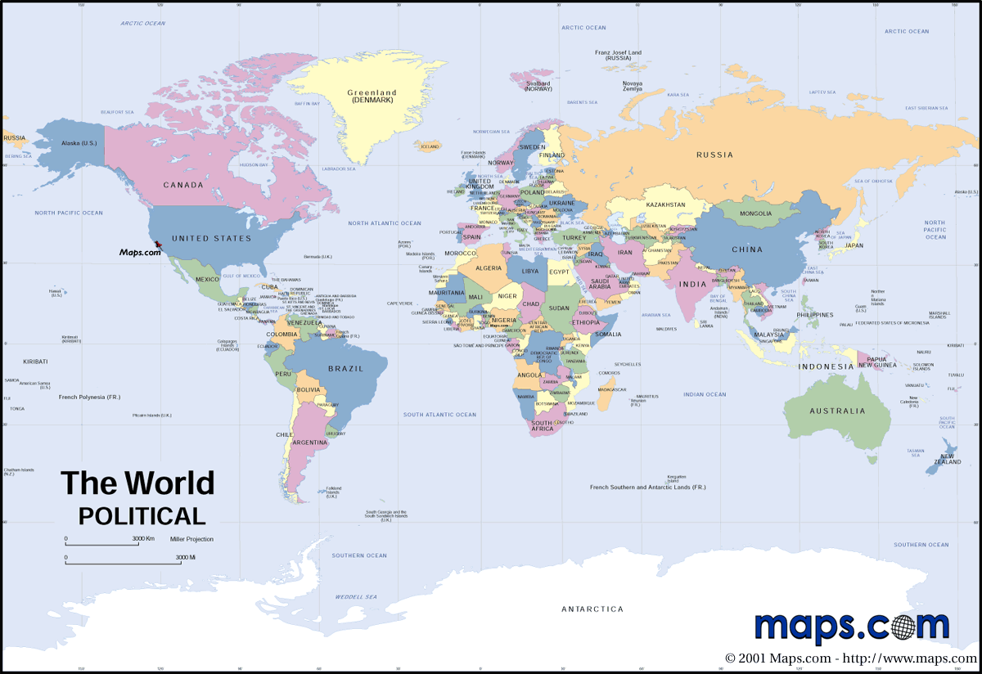
Notes:
The black arrows show the traditional way to India around Africa. The orange arrow shows the route Columbus used to try to get to Asia more quickly.

Slide 4
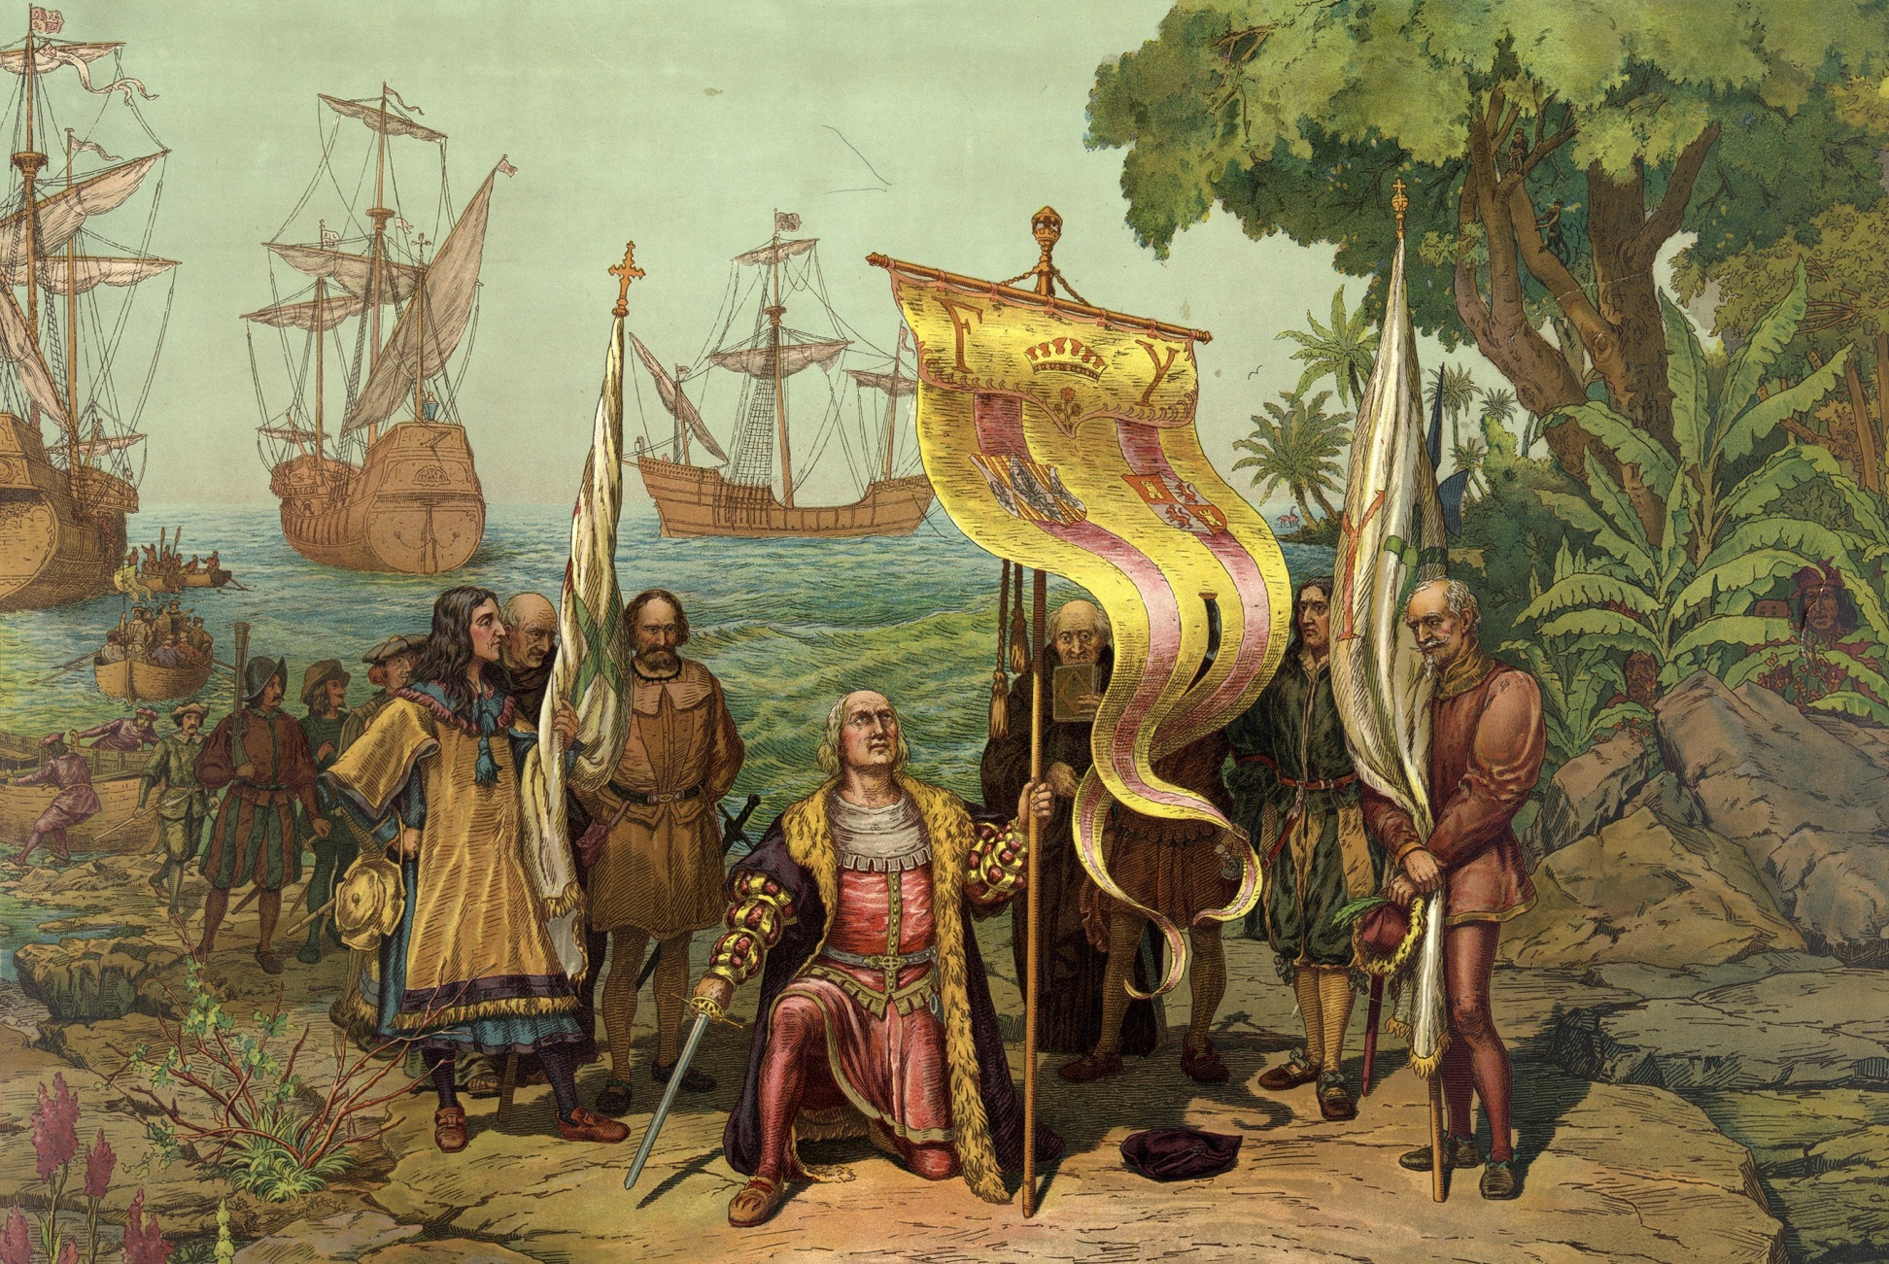
Columbus Discovers America
4
Christopher Columbus Taking Possession of the New Country, L. Prang & Co., 1893; {PD-1923}
Notes:
Columbus, of course, did not find a shorter route to Asia. Instead, he landed first in the Bahamas and thus 'discovered' America. However, as you can see on the right side of the picture, people were already living here when Columbus arrived. These people are now referred to as either Native Americans or American Indians. Even though people already lived in America, Europeans quickly settled in "the new world" and honored Columbus with a holiday. In the United States Columbus Day was made a national holiday in 1937.

Slide 5
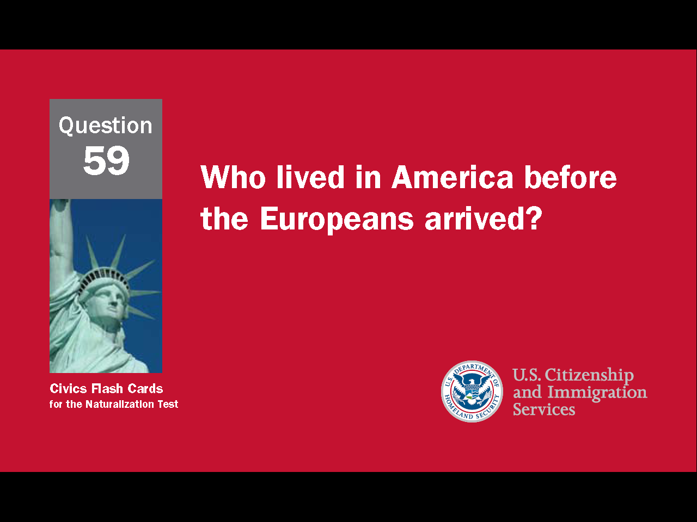
5
Notes:
Question 59. Who lived in America before the Europeans arrived?

Slide 6
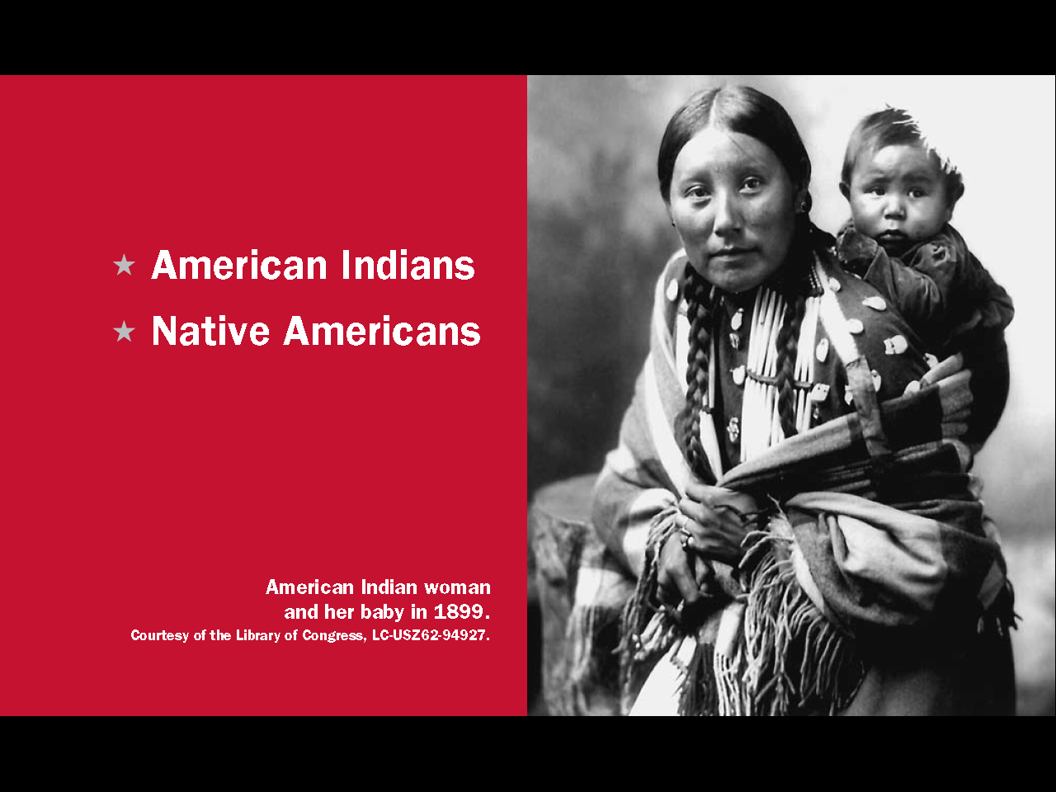
Question #59
Notes:
American Indians, or Native Americans, lived in the United States before the Europeans arrived.

Slide 7
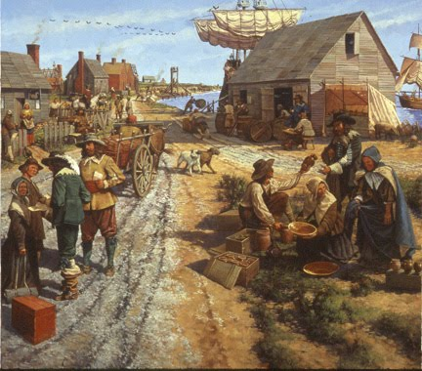
The First Colonies (1607-1732)
Notes:
In the early 1600s, immigrants from Great Britain began making colonies in America. Colonists came to America for many reasons including political, religious and economic freedom. Others came to escape persecution. In 1607, the first permanent British colony was created in Virginia. Most members of that colony came for economic reasons. The second successful colony was in Plymouth, Massachusetts. Plymouth was started by Pilgrims who came here for religious freedom. They sailed over on the Mayflower in 1620.

Slide 8
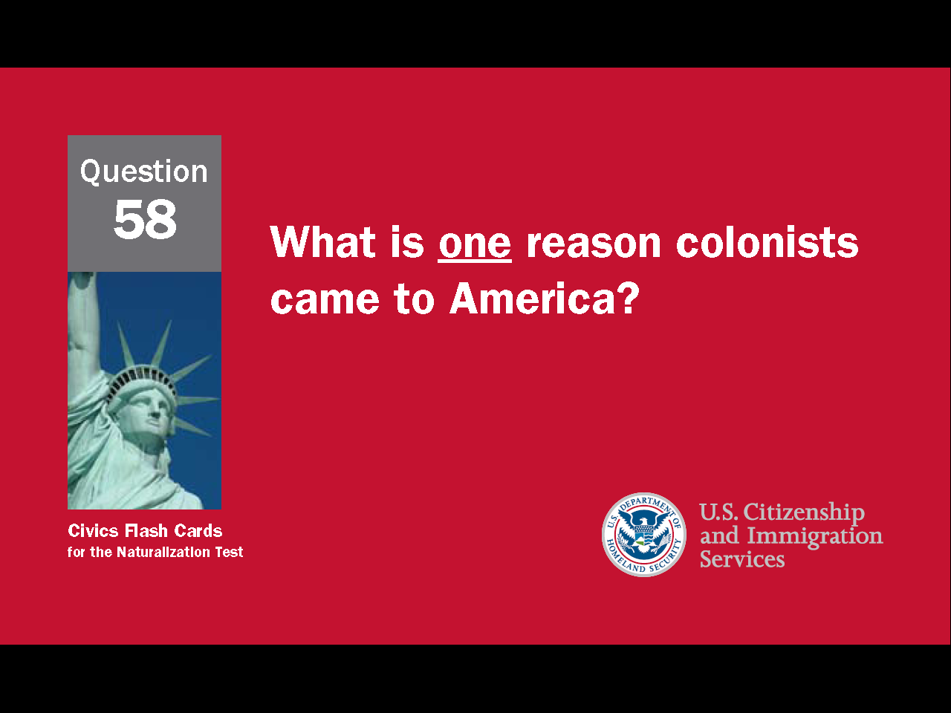
8
Notes:
Question 58. What is one reason colonists came to America?

Slide 9
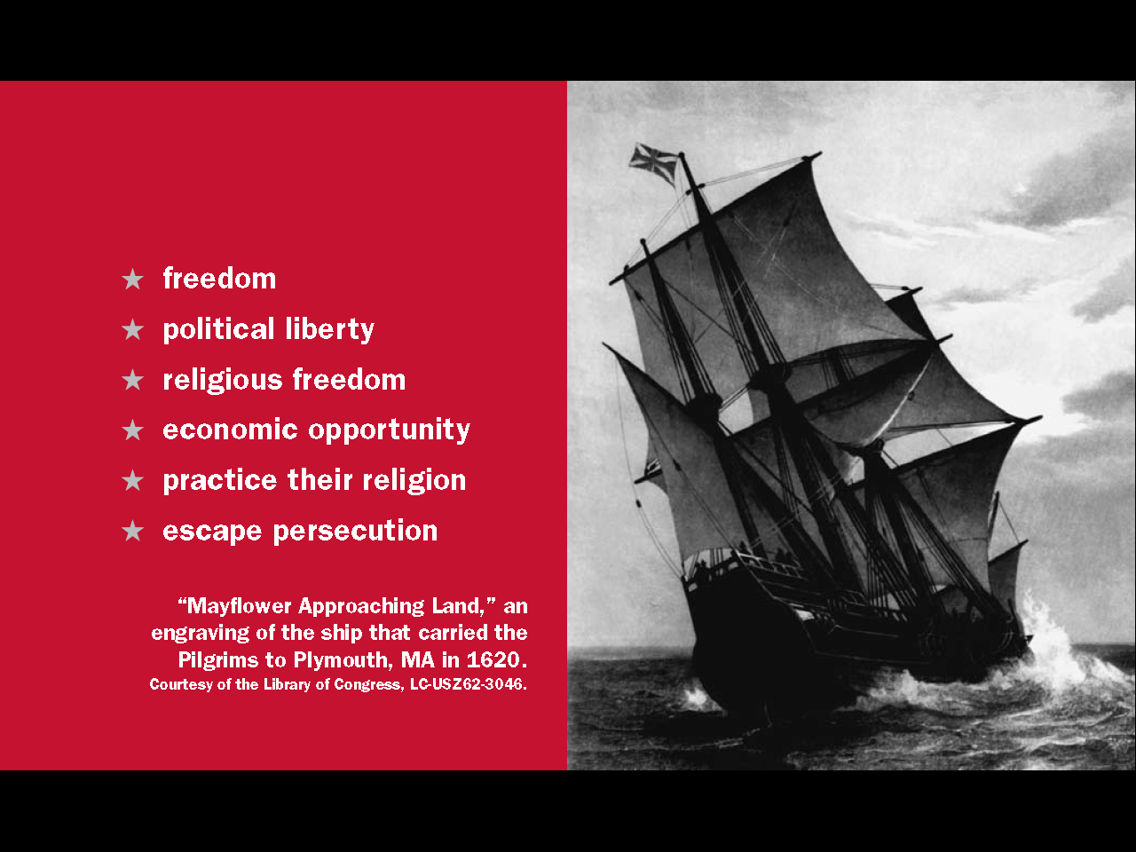
Question #58
Notes:
Colonists came to America for freedom. This idea includes political liberty, religious freedom, economic opportunity, and to escape persecution.

Slide 10
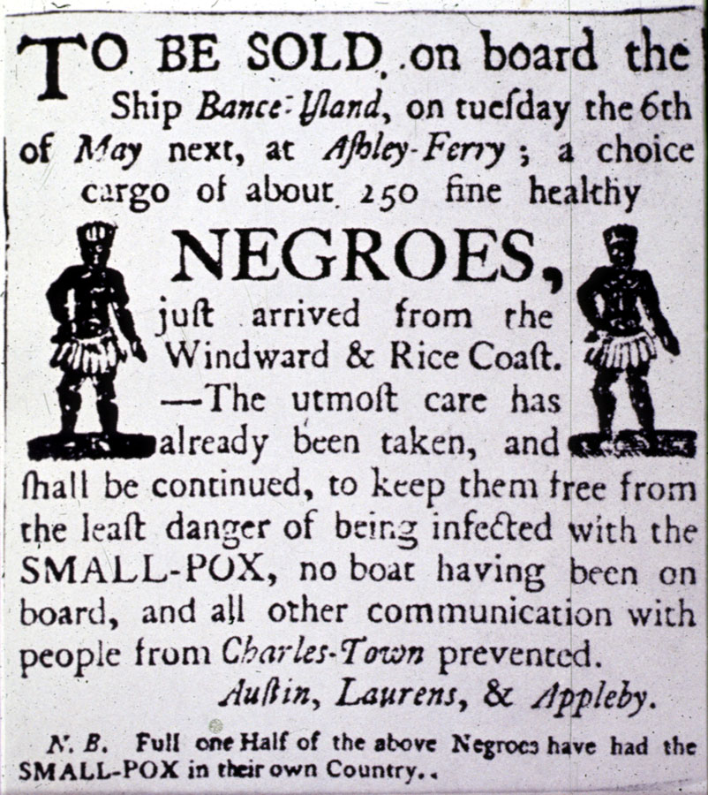
The Slave Trade
Source: Library of Congress, Prints and Photographs Division, LC-USZ62-10293
10
Notes:
Europeans came to America in search of freedom, but at the same time tens of thousands of Africans were brought here against their will and forced to work without pay or rights of any kind. These people are called slaves. By the end of the Colonial Period over 300,000 slaves had been brought to America. This advertisement for a slave sale was placed in a Charleston, South Carolina, newspaper in 1760.

Slide 11
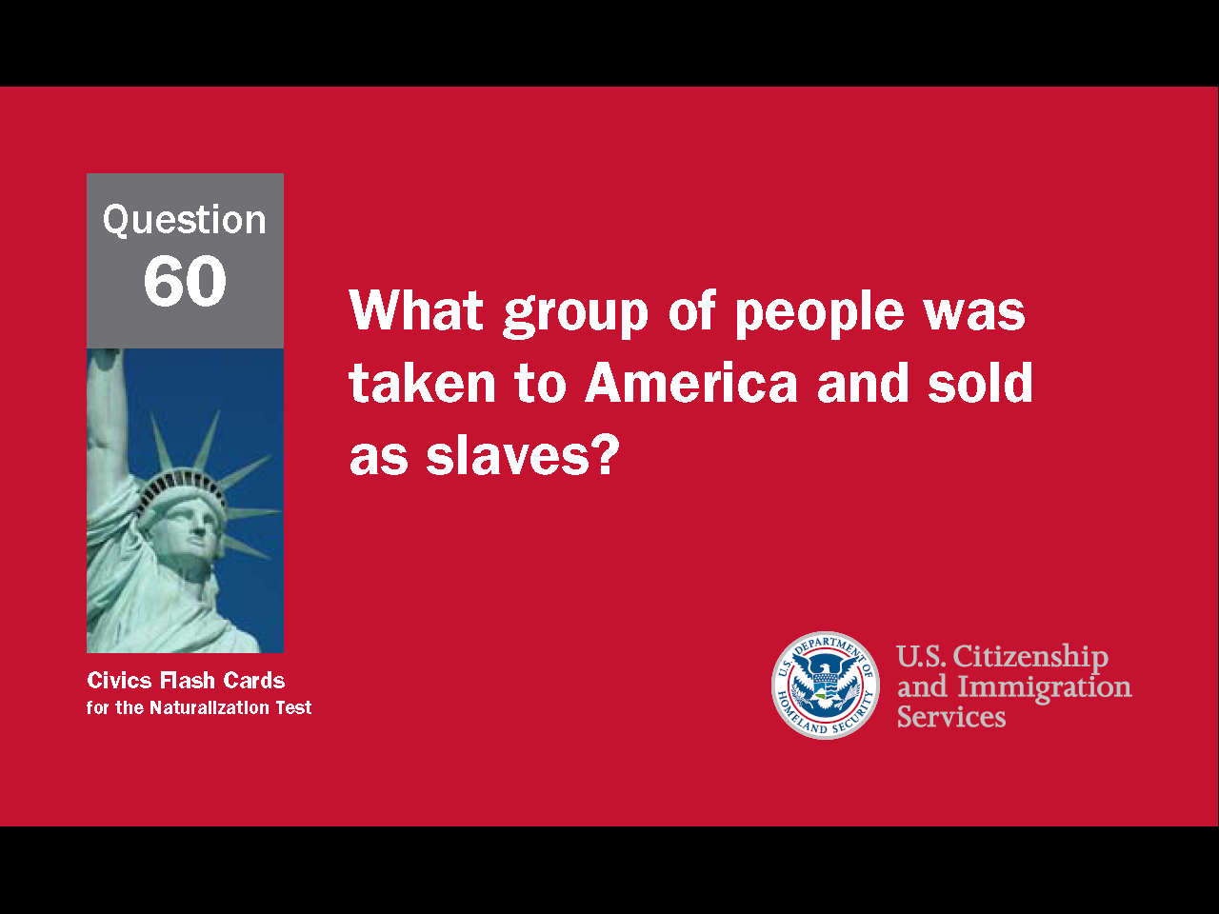
11
Notes:
Question 60. What group of people was taken to America and sold as slaves?

Slide 12
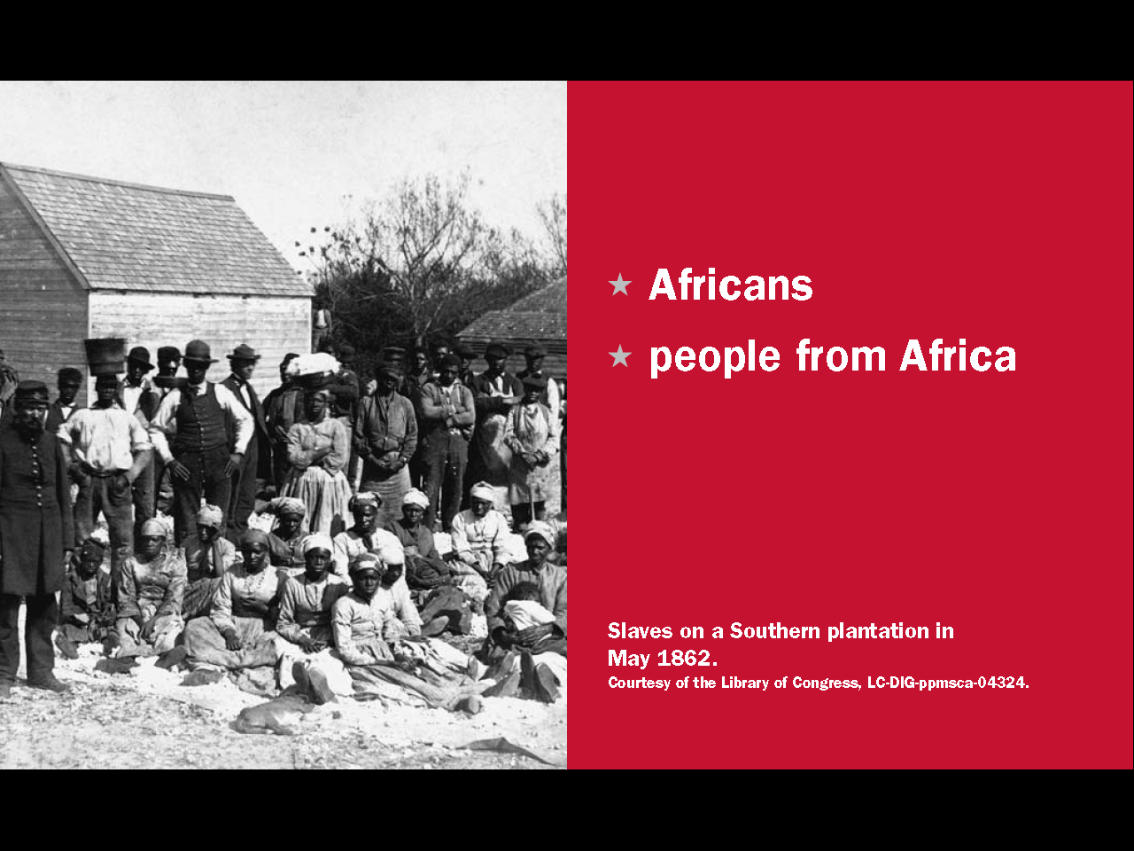
Question #60
Notes:
Africans, or people from Africa, were taken to America and sold as slaves.

Slide 13
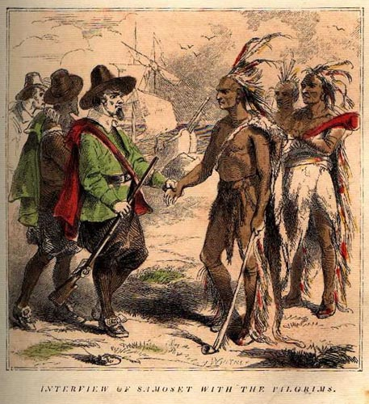
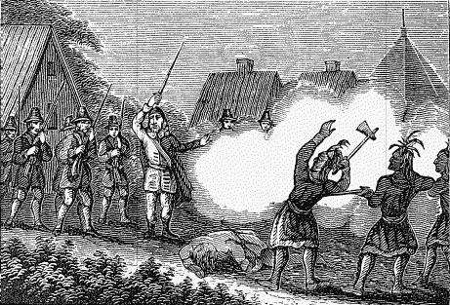
Colonists and Native Americans
Friendship, War, and Dislocation
Notes:
Relations between the colonists and American Indians were not always friendly. Villages on both sides were sometimes attacked and as more colonists came, violence became more common. Eventually, as America expanded west, many American Indian tribes were forced live far from their original homes in separate areas called reservations.

Slide 14
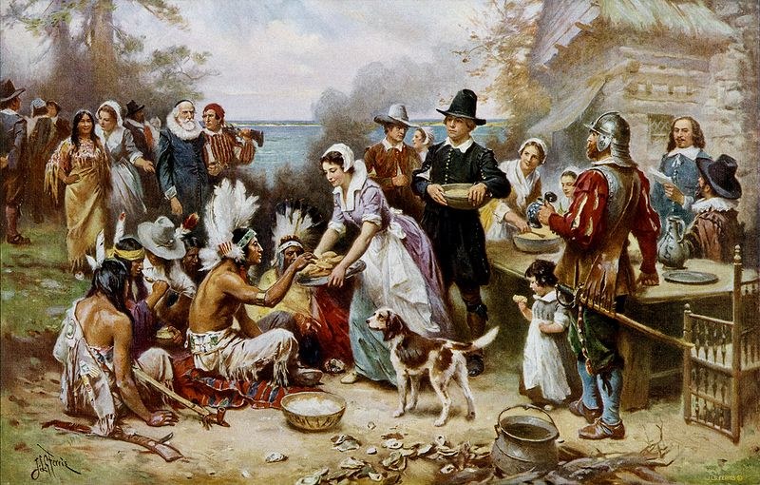
The First Thanksgiving
14
Notes:
However, the most famous example of peaceful relations between colonists and Native Americans is the holiday Thanksgiving. This holiday originated in the colony of Plymouth, Massachusetts. In 1620, over 100 Pilgrims sailed from England for America. Their first winter in America, half of the Pilgrims died. The next year a Native American tribe taught them how to farm. The colonists were very grateful and after their first successful harvest they invited the Native Americans to a feast. In 1863, President Abraham Lincoln made Thanksgiving an official holiday. He wanted it to be a day when Americans give thanks for what they have.

Slide 15
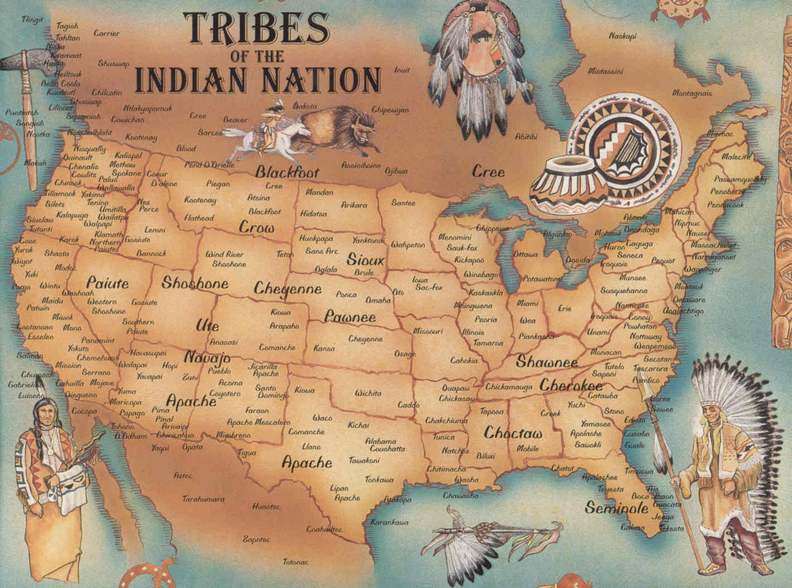
15
Notes:
There are over 500 Native American tribes in the United States. Two of the largest tribes in Connecticut are the Mohegan and Pequot. Some other tribes in the U.S. are the Cherokee, Crow, Sioux /soo/, and Navajo.

Slide 16
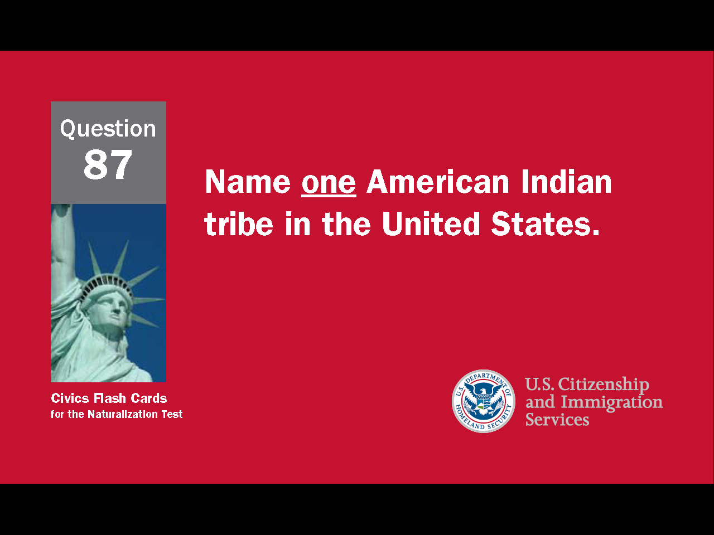
16
Notes:
Question 87. Name one American Indian tribe in the United States.

Slide 17
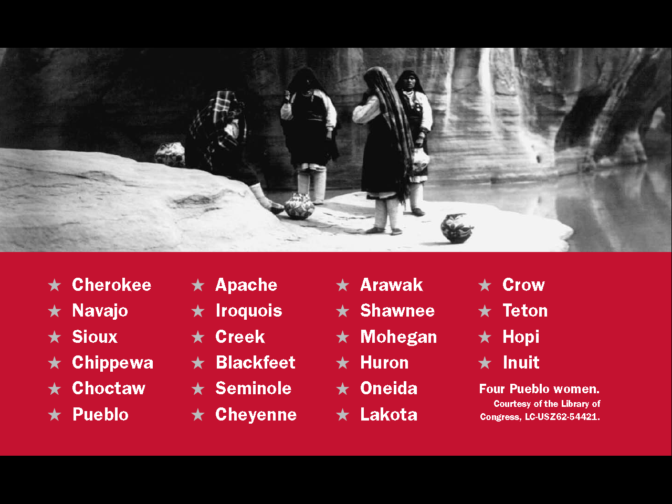
Question #87
Notes:
This page lists the names of twenty-two American Indian tribes, including the six mentioned on the previous page.

Slide 18
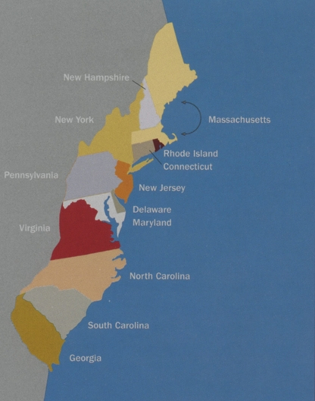
The 13 Original Colonies
Notes:
By the end of the Colonial Period, there were 13 original colonies along the east coast. Later, when the colonies declared independence from Great Britain the 13 original colonies became the first 13 states. At that time, New England contained only four states: Connecticut, Massachusetts, Rhode Island, and New Hampshire. The two other states were created later.

Slide 19
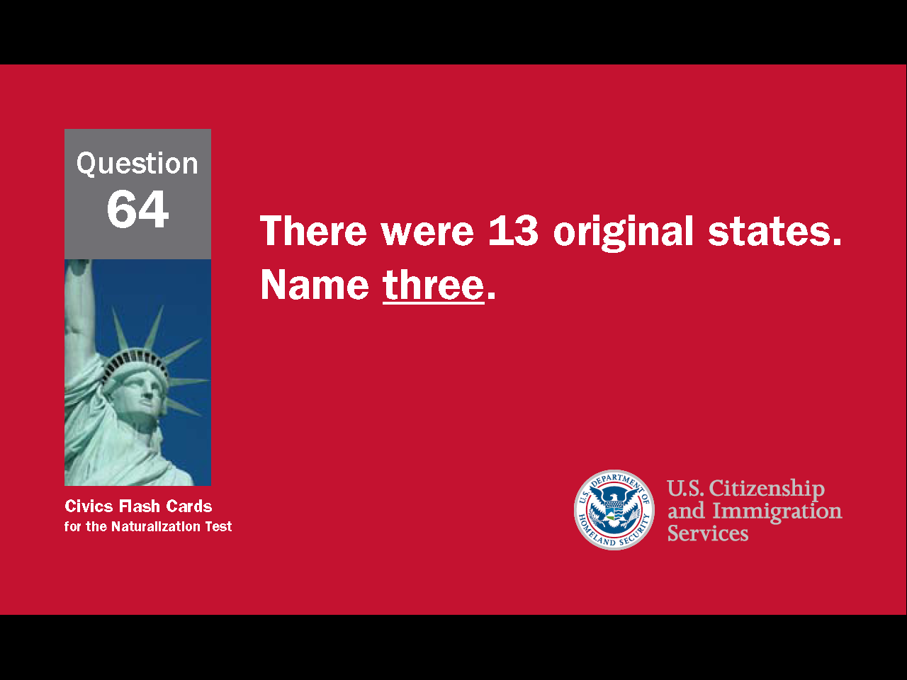
19
Notes:
Question 64. There were 13 Original Colonies. Name three.

Slide 20
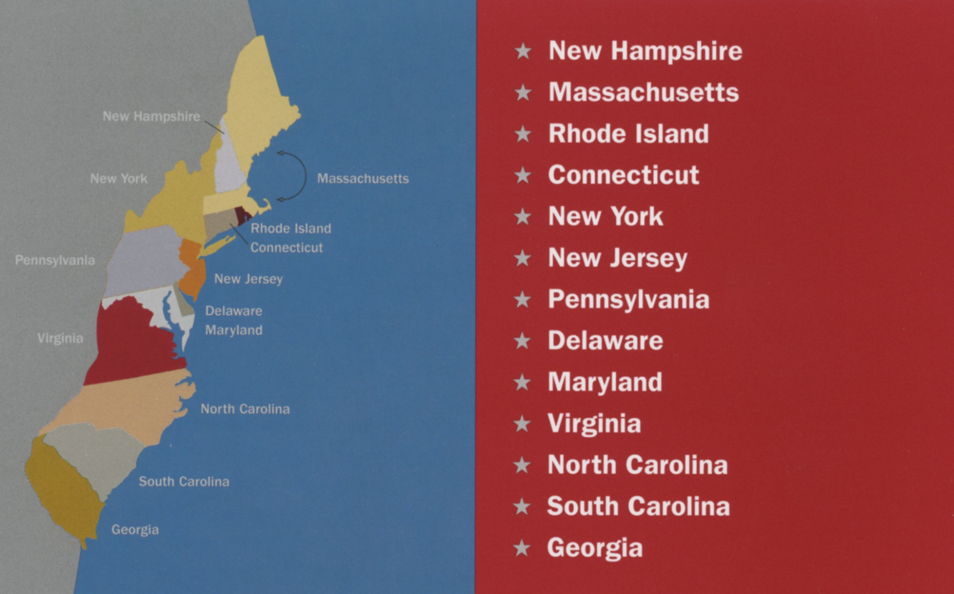
Question #64
20
Notes:
Connecticut, Massachusetts and Rhode Island were all original states. All three are next to each other. Three other original states are New York, New Jersey and Pennsylvania.

