Slide 1
American History
Lesson 1B: Independence
Questions: 61, 62, 63, 8, 9, 100, 99, 68, 69
1
Notes:
Lesson 1B. Independence.
This lesson explains how the 13 colonies won their independence from Great Britain. Years of growing tension between the colonies and Great Britain eventually led to the Revolutionary War and the creation of an independent United States of America. This lesson covers test questions 8, 9, 61, 62, 63, 68, 69, 99, and 100.

Slide 2
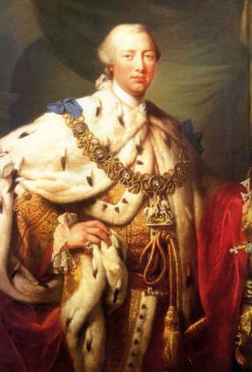
The Government of Great Britain
King George III
King of Great Britain
Not elected; inherited his power from his parents
Ruled Great Britain along with an elected Parliament
Americans had no representation in Parliament
Notes:
Great Britain was ruled by a king and a parliament. The King, George the Third, was the ruler. He inherited his power from his parents, he was not elected. Britain also had a parliament similar to the U.S. Congress, but American colonists had no representation in it.

Slide 3
Wars During the Colonial Period
King William’s War (1688–1697)
Queen Anne’s War (1702–1713)
King George’s War (1744–1748)
French and Indian War (1754–1763)
3
Notes:
During the colonial period, Great Britain fought four wars against Native Americans and the French to defend the 13 colonies. At the same time, they also fought four wars in Europe. To help pay for these wars, Great Britain had the colonists pay more taxes. However, since Americans had no representation in Parliament, they complained that this was "taxation without representation" and therefore unfair. The colonists wanted more self-government and control over their own laws and basic rights.

Slide 4
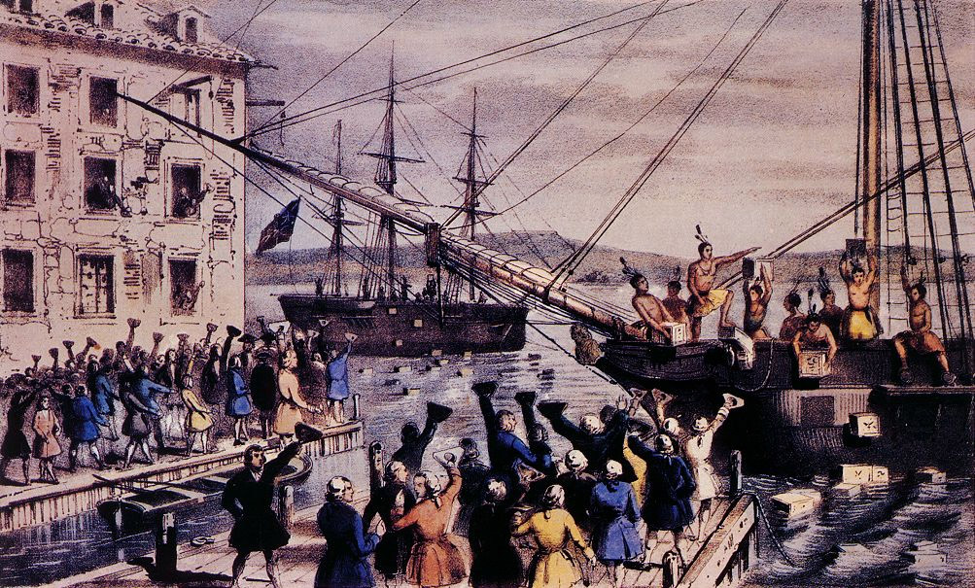
Boston Tea Party (1773)
Notes:
When a tax was placed on tea in 1773, many colonists stopped buying tea. Later that year some colonists in Massachusetts protested by throwing three boatloads of tea into the water. This is now known as The Boston Tea Party.

Slide 5
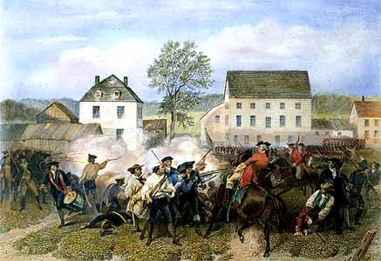
The Revolutionary War (1775-1783)
Notes:
After the Boston Tea Party, relations between the colonists and Great Britain continued to get worse. In 1774, the British Parliament passed new laws to "punish" the Boston protesters. These laws put the Massachusetts government under British control and allowed British troops to live in people's houses. Protests continued, and the next year the British attacked two towns outside of Boston and began the Revolutionary War.

Slide 6
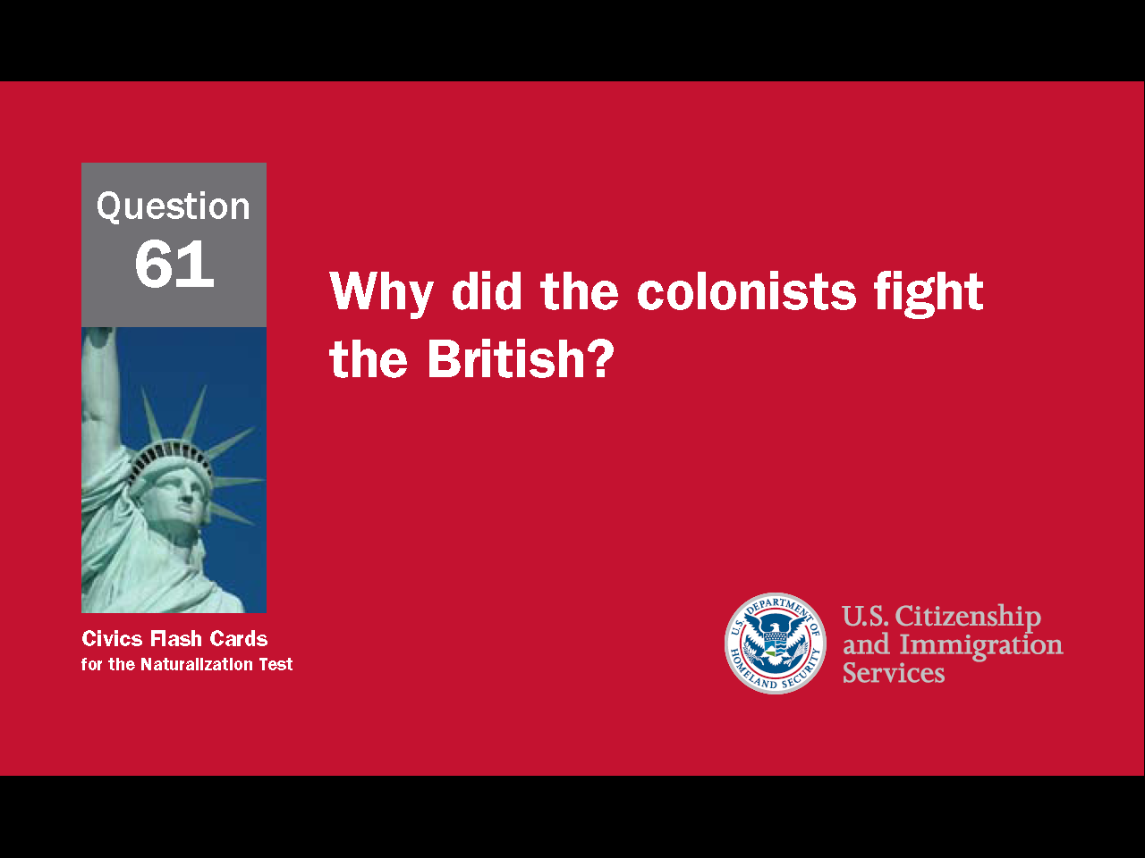
6
Notes:
Question 61. Why did the colonists fight the British?

Slide 7
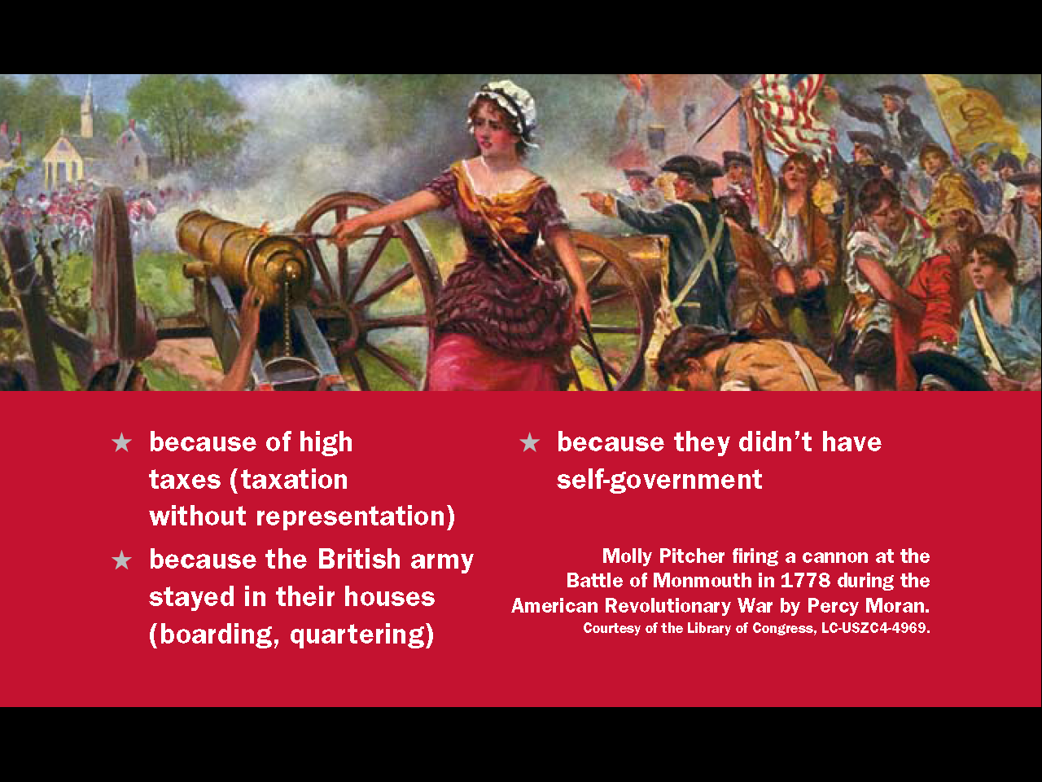
Question #61
Notes:
The colonists fought the British because of high taxes (taxation without representation), because the British army stayed in their houses (quartering), and because they didn’t have the right to choose their own leaders (self-government).

Slide 8
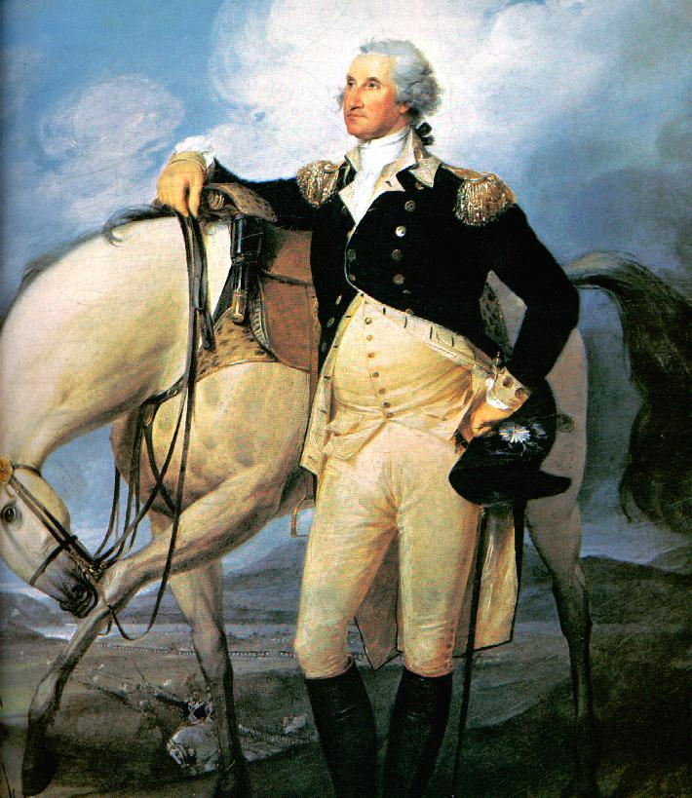
George Washington
Commander of the Colonial Army
Notes:
Great Britain had the largest army and navy in the world, but America had only a small army and no navy. An army officer named George Washington was chosen to command the American army. It was very difficult to build an army, but Washington proved a great leader and eventually led the American army to victory.

Slide 9
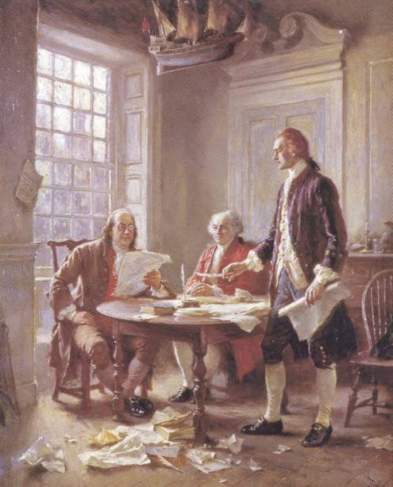
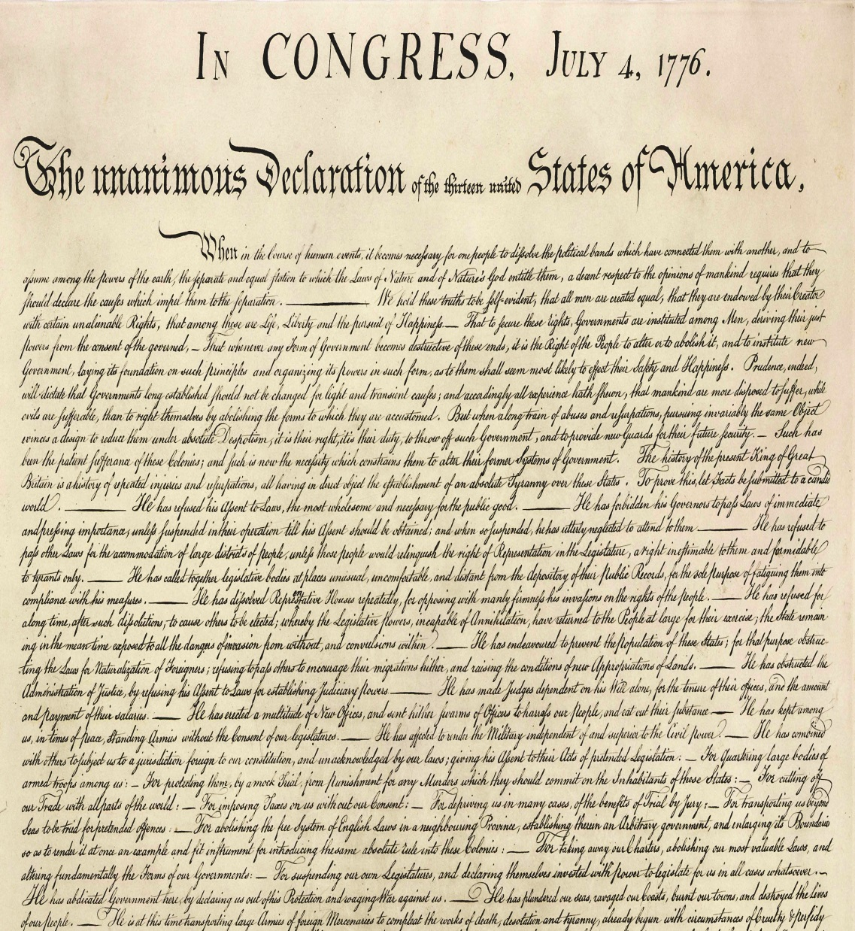
The Declaration of Independence
July 4, 1776
Notes:
In 1776, the colonial government asked the 13 colonies to each create a new government independent of Great Britain. This act made it necessary for the United States to declare independence from England. Thomas Jefferson was chosen to write the document and on July 4, 1776, the Declaration of Independence was adopted by the colonial government. The United States had been born. Like Columbus Day, the 4th of July is also an official holiday. It is called Independence Day.

Slide 10
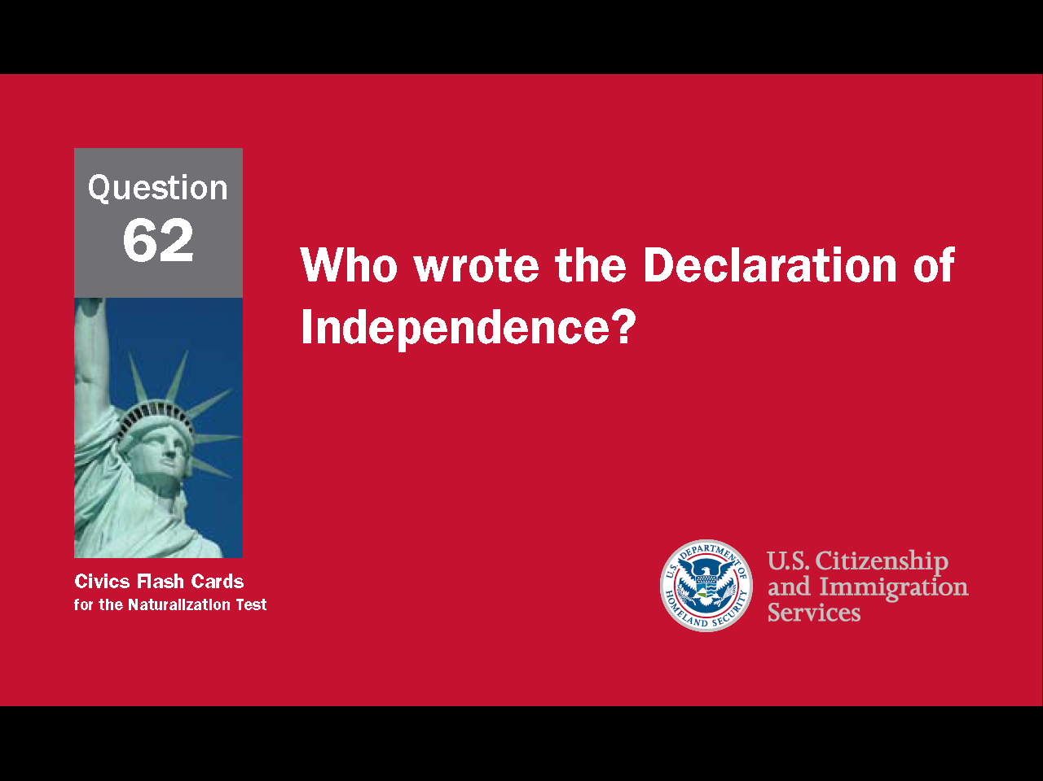
10
Notes:
Question 62. Who wrote the Declaration of Independence?

Slide 11
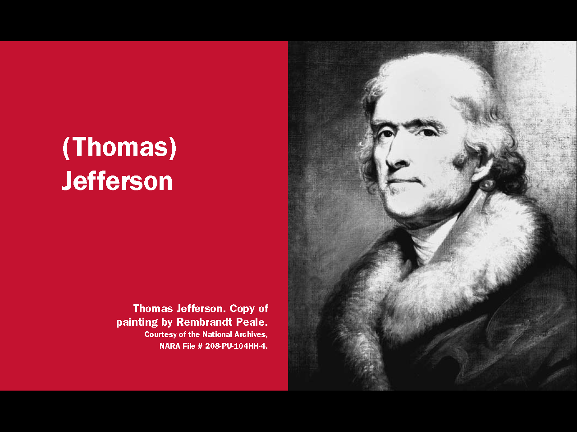
Question #62
Notes:
Thomas Jefferson wrote the Declaration of Independence.

Slide 12
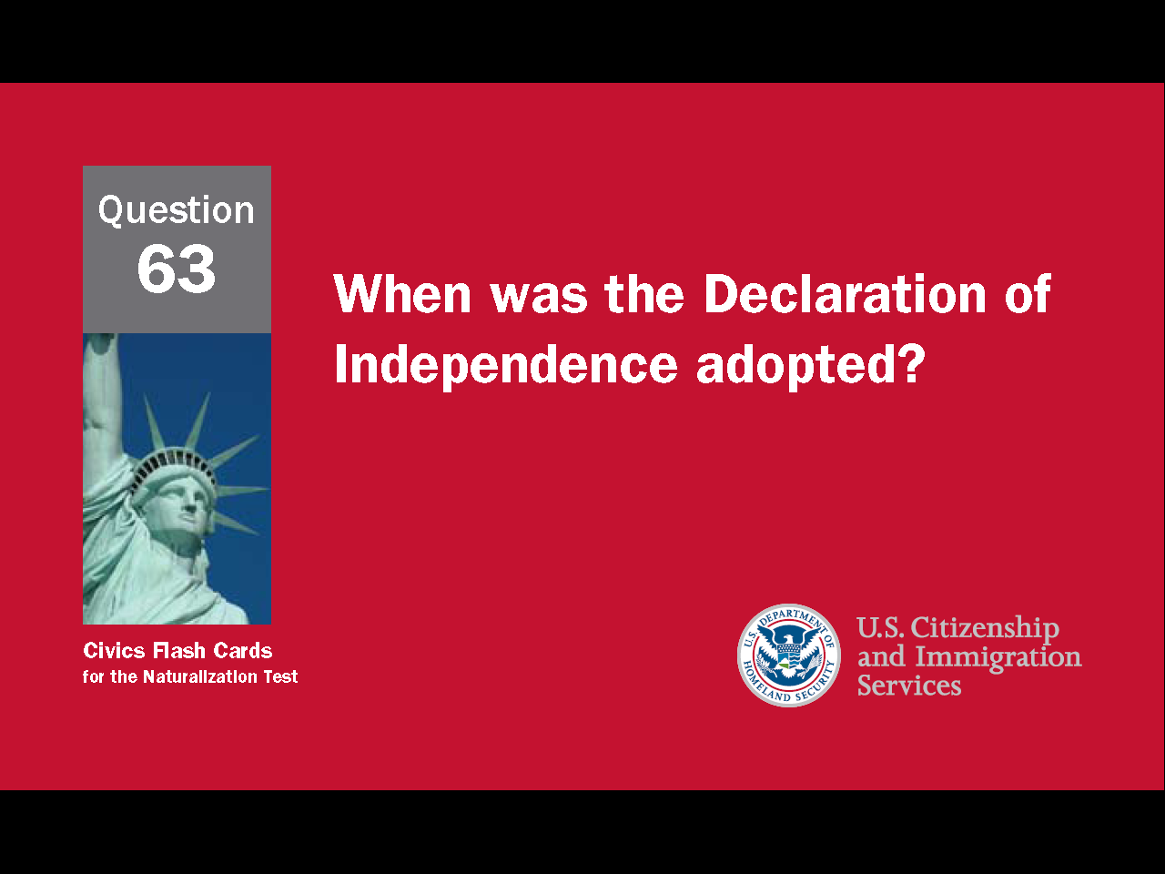
12
Notes:
Question 63. When was the Declaration of Independence adopted?

Slide 13
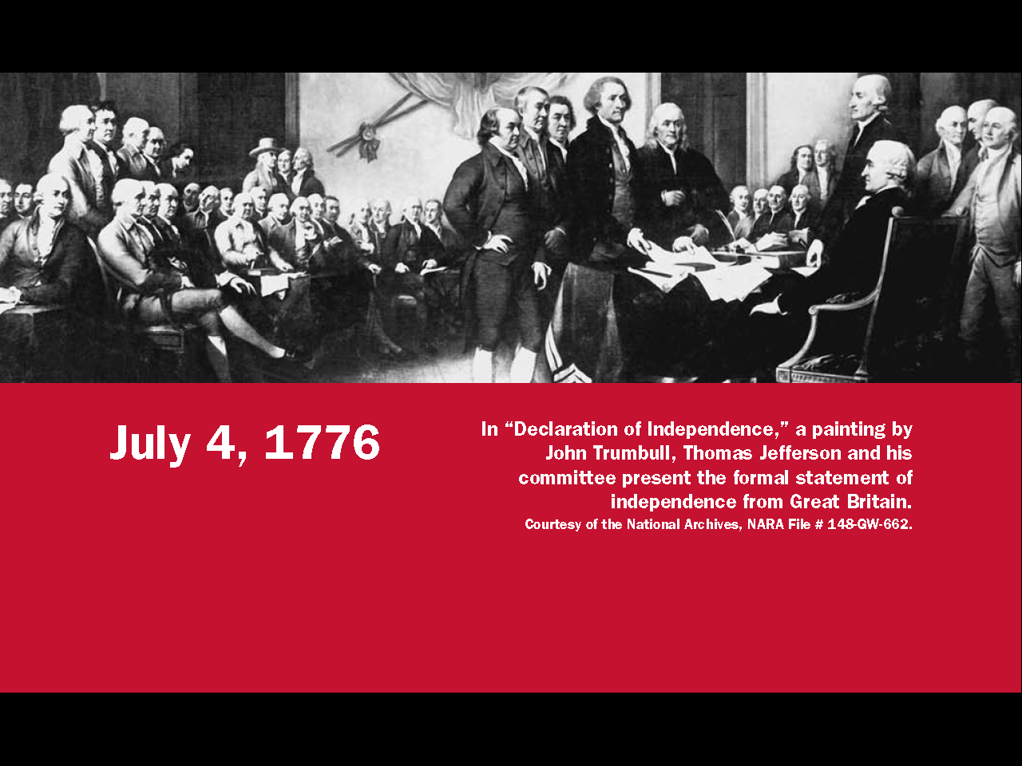
Question #63
Notes:
The Declaration of Independence was adopted on July 4, 1776.

Slide 14
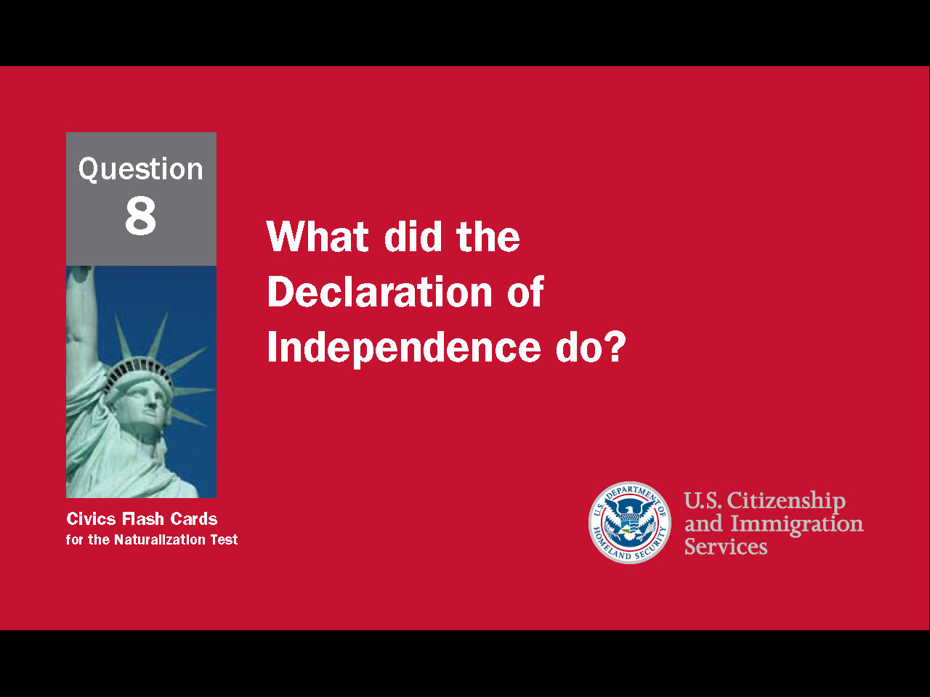
14
Notes:
Question 8. What did the Declaration of Independence do?

Slide 15
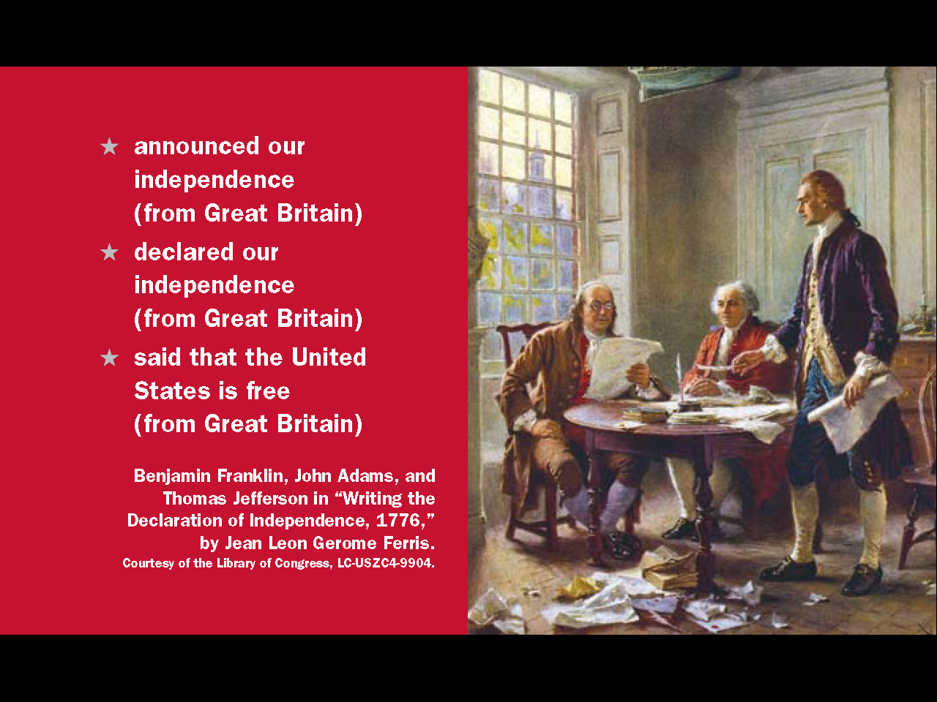
Question #8
Notes:
The Declaration of Independence announced our independence (from Great Britain).
It declared our independence (from Great Britain).
It said that the United States is free (from Great Britain).

Slide 16
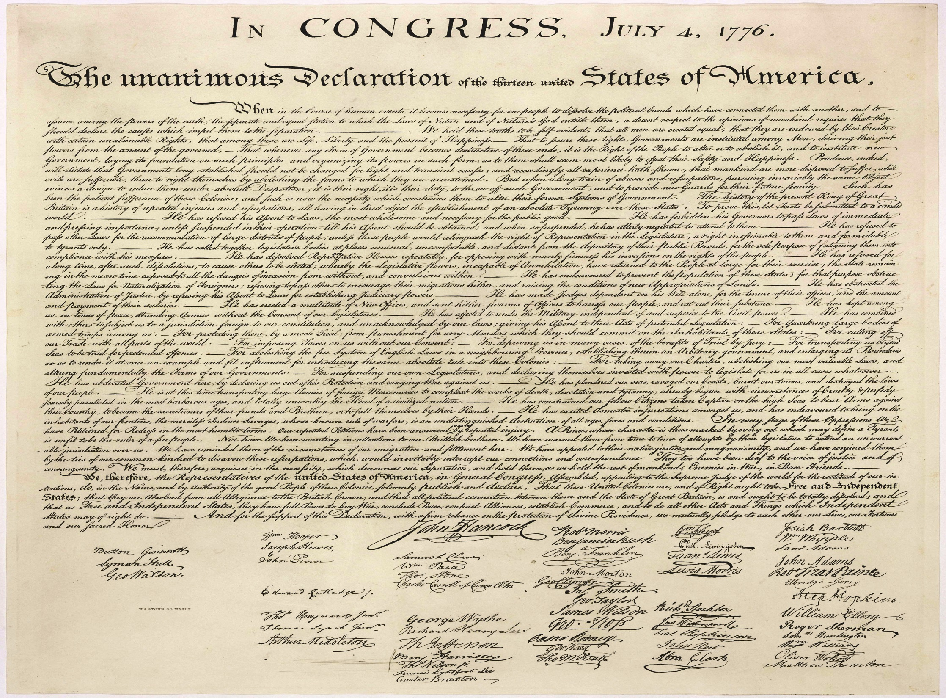
16
Notes:
The Declaration of Independence begins by stating the "self-evident truths" that "all men are created equal" and have certain "unalienable rights" including "life, liberty and the pursuit of happiness." It also lists 27 complaints against King George III and the British Parliament to show how the colonies have been denied these rights and self-government.

Slide 17
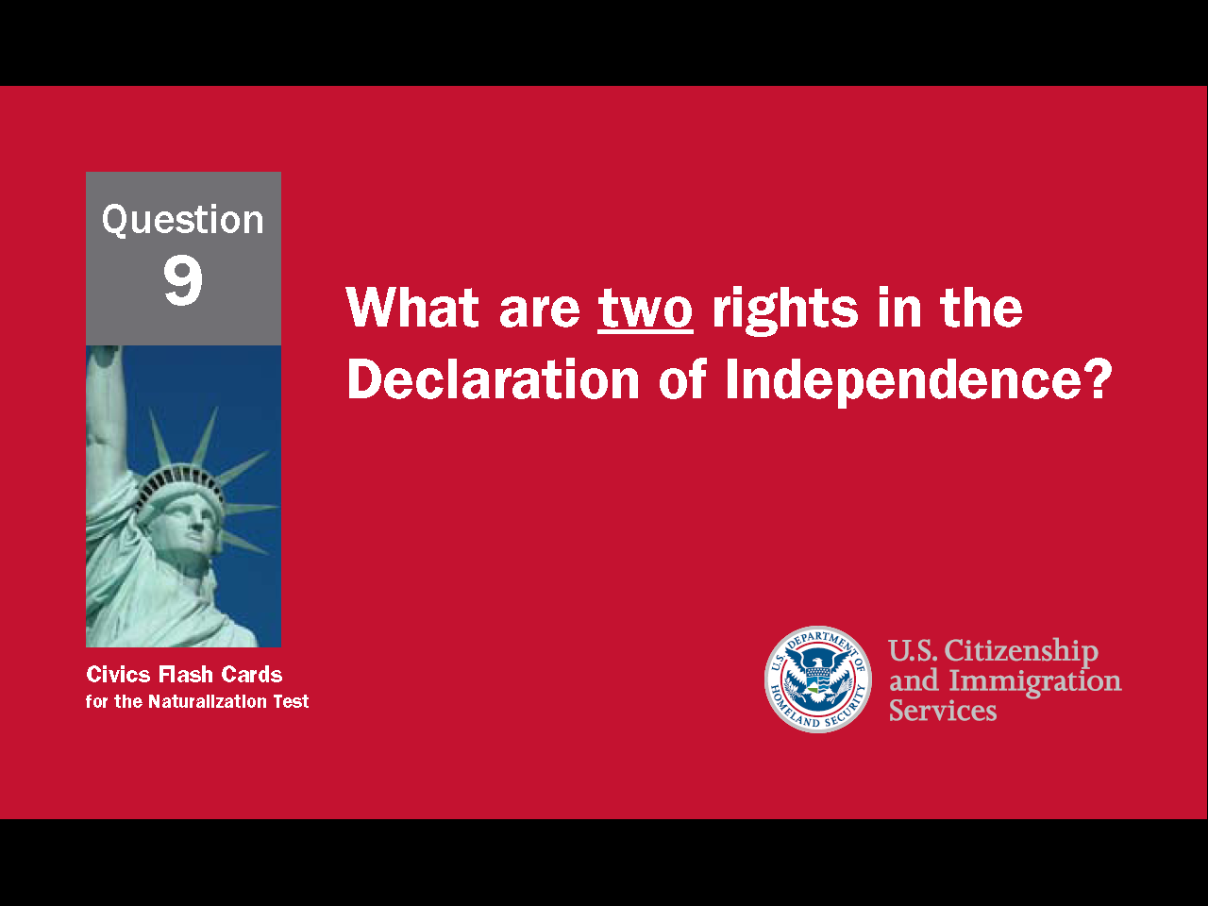
17
Notes:
Question 9. What are two rights in the Declaration of Independence?

Slide 18
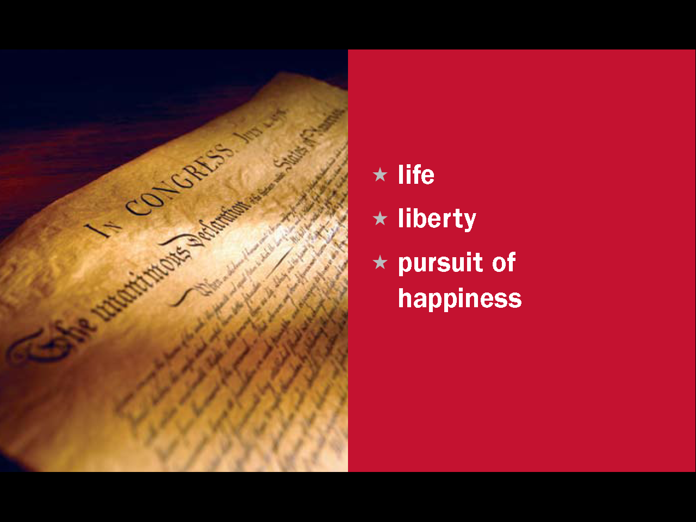
Question #9
Notes:
Some rights from the Declaration of Independence include life, liberty, and the pursuit of happiness.

Slide 19
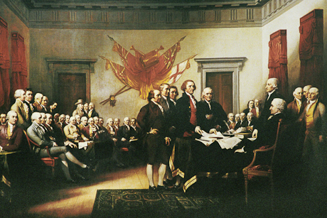
The Founding Fathers
19
Notes:
The signers of the Declaration of Independence are now considered some of America's Founding Fathers. This group includes Benjamin Franklin, Thomas Jefferson, and John Adams. Other Founding Fathers, like George Washington and James Madison, helped write the U.S. Constitution after the Revolutionary War.

Slide 20
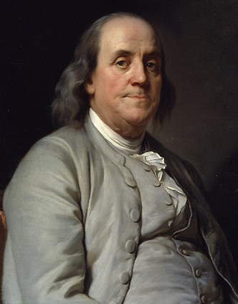
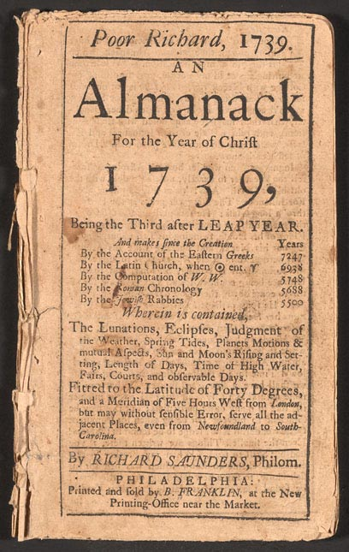
Benjamin Franklin
Notes:
Benjamin Franklin was one of the most influential Founding Fathers. In addition to being the oldest member of the Constitutional Convention, he was a U.S. diplomat, the first Postmaster General of the United States, and he started the first free libraries. He also the writer of "Poor Richard’s Almanac." An almanac is a book of practical information such as weather forecasts, household tips, proverbs, and dates for planting different crops.

Slide 21
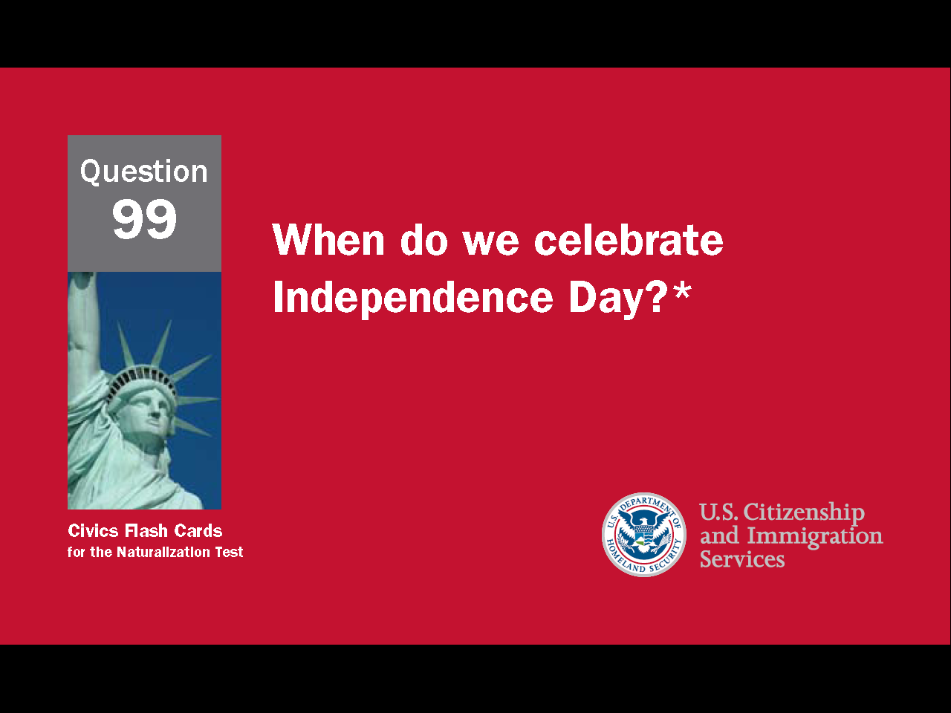
21
Notes:
Question 99. When do we celebrate Independence Day?

Slide 22
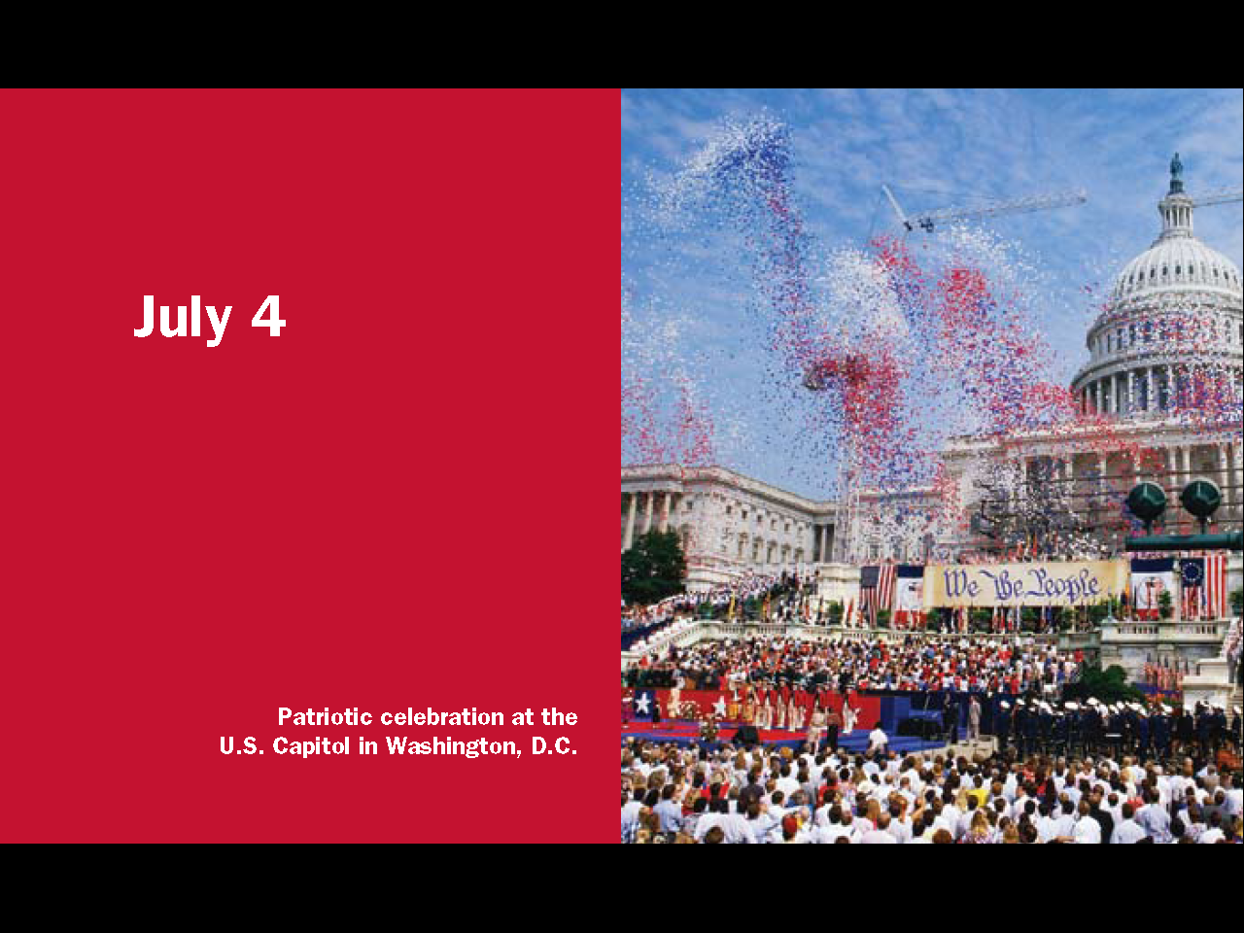
Question #99
22
Notes:
Independence Day is celebrated on July 4.

Slide 23
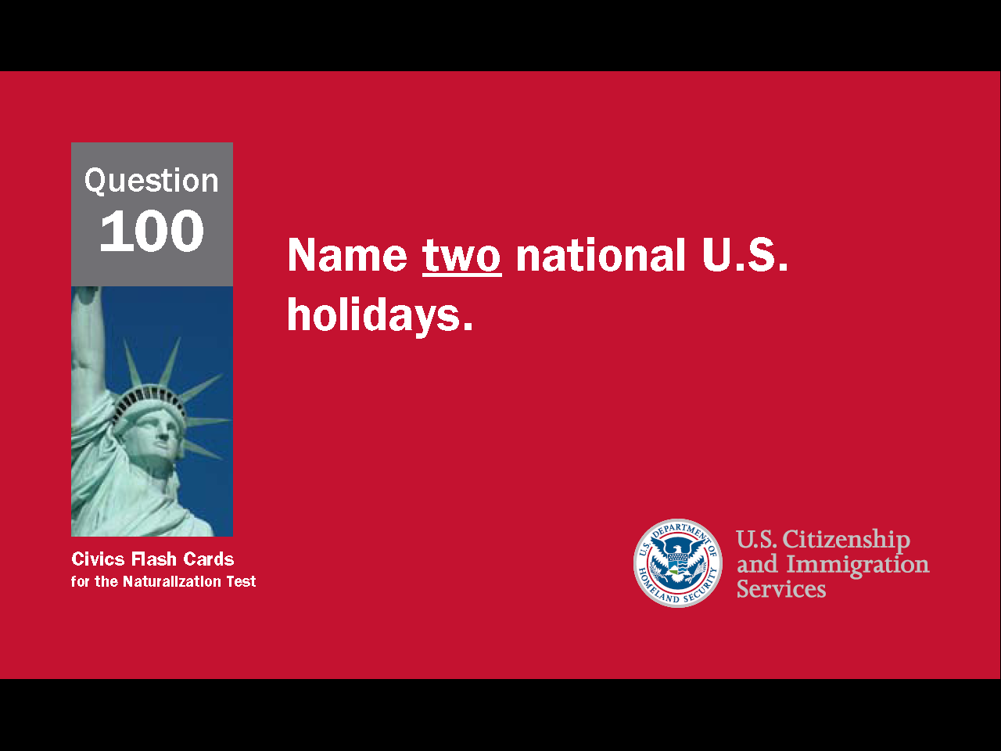
23
Notes:
Question 100. Name two national U.S. holidays.

Slide 24
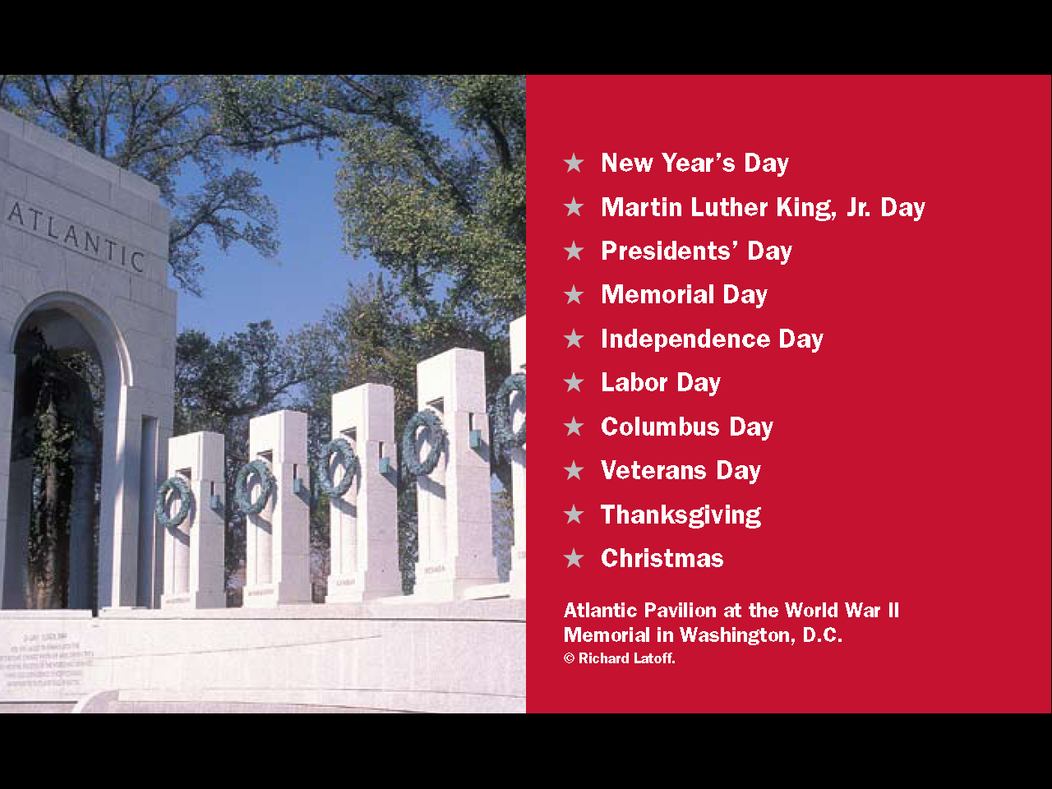
Question #100
24
Notes:
This lesson explained the origins of Columbus Day, Thanksgiving, and Independence Day. Other holidays will be explained in later lessons.

Slide 25
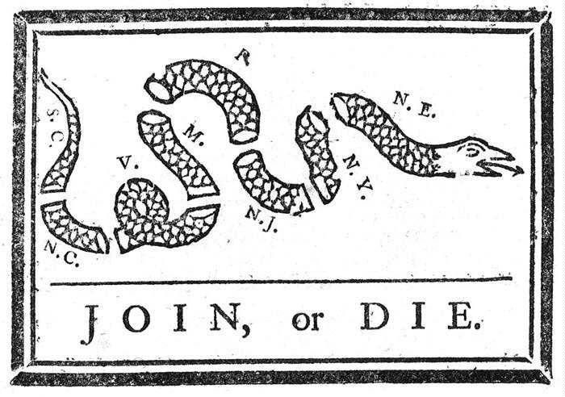
A Call for Unity
25
Notes:
Benjamin Franklin is sometimes referred to as "the First American" because he was one of the first leaders to talk about the need for colonial unity. This drawing is America's first political cartoon. Franklin drew it in 1754 to urge the colonies to unite against attacks by Native Americans and the French. The cartoon was used again during the Revolutionary War as a call for unity. The 13 colonies had to fight together to win, and by doing so, began to see themselves as a single nation, not a group of separate states.

Slide 26
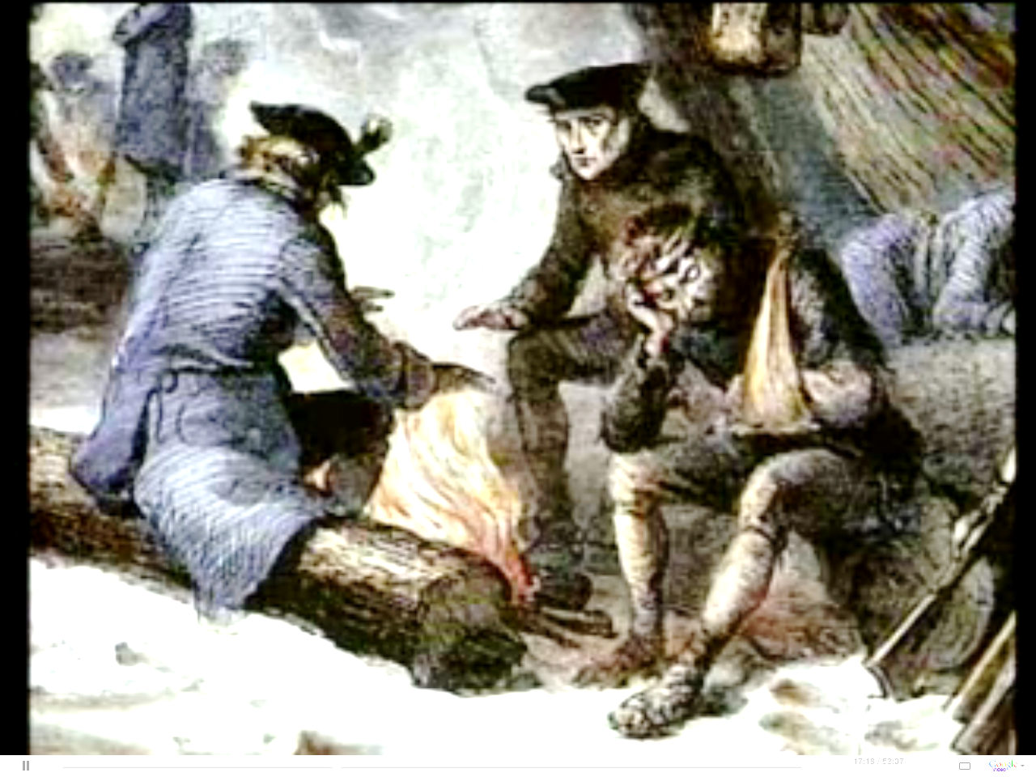
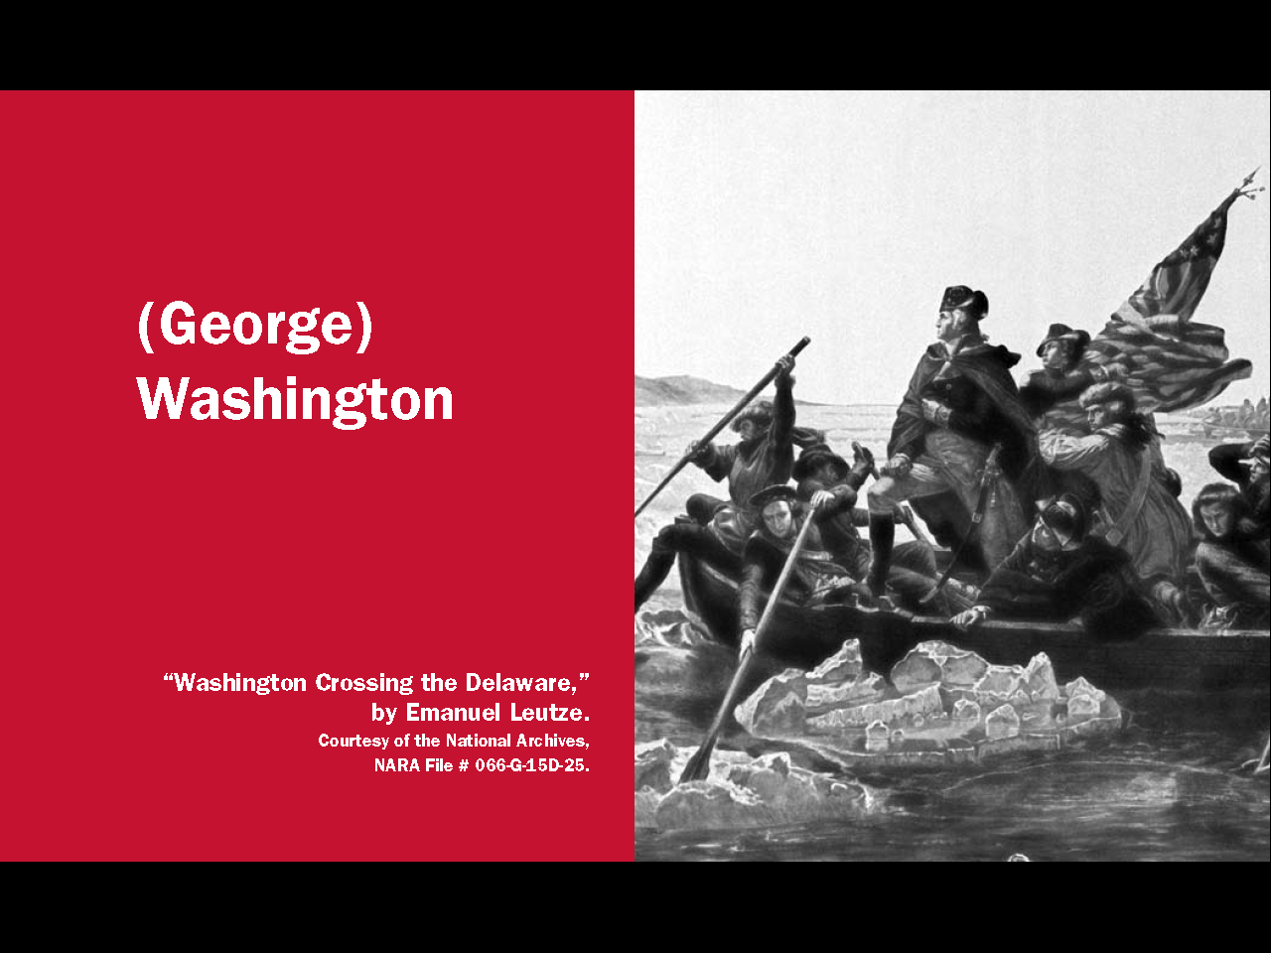
Defeat and Triumph
Notes:
During the Revolutionary War, Great Britain fought the colonists throughout the 13 colonies. After almost two years, the Americans had lost most of the battles and the troops began to lose hope. Then, in the winter of 1776, George Washington made a bold decision. He crossed the Delaware River and made a surprise attack on British troops in Trenton, New Jersey, thus winning a big battle, and restoring the morale of the American army.

Slide 27
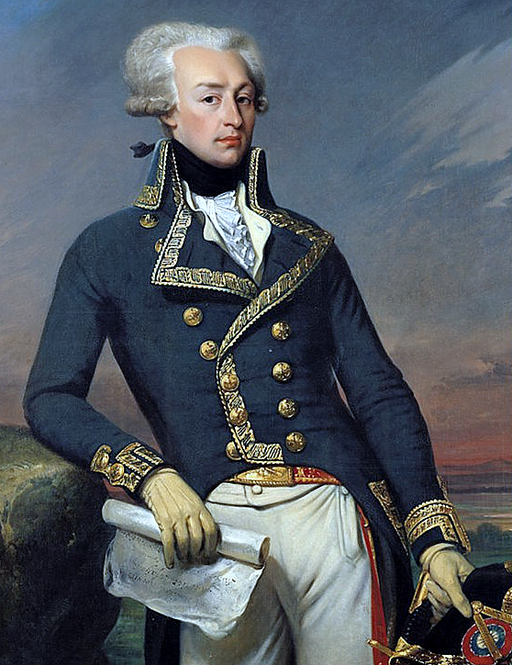
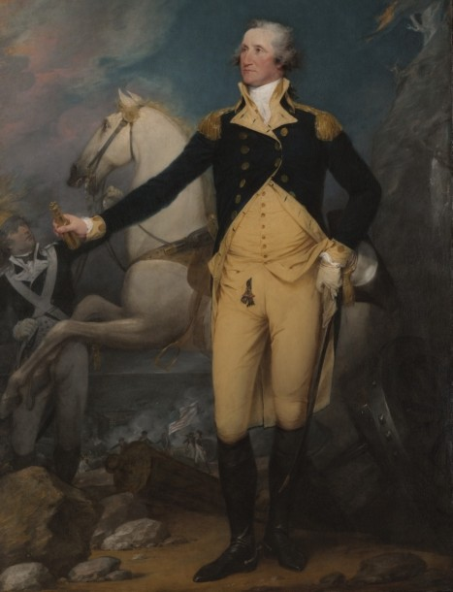
The French Join the Americans
Lafayette
Washington
Notes:
The 13 original states needed help to win the war. Benjamin Franklin was Ambassador to France and, along with Thomas Jefferson, he asked the French to assist the United States. In 1778, after an important American victory in Saratoga, New York, France agreed to fight alongside the Americans. Later, Spain and Holland also joined.

Slide 28
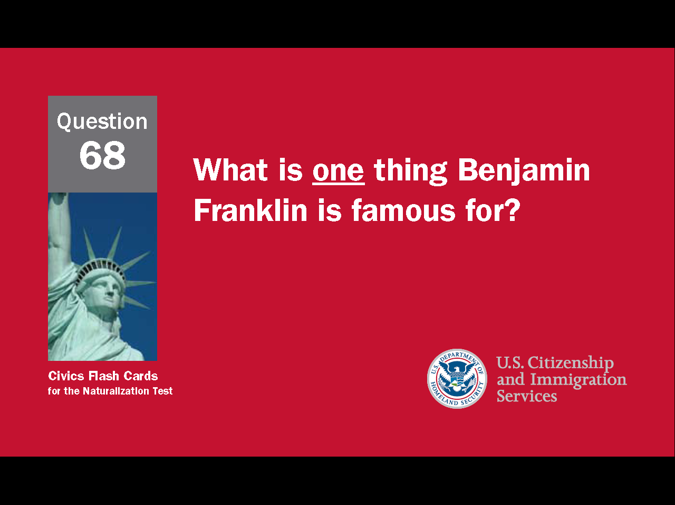
28
Notes:
Question 68. What was one thing Benjamin Franklin is famous for?

Slide 29
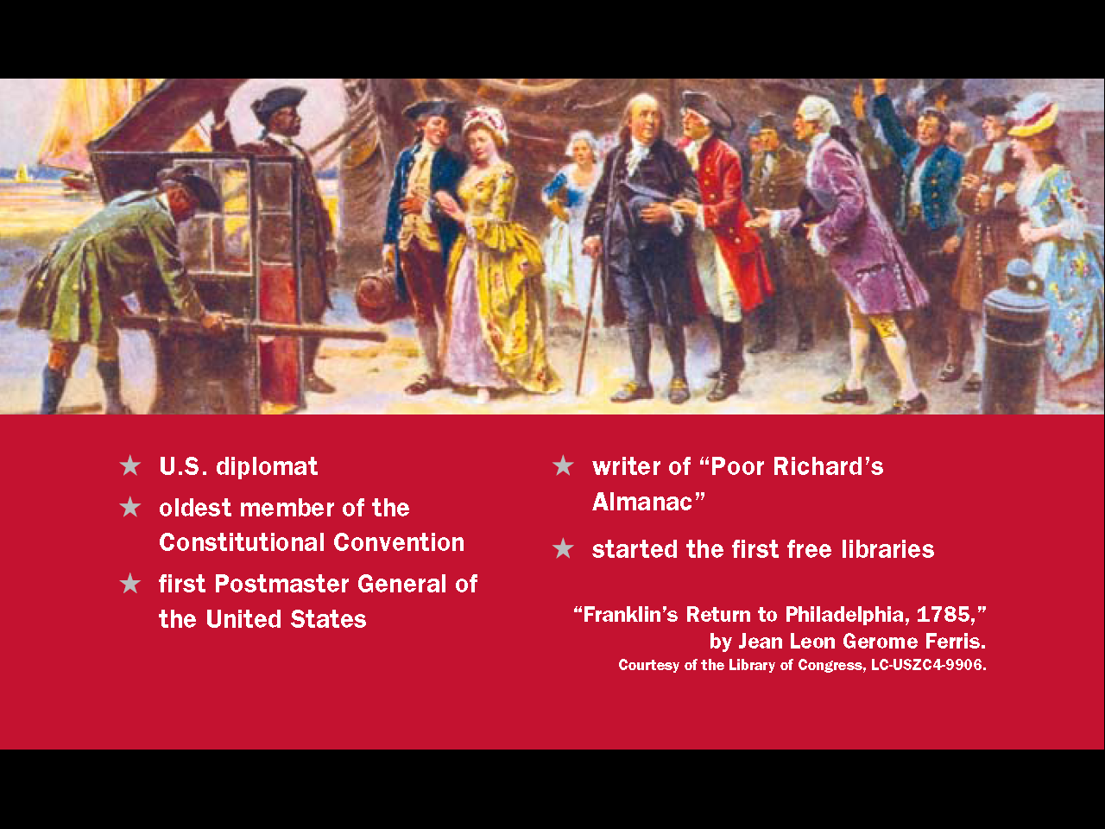
Question #68
29
Notes:
Benjamin Franklin was one of the most influential of the United States' Founding Fathers. He is famous for being a U.S. diplomat. He was also the oldest member of the Constitutional Convention, the first Postmaster General of the United States, the writer of Poor Richard’s Almanac, and he started the first free libraries.

Slide 30
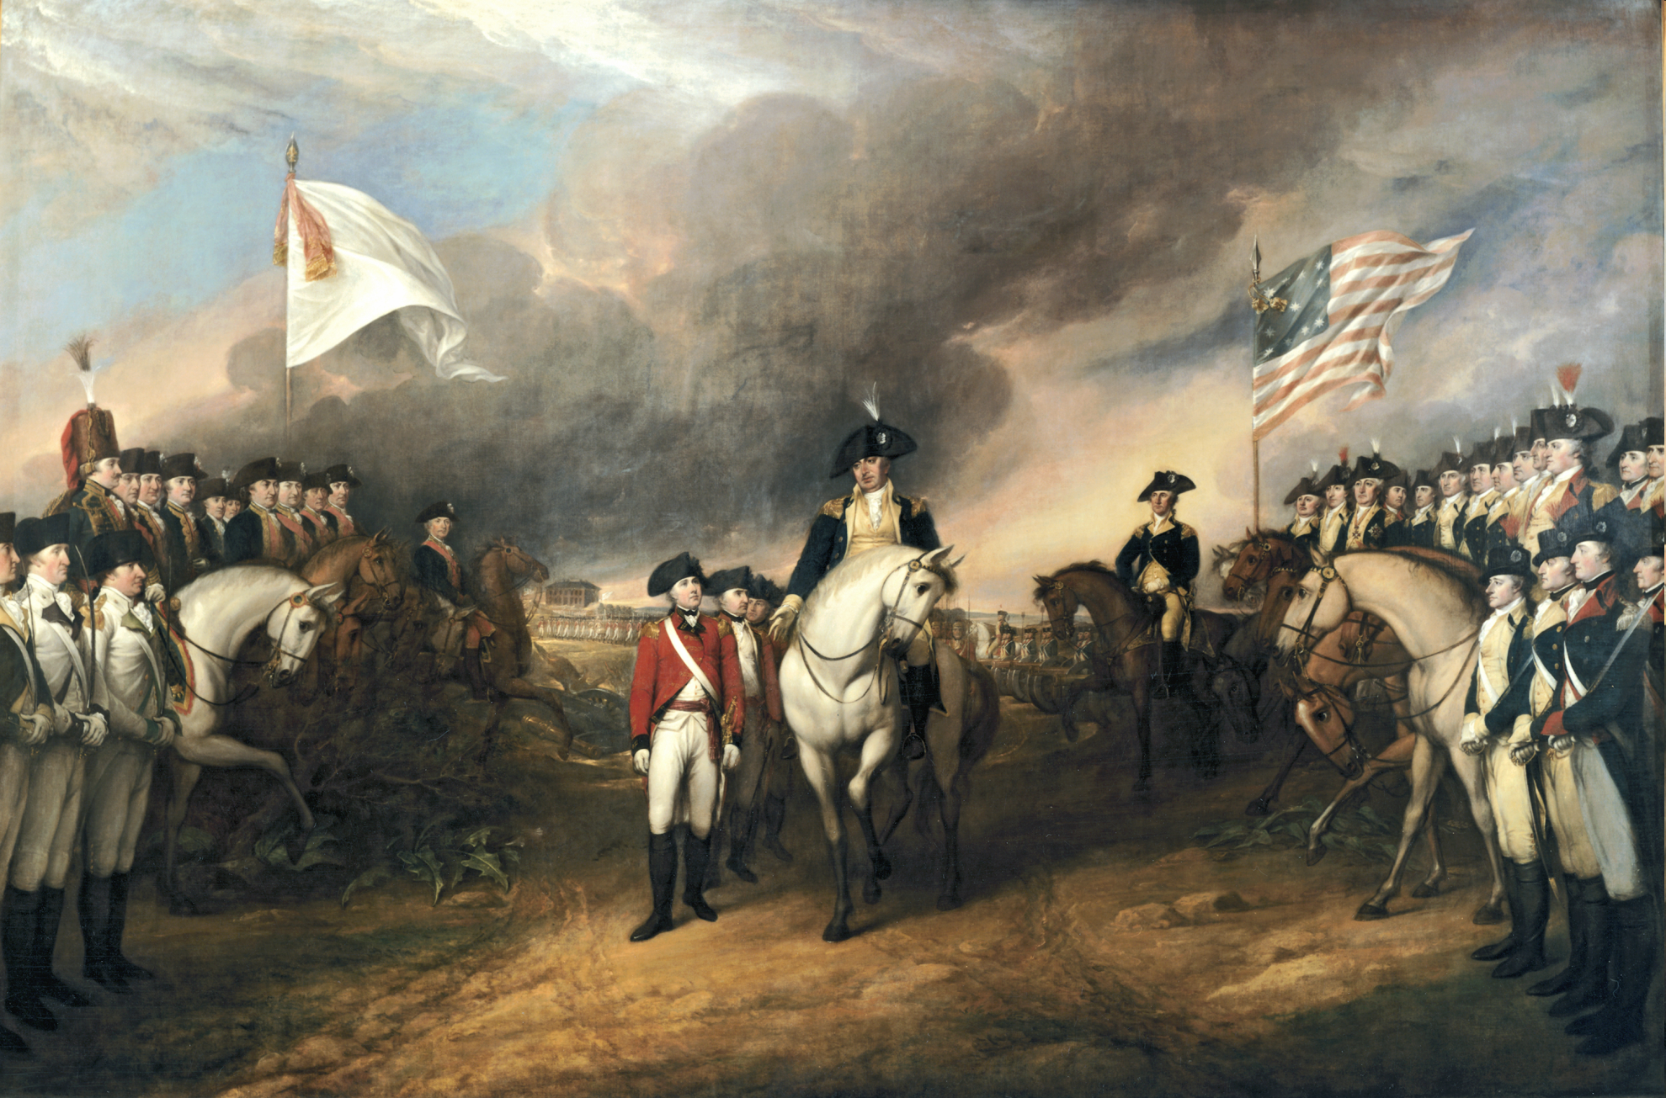
Surrender at Yorktown
Notes:
With three European allies helping the Americans, there was no chance Britain could win the war. In 1781, a large British force surrendered in Yorktown, Virginia, essentially bringing the war to an end. Fighting though continued for two more years until a peace treaty was signed in 1783. In this painting George Washington is accepting the surrender of the British General Cornwallis at Yorktown.

Slide 31
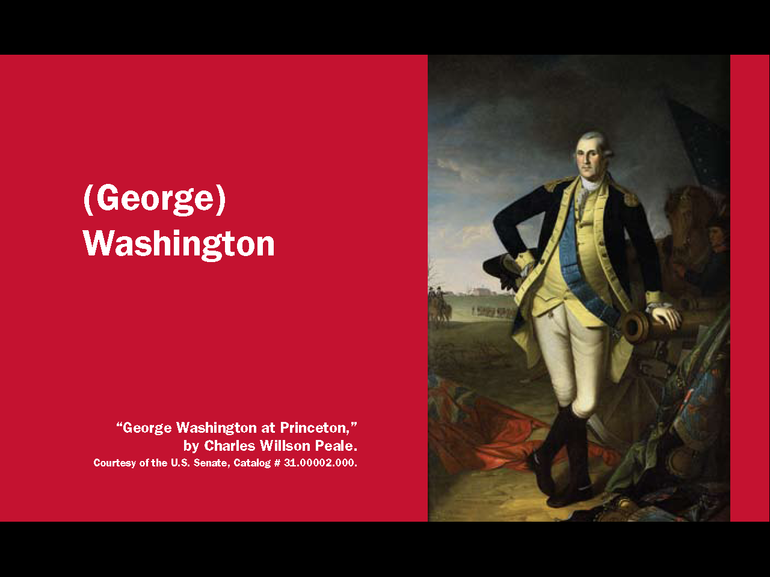
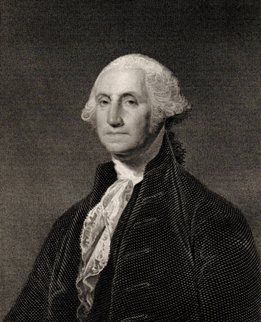
31
Notes:
George Washington is called "the Father of Our Country." He was commander of the army during the Revolutionary War, he helped write the U.S. Constitution, and he was the country's first president. He was so important in the creation of the United States that he was known as "the indispensable man."

Slide 32
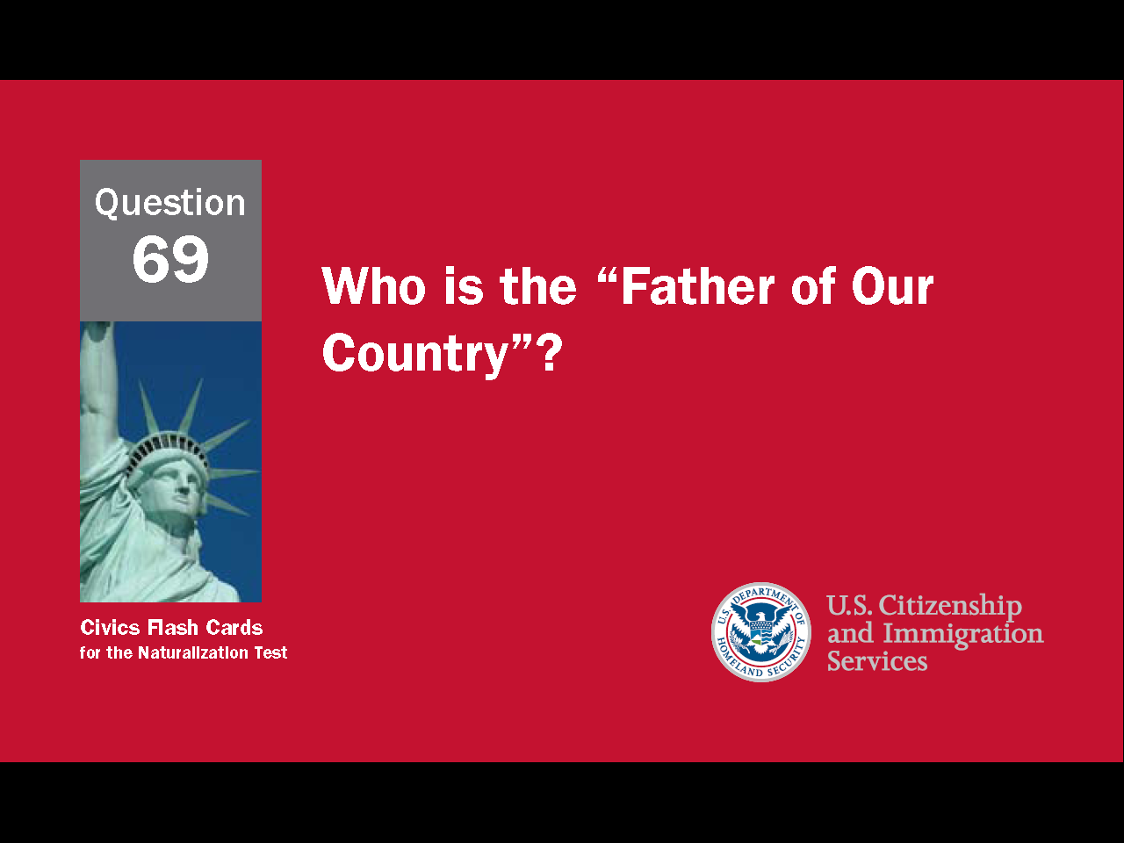
32
Notes:
Question 69. Who is the “Father of Our Country”?

Slide 33
Question #69
33
Notes:
Washington. The "Father of Our Country" is George Washington.

