Slide 1
Lesson 2
American Government
Principles of American Democracy
Questions: 65, 66, 68, 1, 2, 13, 14, 41, 42, 67, 69, 70, 4, 7, 5, 6, 10, 3, 11, 12, 55
1
Notes:
Lesson 2. American Government: Principles of American Democracy.
This lesson explains the principles of American democracy. Understanding the principles of American government can help you better understand the American political process.

Slide 2
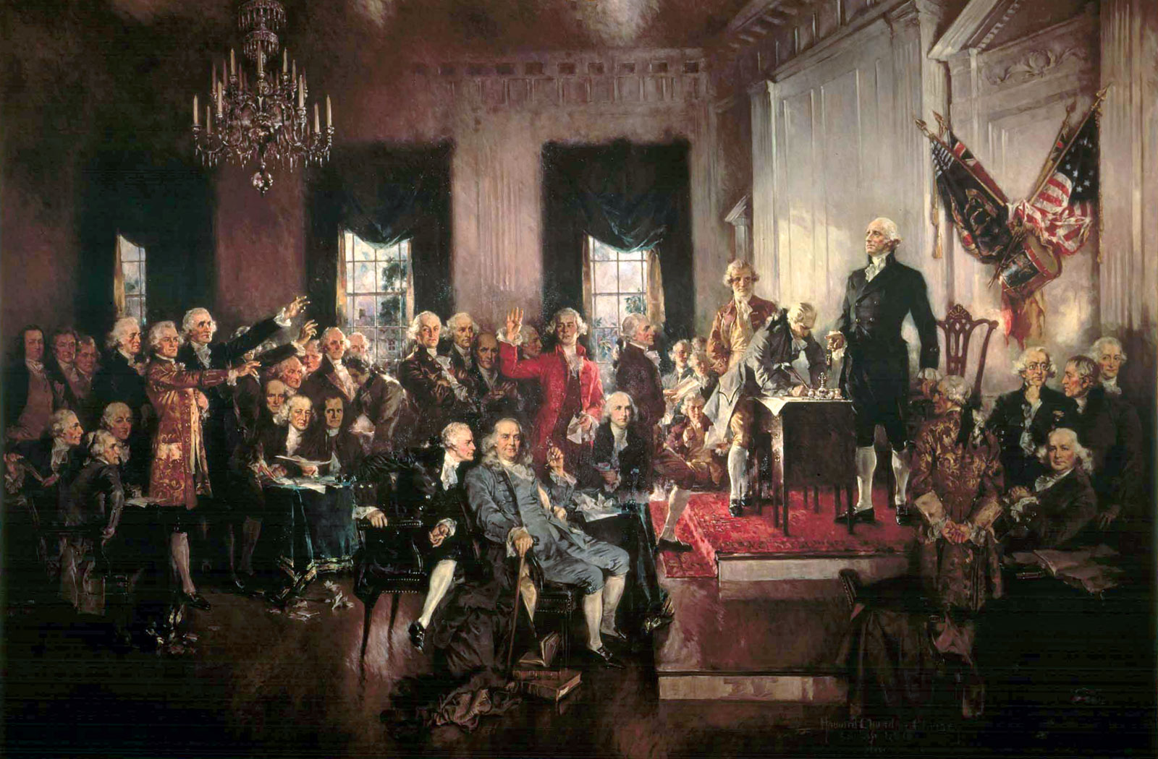
The Constitutional Convention (1787)
Notes:
After the Revolutionary War it was clear that the United States needed a stronger government. In 1787, a convention was held in Philadelphia to decide what changes should be made. For five months, many Founding Fathers - including James Madison, George Washington, and the convention's oldest member, Benjamin Franklin - debated and wrote the U.S. Constitution. This very important convention is now known as the Constitutional Convention.

Slide 3
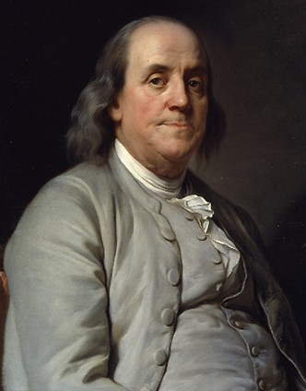
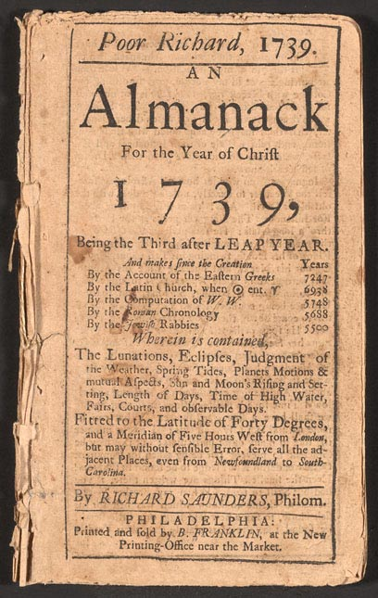
Benjamin Franklin
Notes:
Benjamin Franklin was one of the most influential Founding Fathers. In addition to being the oldest member of the Constitutional Convention, he was a U.S. diplomat, the first Postmaster General of the United States, and he started the first free libraries. He also the writer of "Poor Richard’s Almanac." An almanac is a book of practical information such as weather forecasts, household tips, proverbs, and dates for planting different crops.

Slide 4
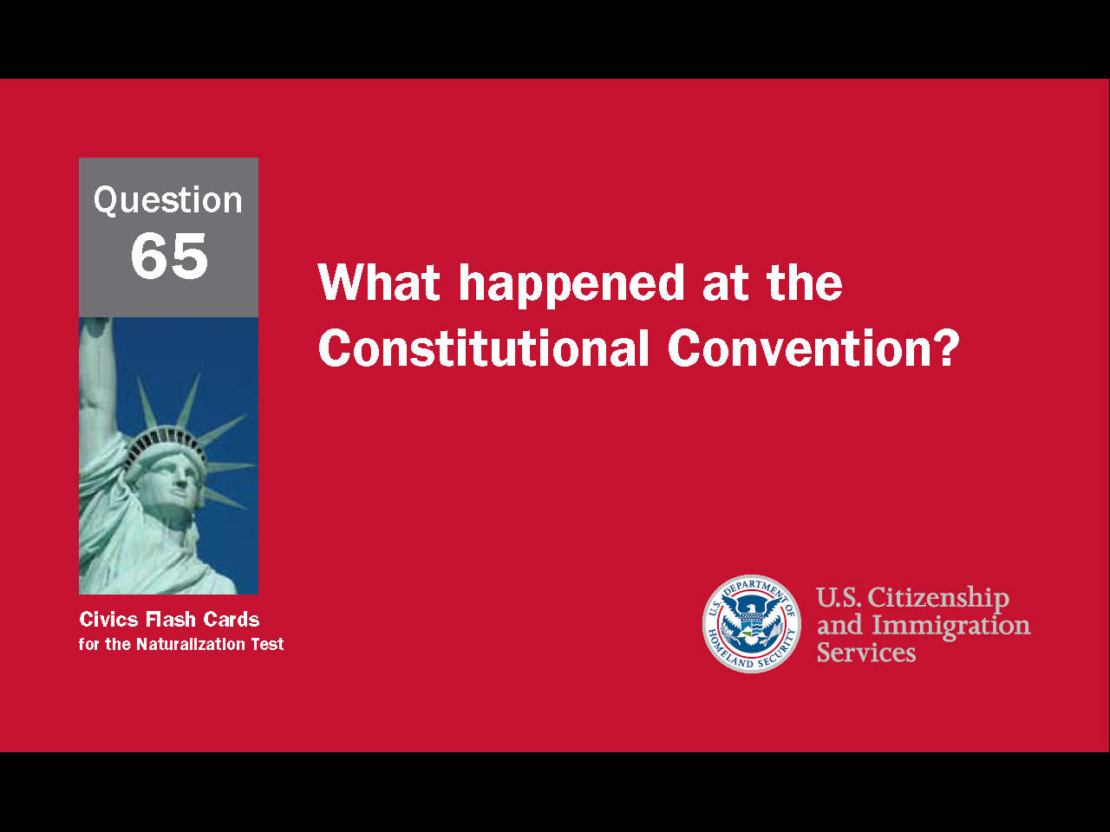
4
Notes:
Question 65. What happened at the Constitutional Convention?

Slide 5
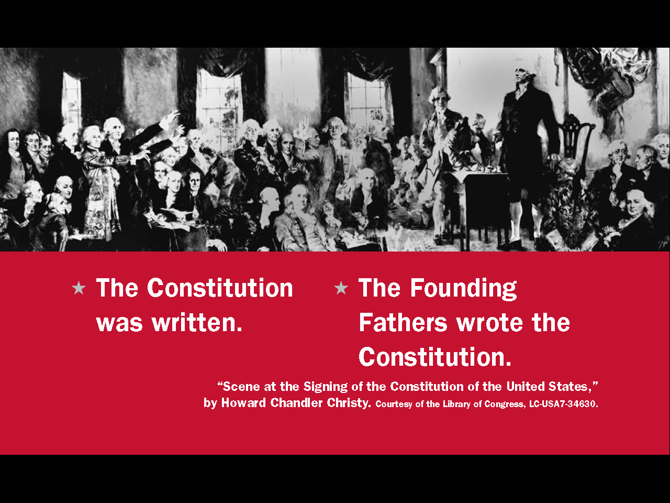
Question #65
5
Notes:
The Constitution was written at the Constitutional Convention.
The Founding Fathers wrote the Constitution at the Constitutional Convention.

Slide 6
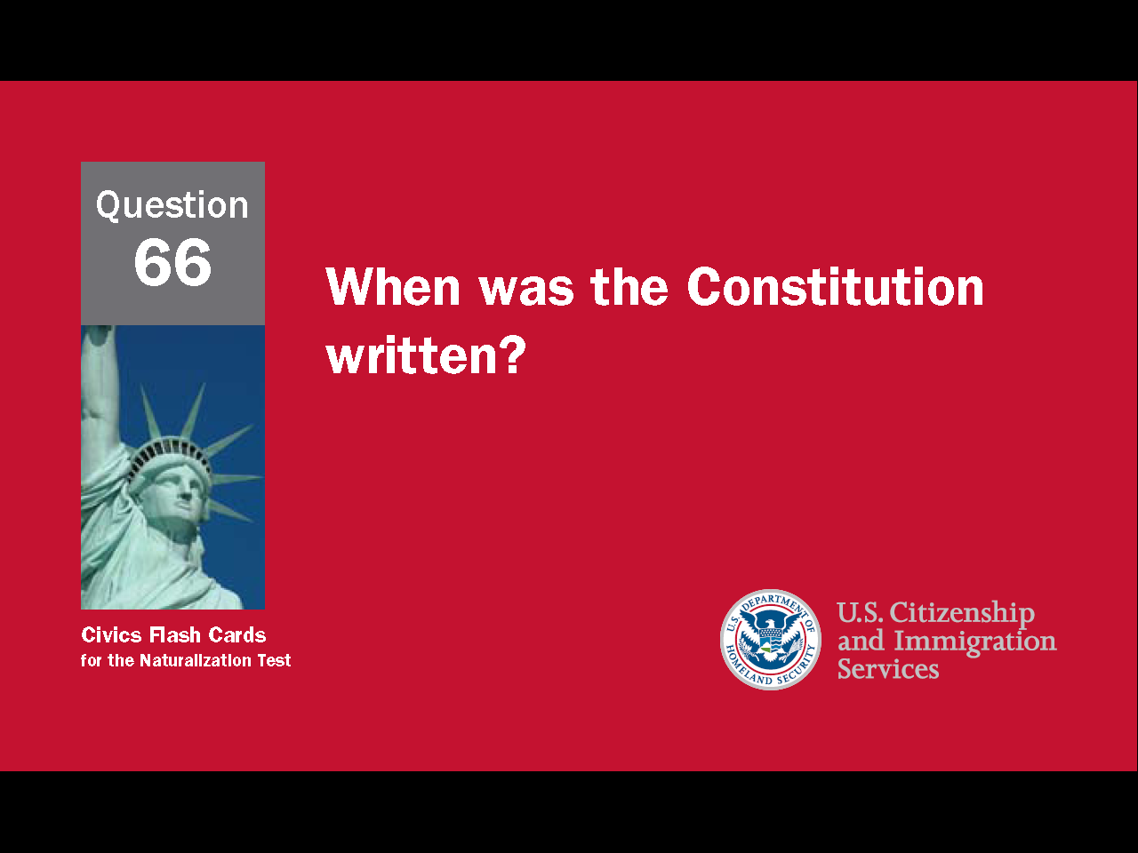
6
Notes:
Question 66. When was the Constitution written?

Slide 7
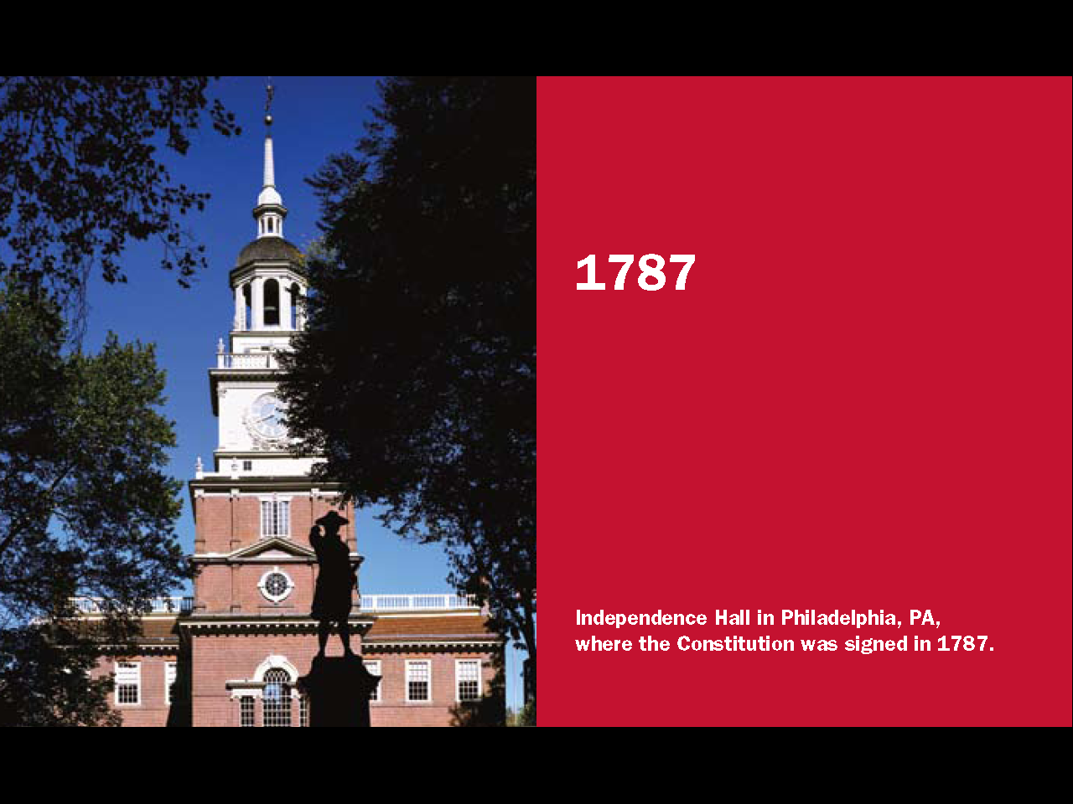
Question #66
Notes:
The Constitution was written in 1787.

Slide 8
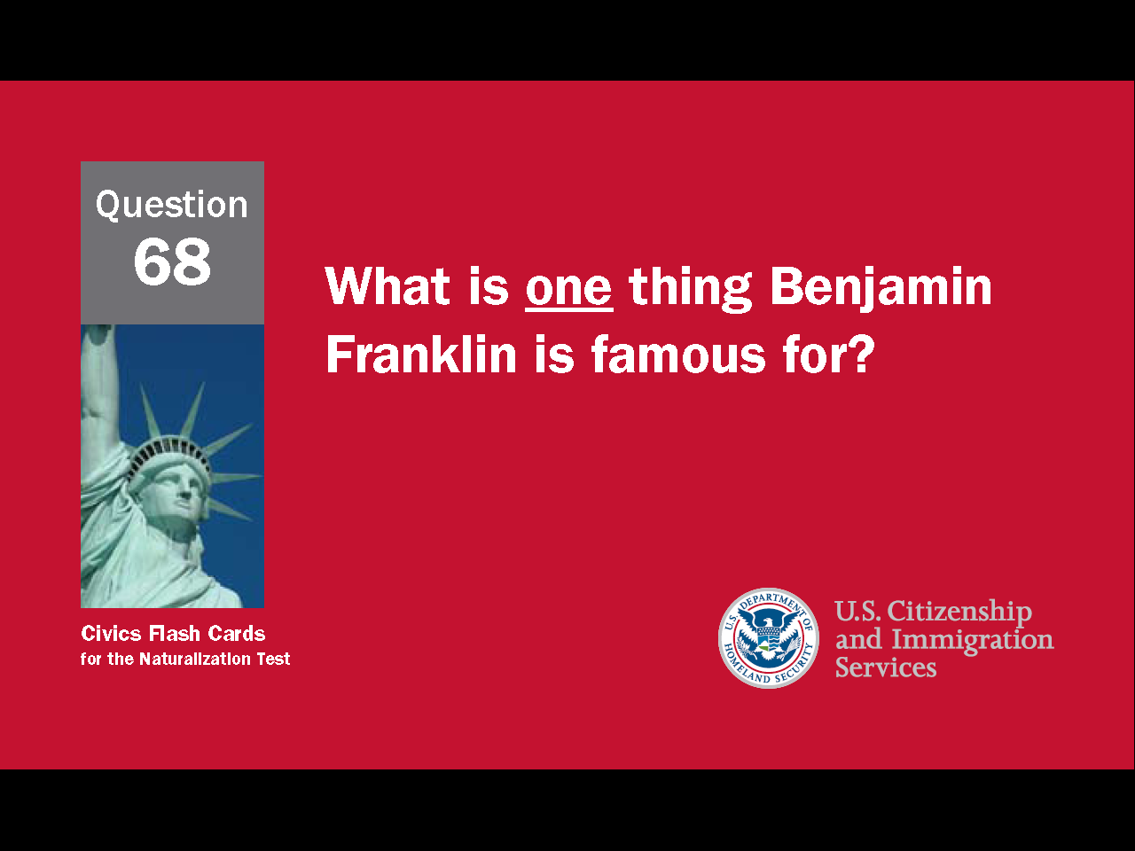
8
Notes:
Question 68. What was one thing Benjamin Franklin is famous for?

Slide 9
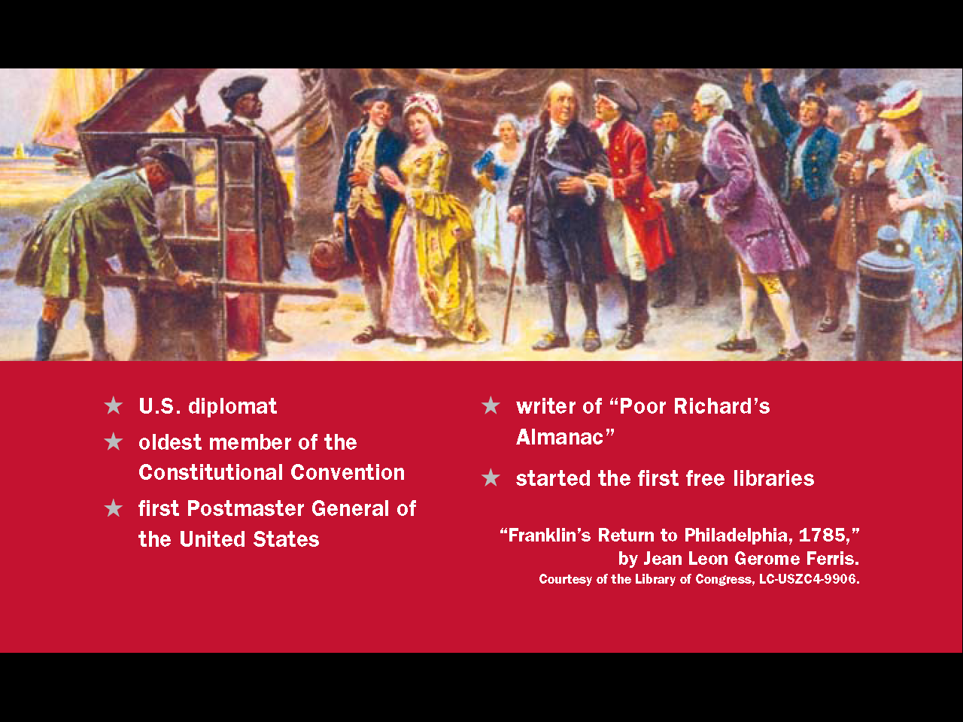
Question #68
9
Notes:
Benjamin Franklin was one of the most influential of the United States' Founding Fathers. He was a U.S. diplomat, the oldest member of the Constitutional Convention, the first Postmaster General of the United States, and the writer of “Poor Richard’s Almanac. He also started the first free libraries.

Slide 10
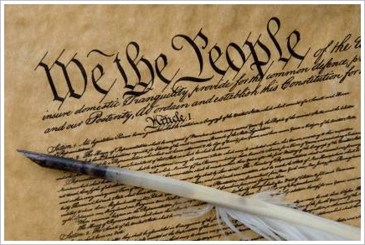
The U.S. Constitution is
the Supreme Law of the Land
sets up the government
defines the government
protects the basic rights of Americans
10
Notes:
The Constitution sets up the government, defines the government, and protects the basic rights of Americans. In this way, the Constitution is the supreme law of the land. As the supreme law in the United States, the Constitution is above any state or federal law.

Slide 11
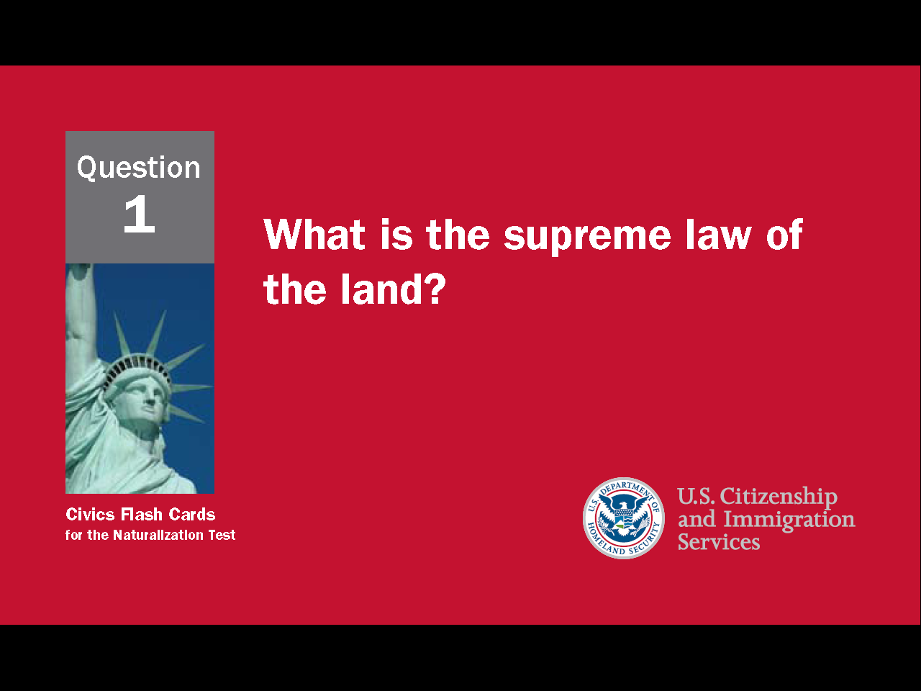
11
Notes:
Question 1. What is the supreme law of the land?

Slide 12
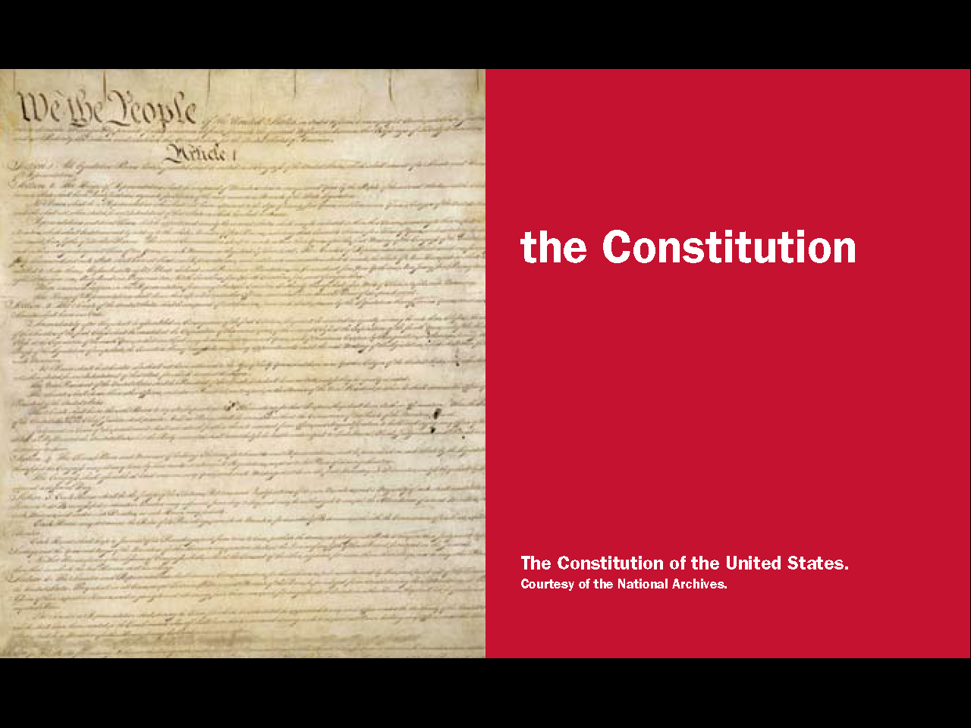
Question #1
Notes:
The Constitution is the supreme law of the land. As the highest law in the United States it is higher than any state or federal law.

Slide 13
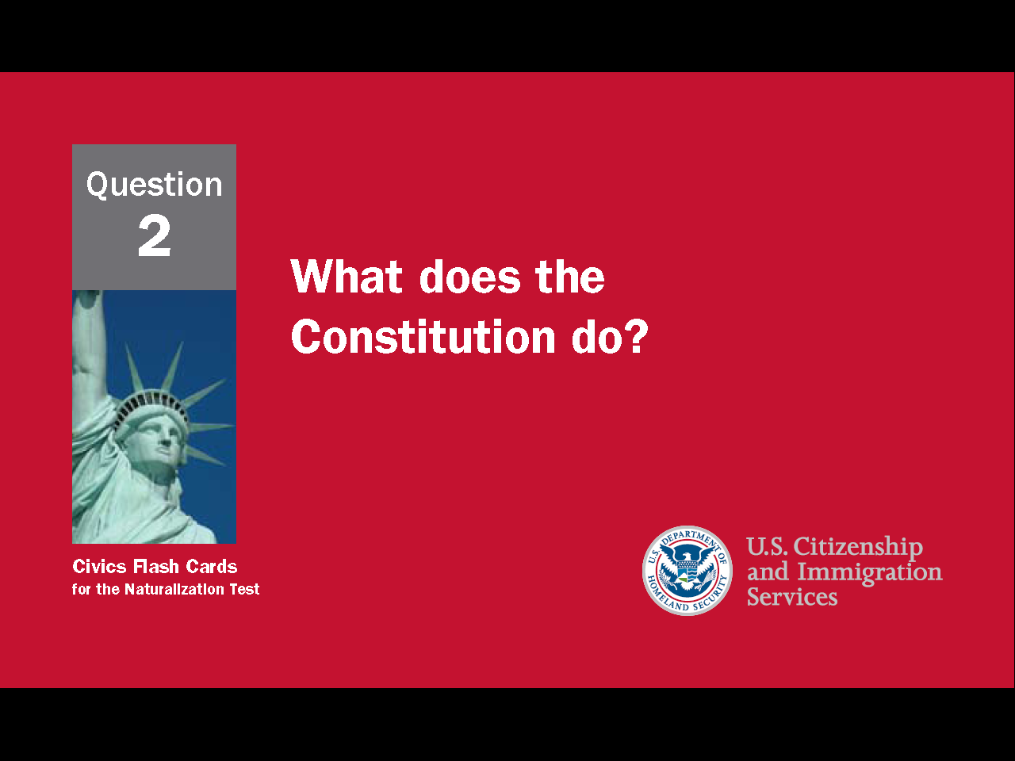
13
Notes:
Question 2. What does the Constitution do?

Slide 14
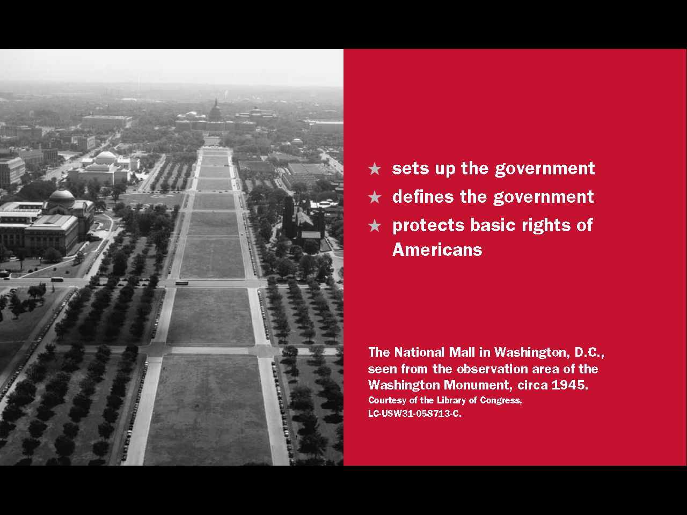

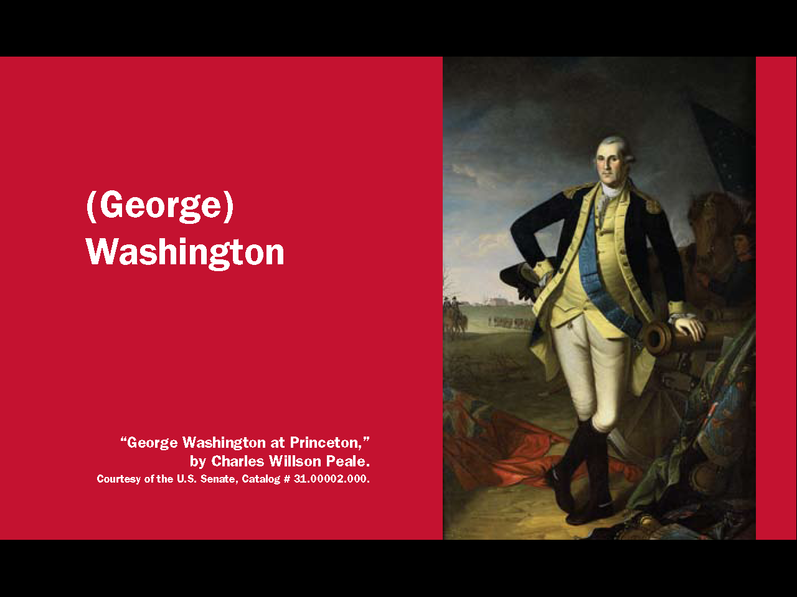
Question #2
Notes:
The Constitution
sets up the government
defines the government
protects the basic rights of Americans

Slide 15
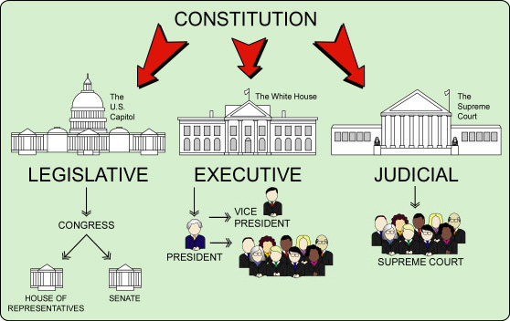
The Constitution Defines the Government and its Powers
|
APPELLATE COURTS
|
FEDERAL COURTS
CABINET
15
Notes:
The Constitution sets up a government with three branches: a legislative, an executive, and a judicial. The legislative branch is also called Congress and consists of the House of Representatives and the Senate. The executive branch, or the President, consists of the President, Vice President and cabinet. The judicial branch refers to the courts. The highest court in the nation is the Supreme Court.

Slide 16
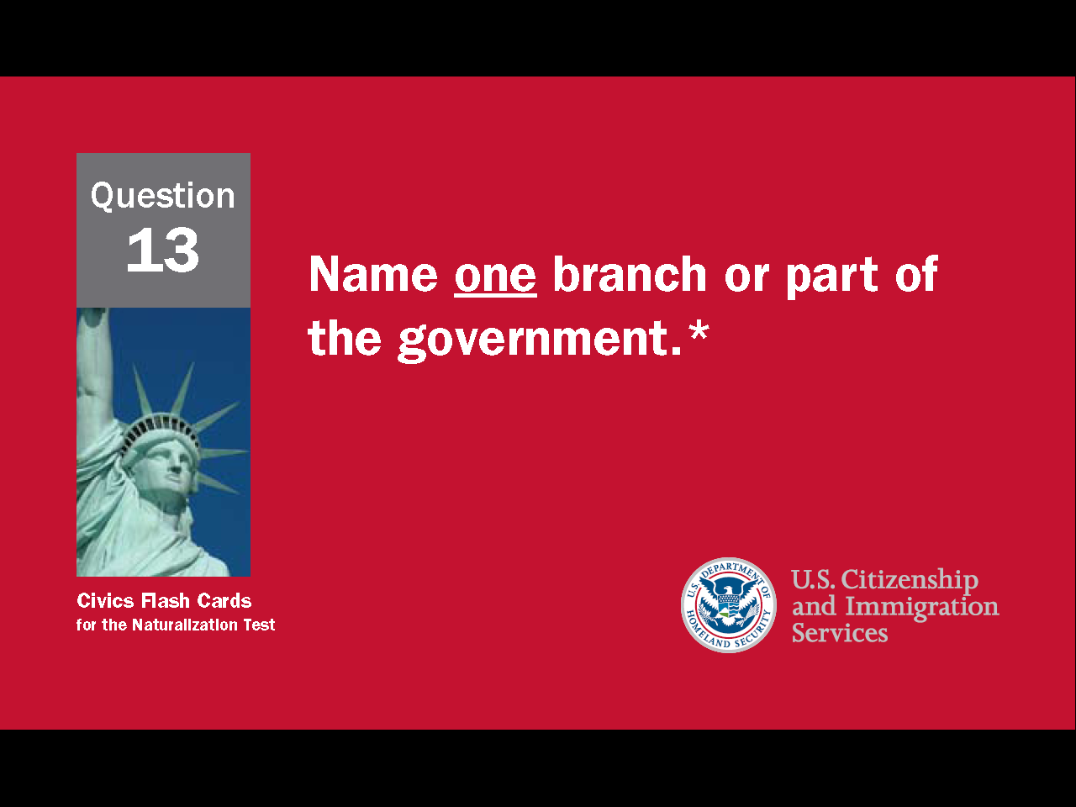
16
Notes:
Question 13. Name one branch or part of the government.

Slide 17
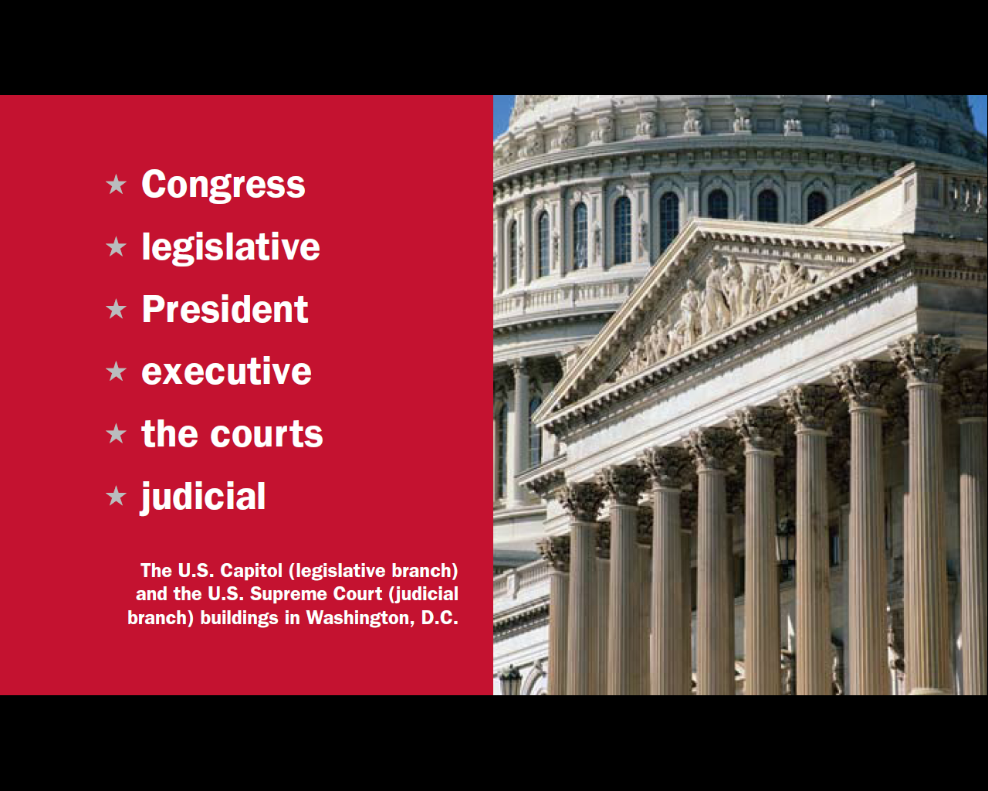
Question #13
17
Notes:
The three parts of the U.S. government are:
Congress, also called the legislative
the President, also known as the executive
and the courts, or the judicial branch

Slide 18
Separation of Powers /
Checks and Balances
PRESIDENT
(Executive Branch)
Can veto a bill
Can declare an executive
action unconstitutional
Can reject a treaty
signed by the president
Appoints federal judges
Can declare a law
unconstitutional
CONGRESS
(Legislative Branch)
THE COURTS
(Judicial Branch)
Approves federal judges
18
Notes:
To stop one branch of the government from becoming too powerful, the Founding Fathers gave each branch separate powers. This is called separation of powers. The Constitution also includes a system of checks and balances which allows one part of the government to "check" another. For example, Congress can reject a treaty signed by the president and the president can veto a bill from Congress. The President appoints federal judges, but Congress must approve them. Lastly, the Supreme Court can declare a law or executive action to be unconstitutional. In these ways, separate powers and checks and balances work to limit the power of government and to protect individual rights.
18

Slide 19
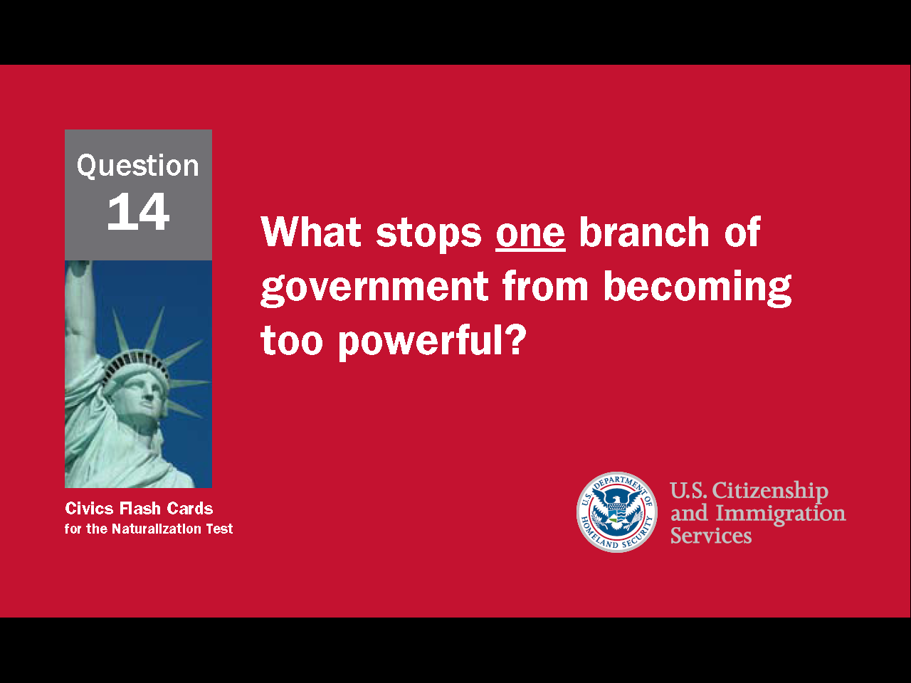
19
Notes:
Question 14. What stops one branch of government from becoming too powerful?

Slide 20
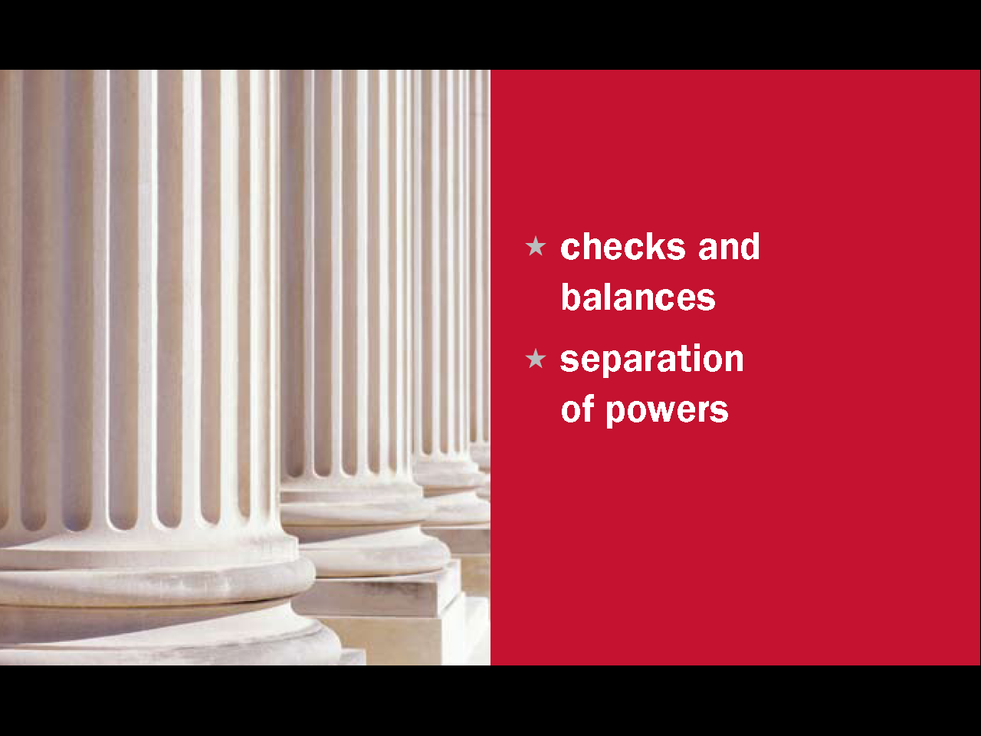
Question #14
20
Notes:
The separation of powers and system of checks and balances keeps one branch of government from becoming too powerful.

Slide 21
A Federal System
Separate and Shared Powers
Federal State
Shared
print money
declare war
create an army
make treaties
establish post offices
regulate trade between
states and countries
establish rules for
naturalization
issue patents
provide schooling and education
provide protection
provide safety
give a driver’s license
approve zoning & land use
conduct elections
establish local governments
regulate trade within a state
collect taxes
borrow money
build roads
establish courts
provide for the general welfare
charter banks and corporations
make and enforce laws
21
Notes:
The Founding Fathers also created a federal system of government. This is another way of preventing the national government from becoming too powerful. A federal system has a central government at the top and state governments below. By creating a broader government, federalism encourages experimentation and keeps the government close to the people. The different governments share certain powers such as establishing courts, making laws and collecting taxes, while other powers belong to only one of the governments. Among the powers granted to the federal government are the ability to print money, create an army, declare war, and make treaties with other countries. However, to protect states' rights and individual rights, the Constitution states that any powers not given to the federal government belong to the states.

Slide 22
A Federal System
Separate and Shared Powers
Federal State
Shared
print money
declare war
create an army
make treaties
establish post offices
regulate trade between
states and countries
establish rules for
naturalization
issue patents
provide schooling and education
provide protection
provide safety
give a driver’s license
approve zoning & land use
conduct elections
establish local governments
regulate trade within a state
collect taxes
borrow money
build roads
establish courts
provide for the general welfare
charter banks and corporations
make and enforce laws
22
Notes:
To protect states' rights and individual rights, the 10th Amendment says that any powers not given to the federal government belong to the states. Some state powers include providing schooling, education, protection and safety. Protection means police, and safety means fire departments. States also give driver’s licenses, and approve zoning and land use. Zoning and land use determines how land is used. This includes whether buildings can be built, what types of buildings and how they are used.

Slide 23
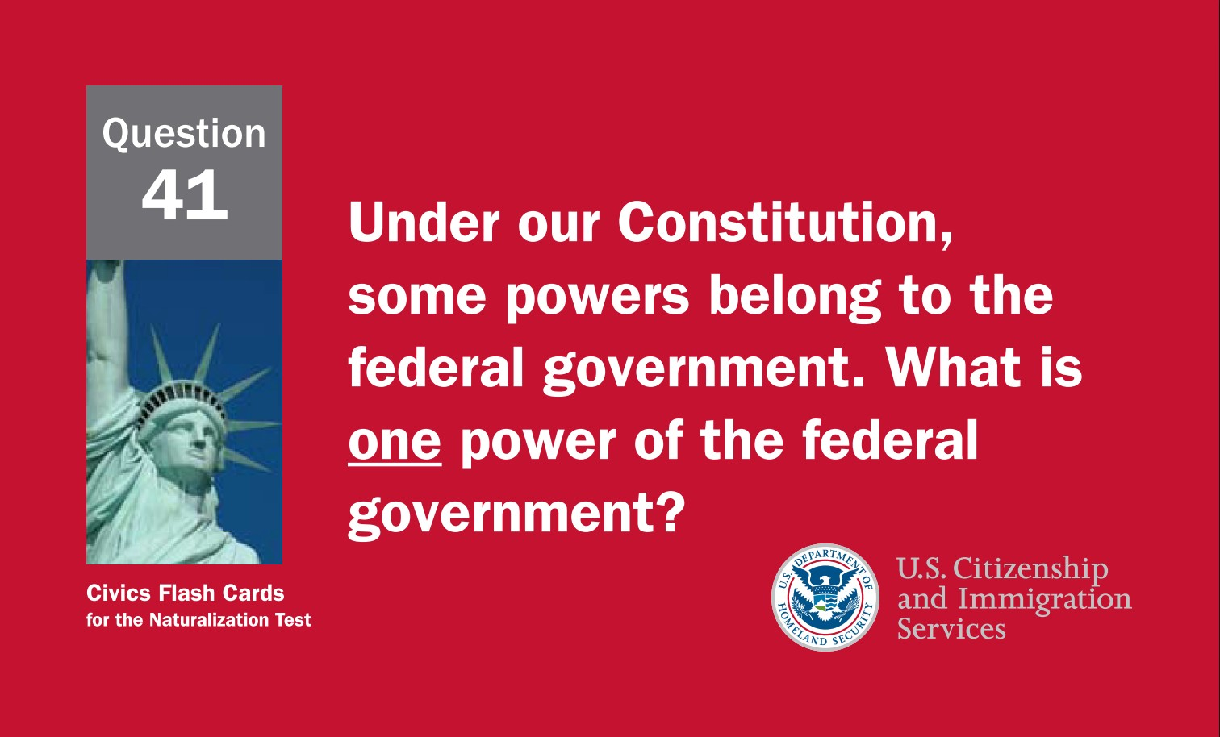
23
Notes:
Question 41. Under our Constitution, some powers belong to the federal government. What is one power of the federal government?

Slide 24
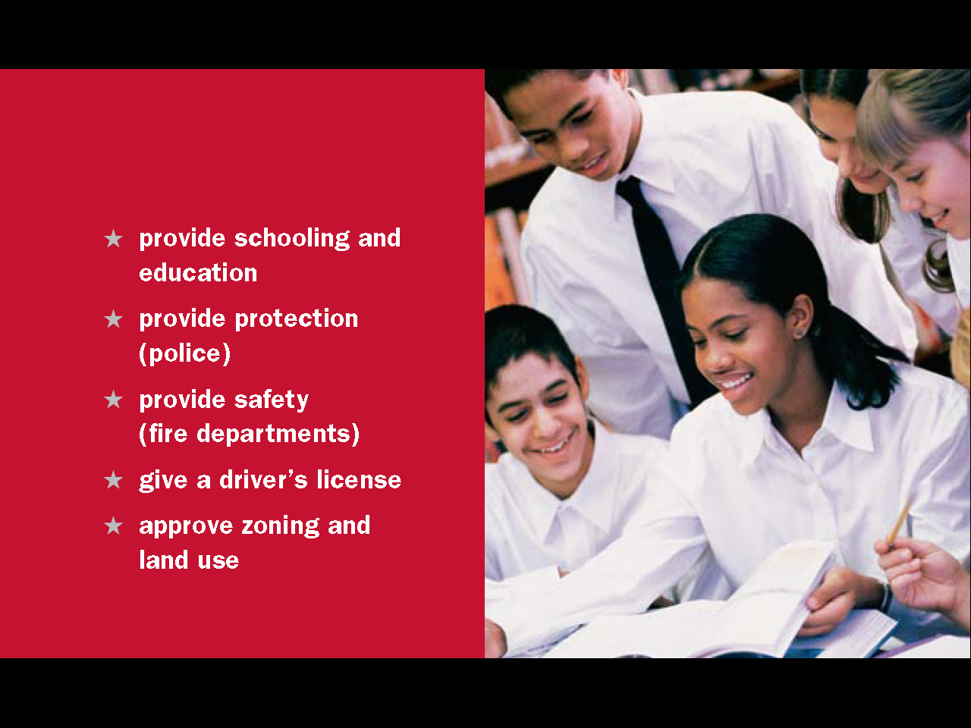
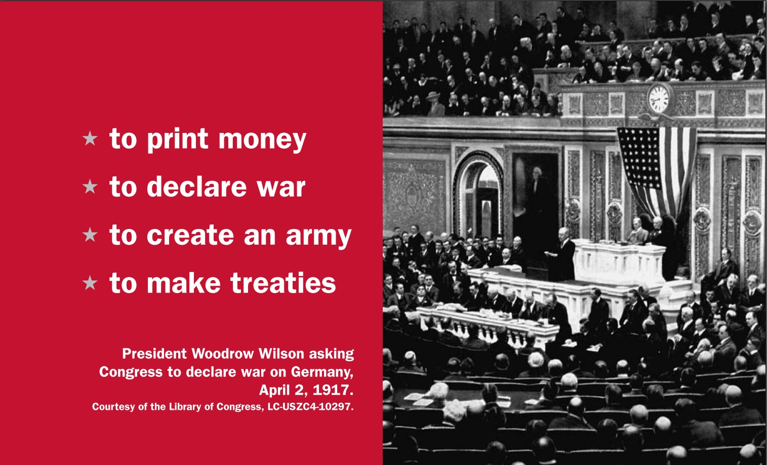
Question #41
24
Notes:
Some powers that belong to the federal government are the powers to
print money
declare war
create an army
make treaties

Slide 25
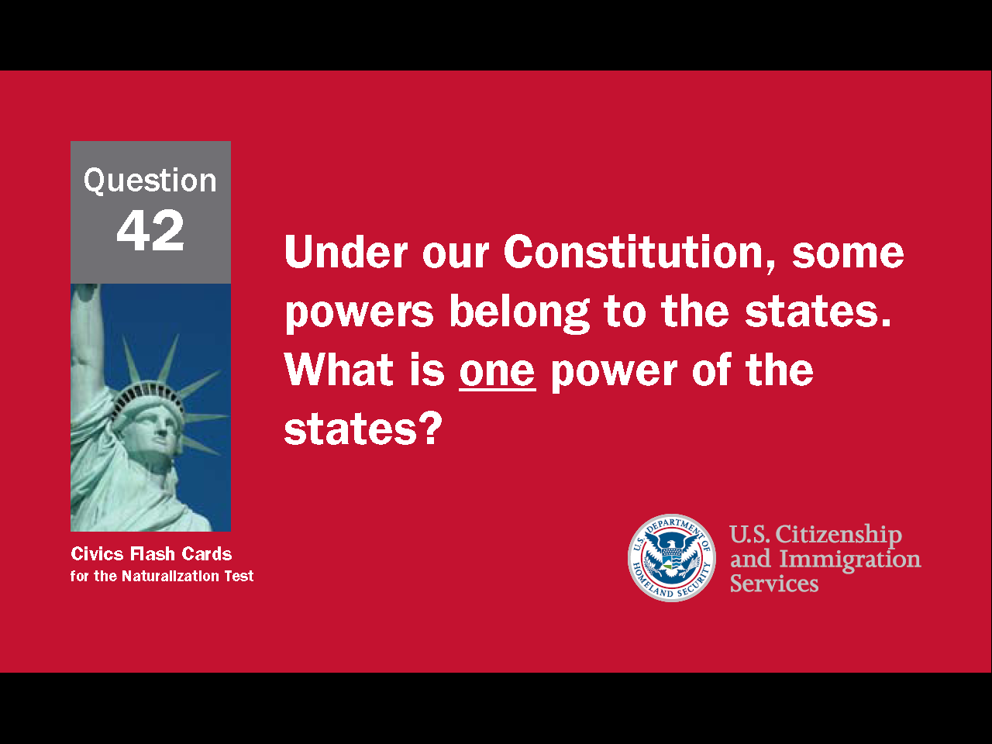
25
Notes:
Question 42. Under our Constitution, some powers belong to the states. What is one power of the states?

Slide 26
Question #42
26
Notes:
According to the Constitution, some of the powers that belong to states are providing schooling, education, protection and safety, giving driver’s licenses, and approving zoning and land use.

Slide 27
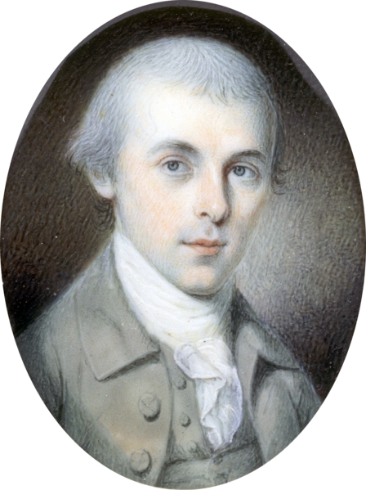
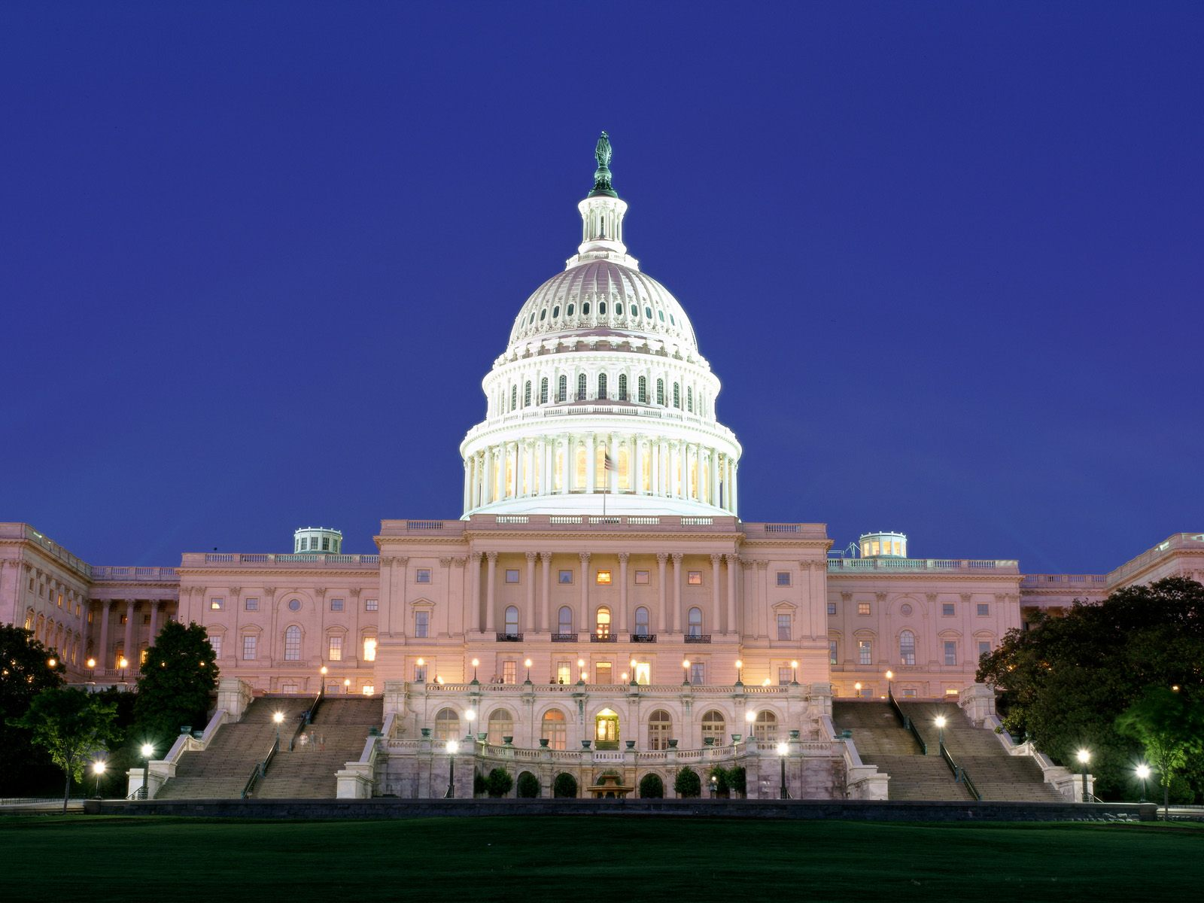
James Madison - Federalist
A United Nation Requires a Strong Government
Notes:
James Madison was the most influential member of the Constitutional Congress and considered "the Father of the Constitution." He was also a Federalist. Federalists believed a strong central government was necessary to unite and protect Americans and to properly conduct the country's foreign affairs.

Slide 28
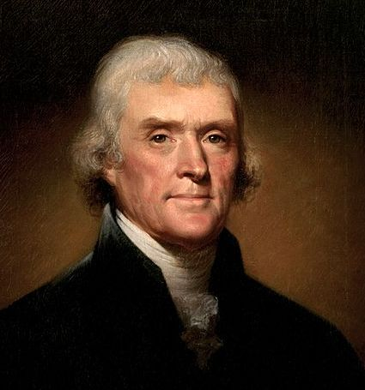
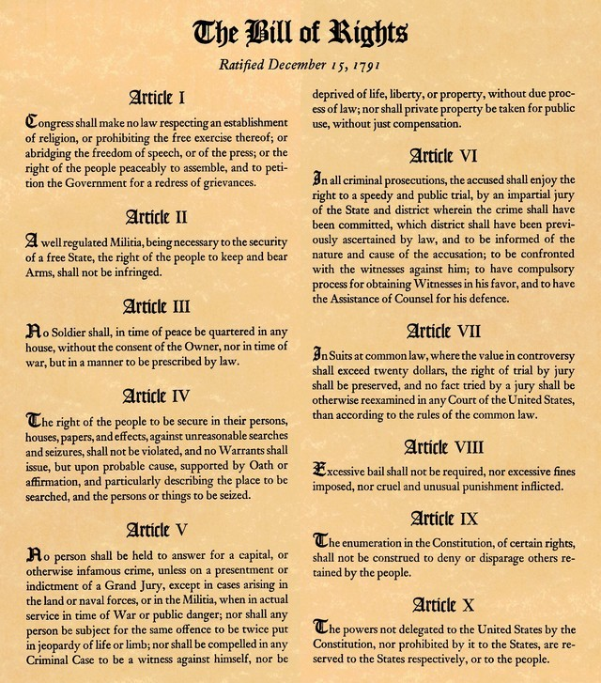
Thomas Jefferson - Anti-Federalist
Limited Government; Guaranteed “Natural Rights”
Notes:
Anti-Federalists, like Thomas Jefferson (who wrote the Declaration of Independence), believed a big government would endanger states' rights and personal liberty. Anti-Federalists also worried that the president could become as powerful as a king.

Slide 29
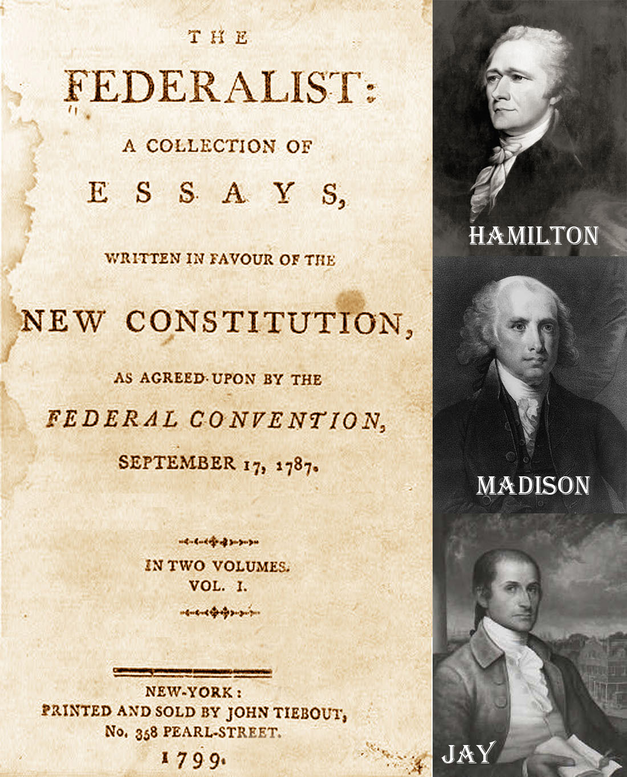
The Federalist Papers
Notes:
Nine states had to accept the Constitution before the new government could be set up. In New York, Anti-Federalist feeling was particularly strong. In response, James Madison, Alexander Hamilton, and John Jay wrote The Federalist Papers, a collection of 85 essays explaining the new Constitution, its form of government and the system of checks and balances. Although Madison, Hamilton, and Jay wrote all the essays, most were published under the anonymous pen-name Publius. In the end, all 13 states voted in support of the new constitution. It is unclear how much influence The Federalist Papers had on New York or other states, but the essays are still read today for their interpretation of the Constitution.

Slide 30
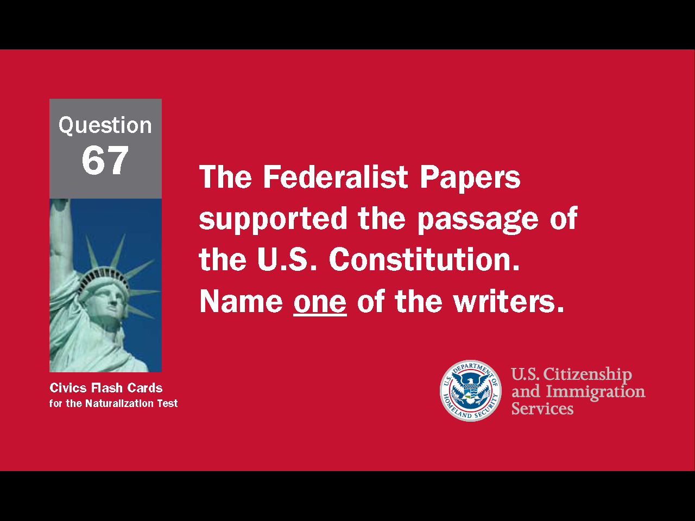
30
Notes:
Question 67. The Federalist Papers supported the passage of the U.S. Constitution. Name one of the writers.

Slide 31
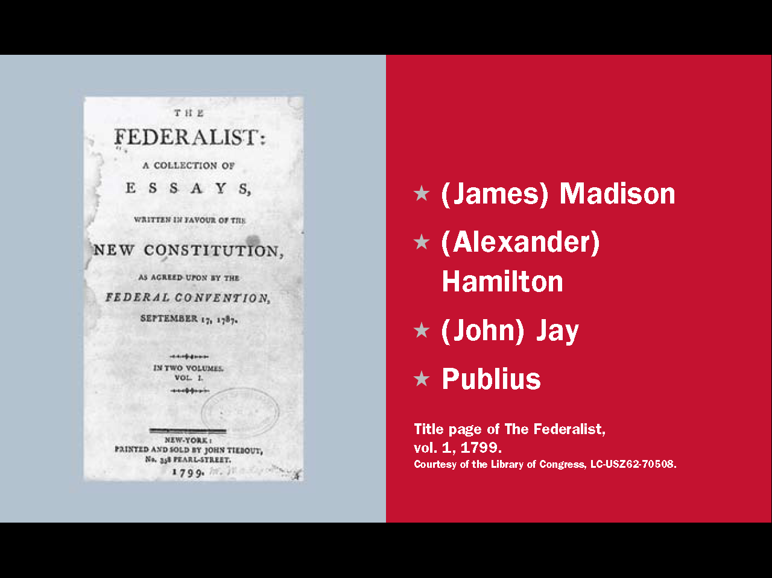
Question #67
Notes:
The three authors of The Federalist Papers were James Madison, Alexander Hamilton, and John Jay. However, most of the essays were published anonymously under the pen-name Publius.

Slide 32
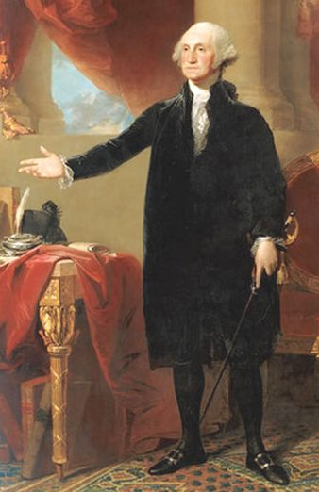
George Washington
First President of the United States
32
Notes:
Once the new Constitution was accepted, a president had to be chosen. Because of his leadership during the Revolutionary War, George Washington had been made president of the Constitutional Convention. His support for the new Constitution convinced many members to accept the new government. Washington's reputation made him a natural choice for the nation's first president. In fact, some Founding Fathers would only accept him as first president. In 1789, Washington was elected President of the United States by unanimous electoral vote. He served only two terms, and then retired, thus setting a precedent that would not be broken until 1941.

Slide 33
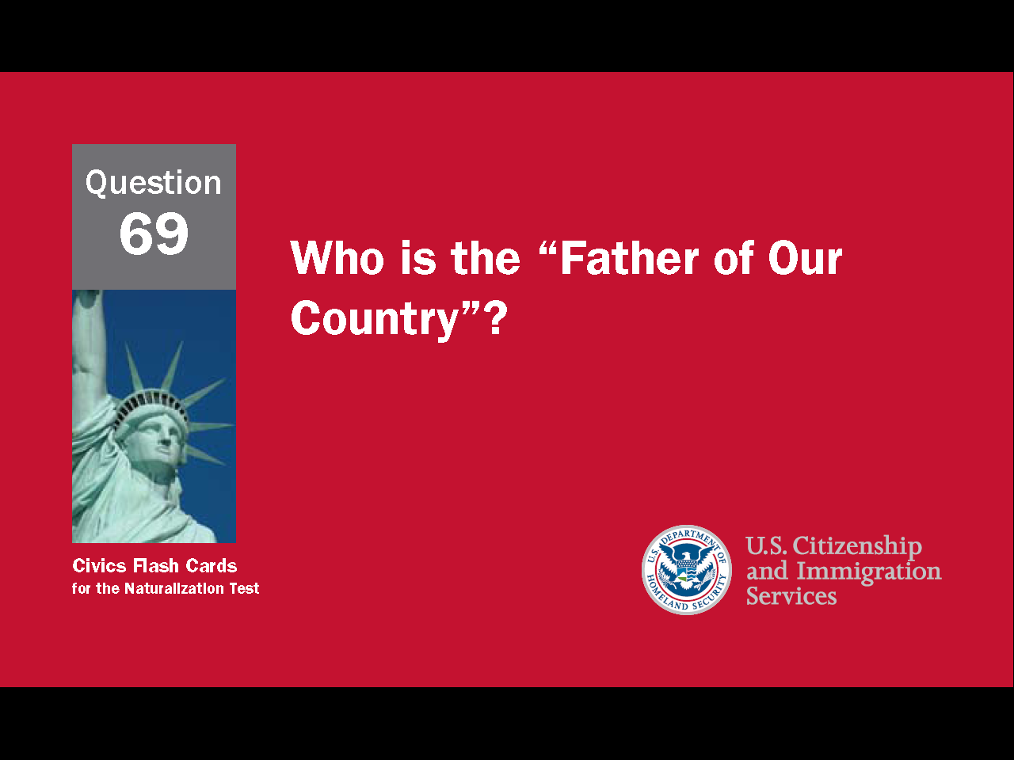
33
Notes:
Question 69. Who is the “Father of Our Country”?

Slide 34
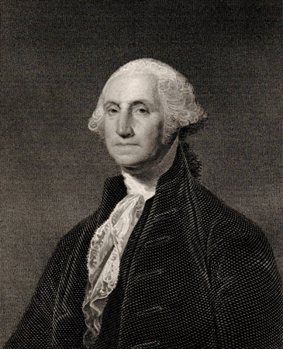
Question #69
34
Notes:
Washington. The "Father of Our Country" is George Washington.

Slide 35
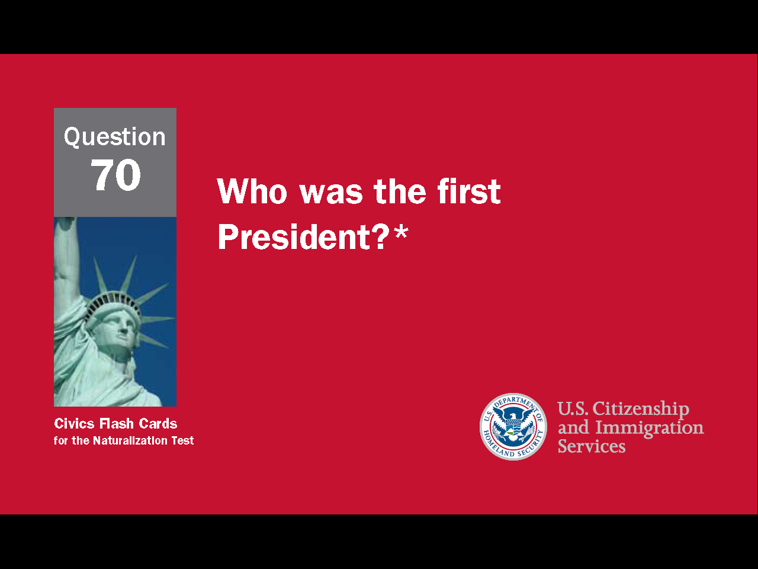
35
Notes:
Question 70. Who was the first President?

Slide 36
Question #70
36
Notes:
George Washington was the first president of the United States and considered "the father of our country."

Slide 37
27 Constitutional Amendments
1st - 10th Amendments: The Bill of Rights, 1791.
11th Amendment: Grants states immunity from outside lawsuits, 1795.
12th Amendment: Requires distinct votes for President and Vice President, 1804.
13th Amendment: Abolished slavery, 1865.
14th Amendment: Defines citizenship; includes clauses on due process and equal protection, 1868.
15th Amendment: Grants voting rights to male citizens of all races, 1870.
16th Amendment: Authorizes a federal income tax, 1913.
17th Amendment: Allows direct Senatorial elections by a state, 1913.
18th Amendment: Enacted prohibition, 1919.
19th Amendment: Grants voting rights to women, 1920.
20th Amendment: "Lame Duck Amendment;" reduces time between election and service of
elected officials, 1933.
21st Amendment: Repealed the 18th Amendment, 1933.
22nd Amendment: Limits a president to two terms, 1951.
23rd Amendment: Granted the District of Columbia electoral votes, 1961.
24th Amendment: Prohibits poll taxes, 1964.
25th Amendment: Clarifies procedures regarding succession of President and Vice President
upon death or inability to serve, 1967.
26th Amendment: Makes 18 the minimum legal voting age, 1971.
27th Amendment: Allows changes in Congressional salary only after a general election (first
submitted in 1789) 1992.
37
Notes:
The Framers of the Constitution included procedures allowing for changes or additions to the Constitution. These are called amendments. So far, 27 amendments have been added to the Constitution, although the 18th Amendment was later repealed. The last amendment was made in 1992.

Slide 38
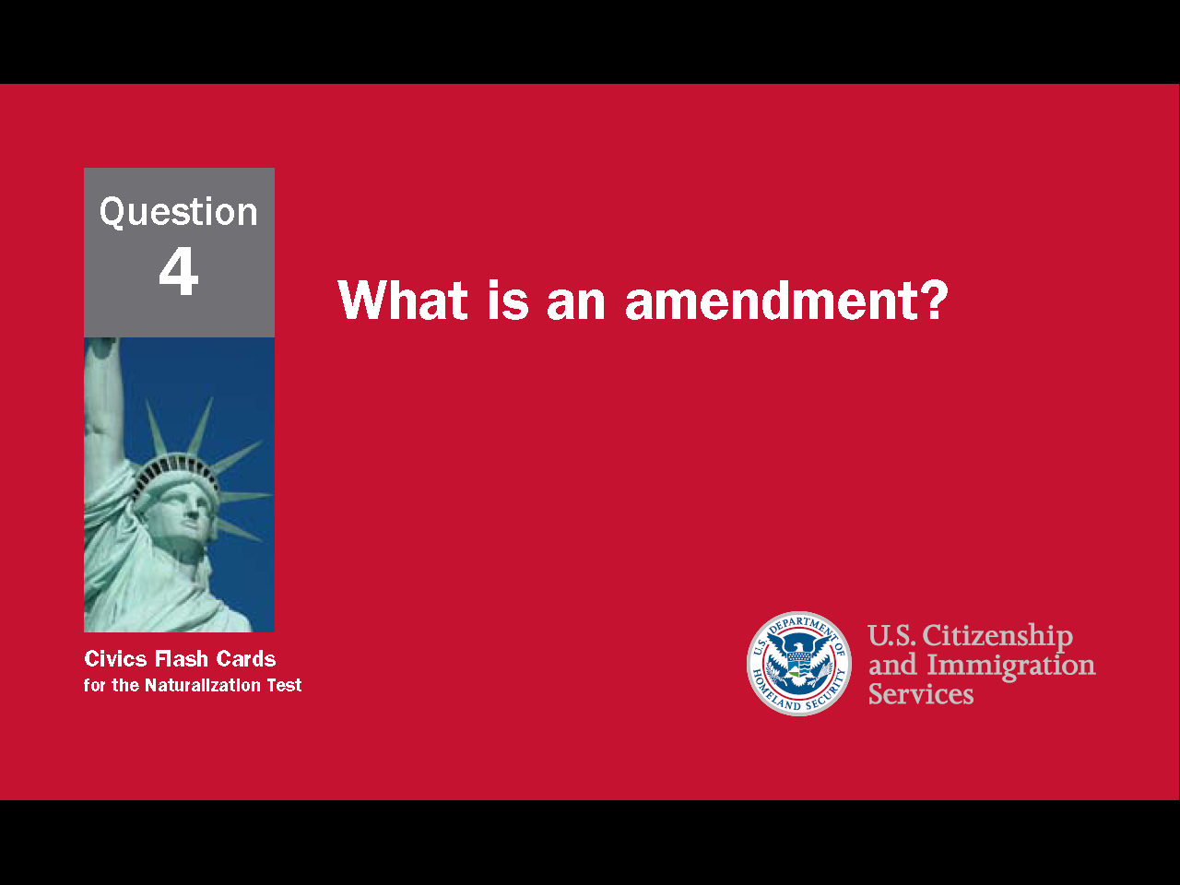
38
Notes:
Question 4. What is an amendment?

Slide 39
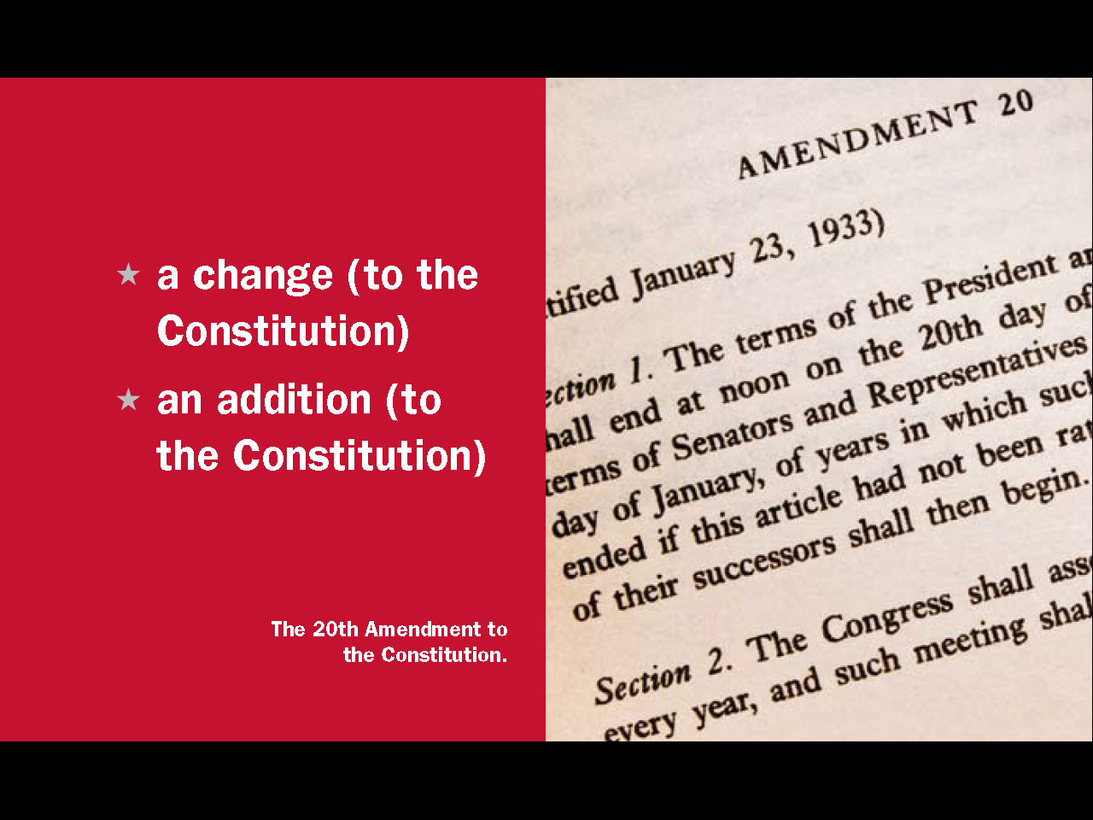
Question #4
Notes:
An amendment is a change or addition to the Constitution.

Slide 40
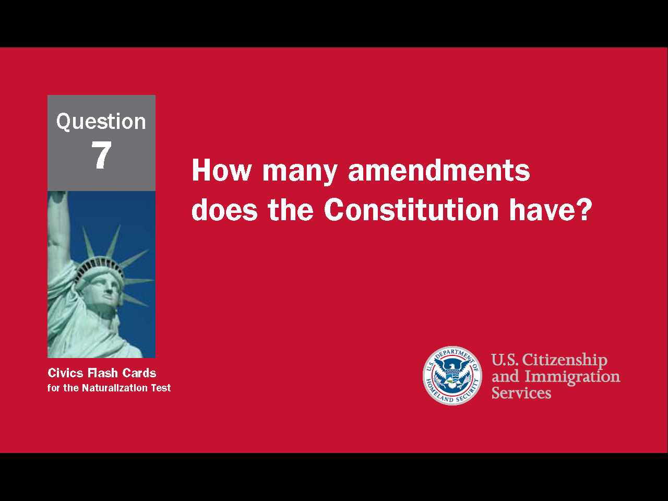
40
Notes:
Question 7. How many amendments does the Constitution have?

Slide 41
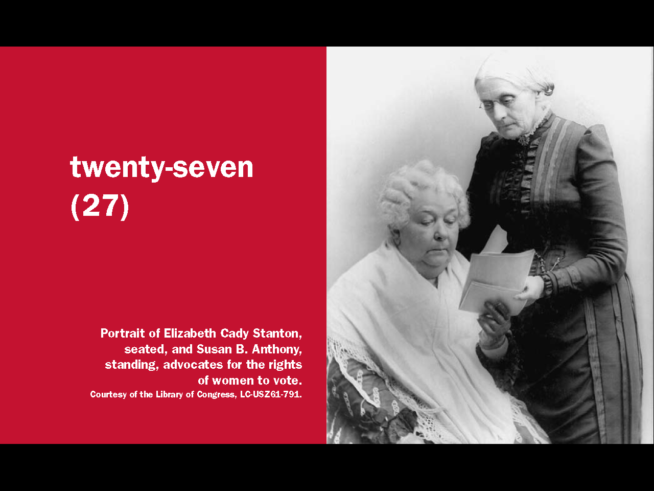
Question #7
Notes:
27. Twenty-seven amendments have been added to the Constitution so far.

Slide 42
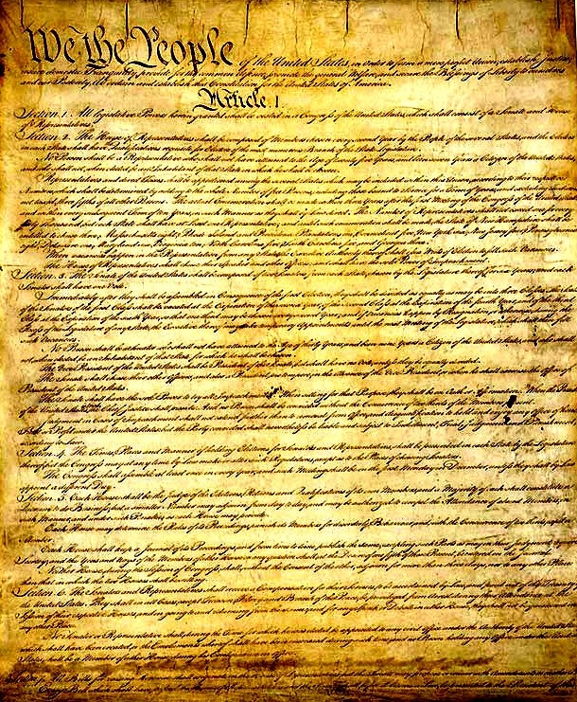
The Constitution and Bill of Rights
The Foundation of a Constitutional Democracy
42
Notes:
The original Constitution defined and set up the government, but did not guarantee any individual rights. Thomas Jefferson wanted a citizen's basic freedoms guaranteed through a Bill of Rights, a document that clearly states an individual's rights and sets the limits on government power. James Madison though believed the Constitution alone offered enough protection. The Federalist Papers even contained an essay opposing the idea of a Bill of Rights. It was believed that any freedoms not listed could then be denied by the government. However, many Anti-Federalists supported Jefferson's idea, and to get them to support the new Constitution, the Federalists agreed to create a Bill of Rights once the Constitution had been accepted. In 1789, Madison wrote the Bill of Rights and in 1791 they became the first ten amendments to the Constitution.

Slide 43
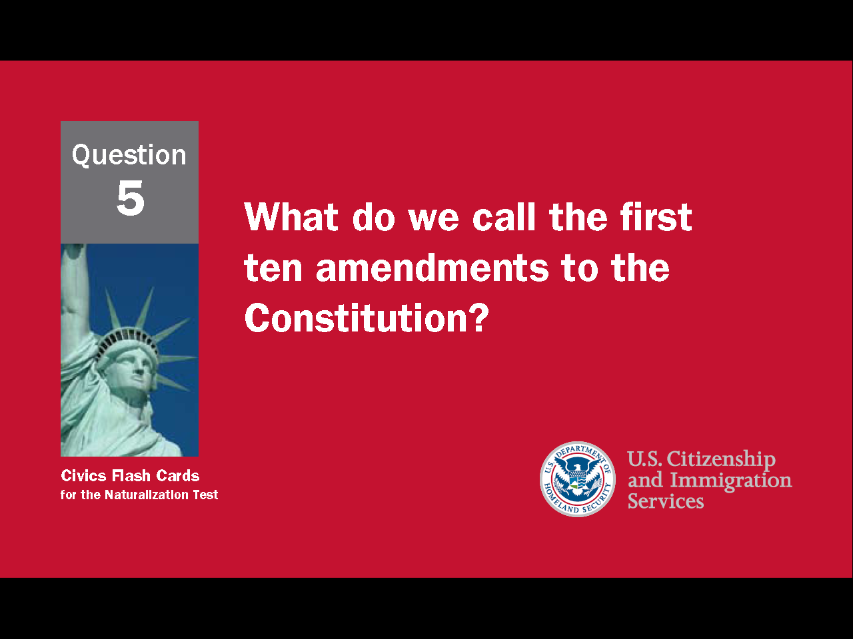
43
Notes:
Question 5. What do we call the first ten amendments to the Constitution?

Slide 44
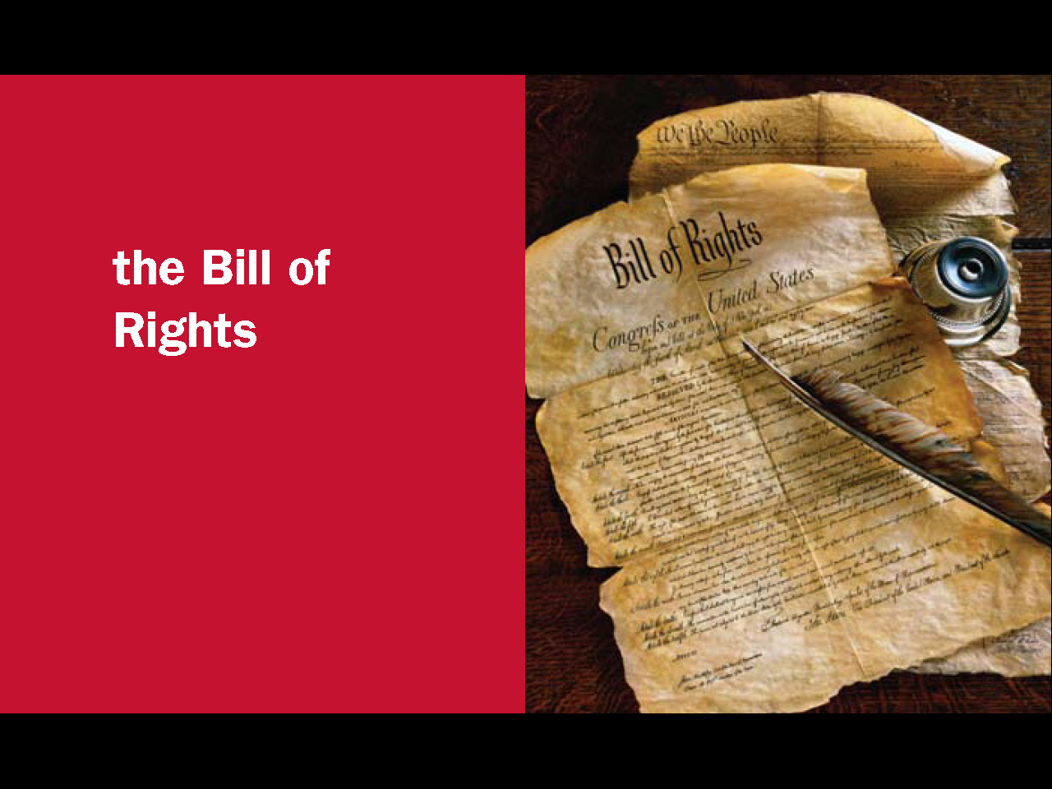
Question #5
Notes:
The Bill of Rights are the first ten amendments to the Constitution.

Slide 45
The First Amendment
Congress shall make no law respecting an establishment of religion, or prohibiting the free exercise thereof; or abridging the freedom of speech, or of the press; or the right of the people peaceably to assemble, and to petition the Government for a redress of grievances.
45
Notes:
The First Amendment in the Bill of Rights guarantees five freedoms: freedom of speech, freedom of religion, freedom of assembly, freedom of the press, and freedom to petition the government. Freedom of speech means a person may say or otherwise express any idea they want. Freedom of religion allows someone to practice or not practice a religion. Freedom of assembly is the freedom to gather in a group. Freedom of the press allows newspapers to print whatever they want, including criticism of the government and its leaders. Freedom to petition the government means any citizen can make a complaint to the government.

Slide 46
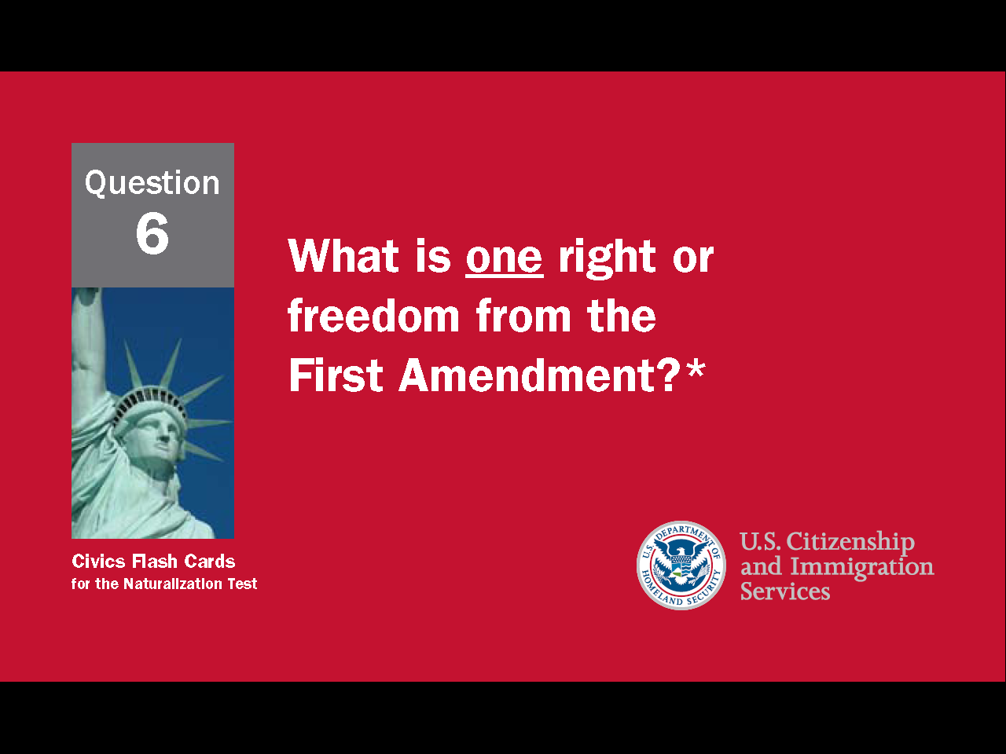
46
Notes:
Question 6. What is one right or freedom from the First Amendment?

Slide 47
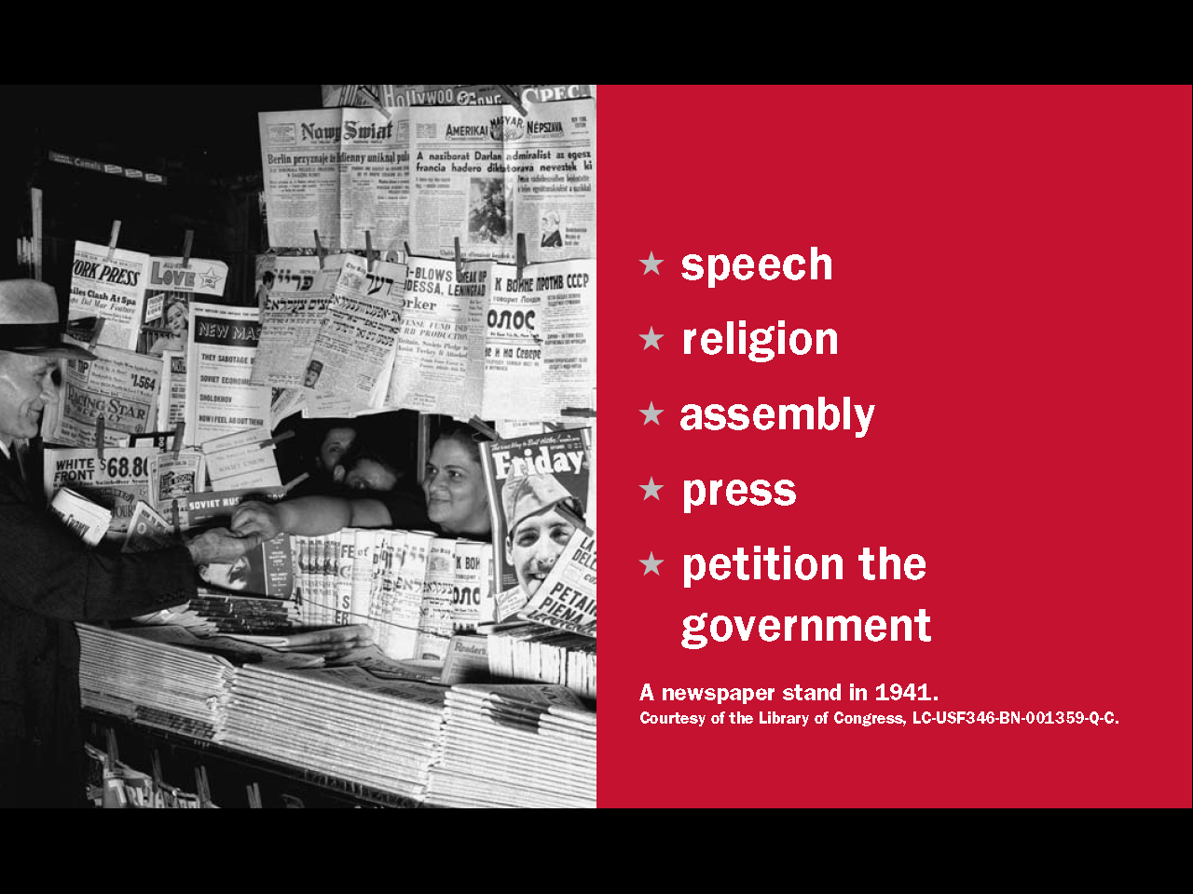
Question #6
Notes:
The First Amendment allows for freedom of speech, freedom of religion, freedom of assembly, freedom of the press, and freedom to petition the government.

Slide 48
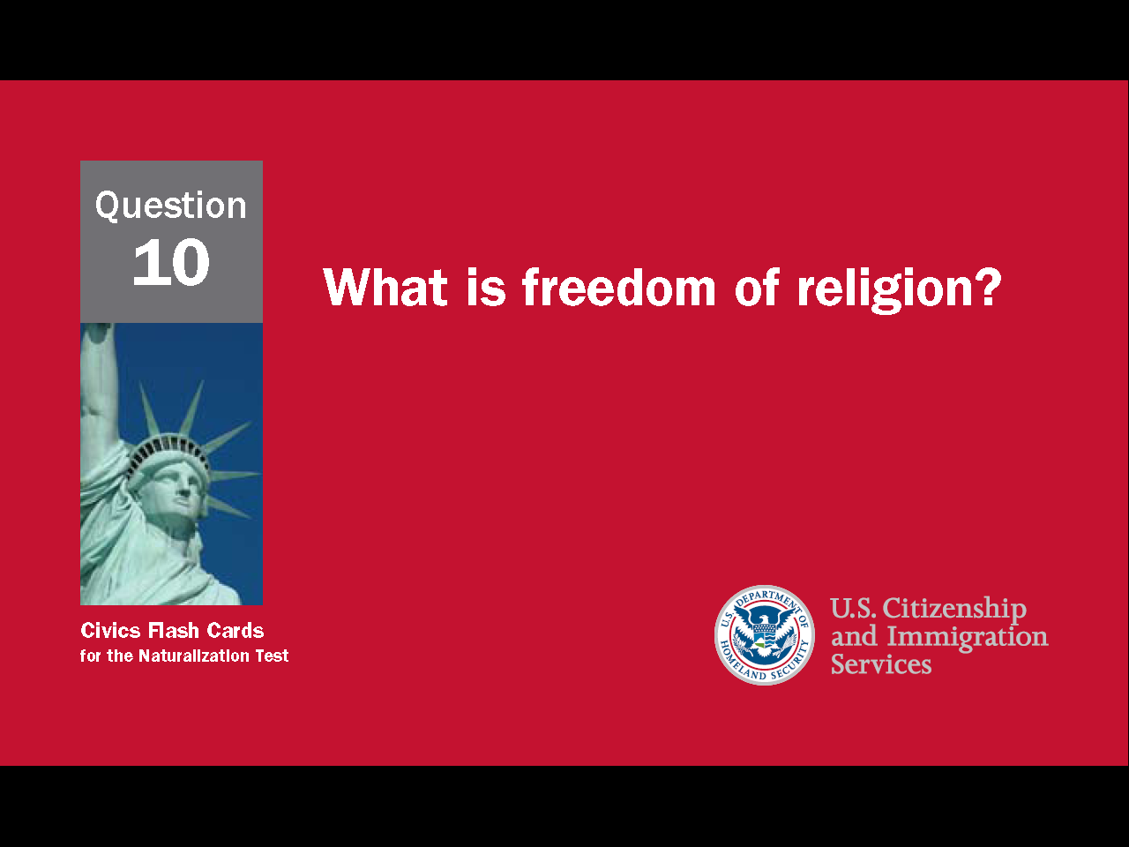
48
Notes:
Question 10. What is freedom of religion?

Slide 49
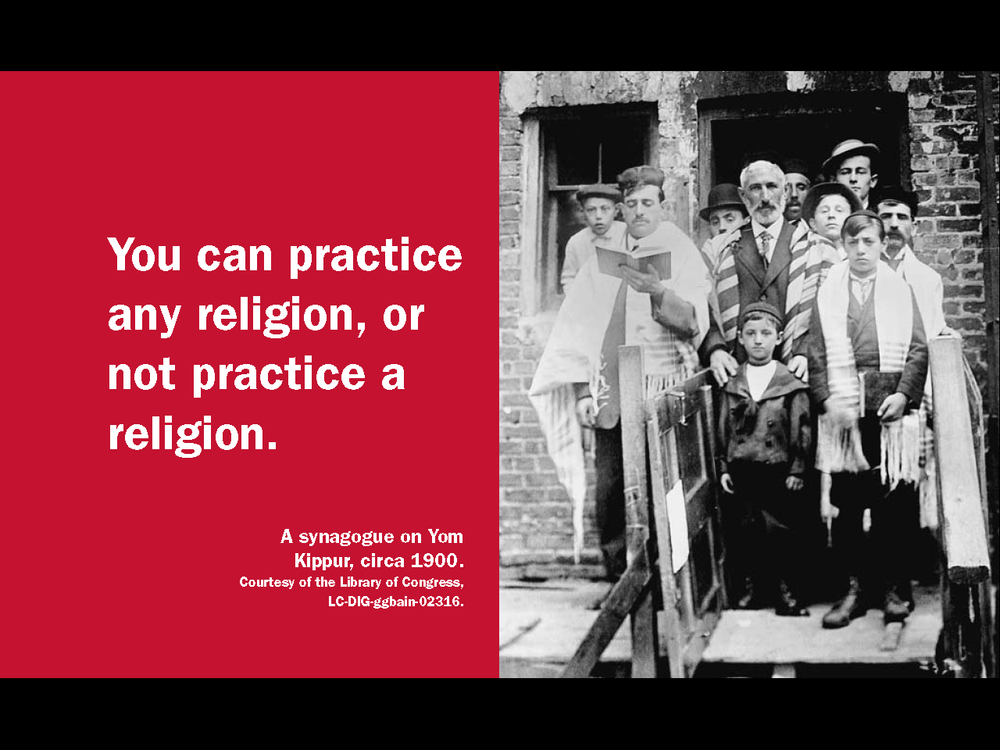
Question #10
Notes:
Freedom of religion means you can practice any religion you want, or not practice a religion.

Slide 50
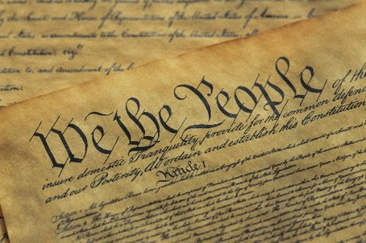
The Idea of Self-government
50
Notes:
The U.S. government is based on the idea of self-government. The Declaration of Independence states that all men are born equal and a nation's citizens, not a king or other ruler, must be allowed to make their own laws. That is why the first three words of the Constitution are "We the people." As President Abraham Lincoln said, the U.S. has "a government of the people, by the people, for the people."

Slide 51
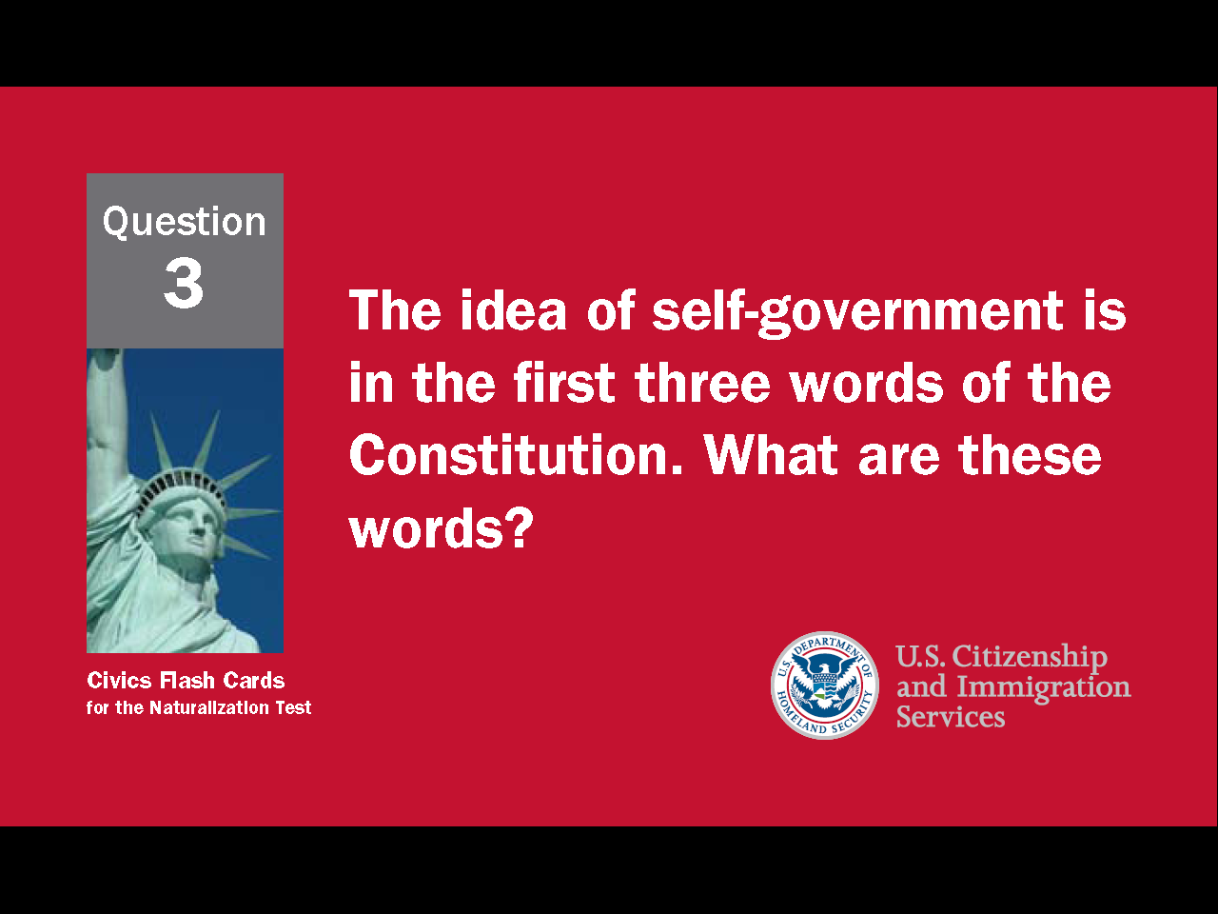
51
Notes:
Question 3. The idea of self-government is in the first three words of the Constitution. What are these words?

Slide 52
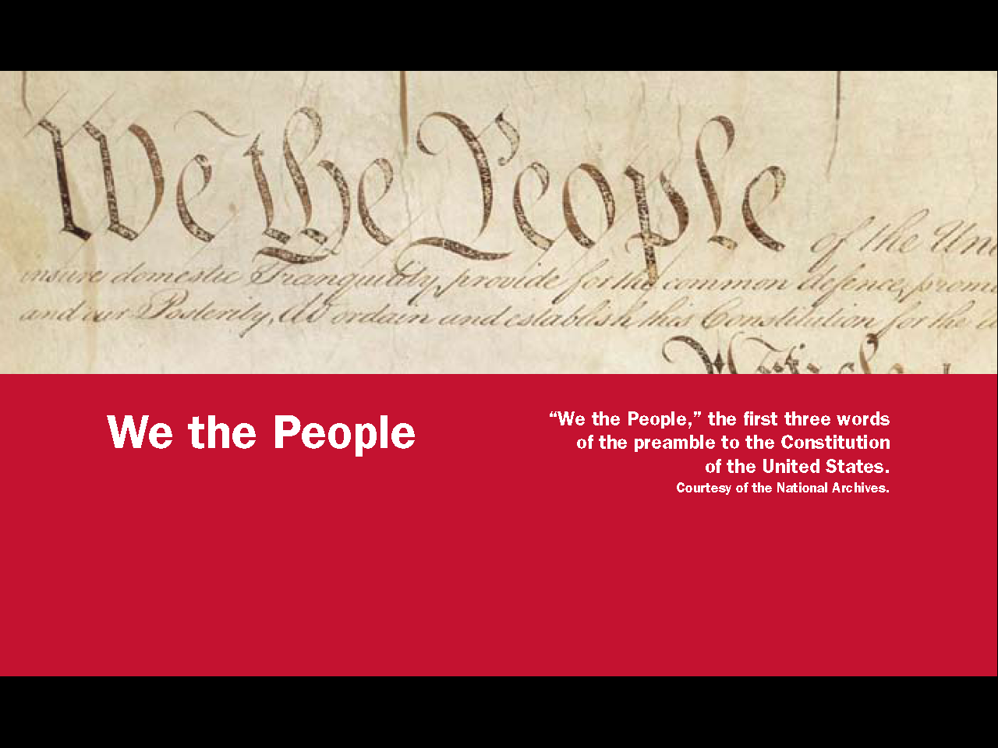
Question #3
Notes:
"We the People" are the first three words of the Constitution and embody the American idea of self-government.

Slide 53

Capitalist Economy / Market Economy
53
Notes:
The economic system of the United States is based on free market capitalism. In capitalism, businesses are privately-owned and operated for profit. In a market economy, what is produced and how much is charged is determined through free competition and the interaction of supply and demand.

Slide 54
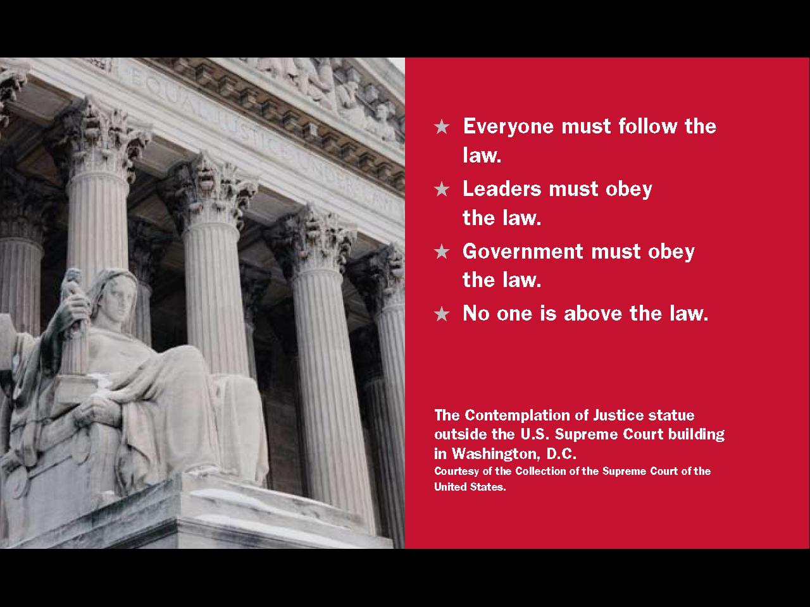

54
Notes:
Question 11. What is the economic system in the United States?

Slide 55


Question #11
55
Notes:
The economic system in the United States is a
capitalist economy
market economy
The economic system in the United States is capitalist with a market economy.

Slide 56
The
Rule
of
Law
Everyone must follow the law
No one is above the law
Leaders must obey the law
Government must obey the law
56
Notes:
In addition to being a foundation for self-government, the Constitution promotes the rule of law. The rule of law means everyone must obey the laws of the nation. No one is above the law, not individuals, not leaders and not the government. In the words of one Founding Father, the United States is "a government of laws, and not of men."

Slide 57

57
Notes:
Question 12. What is the “rule of law”?

Slide 58
Question #12
58
Notes:
The rule of law means:
Everyone must follow the law.
Leaders must obey the law.
The government must obey the law.
No one is above the law.

Slide 59
Ways to Participate in Our Democracy
vote
join a political party
help with a campaign
join a civic group
join a community group
give an elected official your opinion on an issue
call Senators and Representatives
publicly support or oppose an issue or policy
run for office
write to a newspaper
59
Notes:
There are many ways a citizen can become involved in their democracy. This participation is so important that many of the activities are protected by the Constitution. Some ways to participate include:
voting
joining a political party, community group, or civic group
helping with a campaign
giving an elected official your opinion on an issue
calling Senators and Representatives
publicly supporting or opposing an issue or policy
running for office
and writing to a newspaper

Slide 60

60
Notes:
Question 55. What are two ways that Americans can participate in their democracy?

Slide 61

Question #55
61
Notes:
There are many ways Americans can participate in their democracy including voting, joining various types of groups, helping with a campaign, publicly sharing opinions, and running for office.

