Slide 1
Lesson 3
American History
1800 through the Civil War
Questions: 71, 89, 90, 93, 60, 73, 72, 74, 4, 76, 75
1
Notes:
Lesson 3. American History: 1800 through the Civil War.
This lesson is about American history from the end of the Revolutionary War through the Civil War. This lesson covers civics questions 4, 60, 71, 72, 73, 74, 75, 76, 89, 90, and 93.

Slide 2
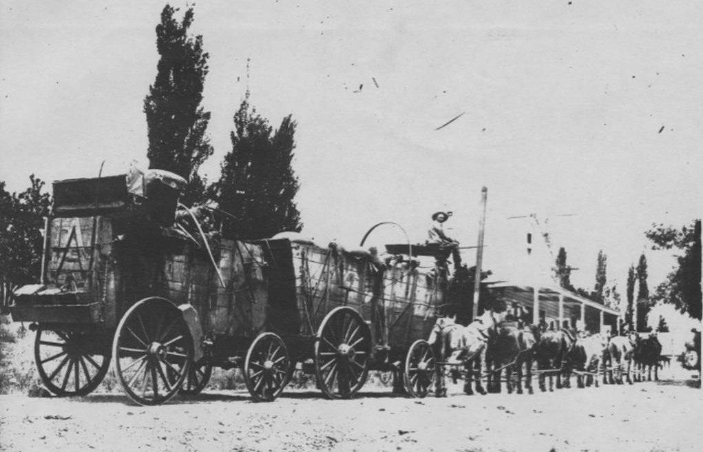
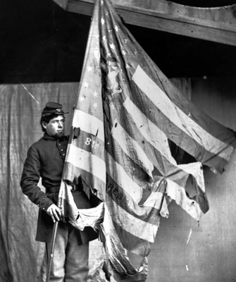
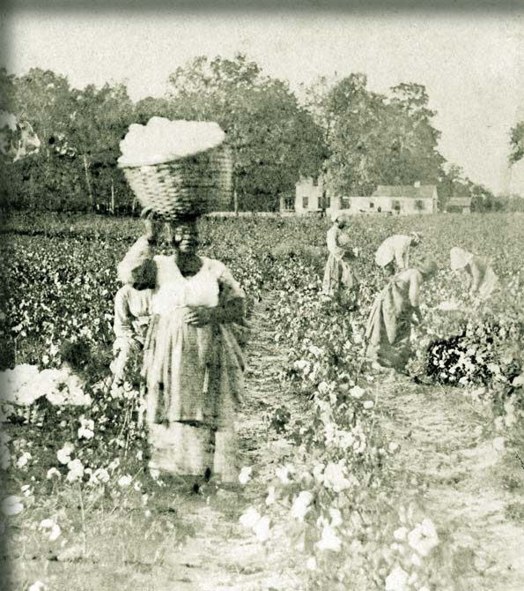
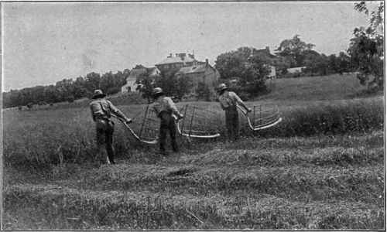
2
Notes:
The 1800s was a time of great change, growth and turmoil in the United States. In the 1800s, the U.S. fought its first international wars, the country rapidly expanded west, the industrial revolution created great social and economic changes, and the issue of slavery split the nation and led to a terrible civil war.

Slide 3
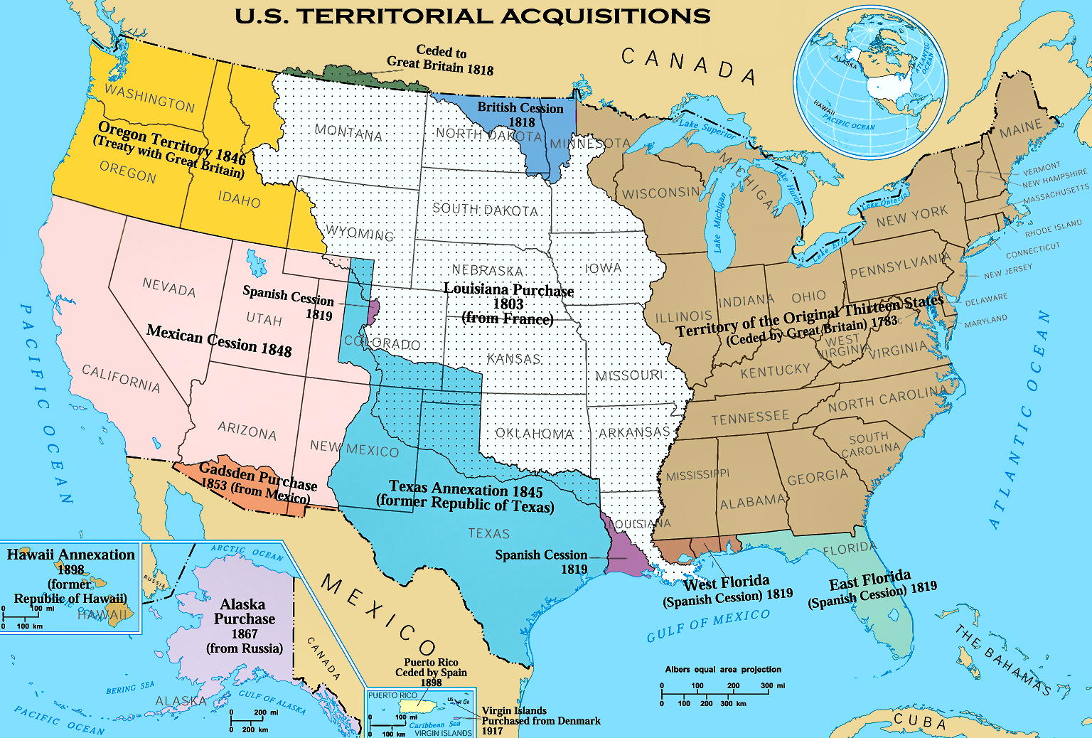
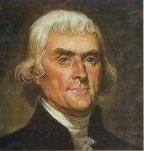
Louisiana (1803)
3
Notes:
After the Revolutionary War, the United States quickly expanded west. This expansion was greatly encouraged after 1803. That year, President Thomas Jefferson bought Louisiana from France. The Louisiana Territory doubled the size of the United States and settlers quickly moved west.

Slide 4
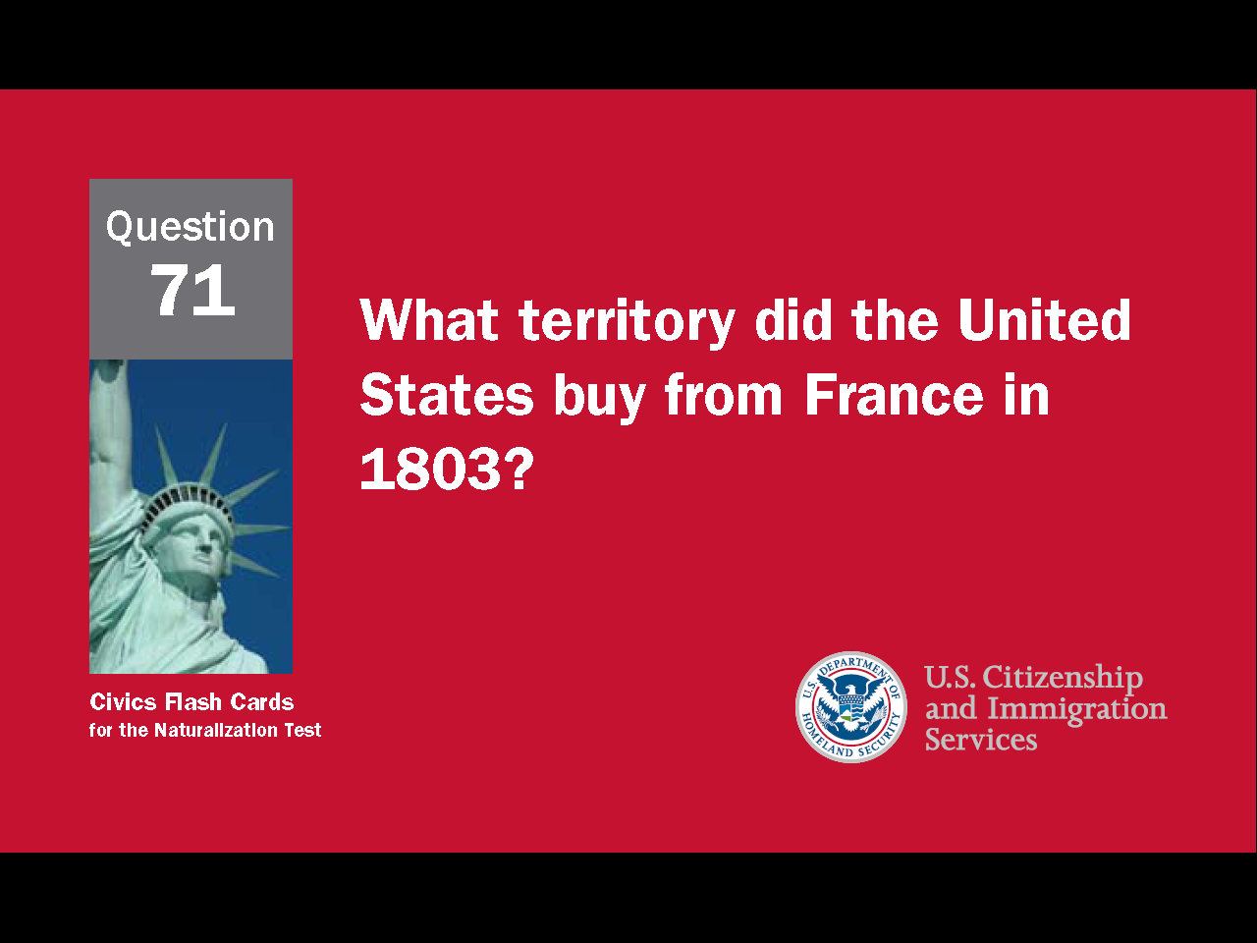
4
Notes:
Question 71. What territory did the United States buy from France in 1803?

Slide 5
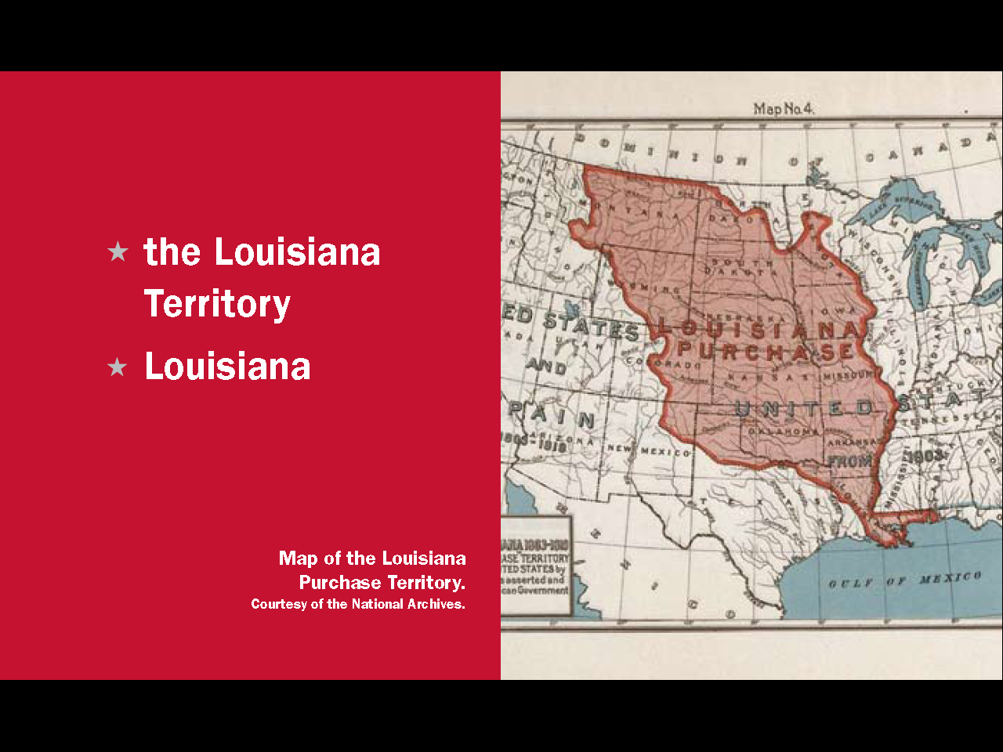
Question #71
5
Notes:
The United States bought Louisiana, or the Louisiana Territory, from France in 1803.

Slide 6
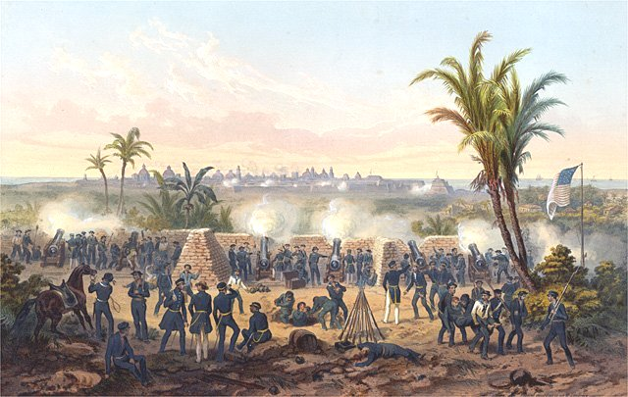
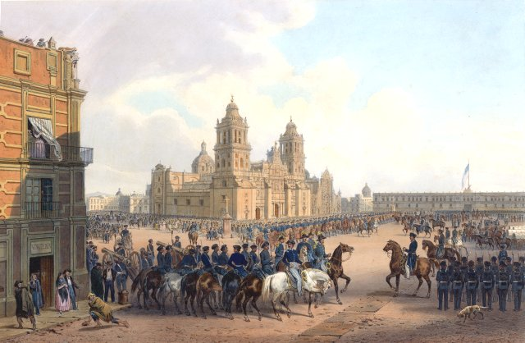
Mexican-American War (1846-1848)
6
Notes:
In the mid-1800s, the westward movement of settlers created problems with Mexico and led to the Mexican-American War. What is now the state of Texas was originally Mexican territory. The territory had a small population and was often attacked by Native Americans. To try to protect the area, Mexico invited immigrants to settle in Texas. So many Americans came, that within 10 years they were 80% of the population. Mexico then tried to end the immigration, but it was too late. A few years later, in 1835, Texas declared its independence. A Mexican army attacked, was defeated, and Mexico agreed to make Texas an independent republic. In 1845, Texas asked to join the United States. The U.S. annexed the territory, Mexico attacked again, and after a series of battles was defeated.
6

Slide 7
7
Notes:
The peace treaty forced Mexico to give up Texas and the rest of their northern territory. Those areas are shown on the map in pink and blue. The United States now stretched across the continent from the Atlantic Ocean in the east to the Pacific Ocean in the west.

Slide 8
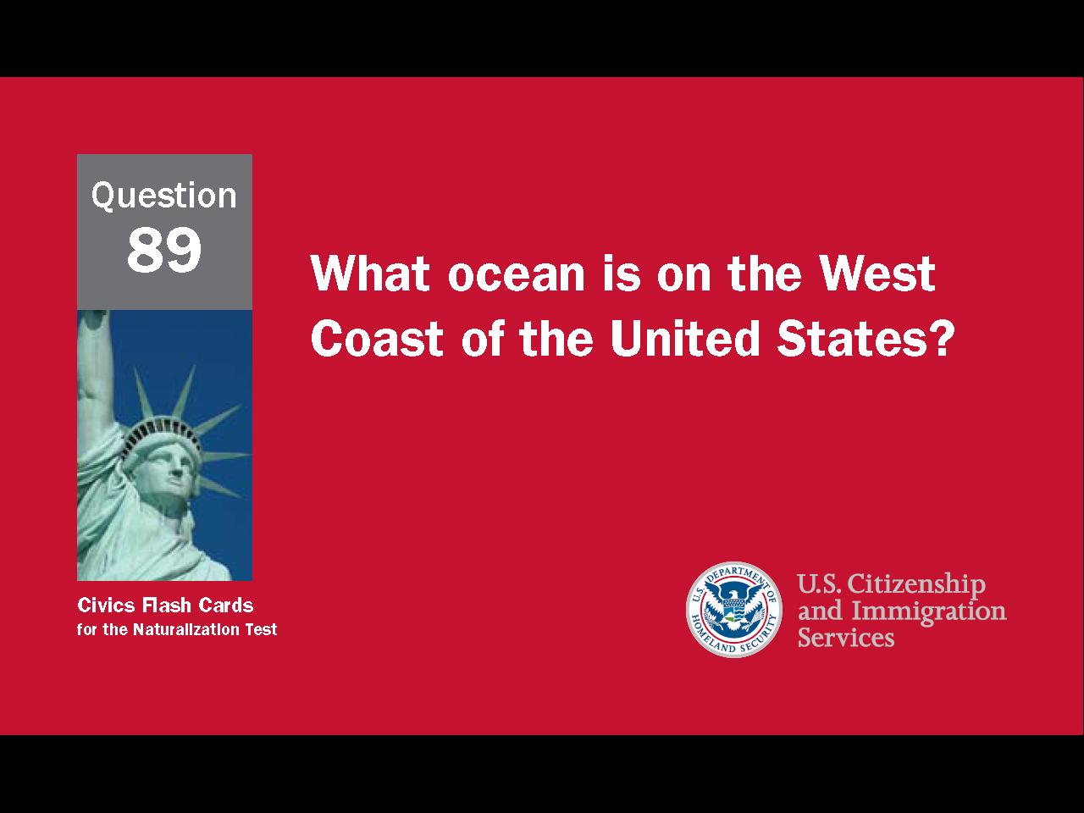
8
Notes:
Question 89. What ocean is on the West Coast of the United States?

Slide 9
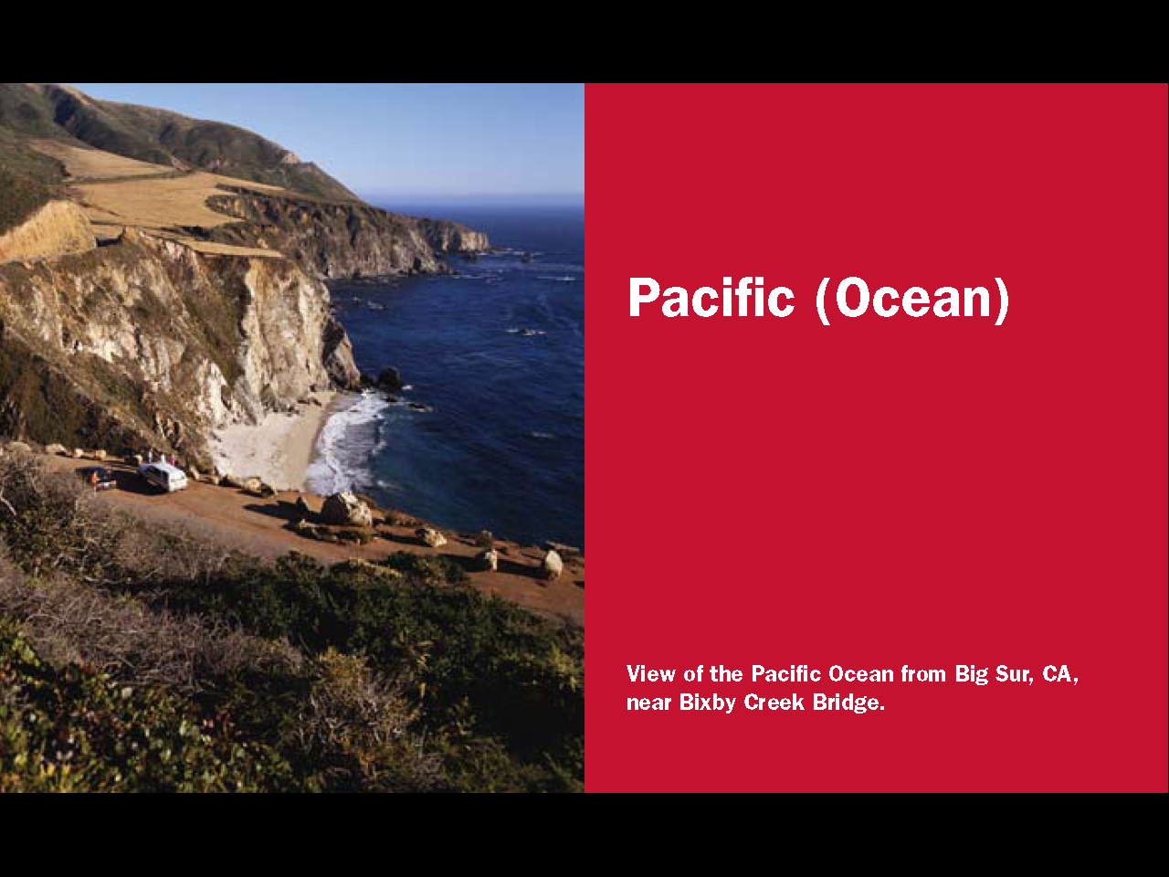
Question #89
9
Notes:
The Pacific (Ocean). The Pacific Ocean is on the west coast of the United States. It is the largest ocean on Earth.

Slide 10
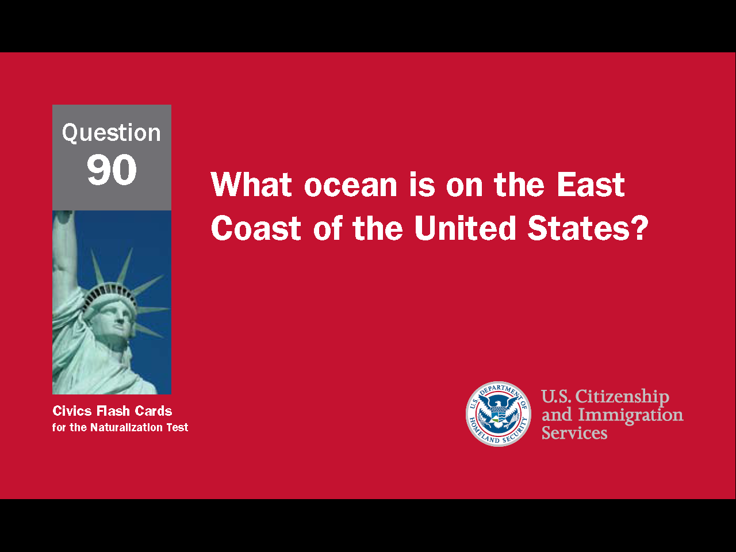
10
Notes:
Question 90. What ocean is on the East Coast of the United States?

Slide 11
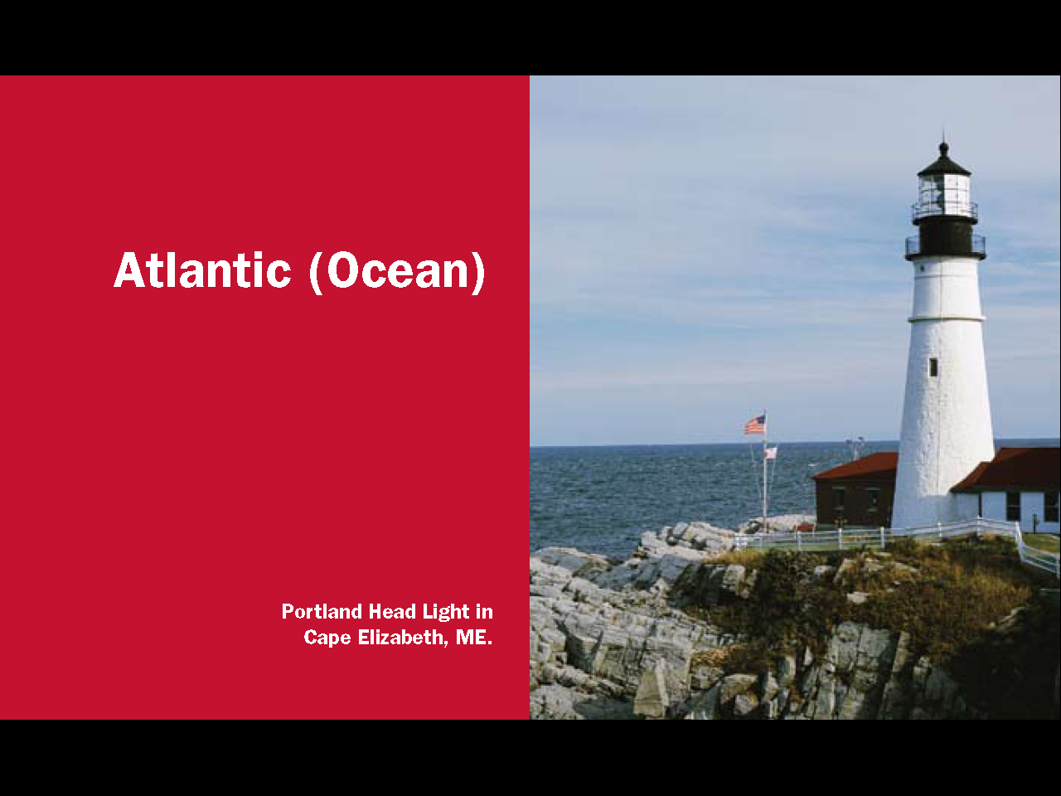
Question #90
11
Notes:
The Atlantic. The Atlantic Ocean is the most traveled ocean in the world.

Slide 12
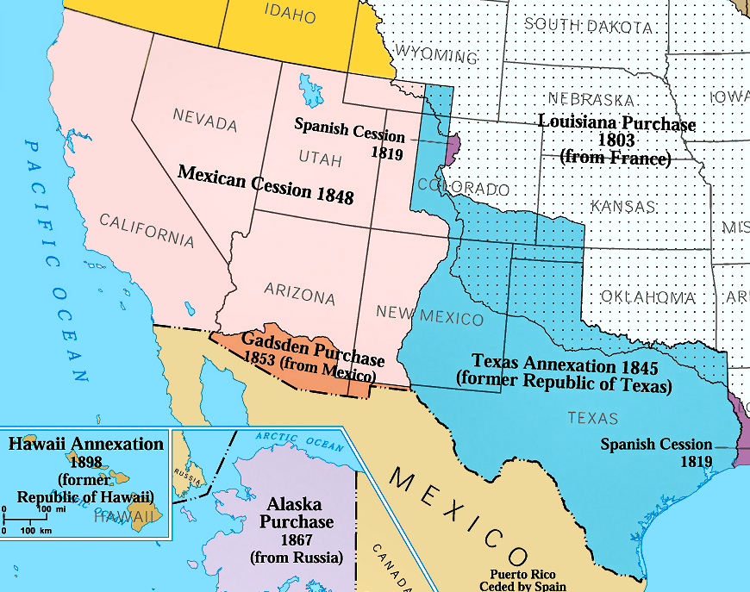
The Gadsden Purchase (1853)
12
Notes:
In 1853, the Gadsden Purchase added more Mexican territory to the United States and created the southern border we have today. The four U.S. states that border Mexico are California, Arizona, New Mexico, and Texas.

Slide 13
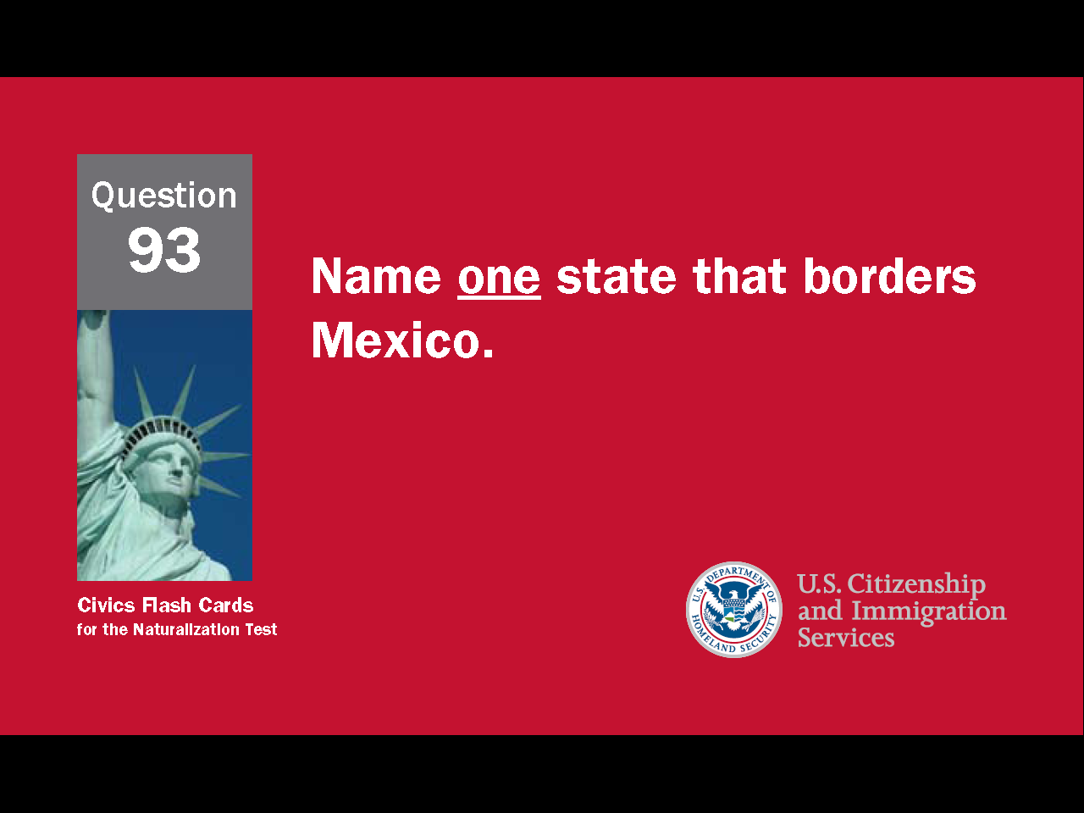
13
Notes:
Question 93. Name one state that borders Mexico.

Slide 14
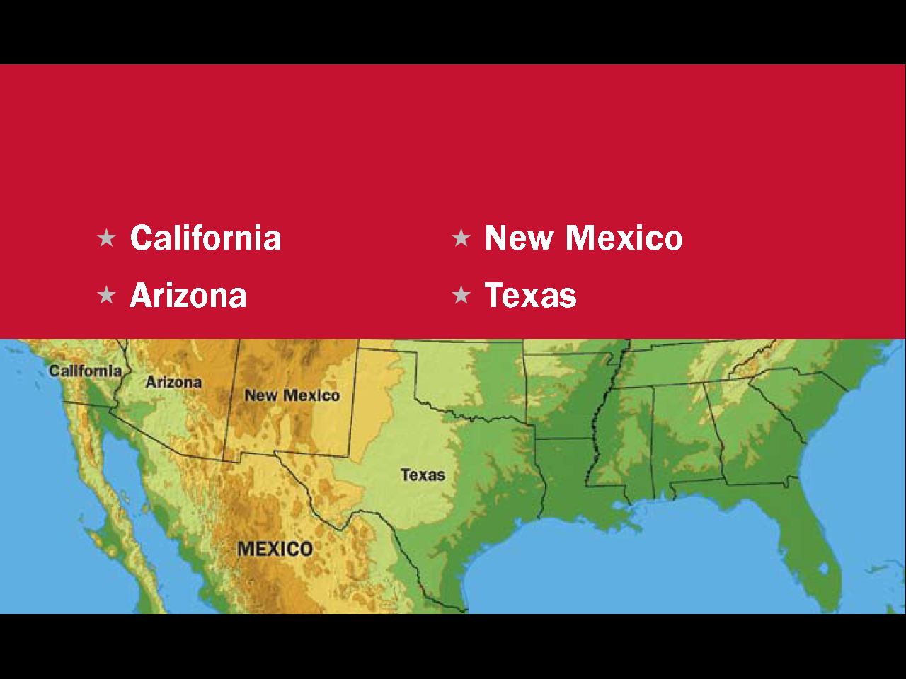
Question #93
14
Notes:
California, Arizona, New Mexico and Texas are the four states that border Mexico.

Slide 15
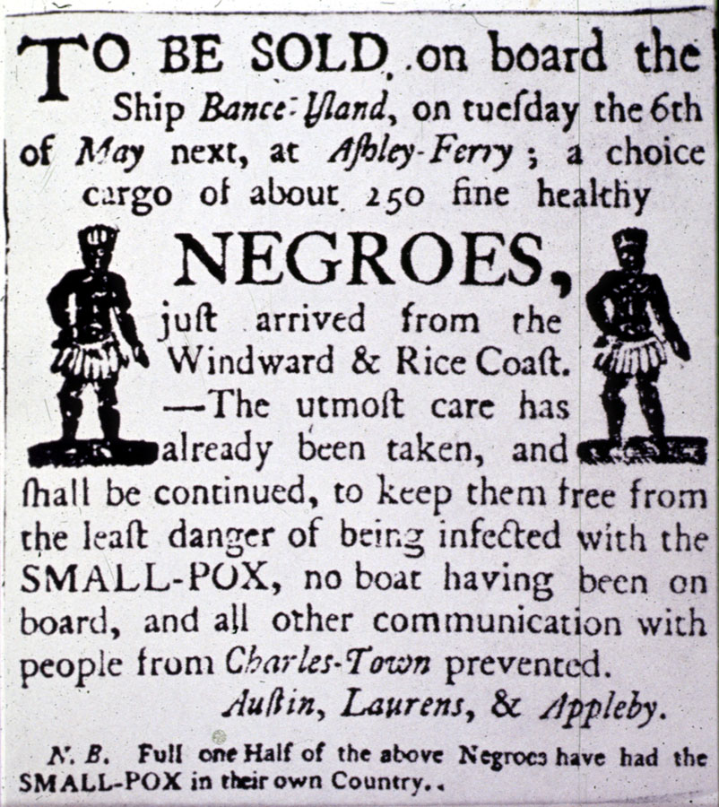
Africans were taken to America and sold as slaves.
Source: Library of Congress, Prints and Photographs Division, LC-USZ62-10293
15
Notes:
Europeans came to America in search of freedom, but at the same time tens of thousands of Africans were brought here against their will and forced to work without pay or rights of any kind. These people are called slaves. By the end of the Colonial Period over 300,000 slaves had been brought to America. This advertisement for a slave sale was placed in a Charleston, South Carolina, newspaper in 1760.

Slide 16

16
Notes:
Question 60. What group of people was taken to America and sold as slaves?

Slide 17
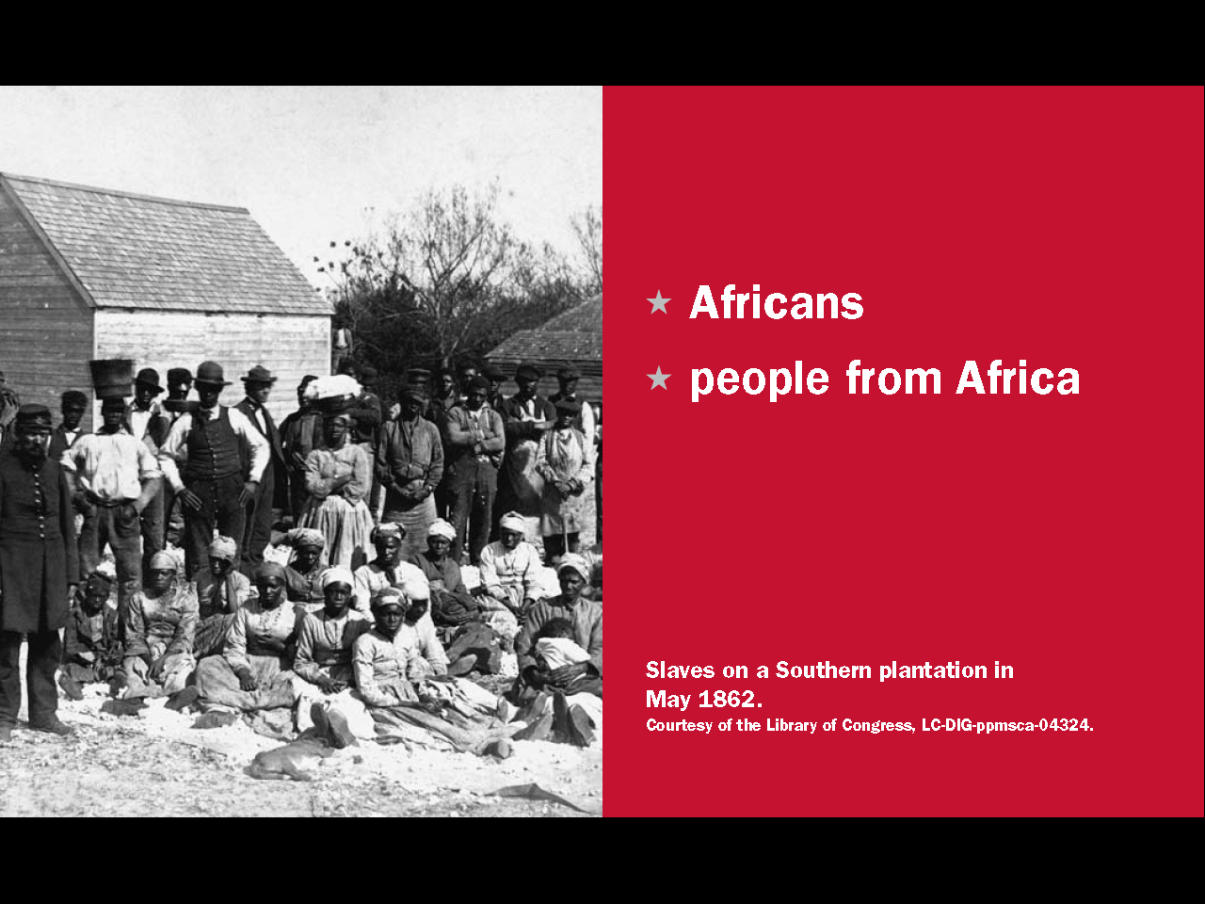
Question #60
17
Notes:
Africans, or people from Africa, were taken to America and sold as slaves.

Slide 18
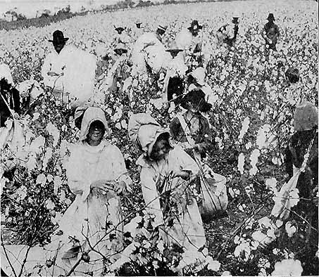
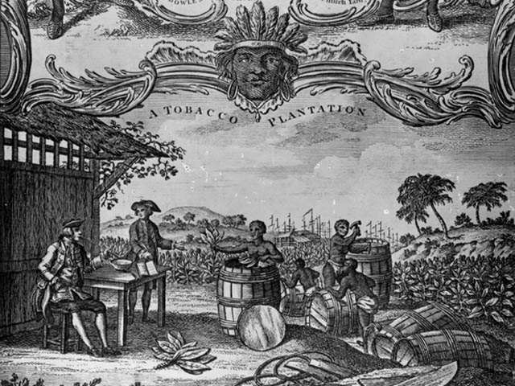
Cotton
<---
Tobacco
--->
18
Notes:
For economic reasons, the southern states always had more slaves than the northern states. Farming was the main industry in the south and manufacturing was more important in the north. This made slaves less necessary. Also, tobacco and cotton were the main crops in the southern states. Both required a lot of labor to grow and harvest. However, originally, cotton was less popular because the plant was difficult to process. Before cotton could be made into cloth, all the seeds had to be removed by hand. The process was so slow that one person could clean only a pound of cotton a day.

Slide 19
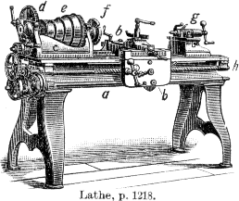
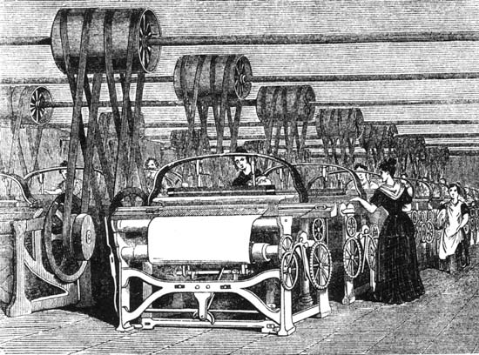
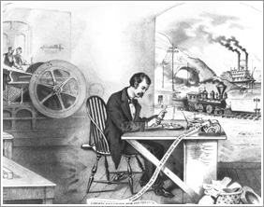
The Industrial Revolution
19
Notes:
In the 1700s and 1800s, there was an industrial revolution Europe and North America. This was a time of great advances in farming, manufacturing, transportation, and technology. For example, in 1793, a man named Eli Whitney invented the cotton gin, a machine that quickly removes the seeds from cotton. The cotton gin is one of the most significant inventions in American history. It transformed the southern economy and society and helped lead America into civil war.

Slide 20
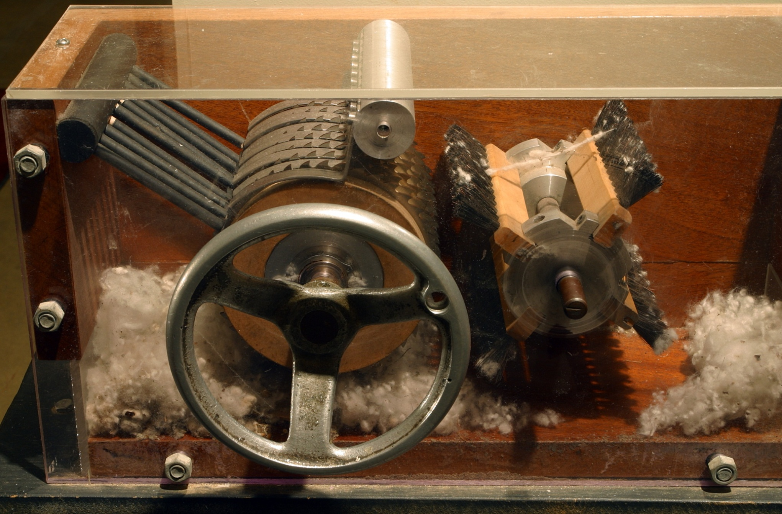
The Cotton Gin (1793)
Cotton gin at the Eli Whitney Museum in Hamden, Connecticut
20
Notes:
This is a picture of a cotton gin at the Eli Whitney Museum in Hamden, Connecticut. What made the cotton gin so important was one person could now clean 50 pounds of cotton a day instead of one pound. This changed southern society in two important ways. First, cotton quickly became the main crop. Second, even though it was now much easier to clean cotton, so much more cotton was grown the demand for slaves actually increased. In 1790, there were 700,000 slaves in the south, by 1850, there were 3.2 million. Congress had banned the importation of slaves in 1807, but the number of slaves in the United States continued to grow because when a slave had a baby, that baby became a slave as well. As a result, by the early 1800s, the American south had become a slave society.

Slide 21
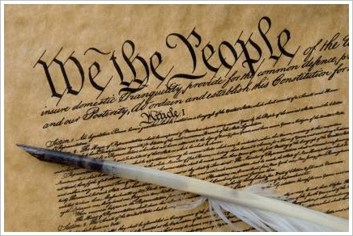
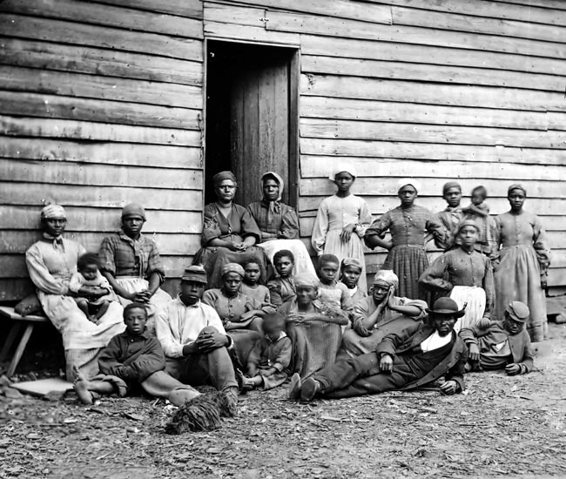
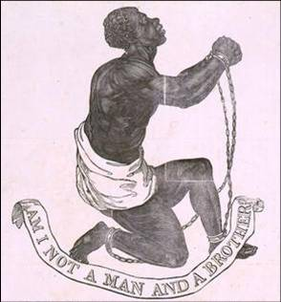
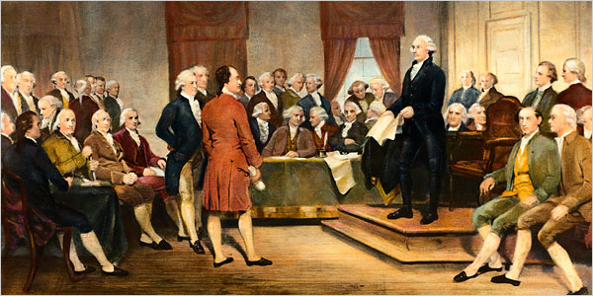
Slavery and the Constitution
21
Notes:
Slavery was already an issue when the U.S. Constitution was written. About half of the Founding Fathers owned slaves. Some of them believed slavery was wrong and should be ended, but to get the new Constitution accepted, they had to compromise and keep slavery legal. Even so, slavery was banned in the Northwest Territory in 1787 and, by 1804, all the northern states had outlawed it. So, the nation was soon divided into free states and slave states. That difference would become more important as slavery became a more serious issue.

Slide 22
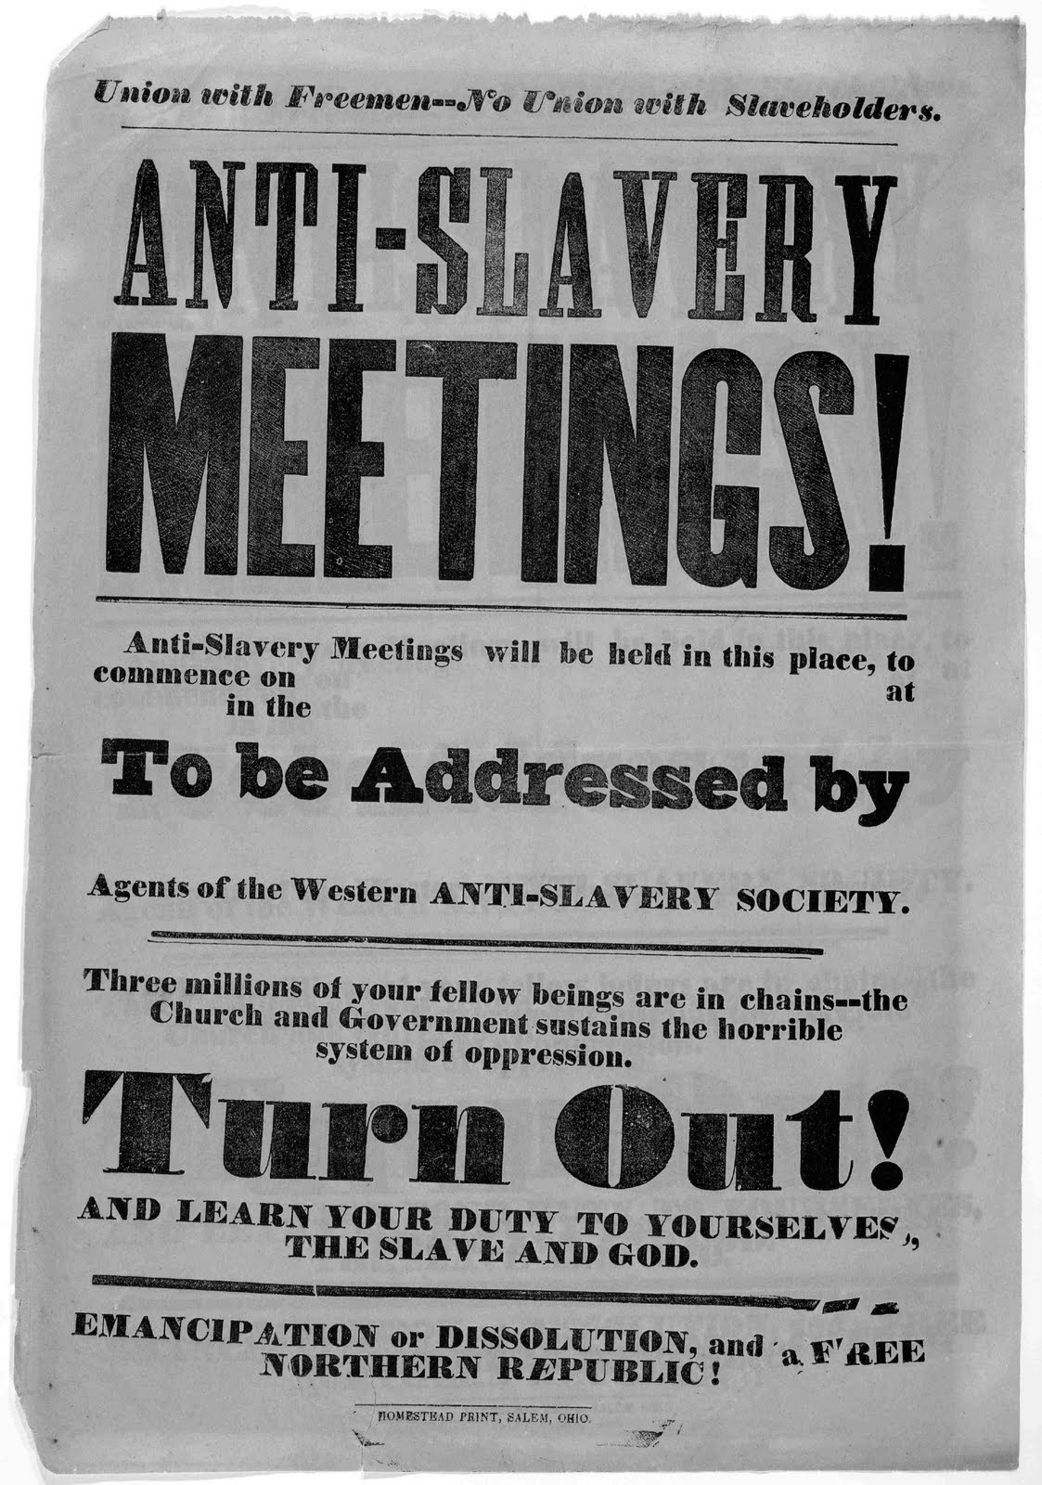
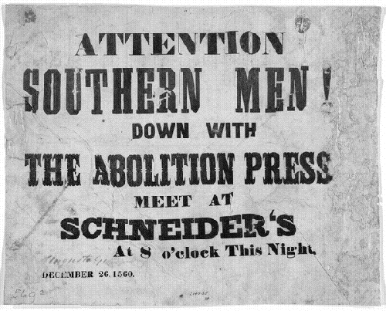
Abolitionists and Supporters of Slavery
22
Notes:
People who wanted to end slavery were called abolitionists. As slavery became more important in the south, anti-slavery feeling throughout the country grew. For example, in 1827, there were 130 abolitionist organizations in the U.S., mostly in the south. By 1838, there were 1,300 groups with 109,000 members. That same year, 2 million names were collected on antislavery petitions.

Slide 23
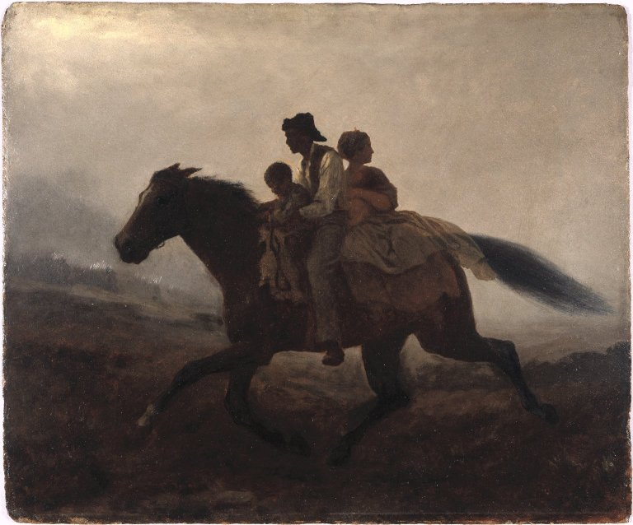
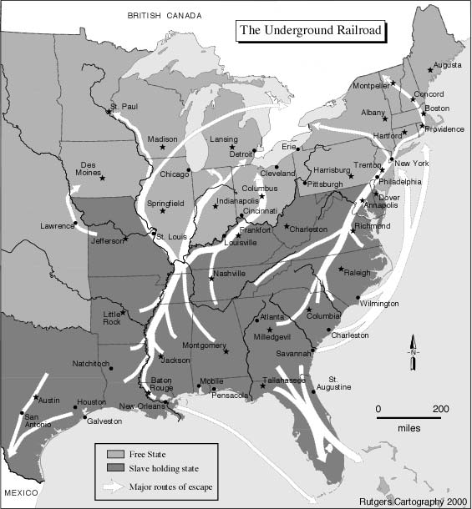
The Underground Railroad
and the Fugitive Slave Act
23
Notes:
Two early issues between the free and slave states were the Underground Railroad and the Fugitive Slave Act of 1793. Slaves were considered property and it was a state's constitutional responsibility to return runaway slaves to their owners, even if the slaves were in a free state. However, many northern states refused to cooperate and wrote laws protecting escaped slaves. Southern states also complained about the Underground Railroad. The Underground Railroad was a series of safe routes and locations used by abolitionists to help tens of thousands of slaves escape to free states, Canada and Mexico.

Slide 24
24
Notes:
The peace treaty forced Mexico to give up Texas and the rest of their northern territory. Those areas are shown on the map in pink and blue. The United States now stretched across the continent from the Atlantic Ocean in the east to the Pacific Ocean in the west.

Slide 25
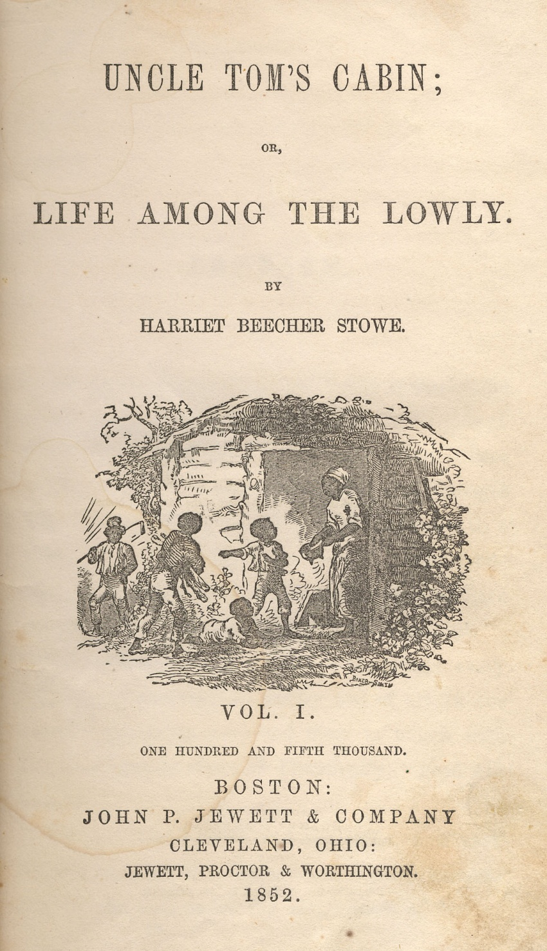
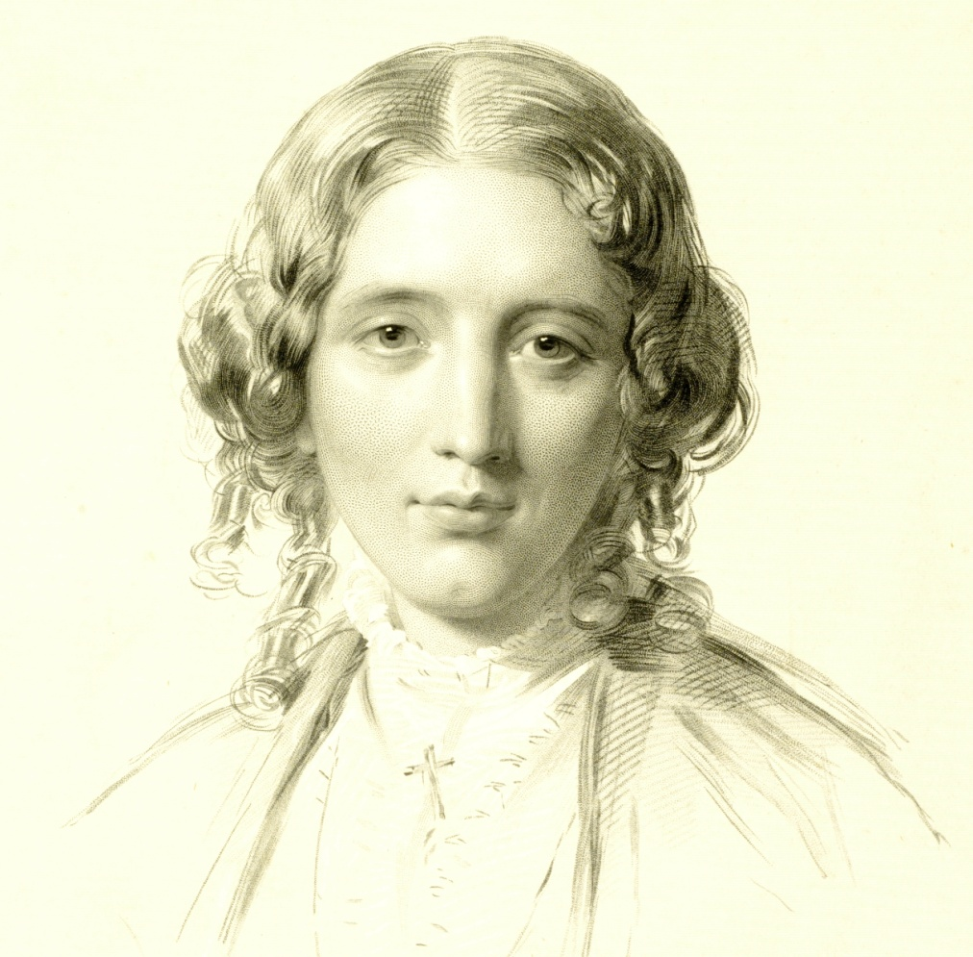
Uncle Tom's Cabin
Harriet Beecher Stowe
25
Notes:
The Compromise of 1850 and the new Fugitive Slave Act greatly angered many people. They also inspired a Connecticut abolitionist named Harriet Beecher Stowe to write a book called Uncle Tom's Cabin. In the book, Stowe describes the terrible conditions slaves lived under. Slave owners insisted the book was untrue, but Uncle Tom's Cabin quickly became a bestseller in the U.S. and Great Britain and turned many people against slavery. Harriet Beecher Stowe had a house in Hartford which is now a museum.

Slide 26
Kansas-Nebraska Act (1854)
26
Notes:
Democratic Senator Stephen A. Douglas of Illinois was one of the strongest supporters of the Compromise of 1850. He believed slavery was a state’s rights issue and that each state should determine whether to allow slavery. Four years later, Douglas created the Kansas-Nebraska Act. This divided the Louisiana Territory into two parts: Kansas and Nebraska. Like with New Mexico and Utah, the settlers would choose the type of state they wanted. Again, the Kansas Nebraska Act greatly angered abolitionists and split the country's two major political parties. After the Act was passed, the Whig party broke up and abolitionist Democrats left the pro-slavery Democratic Party. Many abolitionist politicians then joined the new Republican Party, which had been created in response to the Act.

Slide 27
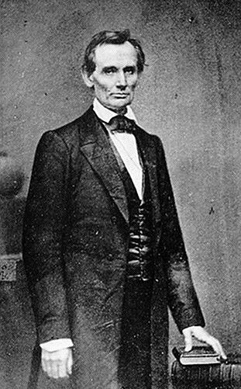
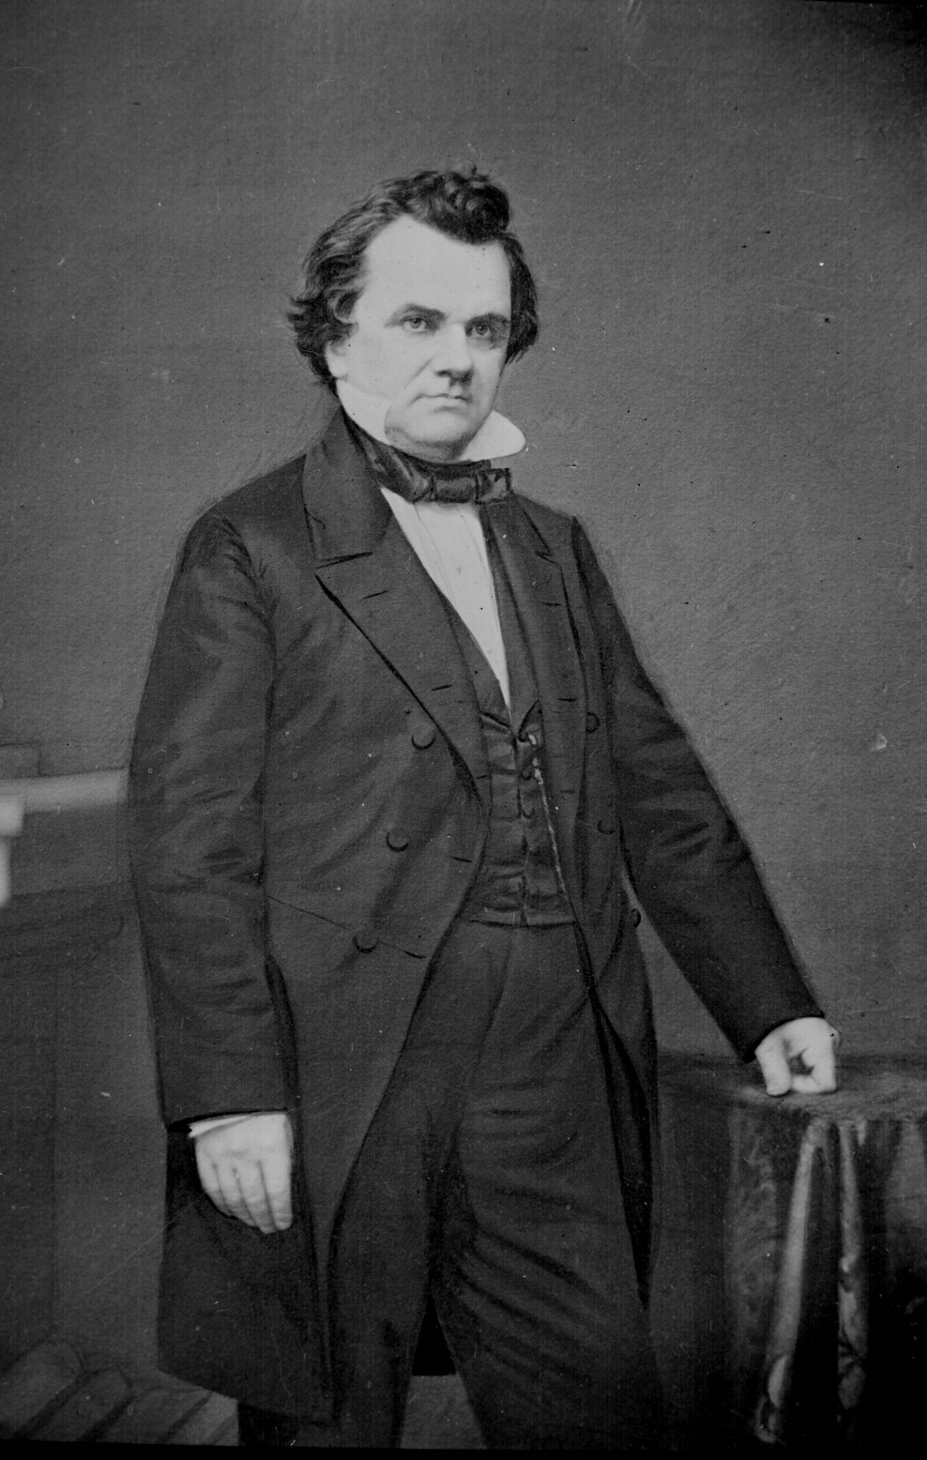
The Lincoln-Douglas Debates
Abraham Lincoln
Stephen Douglas
27
Notes:
By the 1850s, slavery had become the most serious issue in the United States. The compromises were not working and southern states began to talk about leaving the union. In 1858, during the Senate election in Illinois, an unknown Republican candidate named Abraham Lincoln did a series of debates with Stephen Douglas. The main topic was slavery. Lincoln believed slavery was dividing and destroying the nation, while Douglas continued to argue that slavery was a matter of popular sovereignty. Douglas was reelected Senator, but the debates received national attention and made Lincoln into a major political figure.

Slide 28
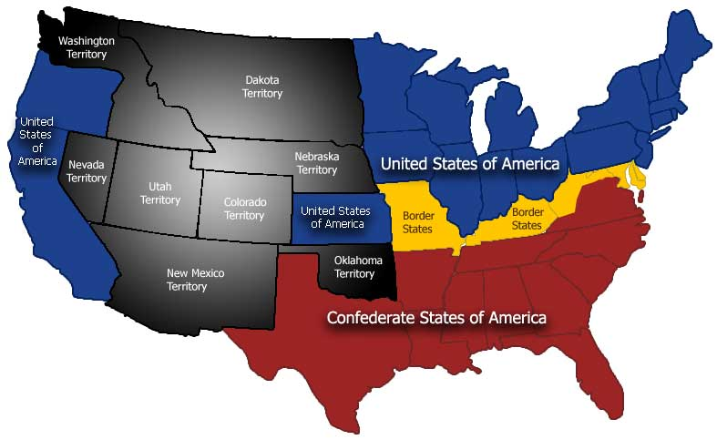
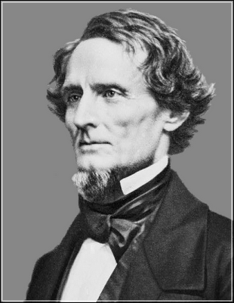
A Nation Divided
Slave, Border, and Free States (1861)
28
Notes:
The debates made Lincoln so famous that he became the Republican presidential candidate. In 1860 he defeated three other candidates, including Stephen Douglas, to become President of the United States. Because the Republican Party was anti-slavery, southern states began leaving the union even before Lincoln began his presidency. By February 1861 seven states had left and elected their own president, Jefferson Davis. Eventually, 11 southern states would leave and form a new country called the Confederate States of America. On the map, the yellow states are the border states. Border states were slave states that chose to remain in the Union.

Slide 29
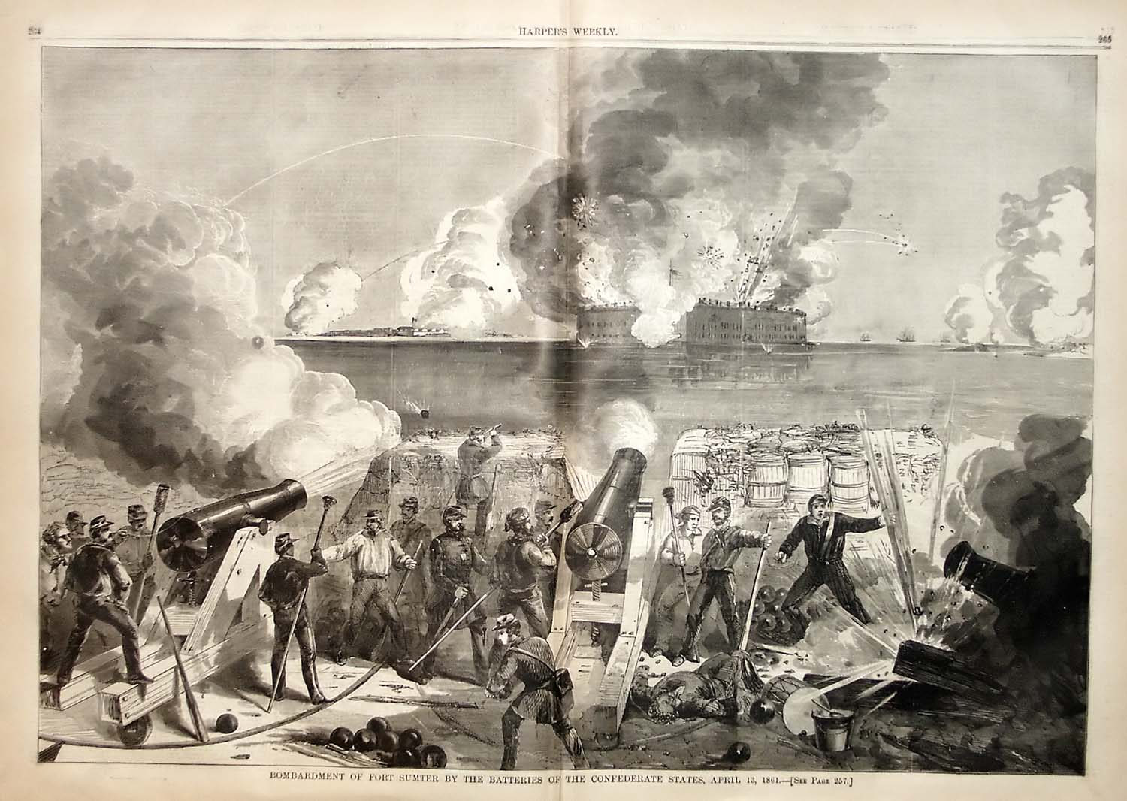
The Civil War
The Civil War (1861-1865)
29
Notes:
In April 1861, the Confederate Army attacked the Union Army at Fort Sumter in South Carolina. That began what is now called the Civil War or the War between the States. The Civil War lasted until 1865 when the Confederate Army surrendered. The war ended slavery and saved the union, but also destroyed much of the south and killed more Americans than any other war in history.

Slide 30

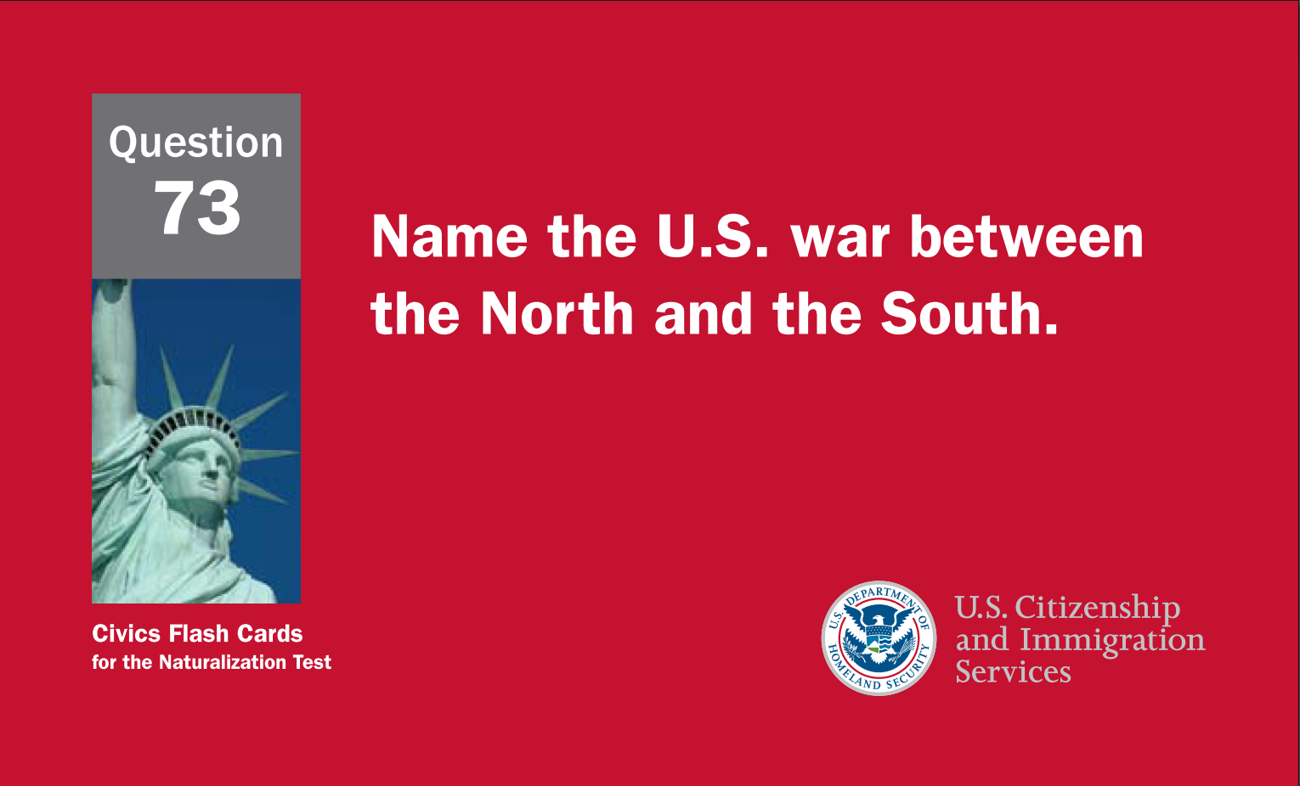
30
Notes:
Question 73. Name the U.S. war between the North and the South.

Slide 31
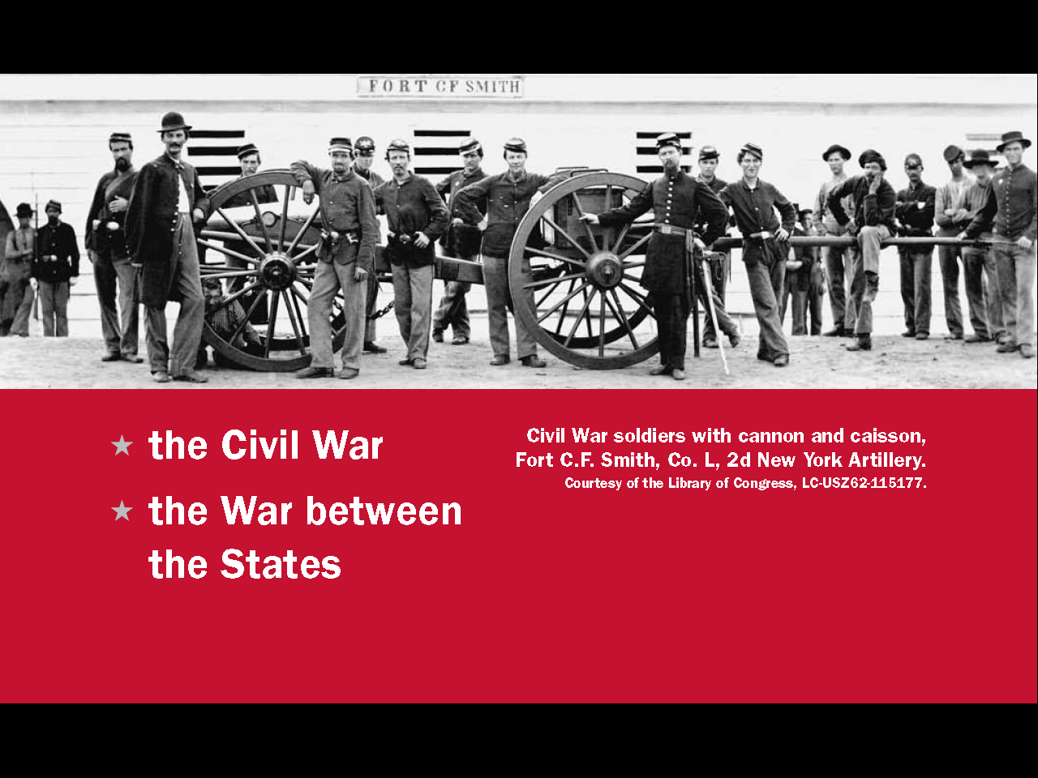
Question #73
31
Notes:
The U.S. war between the North and the South is called the Civil War or the War between the States.

Slide 32
32
Notes:
Question 72. Name one war fought by the United States in the 1800s.

Slide 33
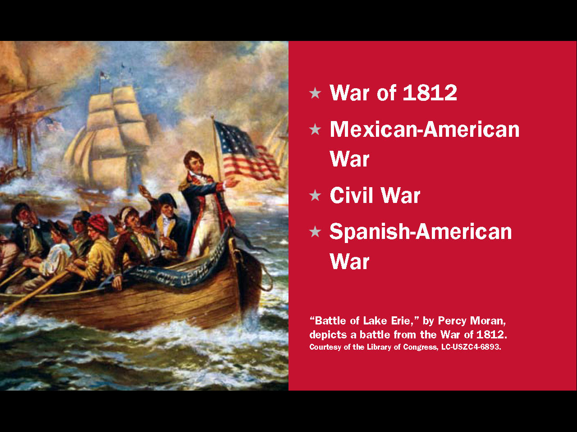
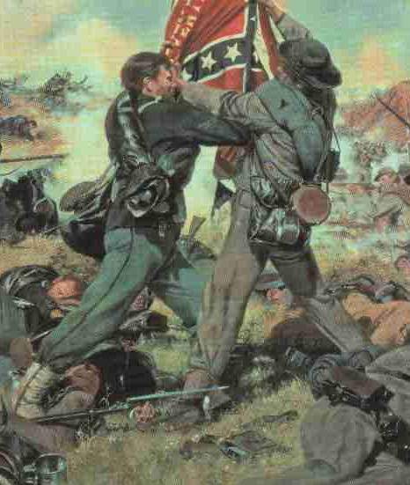
Question #72
33
Notes:
The United States fought several wars in the 1800s. The two mentioned in this lesson are the Mexican-American War and the Civil War. Two other wars are the War of 1812 and the Spanish-American War.

Slide 34
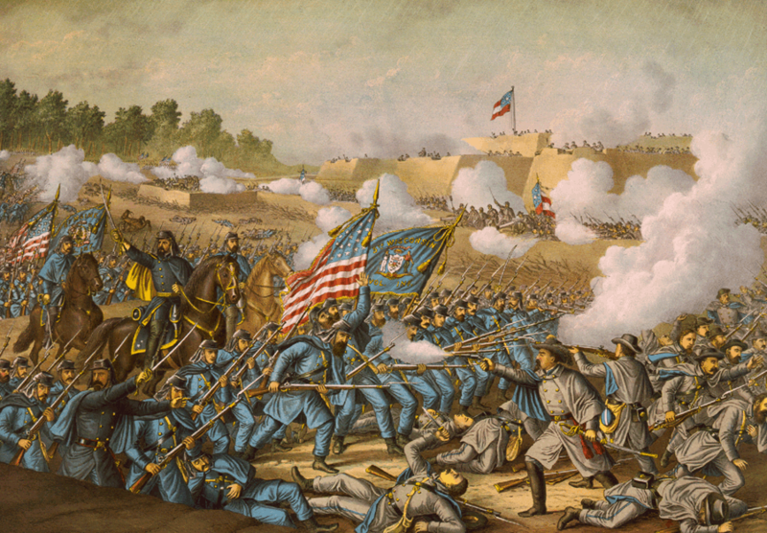
Problems that Led to the Civil War
slavery
states' rights
economic reasons
34
Notes:
Slavery was the main cause of the Civil War, but related to slavery were two other issues: states' rights and economic reasons. To the slave states, slavery was a matter of states' rights because the Constitution did not expressly forbid slavery and the Constitution protected private property. Slavery was also an economic issue because much of the southern economy required slaves. In fact, slaves made up one-third to one-half of the population of the slave states. Therefore, as the debate over slavery continued, the southern states felt they no could longer stay part of the United States.

Slide 35
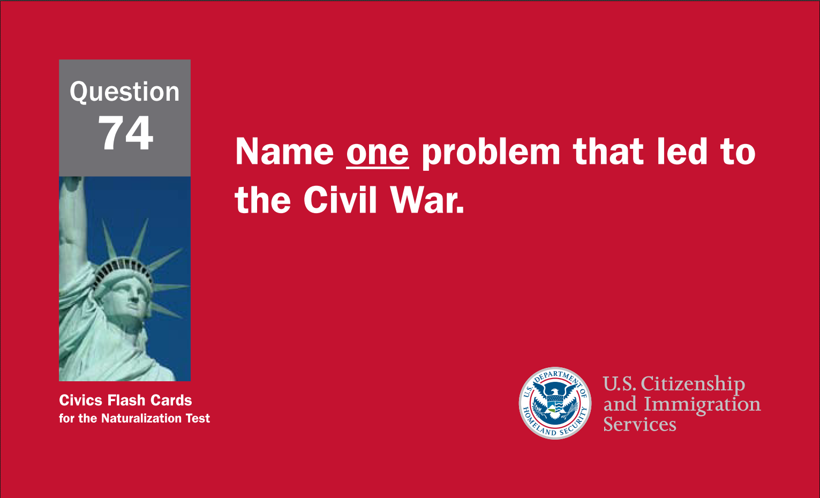
35
Notes:
Question 74. Name one problem that led to the Civil War.

Slide 36
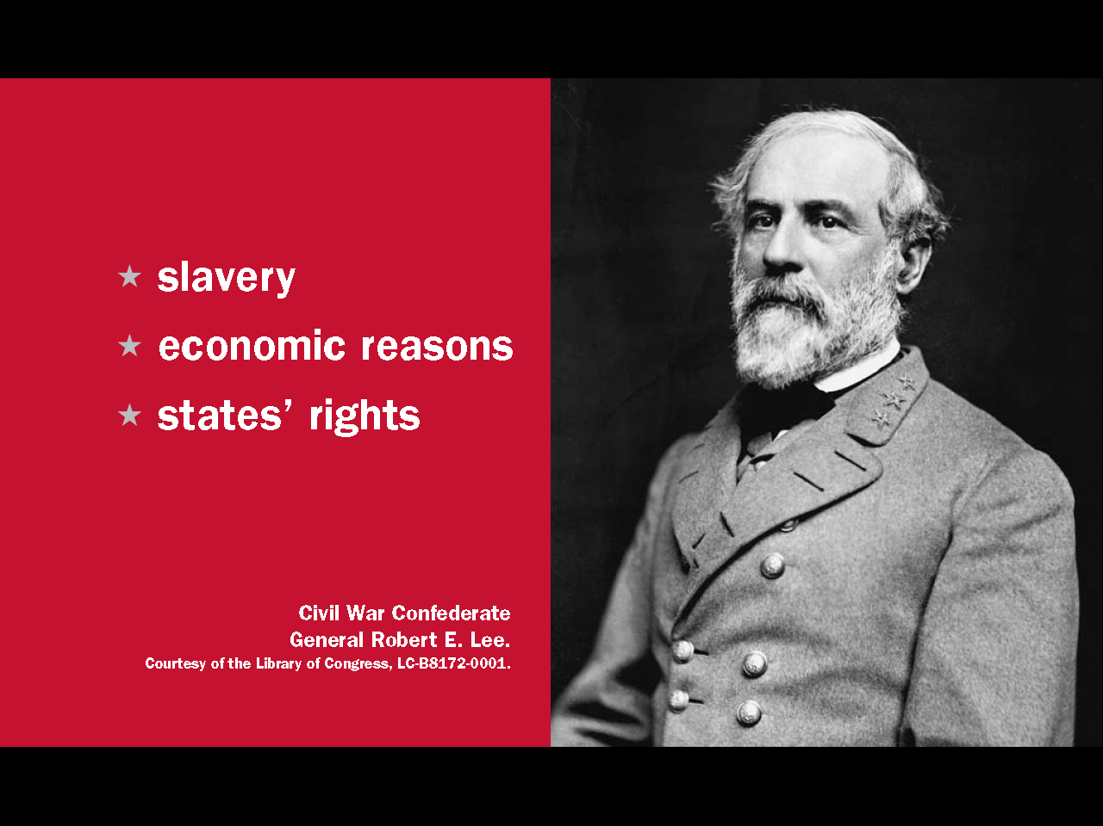
Question #74
36
Notes:
Slavery, economic rights and states' rights are three problems that led to the Civil War.

Slide 37
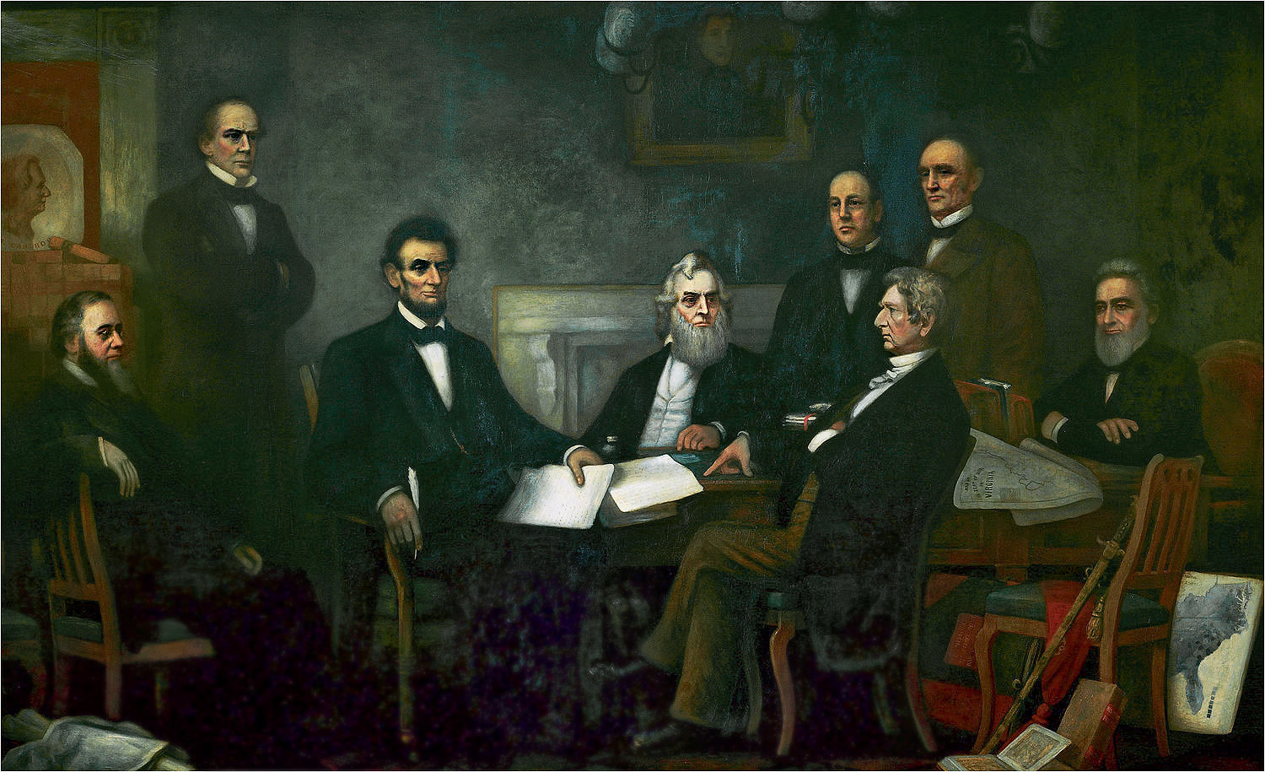
The Emancipation Proclamation freed slaves in the Confederate States.
First Reading of the Emancipation Proclamation of President Lincoln by Francis Bicknell Carpenter
37
Notes:
When the Civil War began, President Lincoln’s main concern was preserving the Union. However, Lincoln needed the full support of abolitionists to win the war. So, he told the Confederate States that he would free their slaves if the states did not return to the Union. When the Confederacy refused, Lincoln issued the Emancipation Proclamation. The Emancipation Proclamation freed slaves in the Confederate States. After the Emancipation Proclamation, abolition, along with saving the union, became a central goal of the war.

Slide 38
Constitutional Amendments
1st - 10th Amendments: The Bill of Rights, 1791.
11th Amendment: Grants states immunity from outside lawsuits, 1795.
12th Amendment: Requires distinct votes for President and Vice President, 1804.
13th Amendment: Abolished slavery, 1865.
14th Amendment: Defines citizenship, 1868.
15th Amendment: Grants voting rights to male citizens of all races, 1870.
16th Amendment: Authorizes a federal income tax, 1913.
17th Amendment: Allows direct Senatorial elections by a state, 1913.
18th Amendment: Enacted prohibition, 1919.
19th Amendment: Grants voting rights to women, 1920.
20th Amendment: "Lame Duck Amendment;" reduces time between election and service of
elected officials, 1933.
21st Amendment: Repealed the 18th Amendment, 1933.
22nd Amendment: Created the presidential term limit, 1951.
23rd Amendment: Granted the District of Columbia electoral votes, 1961.
24th Amendment: Prohibits poll taxes, 1964.
25th Amendment: Clarifies procedures regarding succession of President and Vice President
upon death or inability to serve, 1967.
26th Amendment: Makes 18 the minimum legal voting age, 1971.
27th Amendment: Allows changes in Congressional salary only after a general election (first
submitted in 1789) 1992.
38
Notes:
The U.S. Constitution includes procedures allowing for changes or additions to it. Such changes or additions are called amendments. After the Civil War, three amendments related to slavery were added.

Slide 39
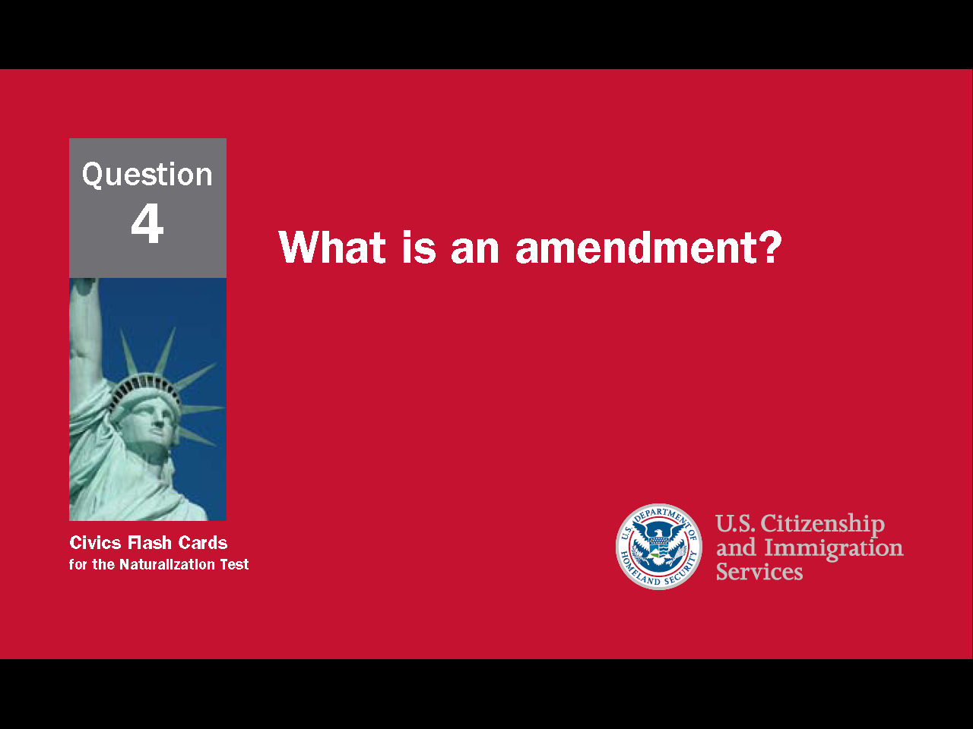
39
Notes:
Question 4. What is an amendment?

Slide 40
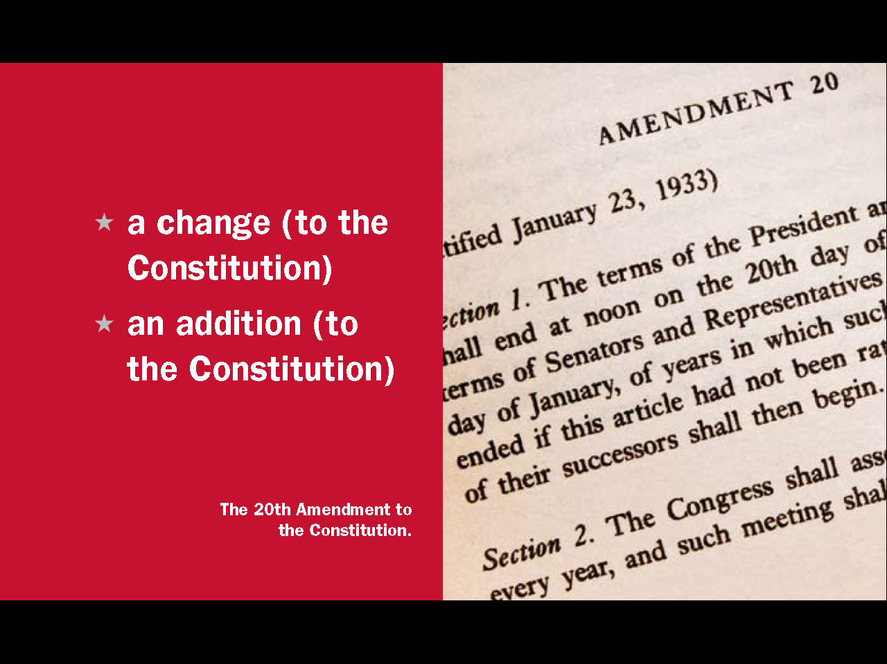
Question #4
40
Notes:
An amendment is a change or addition to the Constitution.

Slide 41
13th, 14th, and 15th Amendments
13th Amendment: Abolished slavery,
1865.
14th Amendment: Defines citizenship;
1868.
15th Amendment: Grants voting rights
to male citizens of all races, 1870.
41
Notes:
Lincoln didn't actually have authority to free the slaves. His power came only from being a wartime president. Also, the Emancipation Proclamation didn't make slavery illegal, free slaves in the border states, or make freed slaves into citizens. Therefore, Lincoln encouraged Congress to adopt an Amendment outlawing slavery. This became the 13th Amendment and was ratified after the Civil War in December 1865. In 1868, the 14th Amendment gave citizenship to all former slaves, and two years later, the 15th Amendment gave African-American men the right to vote.

Slide 42


42
Notes:
Question 76. What did the Emancipation Proclamation do?

Slide 43

Question #76
43
Notes:
The Emancipation Proclamation
freed the slaves
freed slaves in the Confederacy
freed slaves in the Confederate states
freed slaves in most Southern states

Slide 44

Abraham Lincoln
led the United States during the Civil War
saved the union
freed the slaves
44
Notes:
Abraham Lincoln did several important things as President. He successfully led the United States through the Civil War, he saved the union, and he freed the slaves. Lincoln was also the first U.S. president to be assassinated. He was shot by a southerner five days after the Confederate Army surrendered.

Slide 45

45
Notes:
Question 75. What is one important thing that Abraham Lincoln did?

Slide 46
Question #75
46
Notes:
Abraham Lincoln did many important things as president. Among them he freed the slaves, saved the Union, and led the United States during the Civil War. Lincoln was also the first U.S. president to be assassinated. He was shot by a southerner five days after the Confederate Army surrendered.

