Slide 1
Lesson 4 American History
Civil Rights
Questions: 84, 2, 51, 4, 37, 38, 77, 12, 32, 85, 48
1
Notes:
Lesson 4. American History: Civil Rights. This lesson explains the history of the civil rights movements in America.

Slide 2
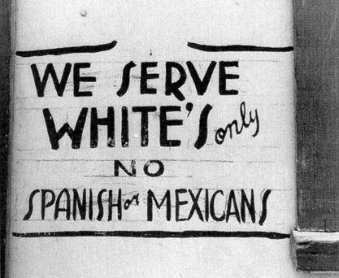
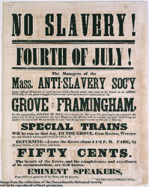
Civil Rights Movement
The civil rights movement in the United States tried to end racial discrimination.
2
Notes:
The civil rights movement in the United States tried to end racial discrimination. The movement began before the Civil War and ended in the 1960s. At the same time, other groups were working to gain many of the same rights as African Americans. Together, the different groups successfully used nonviolent means to try to end racial discrimination and achieve equal voting rights and greater equality for all Americans.

Slide 3
3
Notes:
Question 84. What movement tried to end racial discrimination?

Slide 4
Question #84
4
Notes:
The civil rights movement tried to end racial discrimination.

Slide 5
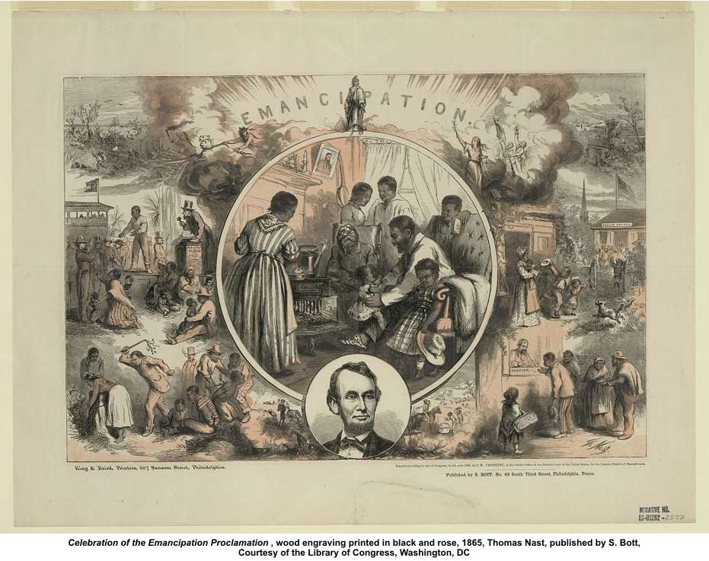
5
Notes:
At the end of the Civil War slavery was outlawed by the 13th Amendment. However, discrimination against African Americans was very common and racial segregation was universal in the southern states. In those states, blacks and whites had separate seating areas in buses, trains, movie theaters and restaurants. There were also separate water fountains, public bathrooms and schools. In addition, blacks and whites could not marry. African Americans also faced discrimination in employment, housing, and health care.

Slide 6
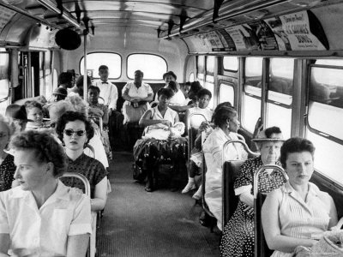
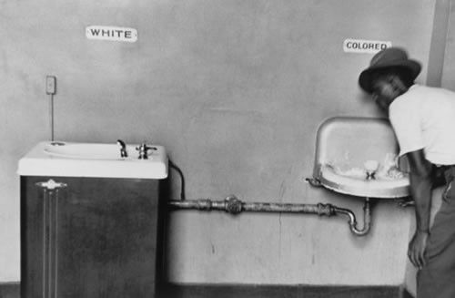
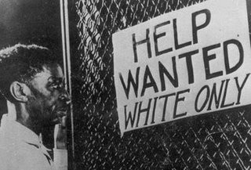
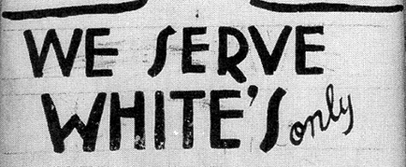
Segregation = Unconstitutional
6
Notes:
Even though the U.S. Constitution protects the basic rights of Americans, most southern states had laws protecting segregation and other forms of discrimination. These laws were unconstitutional and meant African Americans and other minorities were denied rights normally guaranteed anyone living in the United States. These included freedom of expression, speech, and assembly, as well as the right to petition the government and to bear arms.

Slide 7
7
Notes:
Question 2. What does the Constitution do?

Slide 8
Question #2
8
Notes:
The Constitution
sets up the government
defines the government
and protects the basic rights of Americans

Slide 9
9
Notes:
Question 51. What are two rights of everyone living in the United States?

Slide 10
Question #51
10
Notes:
Some rights of everyone living in the United States are:
freedom of expression
freedom of speech
freedom of assembly
freedom to petition the government
freedom of worship
and the right to bear arms.
The first five freedoms come from the 1st Amendment to the Constitution.

Slide 11
Constitutional Amendments
1st - 10th Amendments: The Bill of Rights, 1791.
11th Amendment: Grants states immunity from outside lawsuits, 1795.
12th Amendment: Requires distinct votes for President and Vice President, 1804.
13th Amendment: Abolished slavery, 1865.
14th Amendment: Defines citizenship; includes clauses on due process and equal protection, 1868.
15th Amendment: Grants voting rights to male citizens of all races, 1870.
16th Amendment: Authorizes a federal income tax, 1913.
17th Amendment: Allows direct Senatorial elections by a state, 1913.
18th Amendment: Enacted prohibition, 1919.
19th Amendment: Grants voting rights to women, 1920.
20th Amendment: "Lame Duck Amendment;" reduces time between elections and the service of
elected officials, 1933.
21st Amendment: Repealed the 18th Amendment, 1933.
22nd Amendment: Creates the presidential term limit, 1951.
23rd Amendment: Grants the District of Columbia electoral votes, 1961.
24th Amendment: Prohibits poll taxes, 1964.
25th Amendment: Clarifies procedures regarding succession of President and Vice President upon
death or inability to serve, 1967.
26th Amendment: Establishes 18 as the minimum legal voting age, 1971.
27th Amendment: Allows changes in Congressional salary only after a general election (originally
submitted in 1789) 1992.
11
Notes:
The Constitution allows changes or additions to be made to it. Such changes to the Constitution are called amendments. As a result of the civil rights movement, several amendments were added to guarantee some of the basic freedoms of all Americans.

Slide 12
12
Notes:
Question 4. What is an amendment?

Slide 13
Question #4
13
Notes:
An amendment is a change or addition to the Constitution.

Slide 14
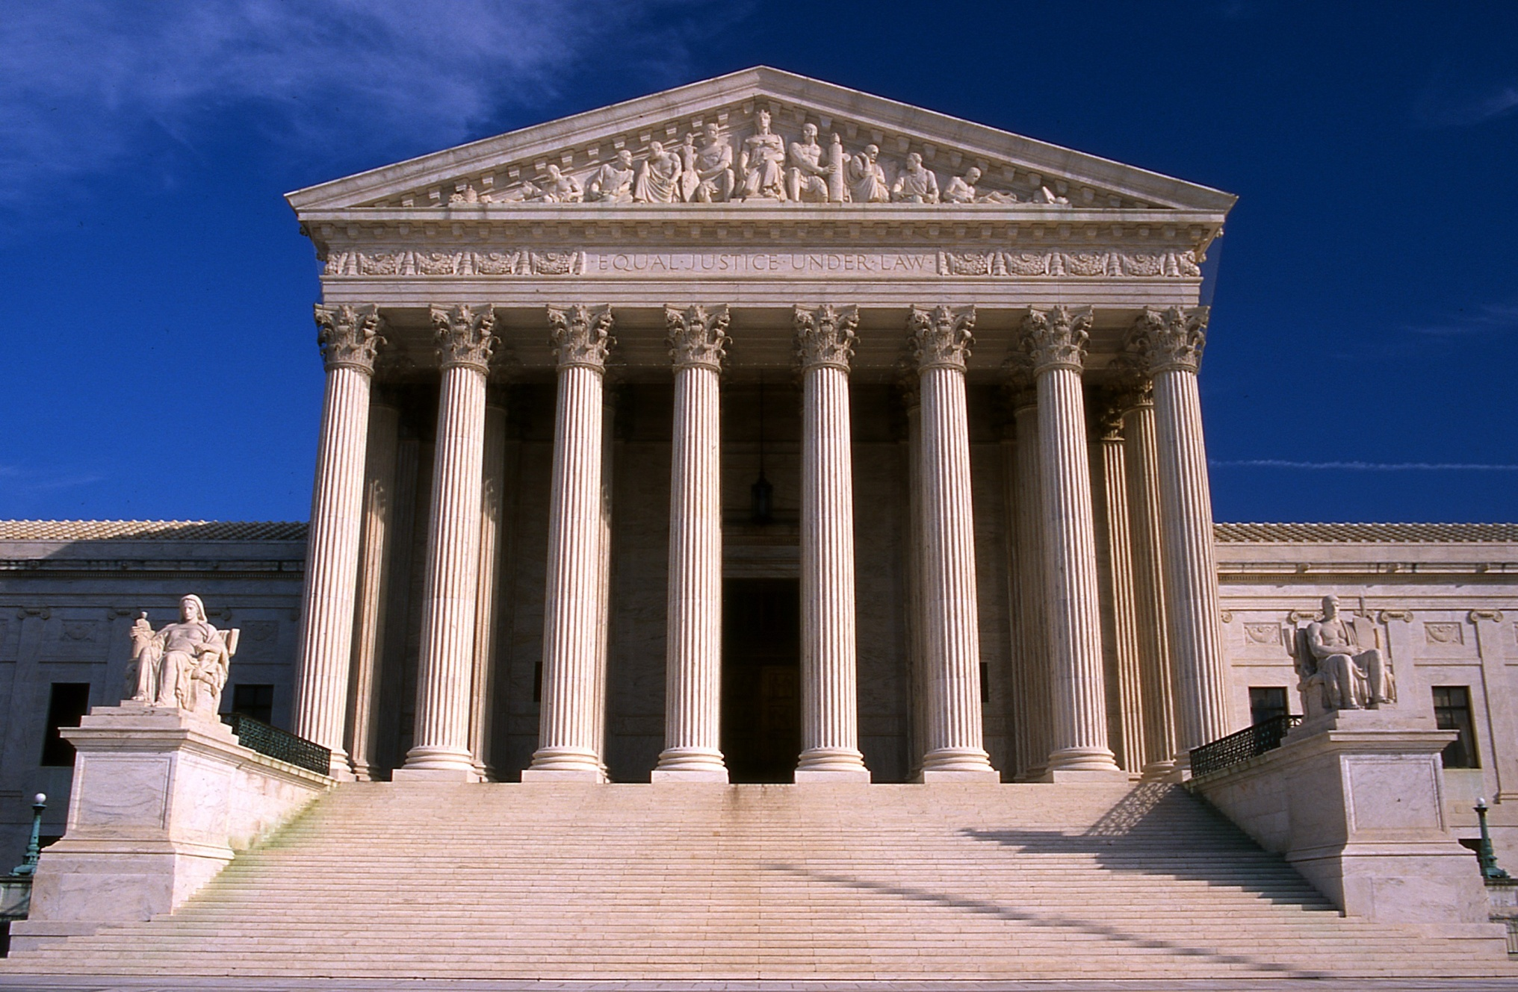
The U.S. Supreme Court, Washington, D.C.
14
Notes:
The job of the judicial branch of the U.S. government is to review and explain laws and determine whether a law is constitutional. The highest court in the nation is the Supreme Court. Since African Americans were being denied rights guaranteed by the Constitution, the Supreme Court was often used by African Americans to try to gain their Constitutional rights.

Slide 15
15
Notes:
Question 37. What does the judicial branch do?

Slide 16
Question #37
16
Notes:
Question 37. What does the judicial branch do?
reviews laws
explains laws
resolves disputes (disagreements)
and decides if a law goes against the Constitution

Slide 17
17
Notes:
Question 38. What is the highest court in the United States?

Slide 18
Question #38
18
Notes:
The Supreme Court is the highest court in the United States.

Slide 19
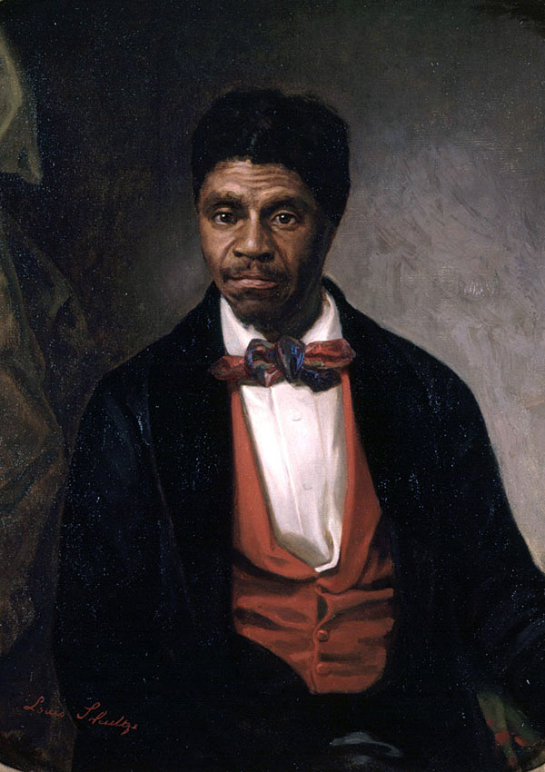
Scott v. Sandford (1857)
"A free negro of the African race, whose ancestors were brought to this country and sold as slaves, is not a "citizen" within the meaning of the Constitution of the United States."
Scott v. Sandford, U.S. Supreme Court (1857)
Dred Scott
19
Notes:
One problem with using to the Supreme Court was the court did not always support the rights of African Americans. In 1857, the Court ruled in Scott versus Sandford that people of African descent were not U.S. citizens and therefore not protected by the Constitution. After the Civil War this ruling was overturned by the 14th Amendment. The 14th amendment says that anyone born in the United States is automatically an American citizen. However, this idea was ignored in many states, particularly southern states. The states then created so-called Jim Crow laws that made segregation and other forms of discrimination legal.

Slide 20
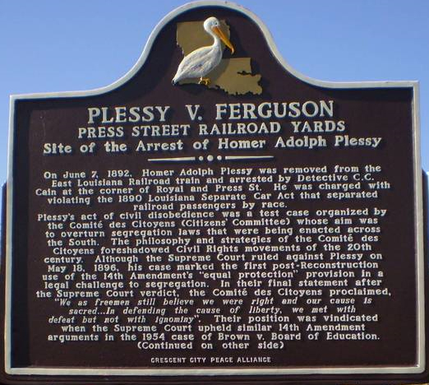
Plessy v. Ferguson (1896)
"the 14th Amendment... (does not) abolish distinctions based upon color, or... enforce social equality, or a commingling of the two races..."
20
Notes:
States defended segregation by arguing that the 14th Amendment did not prohibit discrimination by individuals and that segregation created "separate but equal" facilities. In 1883, the Supreme Court agreed that states could not prohibit discrimination by individuals and, three years later, in the case of Plessy versus Ferguson, the Court defended the separate but equal idea. Those decisions made segregation legal and it would be 70 years before it was ended.

Slide 21
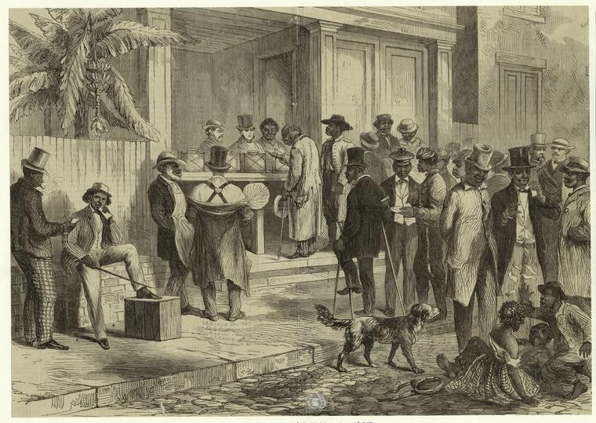
The 15th Amendment (1870)
21
Notes:
The United States has always been a democracy, but, originally, only white male land owners could vote. After slavery was outlawed in 1865, the next victory for African Americans came in 1870 when the 15th Amendment allowed men of any race to vote. However, since the Constitution allowed individual states to create their own voting rules, southern states made new laws to keep black men from voting. The most common laws required a voter to pass a reading test or pay a poll tax. This prevented many Americans, both black and white, from voting, and therefore denied them any meaningful political power.

Slide 22
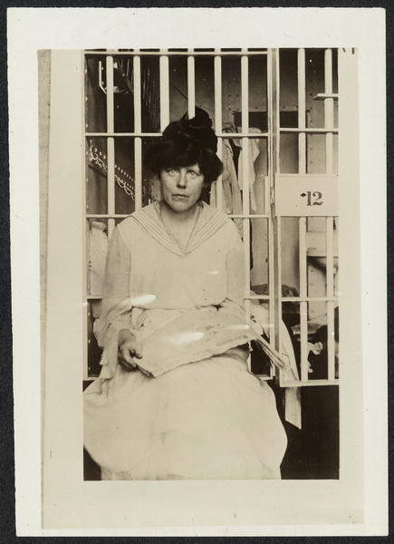
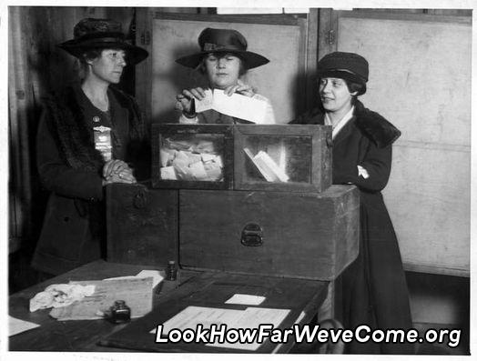
Woman's Suffrage (1920)
Amendment XIX
The right of citizens of the United States to vote shall not be denied or abridged by the United States or any State on account of sex.
22
Notes:
Women were another group who could not originally vote. In the 1800s, a few states started to allow women to vote, but activists wanted universal suffrage. One of the most famous activists in the struggle for women's suffrage was Susan B. Anthony. Anthony spent her life fighting for women's rights and civil rights. She protested against slavery, argued for equal rights, and tried for 30 years to help women get the vote. In 1872, she became the first woman in America to vote, although she had to vote illegally. She was arrested and told to pay a $100 fine. She refused, and two years later the U.S. Congress cancelled the fine. However, that victory did not change the laws. Activists continued to work for female suffrage and in 1920 - 14 years after Susan B. Anthony died - the 19th Amendment gave women the right to vote.

Slide 23
23
Notes:
Question 77. What did Susan B. Anthony do?

Slide 24
Question #77
24
Notes:
Susan B. Anthony fought for women’s rights and civil rights.

Slide 25
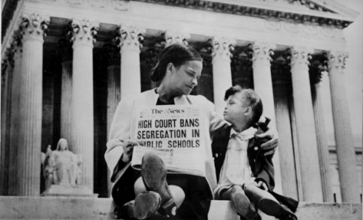
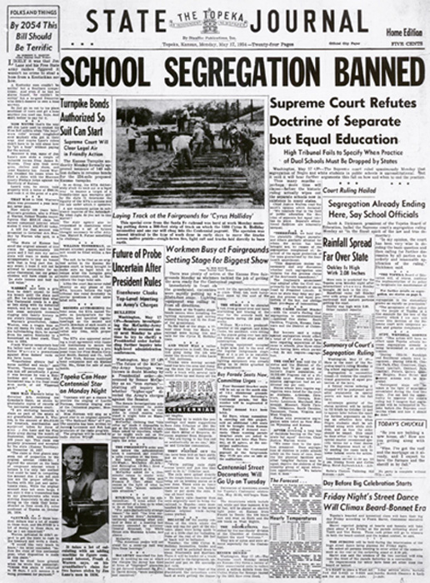
Brown v. Board of Education (1954)
We conclude that in the field of public education the doctrine of 'separate but equal' has no place. Separate but equal educational facilities are inherently unequal.
25
Notes:
Women got voting rights through non-violent methods and civil disobedience. Most African American protesters used the same tactics, in addition to bringing cases to the Supreme Court. In 1951, a group of activists brought a class action suit against the Board of Education in Topeka, Kansas. The case of Brown versus Board of Education argued that separate but equal was not true because African American schools were inferior to white schools. In 1954, the Supreme Court unanimously agreed. The court declared "separate educational facilities are inherently unequal" and in violation of the Equal Protection Clause of the 14th Amendment. The Equal Protection Clause requires a state to provide equal protection to everyone. This decision immediately made school segregation illegal throughout the United States.

Slide 26
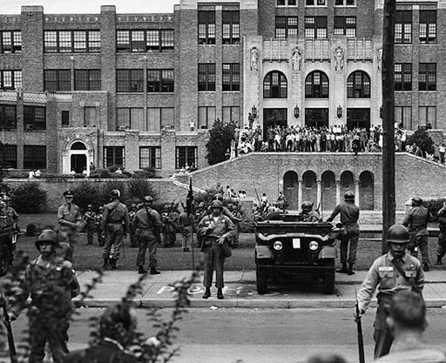
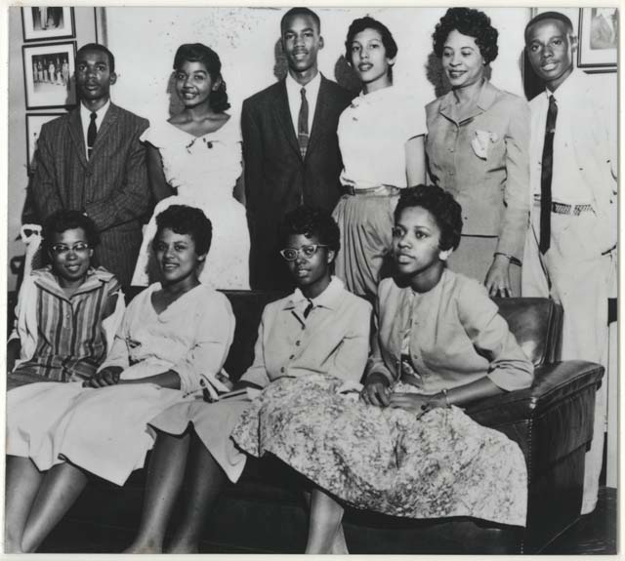
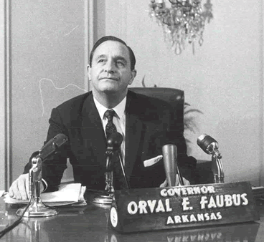
The Little Rock Nine
26
Notes:
Most schools did not immediately desegregate. For example, Little Rock, Arkansas, allowed its first nine African American students into a white high school in September 1957. These students became known as the Little Rock Nine and their experience was a serious test for the U.S. government. When the Little Rock Nine tried to go to school, Orval Faubus, the Governor of Arkansas, used the Arkansas National Guard to stop them.

Slide 27
The
Rule
of
Law
Everyone must follow the law
No one is above the law
Leaders must obey the law
Government must obey the law
27
Notes:
In addition to being a foundation for self-government, the Constitution promotes the rule of law. The rule of law means everyone must obey the laws of the nation. No one is above the law, not individuals, not leaders and not the government. In the words of one Founding Father, the United States is "a government of laws, and not of men."

Slide 28
28
Notes:
Question 12. What is the “rule of law”?

Slide 29
Question #12
29
Notes:
The rule of law means:
Everyone must follow the law.
Leaders must obey the law.
The government must obey the law.
No one is above the law.

Slide 30
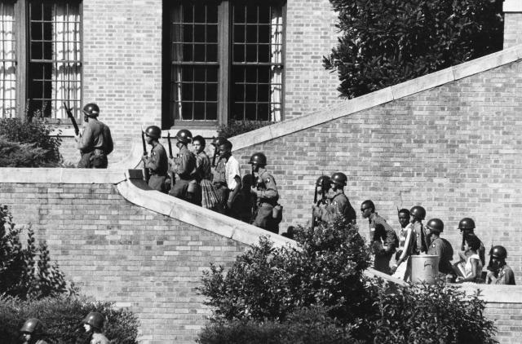
Federal Troops Arrive
30
Notes:
When Governor Faubus refused to protect the black students, President Eisenhower took over the Arkansas National Guard and replaced them with federal troops. These new soldiers escorted the children into school, but the nine faced constant harassment and discrimination for the whole year. At the end of the school year, Faubus closed all the high schools in Little Rock. The schools remained closed all year, a period now known as The Lost Year.

Slide 31
31
Notes:
Question 32. Who is the Commander in Chief of the military?

Slide 32
Question #32
32
Notes:
The President is Commander in Chief of the military. The military consists of the Army, Navy, Air Force, Marines, Coast Guard, and National Guard.

Slide 33
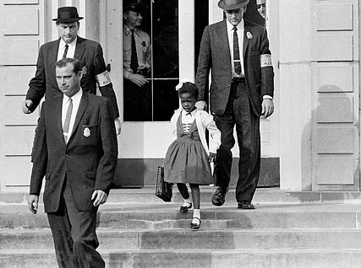
Another Milestone in Civil Rights
33
Notes:
Eventually, the schools in Little Rock desegregated, although it took several years, and many other cities took much longer. In this picture, U.S. Marshals escort Ruby Bridges to school in New Orleans, Louisiana on November 14, 1960. With Marshals by her side, Bridges became the first black child to enter an all-white elementary school in the American South.

Slide 34
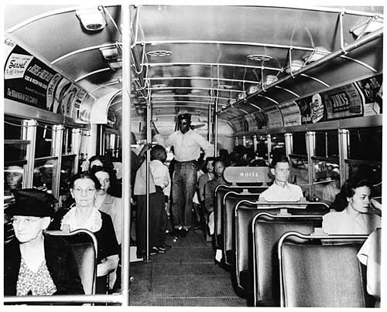
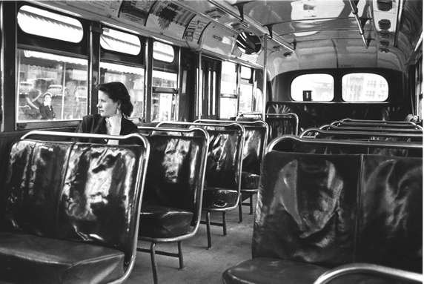
The Montgomery Bus Boycott
Browder v. Gayle (1956)
34
Notes:
An equally important event from this time was the Montgomery Bus Boycott. Like many public transit systems, the buses in Montgomery, Alabama, required black passengers to sit at the back of the bus. On December 1, 1955, a local activist named Rosa Parks was told to give her seat to a white man. She refused, was arrested, and fined $14. In response, civil rights organizers, including Martin Luther King, started a boycott of the Montgomery bus system. The boycott lasted over a year and while it was happening, a class action suit against the bus company went to the Supreme Court. In this case, Browder versus Gayle, the Supreme Court again used the Equal Protection Clause of the 14th Amendment to declare segregated buses, like segregated schools, unconstitutional.

Slide 35
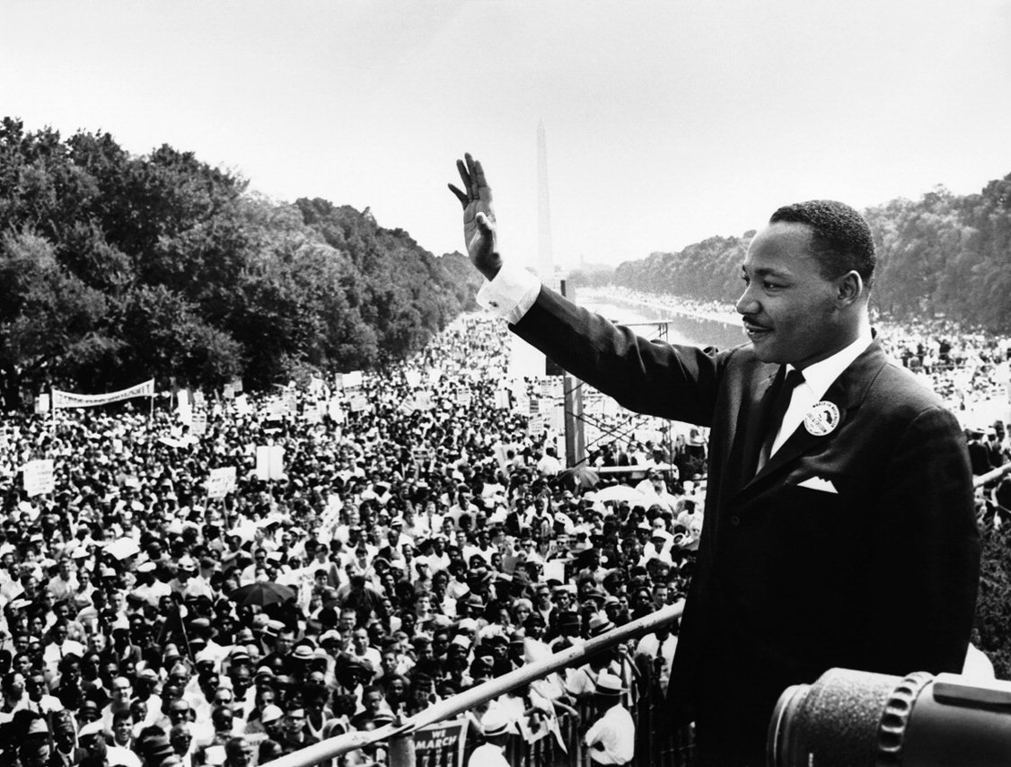
Martin Luther King Jr.
35
Notes:
The most important leader in the civil rights movement was Martin Luther King Jr. He was a Baptist minister who fought for civil rights and worked for equality for all Americans. He believed the civil rights movement could only succeed through non-violent means.

Slide 36
36
Notes:
Question 85. What did Martin Luther King, Jr. do?

Slide 37
Question #85
37
Notes:
Martin Luther King Jr. fought for civil rights and worked for equality for all Americans. For his work, he won the Nobel Peace Prize in 1964.

Slide 38
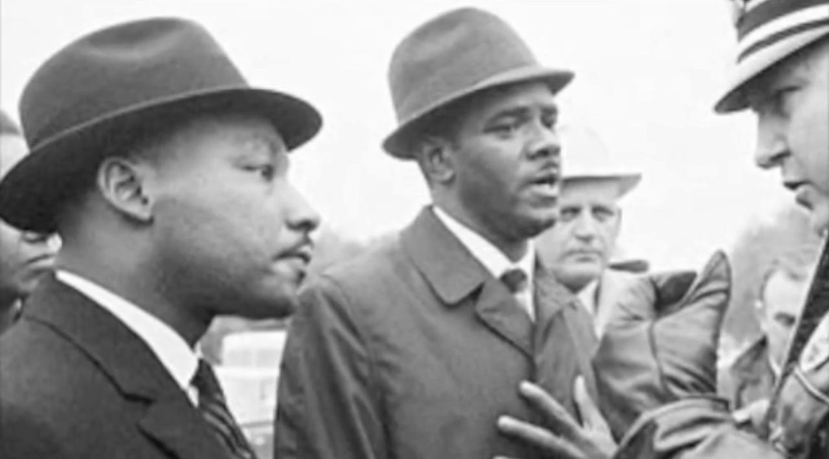
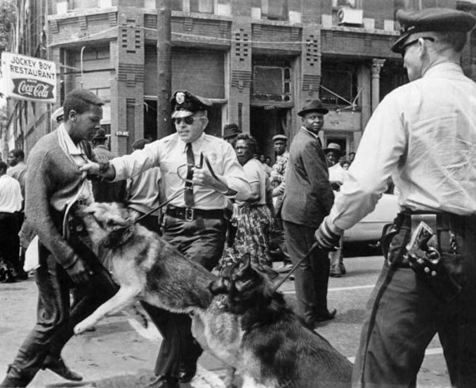
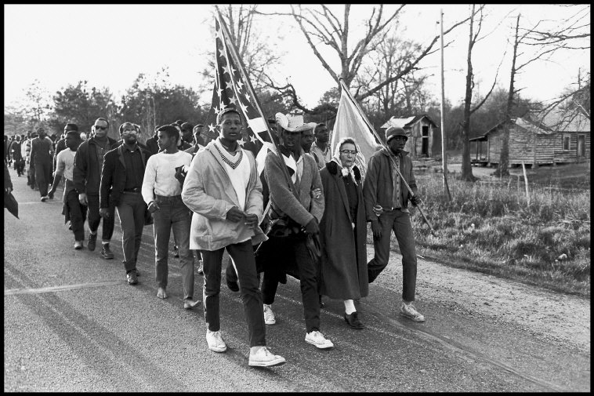
The Birmingham Campaign (1962-63)
38
Notes:
Although Little Rock and Montgomery were great successes, segregation remained legal in most places. Martin Luther King believed he had to show Americans and the world how bad racism still was in the South to get the federal government to act. So, he decided to lead a protest in one of the most segregated cities in the country, Birmingham, Alabama. In Birmingham, segregation was not only legal, it was required. Less than 10% of the black population could vote, professional jobs were reserved for whites, and there were dozens of unsolved murders and bombings against African Americans.

Slide 39
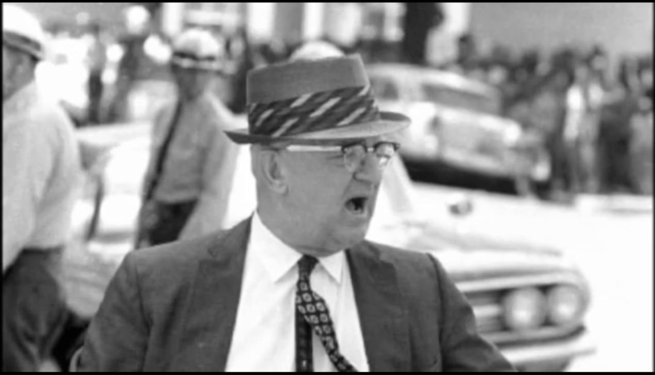
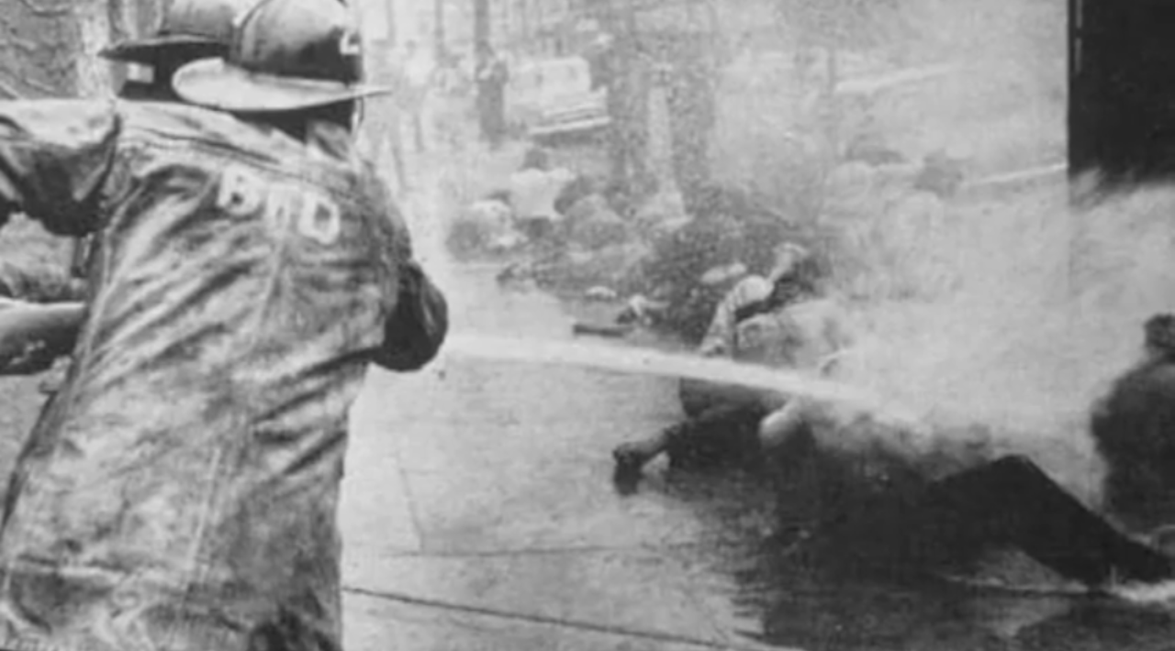
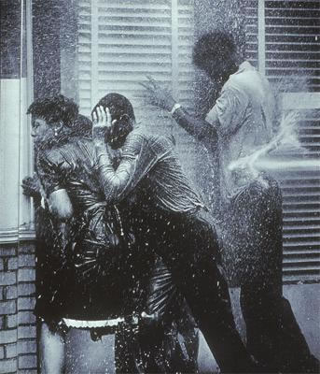
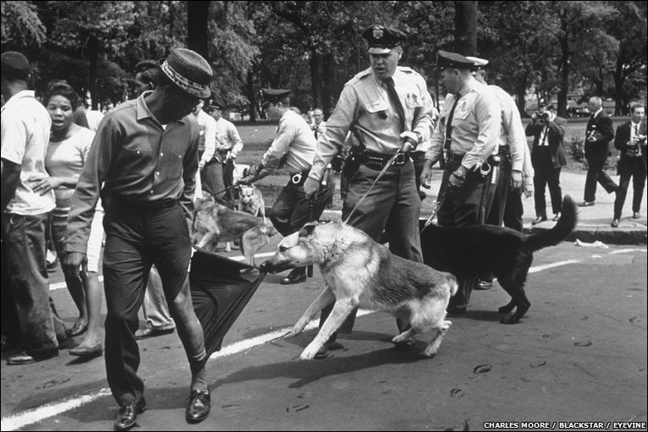
39
Notes:
The Birmingham campaign lasted nearly a year. It began in 1962 with a series of nonviolent boycotts, demonstrations and protests against local businesses. The idea was to create a situation so difficult that the city would eventually have to negotiate. A few white businesses changed their policies until the city threatened to close any business that did not follow the segregation laws. Organizers then decided they needed to be more confrontational. A series of protests were conducted in the spring of 1963 in which Martin Luther King and many others were arrested. Police dogs were used against the protesters this time, but the violence received little national attention.

Slide 40
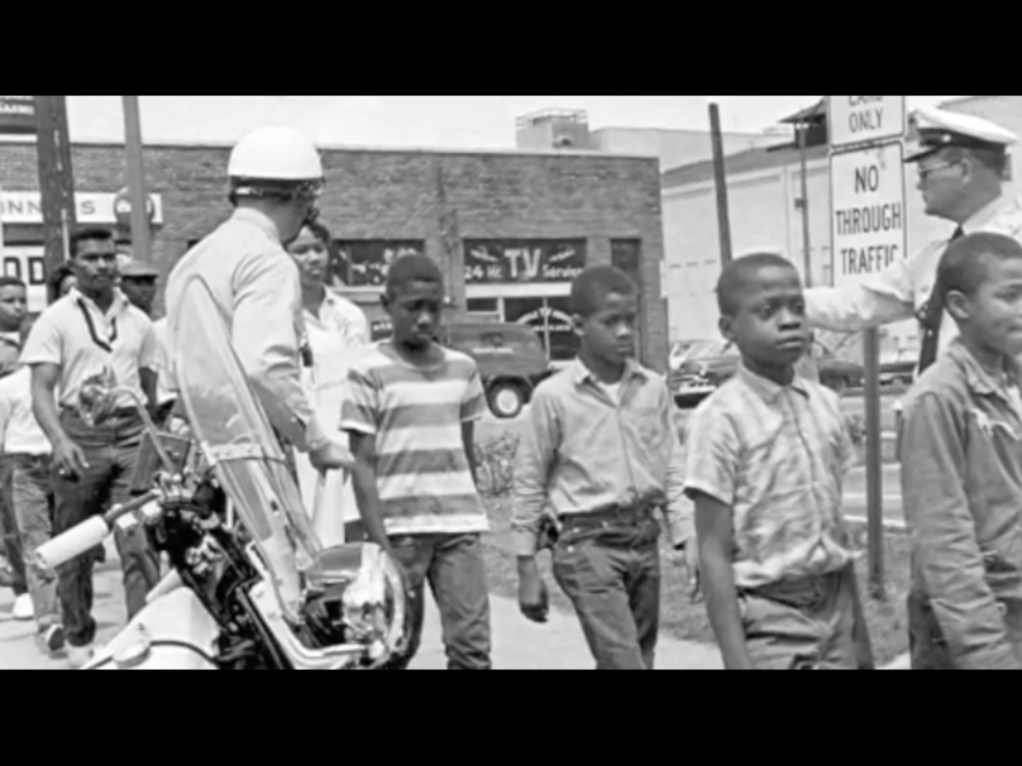
The Birmingham Children's March
May 2-5, 1963
40
Notes:
A controversial decision was then made. It was decided to use school children for the next demonstration. What is now known as the Birmingham Children's March started on May 2, 1963 and continued for four days. On the first day, 1,200 students were arrested and by the fourth day, 2,500 protesters were in jail. To try to stop the marchers, the fire department used powerful water hoses and the police attacked with dogs. Pictures of children being knocked down by fire hoses and people being bitten by dogs shocked many Americans and caused international embarrassment. While not everyone agreed with the use of children to protest, the actions of the Birmingham city government forced Washington to start talking about desegregation and the protection of everyone's civil rights.

Slide 41
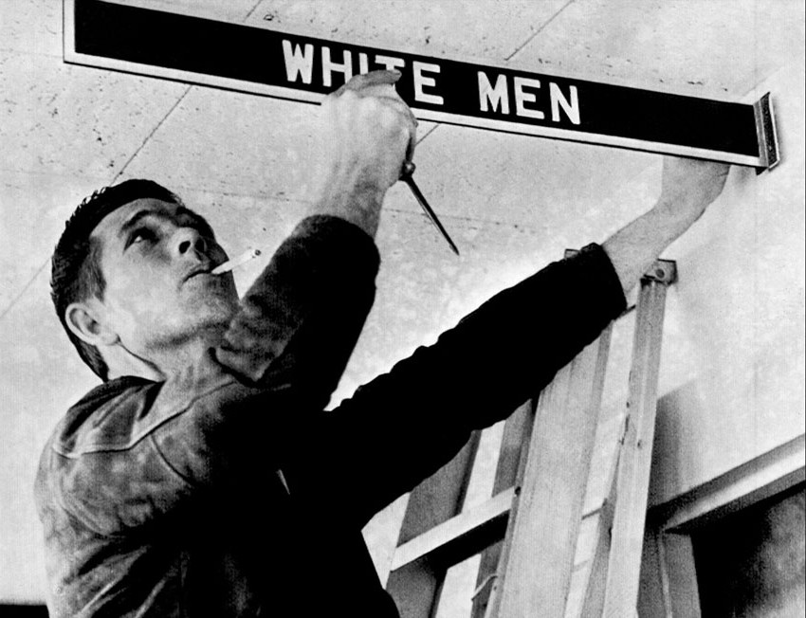
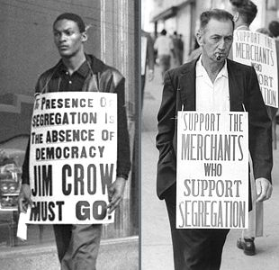
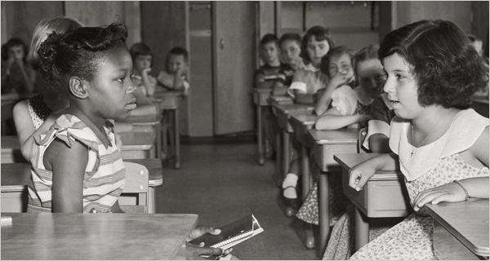
41
Notes:
On May 8th, white business owners agreed to most of the demands of the protesters, but desegregation was slow and for months there was violence and resistance. Several buildings were bombed including a church, the hotel Martin Luther King stayed in, and the house of King's brother. In addition, the Governor of Alabama sent troops to prevent black students from going to white schools.

Slide 42
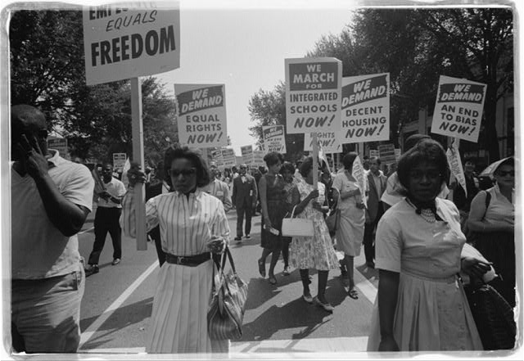
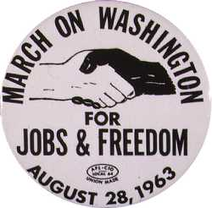
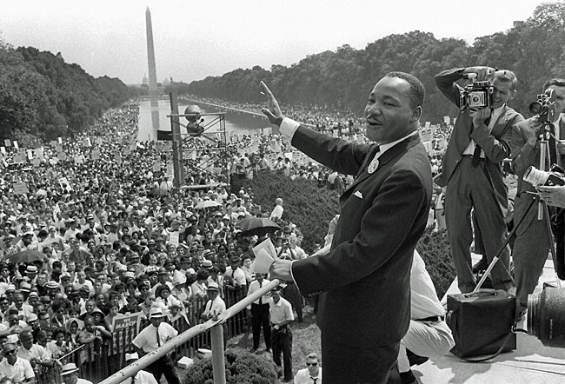
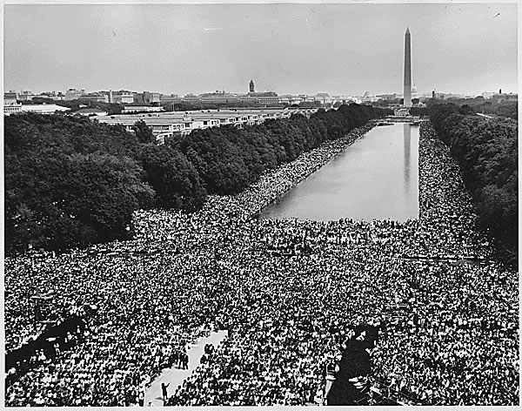
42
Notes:
After Birmingham, Martin Luther King planned a march on Washington D.C. to demand civil rights and equal rights in education, employment and businesses. On August 28, 1963, 250,000 people participated in The March on Washington for Jobs and Freedom. This march became one of the most iconic events of the civil rights movement.

Slide 43
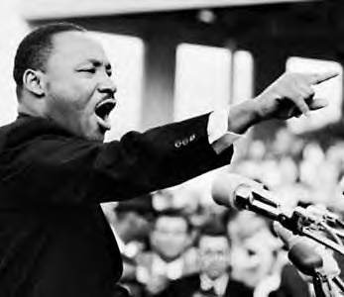
"I Have a Dream"
...when we allow freedom to ring, when we let it ring from every village and every hamlet, from every state and every city, we will be able to speed up that day when all of God's children, black men and white men, Jews and Gentiles, Protestants and Catholics, will be able to join hands and sing in the words of the old Negro spiritual, "Free at last! free at last! thank God Almighty, we are free at last!"
43
Notes:
At this demonstration Martin Luther King gave his famous "I Have a Dream" speech in which he imagined a world free of racial discrimination, a world in which everyone would be "free at last."

Slide 44
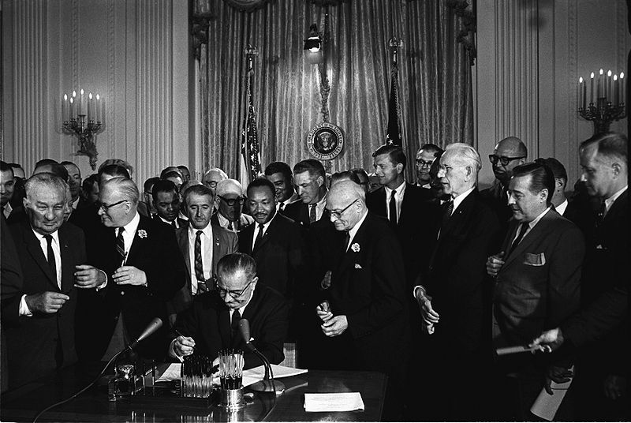
The Civil Rights Act of 1964
44
Notes:
Early the next year, the 24th Amendment was passed. This Amendment outlawed poll taxes. Later that year, the Civil Rights Act of 1964 was also passed. The act outlawed all segregation and other forms of discrimination based on race, color, religion or national origin. President Lyndon Johnson signed the bill on July 2, 1964.

Slide 45
45
Notes:
Question 48. There are four amendments to the Constitution about who can vote. Describe one of them.

Slide 46
Question #48
46
Notes:
There are four amendments to the Constitution about voters' rights. One amendment grants voting rights to any citizen who is eighteen or older. Another outlaws poll taxes. A third amendment allows both men and women to vote, and the last one allows a male citizen of any race to vote.

Slide 47
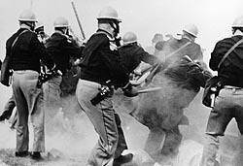
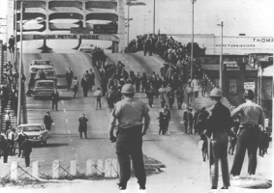
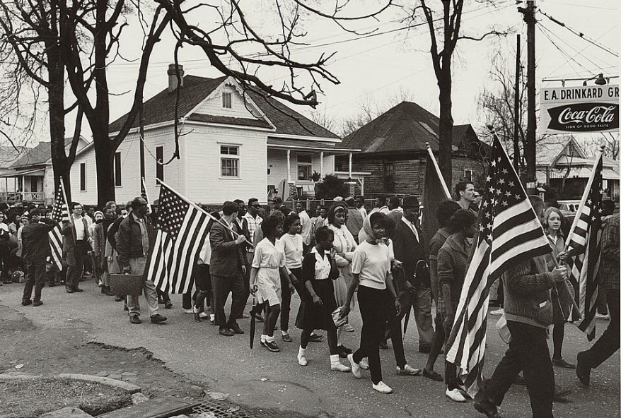
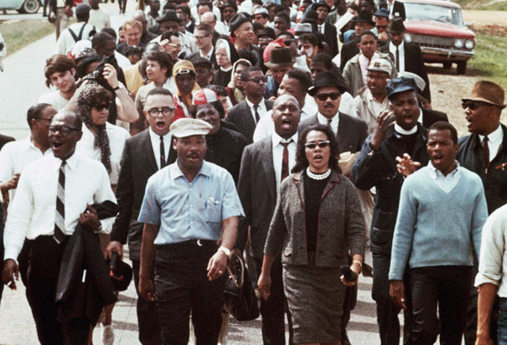
Selma to Montgomery March (1965)
47
Notes:
The Civil Rights Act of 1964 was not the end of the civil rights movement because it did not address all the problems with voting rights. Protests and other activities such as voter registration drives continued throughout the south. Attempts to register black voters in Selma, Alabama, where fewer than 1% could vote, led to attacks on organizers and protesters. After one protester was shot and killed, a march from Selma to Montgomery was organized. The first march took place on March 7, 1965 and became known as "Bloody Sunday" when 600 marchers were attacked by police with clubs and tear gas. During the second march two days later, 2,500 protesters were prevented from crossing a bridge by police. The third march started March 16, but this time the marchers were protected by 4,000 soldiers and federal agents. The violent reaction to the Selma marchers caused President Johnson to insist Congress write a strong voting rights bill.

Slide 48
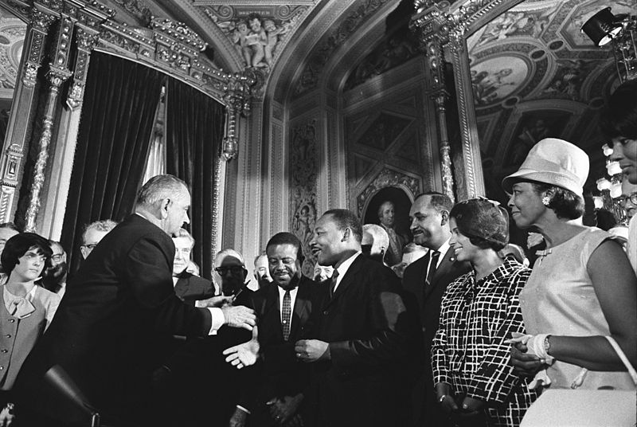
The Voting Rights Act (1965)
48
Notes:
Congress acted quickly and created the Voting Rights Act prohibiting any "practice ... to deny... the right of any citizen of the United States to vote on account of race or color." President Johnson signed bill into law on August 6, 1965. Martin Luther King and Rosa Parks attended the signing ceremony.

Slide 49
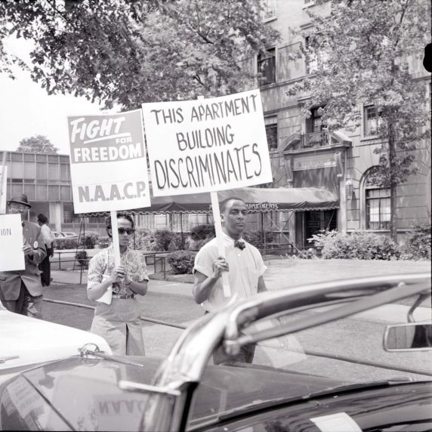
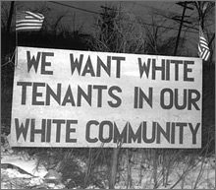
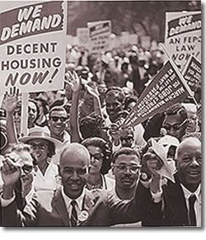
The Civil Rights Act of 1968
49
Notes:
The Civil Rights Act and Voting Rights Act was followed by the Civil Rights Act of 1968. Also called the Indian Civil Rights Act of 1968 and the Fair Housing Act, the act outlawed discrimination in the sale, rental, or financing of housing. In 1988, the law was updated to protects people with disabilities and families with children.

Slide 50
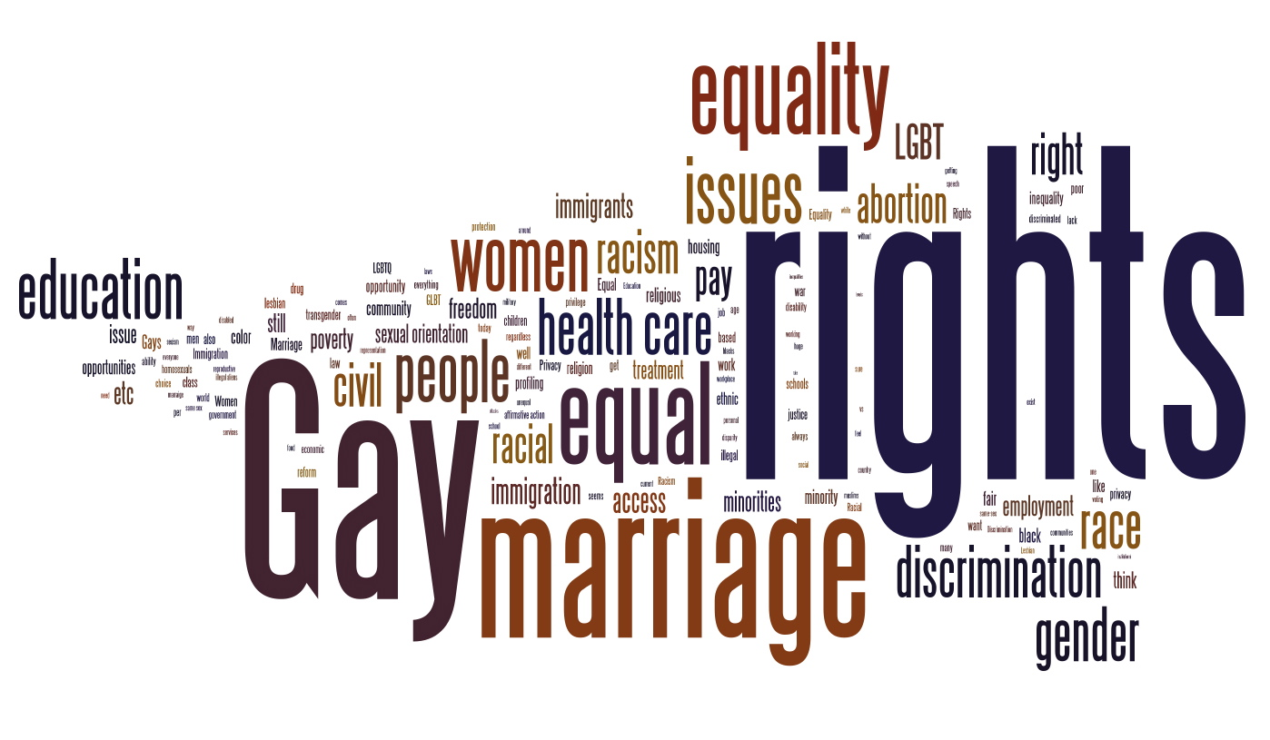
Source: http://civilrightsproject.wordpress.com/article-on-survey-here/
50
Notes:
The civil rights movement ended official discrimination and made it more difficult for individual forms of discrimination. However, the ultimate goal of the civil rights movement has always been guaranteed equal rights for all Americans. In that respect, the movement continues today. Some current issues include equal pay for women, gay rights, immigrant rights, and health care as a civil right.

Slide 51
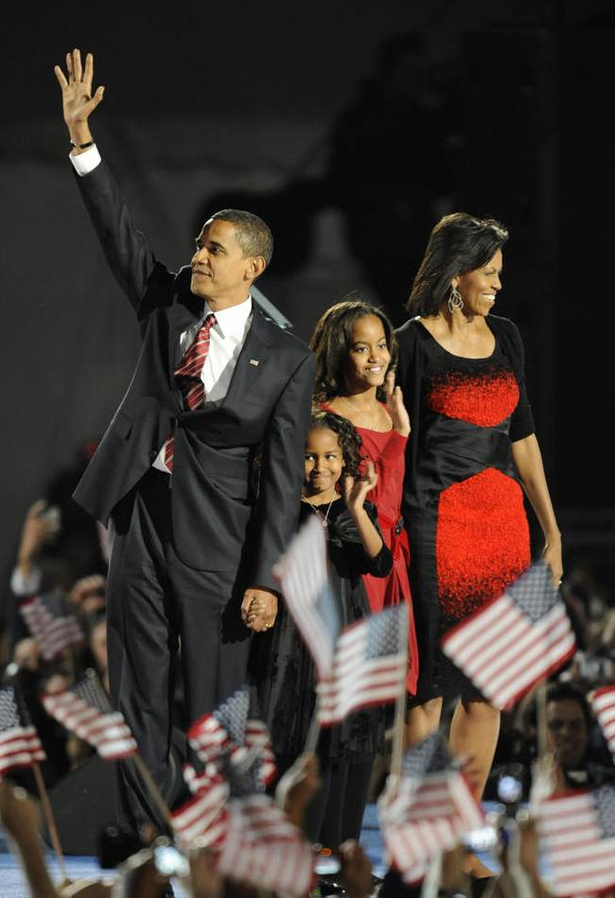
America's First Black President
51
Notes:
In 2008 America elected its first ever black president, Barack Obama. This was seen by many as a sign that racism has become less of a problem in the United States.

