Slide 1
Lesson 5
American History
International Wars
Questions: 71, 94, 98, 89, 90, 72, 79, 11, 80, 82, 81, 83, 78, 86
1
Notes:
Lesson 5. American History: International Wars.
This lesson explains the more important international wars fought by the United States in the 1800s and 1900s.

Slide 2
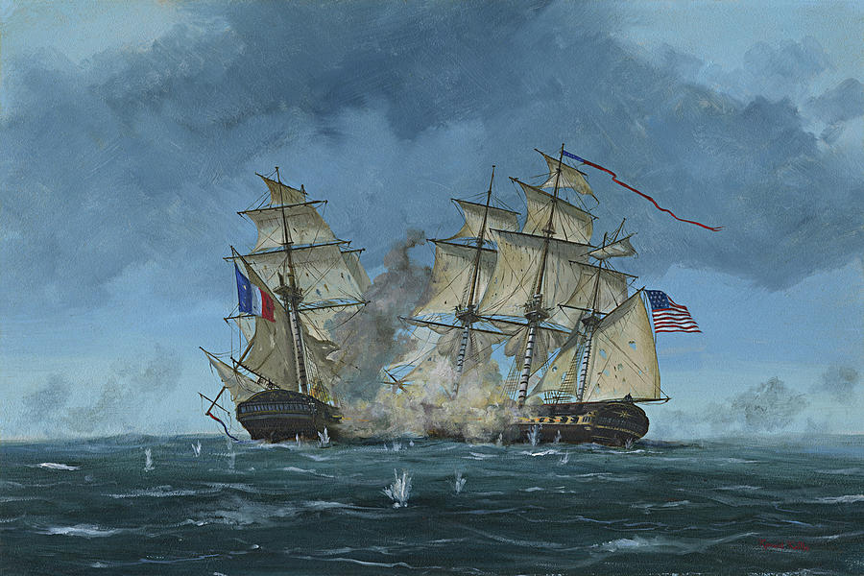
War of 1812 (1812-1815)
2
Notes:
The United States fought several international wars in the 1800s. The wars were fought to expand U.S. territory and regional influence, establish international borders, and defend national sovereignty. The first war was the War of 1812. This was the first time America declared war on another nation. The War of 1812 was fought against Great Britain in the United States and in Canada. In 1803, Britain started fighting France. The French ruler at that time was Napoleon Bonaparte. America declared its neutrality in that war and continued to trade with both France and Britain. However, Britain blockaded American ports. The British also boarded the U.S. ships and impressed American sailors into the British Navy.

Slide 3
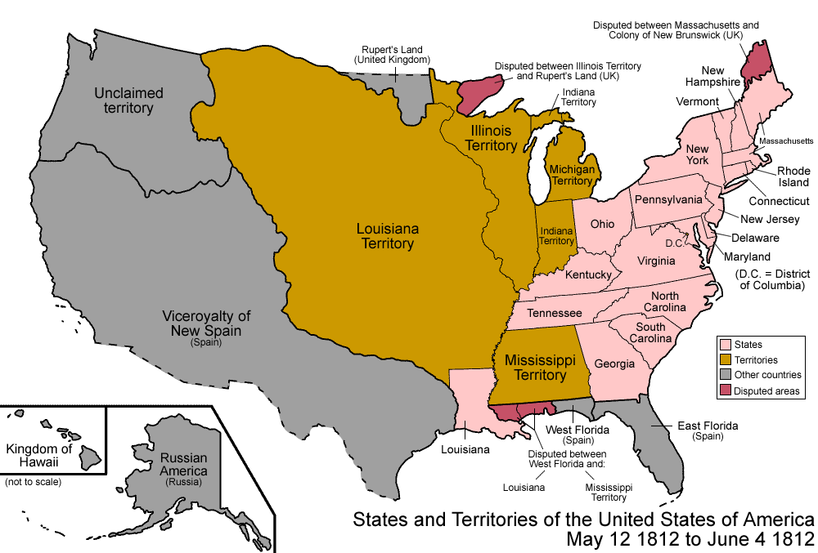
American Expansion
3
Notes:
For those reasons, in 1812, the U.S. declared war on Great Britain. The War of 1812 lasted three years. During the war the United States invaded Canada and Britain attacked several U.S. cities, including the new capital, Washington, D.C. However, the war was very expensive and neither country was able to win a big victory. Also, after Napoleon was defeated, the British ended their blockade. That made it much easier to stop the war. As part of the peace treaty, the U.S.-Canada border remained the same and British support for the Native Americans ended, which made westward expansion easier.
3

Slide 4
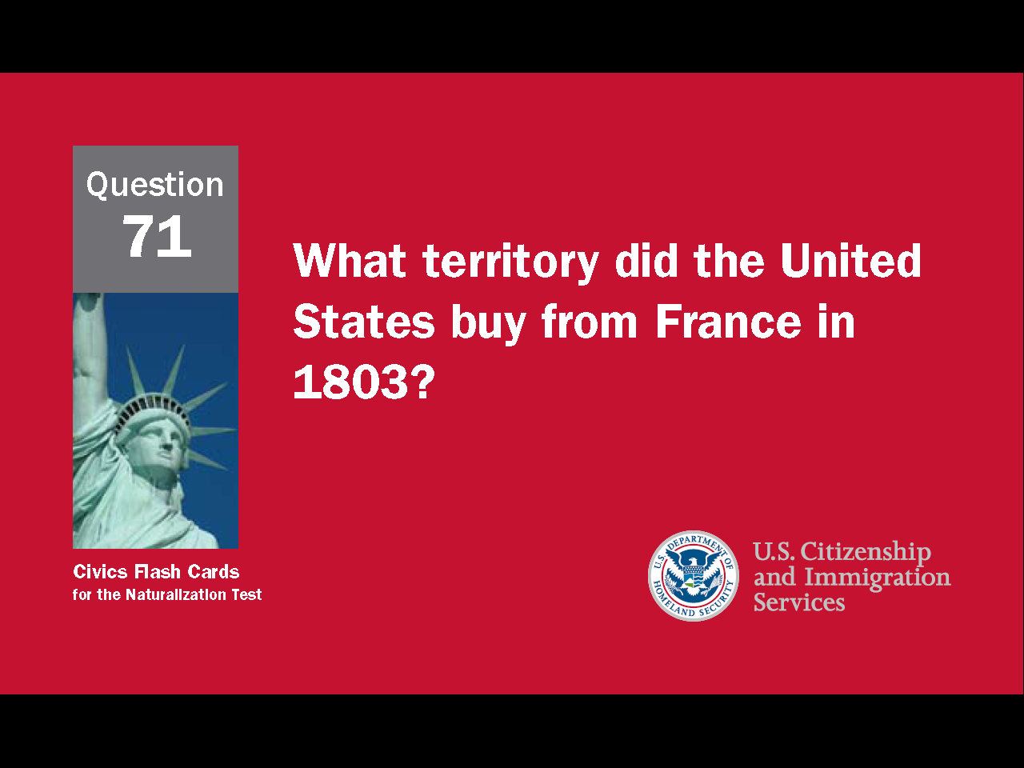
4
Notes:
Question 71. What territory did the United States buy from France in 1803?

Slide 5
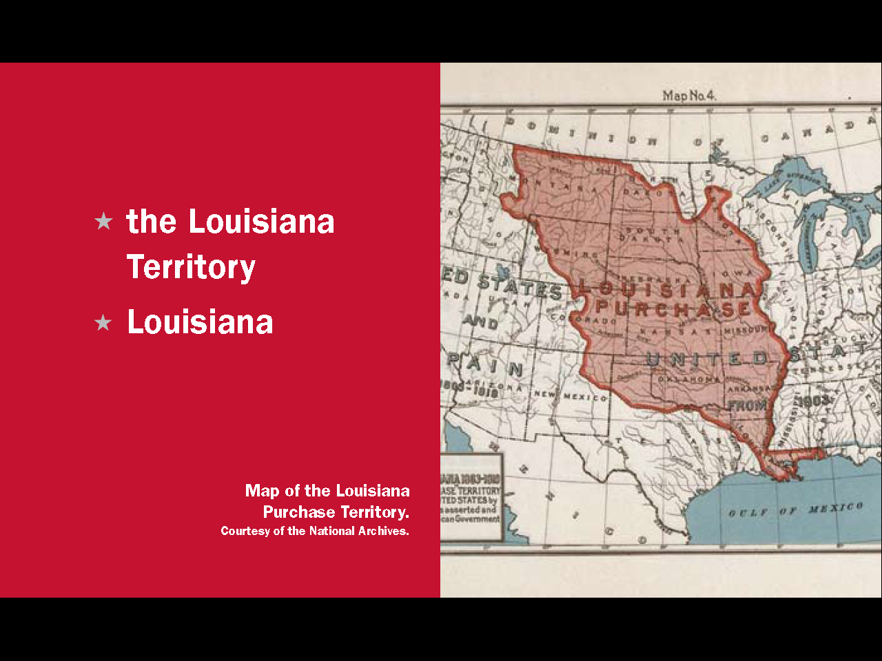
Question #71
5
Notes:
The United States bought Louisiana, or the Louisiana Territory, from France in 1803.

Slide 6
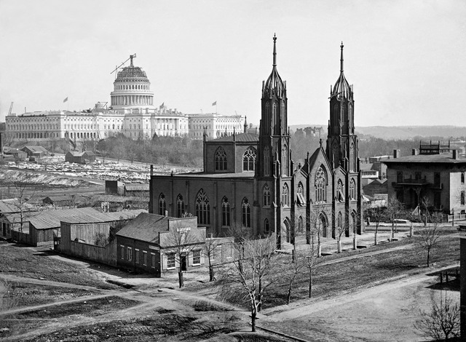
The Creation of Washington D.C.
Source: Brady-Handy Collection, Library of Congress
6
Notes:
The capital of the United States is Washington, D.C. In 1790, Congress approved the creation of a national capital. The area they chose was set up as a federal district, not a state, and named the District of Columbia. This is because, at the time, Columbia was a poetic name for the United States. The next year, the city itself was named in honor of the first president, and father of our country, George Washington.

Slide 7
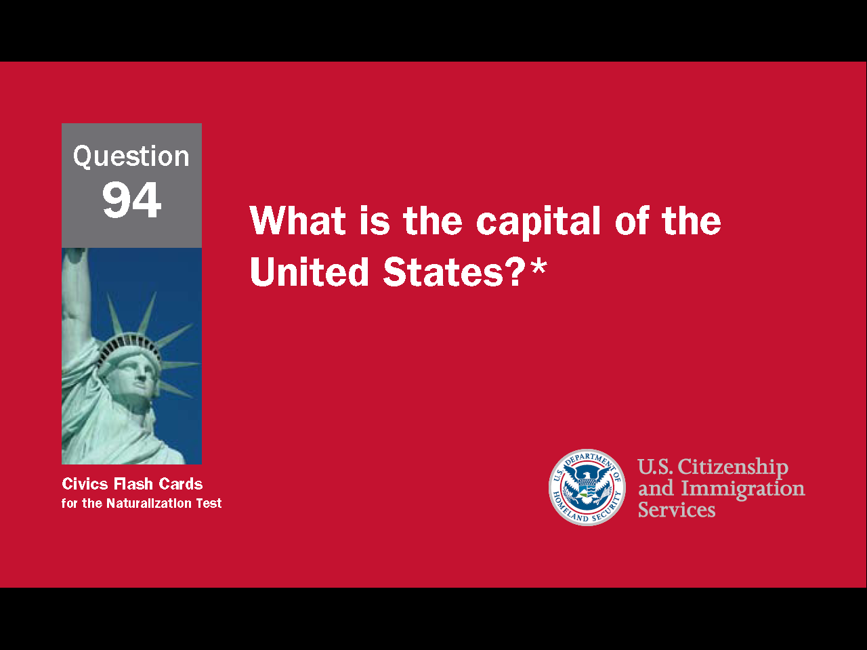
7
Notes:
Question 94. What is the capital of the United States?

Slide 8
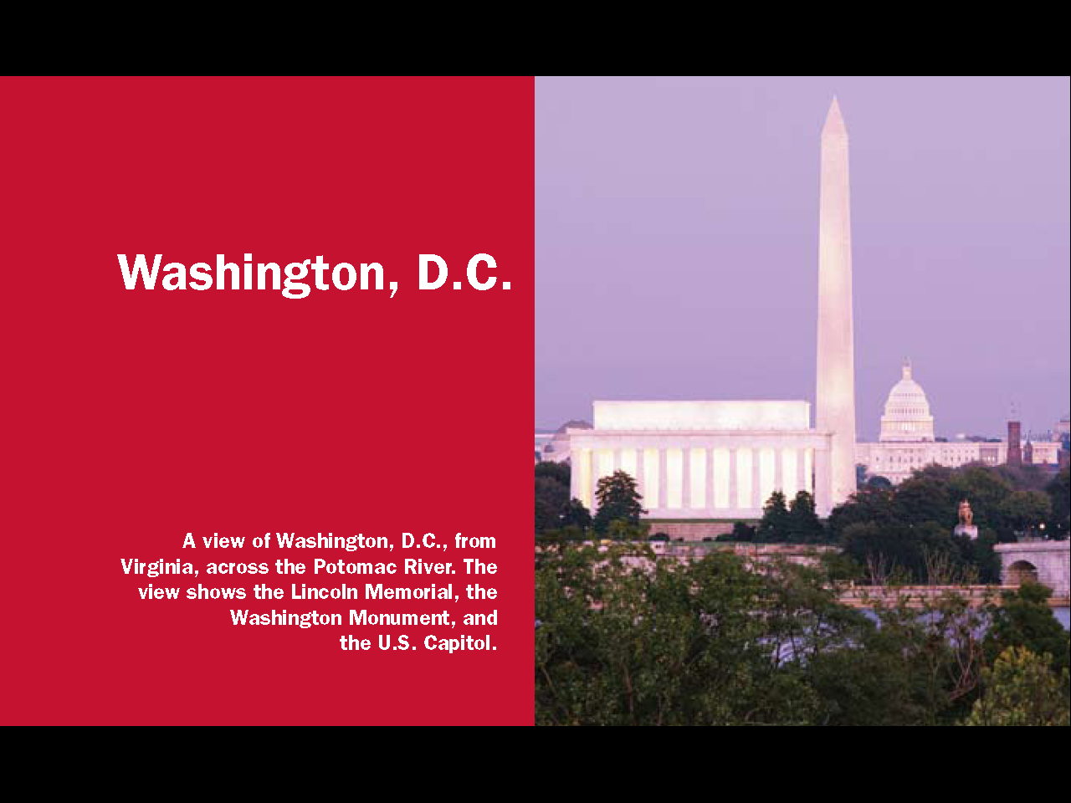
Question #94
8
Notes:
Washington, D.C. is the capital of the United States. D.C. stands for District of Columbia.

Slide 9
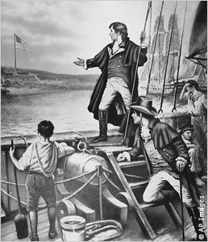
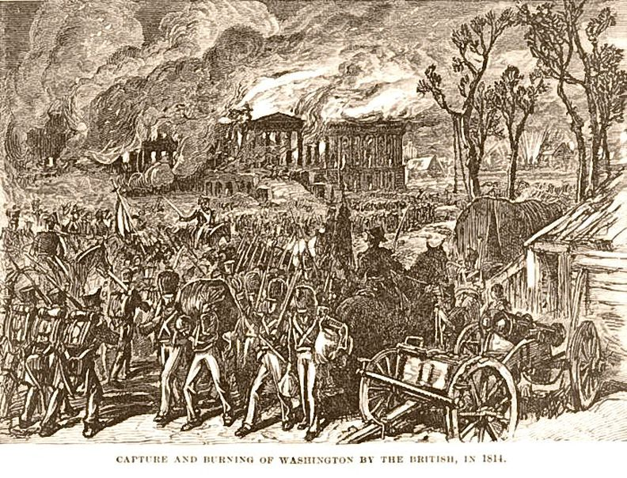
The War of 1812 Ends
9
Notes:
For those reasons, in 1812, the U.S. declared war on Great Britain. The War of 1812 lasted three years. During the war the United States invaded Canada and Britain attacked several U.S. cities, including the new capital, Washington, D.C. However, the war was very expensive and neither country was able to win a big victory. Also, after Napoleon was defeated, the British ended their blockade. That made it much easier to stop the war. As part of the peace treaty, the U.S.-Canada border remained the same and British support for the Native Americans ended, which made westward expansion easier.
9

Slide 10
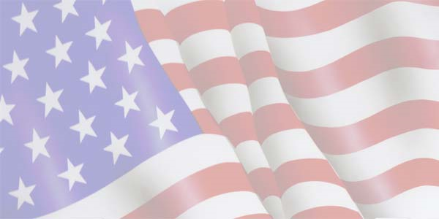
The Star-Spangled Banner
Oh, say, can you see, by the dawn's early light,
What so proudly we hail'd at the twilight's last gleaming?
Whose broad stripes and bright stars, thro' the perilous fight,
O'er the ramparts we watch'd, were so gallantly streaming?
And the rockets' red glare, the bombs bursting in air,
Gave proof thro' the night that our flag was still there.
O say, does that star-spangled banner yet wave
O'er the land of the free and the home of the brave?
10
Notes:
The War of 1812 is famous in American history because during it the British attacked Washington D.C. and burned down the White House and Capital. It is also famous for inspiring the U.S. national anthem, “The Star-Spangled Banner.” The song came from a poem written the morning after the British bombed an American fort. A soldier there, Francis Scott Key, was inspired to write when he saw the U.S. flag was still flying over the fort. The song has three verses, but traditionally only the first verse is sung. “The Star-Spangled Banner” was made the official national anthem in 1931.

Slide 11

11
Notes:
Question 98. What is the name of the national anthem?

Slide 12
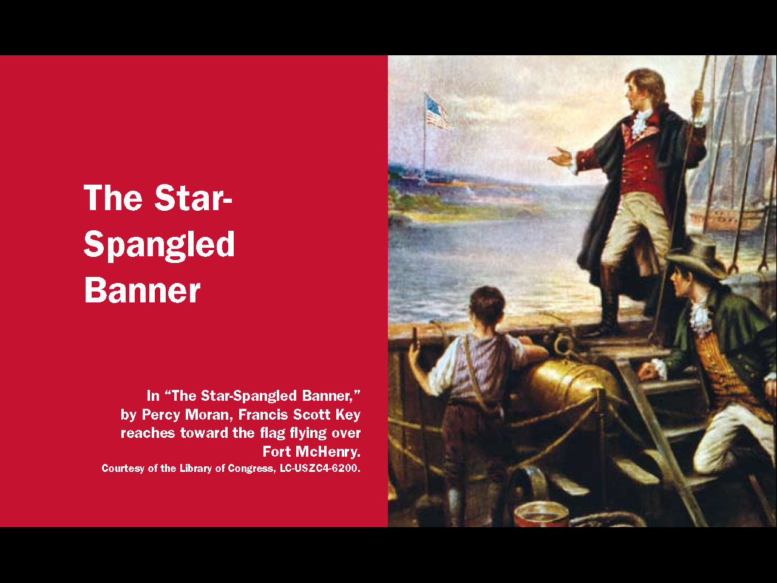
Question #98
12
Notes:
The name of the national anthem is the “Star-Spangled Banner.”

Slide 13
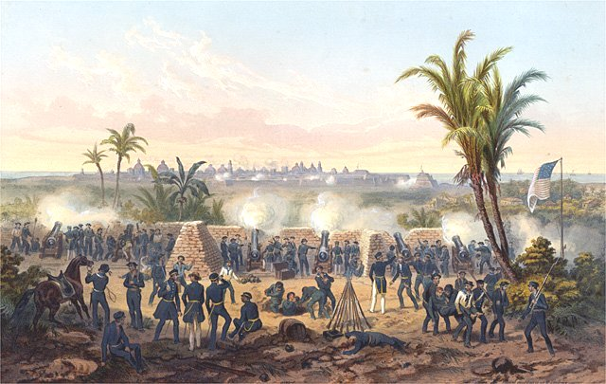
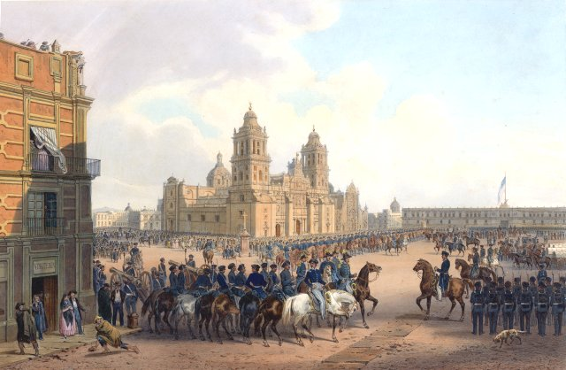
Mexican-American War (1846-1848)
13
Notes:
The Mexican-American War was the result of America's expansion west. What is now the state of Texas was originally Mexican territory. The territory had a small population and was often attacked by Native Americans. To try to protect their country, Mexico invited immigrants to settle in Texas. So many Americans came, that within 10 years they were 80% of the population. Mexico then tried to end the immigration, and a few years later, in 1835, Texas declared its independence. A Mexican army attacked, was defeated, and Mexico agreed to make Texas an independent republic. In 1845, Texas asked to join the United States. The U.S. annexed Texas, Mexico attacked again, and after a series of battles was defeated.
13

Slide 14
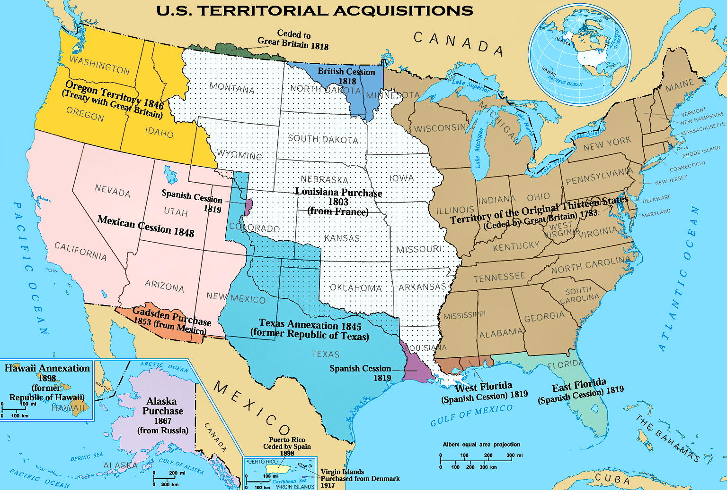
Mexican-American War (1846-1848)
14
Notes:
The Mexican-American War was the result of America's expansion west. What is now the state of Texas was originally Mexican territory. The territory had a small population and was often attacked by Native Americans. To try to protect their country, Mexico invited immigrants to settle in Texas. So many Americans came, that within 10 years they were 80% of the population. Mexico then tried to end the immigration, and a few years later, in 1835, Texas declared its independence. A Mexican army attacked, was defeated, and Mexico agreed to make Texas an independent republic. In 1845, Texas asked to join the United States. The U.S. annexed Texas, Mexico attacked again, and after a series of battles was defeated.

Slide 15
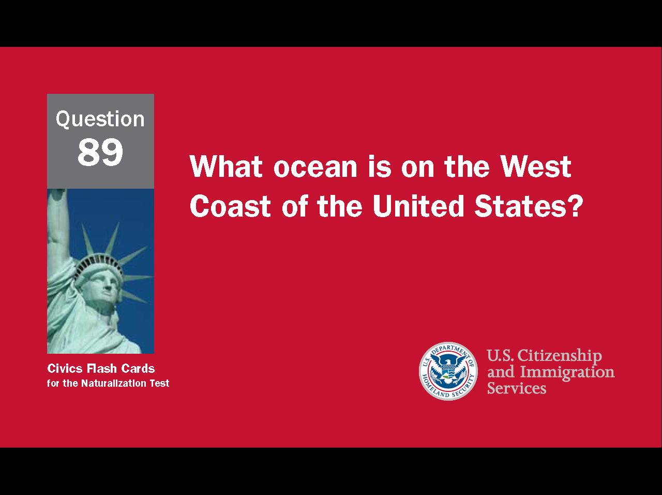
15
Notes:
Question 89. What ocean is on the West Coast of the United States?

Slide 16
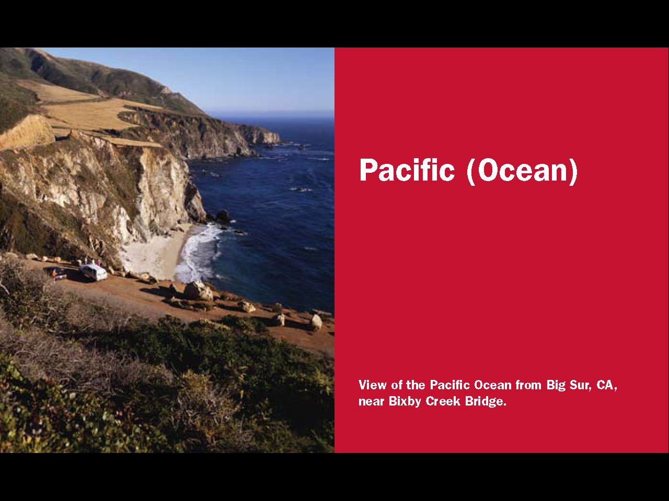
Question #89
16
Notes:
The Pacific. The Pacific Ocean is the largest ocean on Earth.

Slide 17
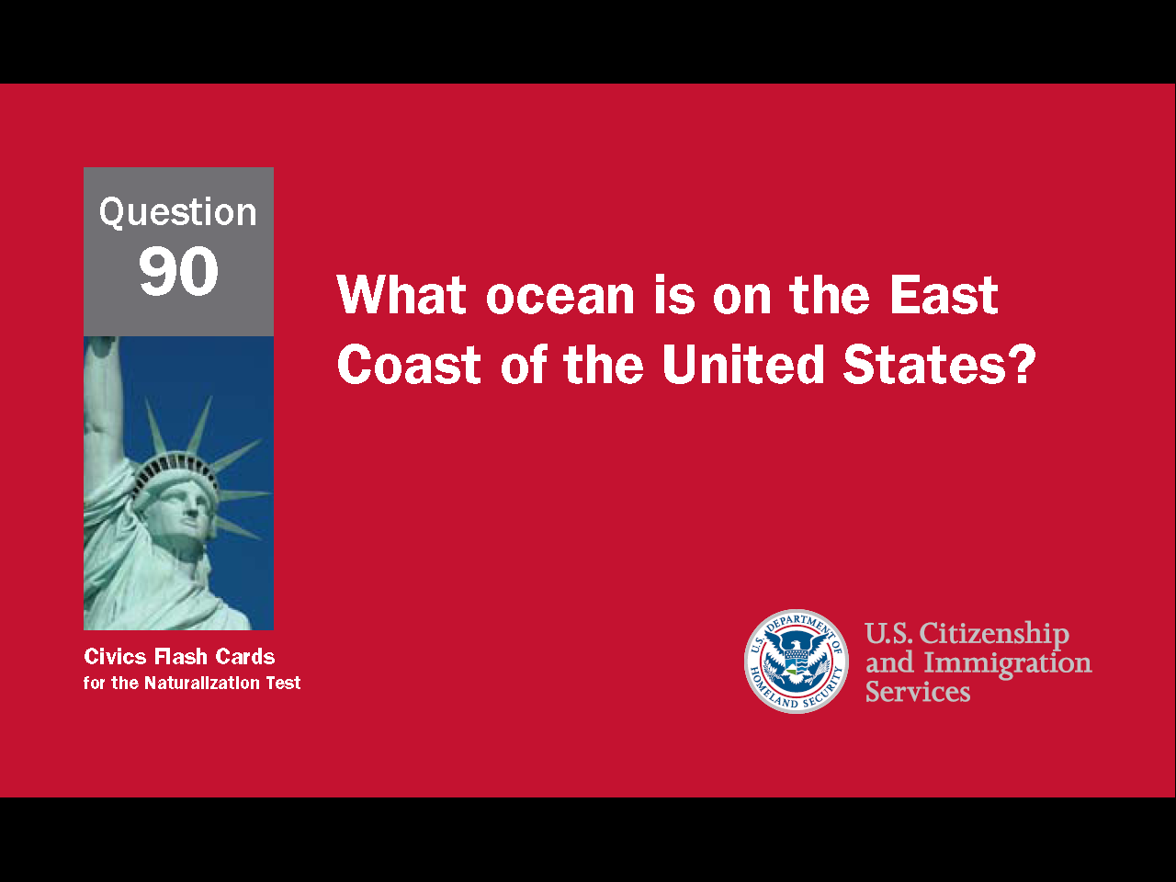
17
Notes:
Question 90. What ocean is on the East Coast of the United States?

Slide 18

Question #90
18
Notes:
The Atlantic. The Atlantic Ocean is the most traveled ocean in the world.

Slide 19
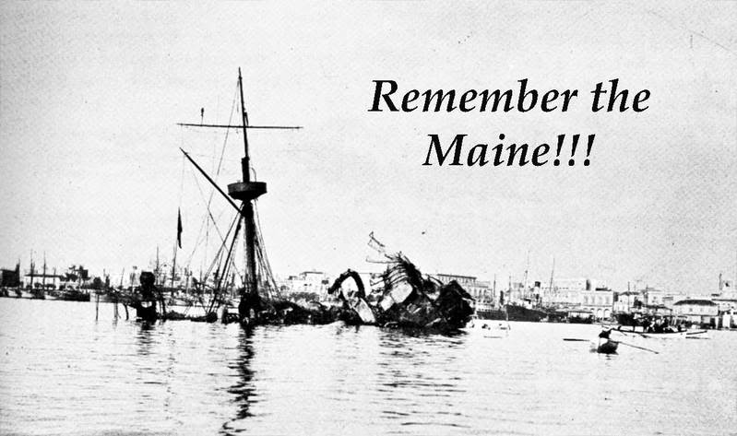
Spanish-American War (1898)
19
Notes:
The last war of the 1800s was the Spanish-American War. Cuba had been a Spanish territory since the time of Columbus. In 1895, a war for independence began. To try to maintain control, the Spanish forced many Cubans into camps in which as many as 200,000 people may have died. This caused great concern and anger in the U.S. and in 1898 the U.S. sent the battleship Maine to protect Americans living in Cuba. A month later a large explosion sank the Maine. While most likely an accident, the Spanish were blamed, and the United States declared war. The Spanish-American War was fought on Cuba and in the Pacific Ocean around the Philippines and Guam. The Spanish were quickly defeated, and as part of the peace treaty, the U.S. won control of Cuba, Puerto Rico, Guam, and the Philippines.

Slide 20

20
Notes:
Question 72. Name one war fought by the United States in the 1800s.

Slide 21
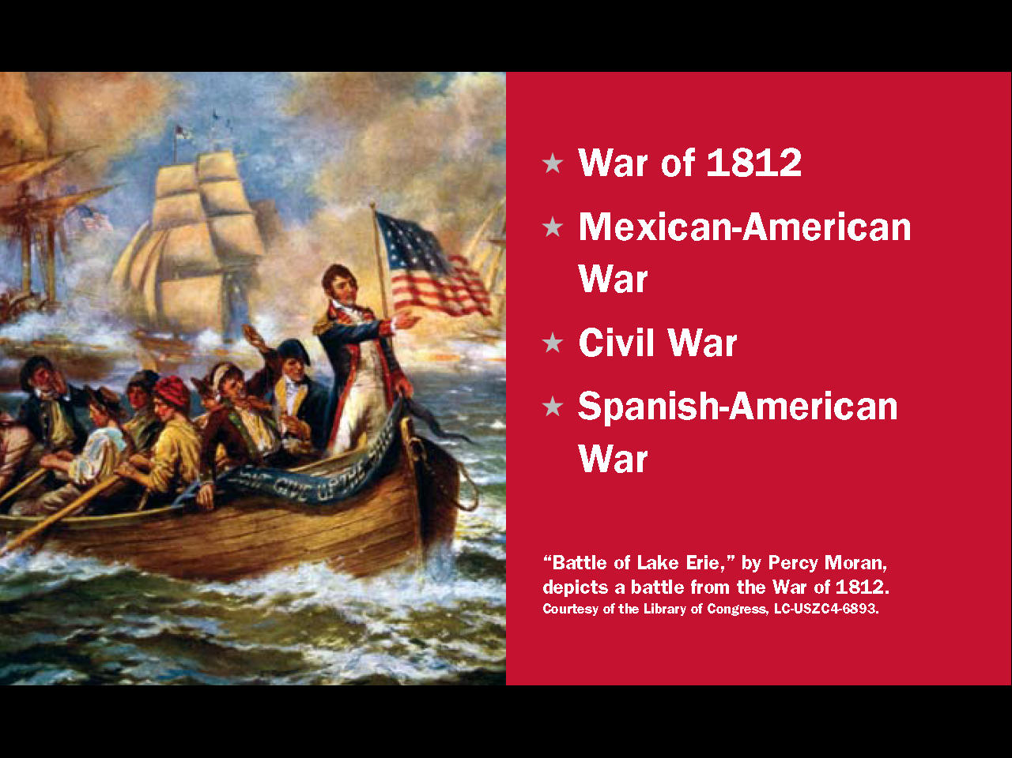
Question #72
21
Notes:
The United States fought several wars in the 1800s. Four of them are
the War of 1812
the Mexican-American War
the Civil War
and the Spanish-American War. The Civil War is not in this lesson because it was not an international war.

Slide 22
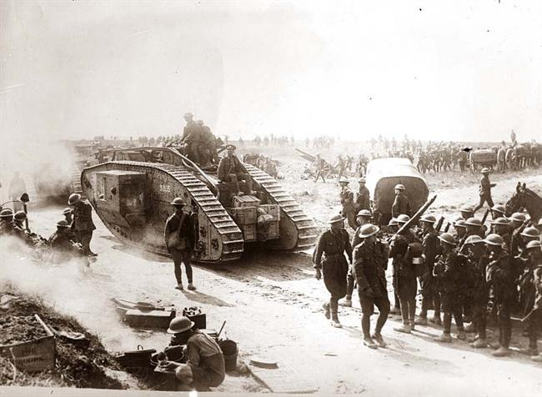
World War I (1914-1918)
22
Notes:
There were two world wars in the first half of the 1900s. The U.S. eventually entered both wars on the side of Britain, France and Russia. World War I, was fought in Europe from 1914 to 1918. The causes of the World War I are complicated but include militarism, imperialism, nationalism, and military alliances. The major European countries had been fighting each other for centuries. In the early 1900s, relations were so bad that a minor, local event pushed Europe into one of the deadliest wars in history.

Slide 23
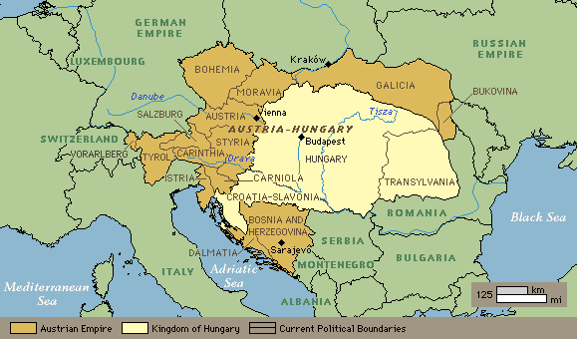
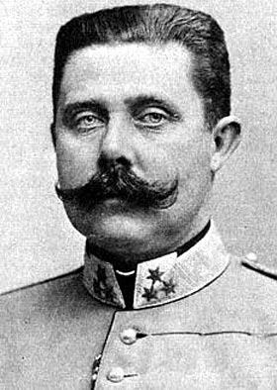
The Spark of War
Franz Ferdinand
23
Notes:
World War I started after the assassination of a member of the Austro-Hungarian monarchy, Archduke Franz Ferdinand. Ferdinand was killed by a Serb who wanted his country freed from the Austro-Hungarian Empire. Tensions in Europe quickly grew after the assassination and diplomacy failed to calm the situation. Within six weeks, Europe was at war. The war began when Austria attacked Serbia and Germany attacked Belgium, France, and Russia. Great Britain then entered the war because it had promised to defend Belgium.

Slide 24
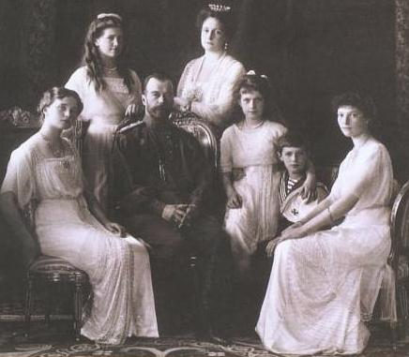
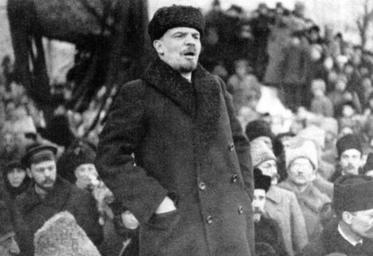
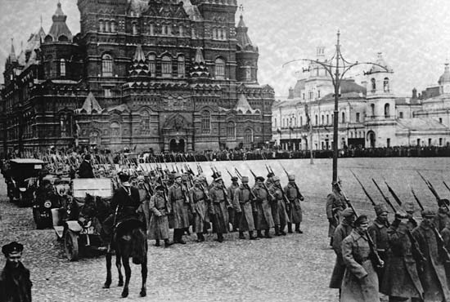
The Russian Revolution (1917)
24
Notes:
During the war, there was a revolution in Russia. In 1917, Communists overthrew the Russian monarchy. Communism is an economic and political system in which the government owns all property and industry and decides what is produced and how much it costs. In that way, Communism is the opposite of capitalism. Communist governments are also totalitarian, which means citizens have few rights or freedoms. After the revolution, Russia's communist government changed the country's name to the Soviet Union.

Slide 25
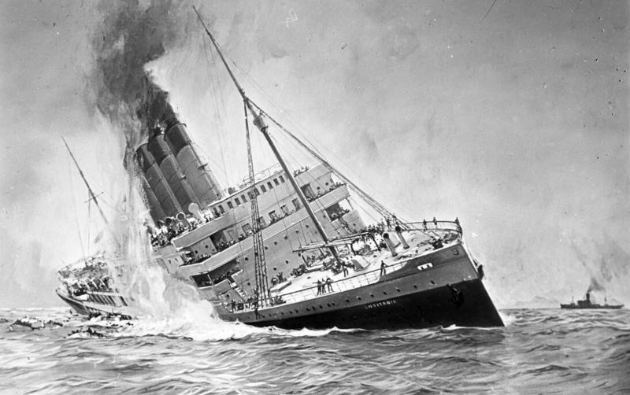
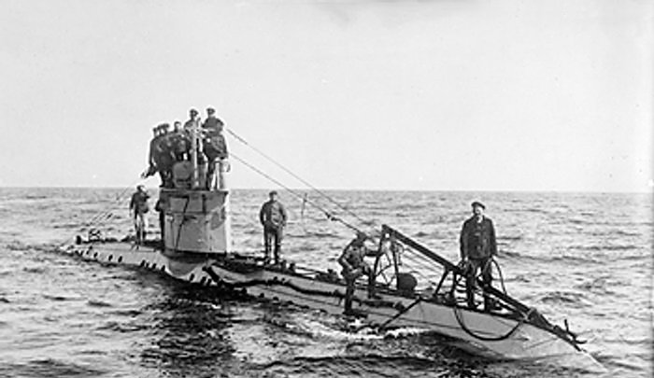
The Sinking of the Lusitania (1915)
25
Notes:
Like before the War of 1812, at the beginning of World War I, the U.S. attempted to be neutral and continued to trade with Britain. Great Britain is an island nation so most of its food and materiel come by ship. Germany tried to blockade Britain using submarines and in February 1915 declared it would sink any ship it found near Britain. A couple of months later, 128 Americans died when a German submarine sank the British passenger ship Lusitania. The U.S. protested, but shortly after Germany started sinking American ships. The Germans knew this would force the U.S. to declare war, so they sent a telegram encouraging Mexico to attack the United States. Mexico refused, but President Woodrow Wilson could no longer ignore Germany's actions and Congress declared war on April 6, 1917.
25

Slide 26
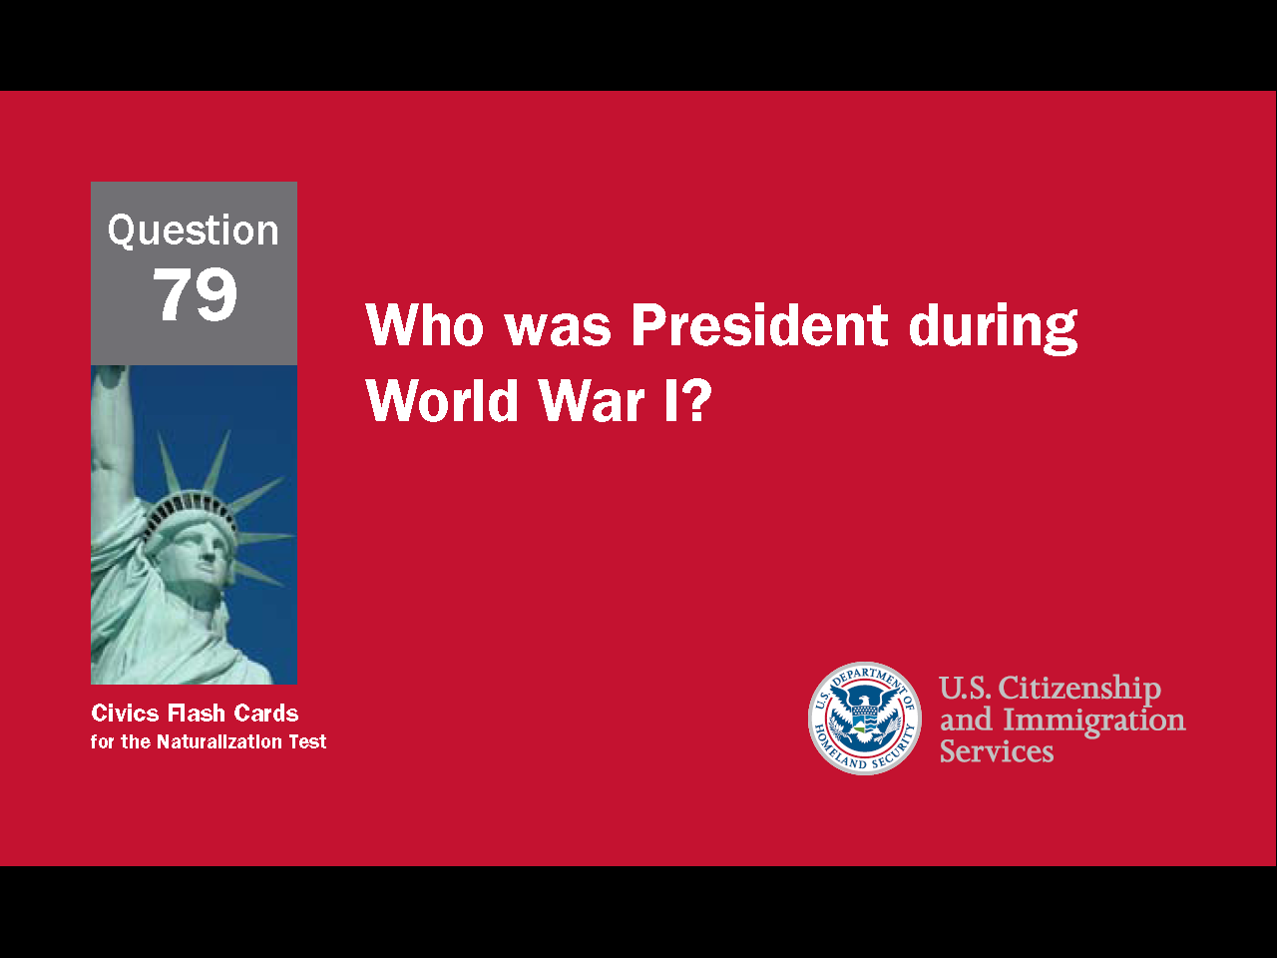
26
Notes:
Question 79. Who was President during World War I?

Slide 27
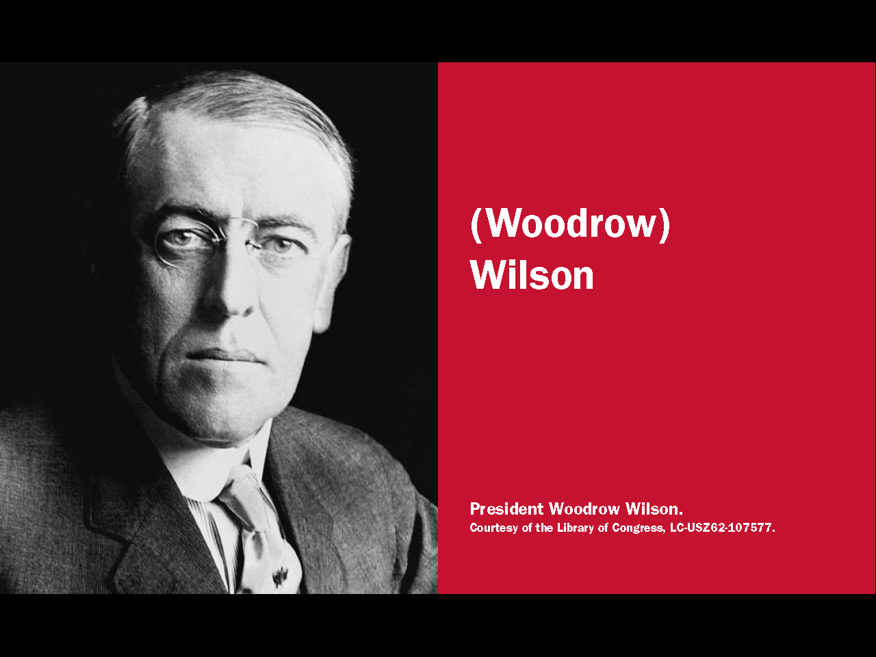
Question #79
27
Notes:
Woodrow Wilson was president during World War I.

Slide 28
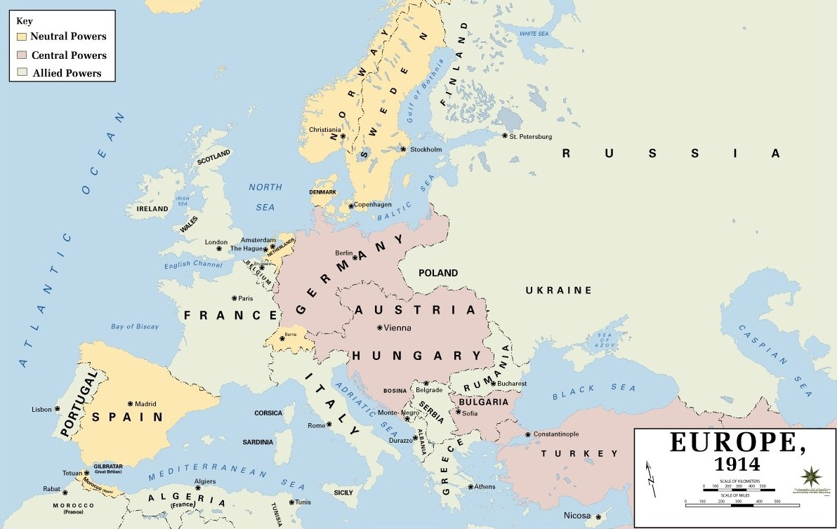
28
Notes:
With the U.S. now fighting along with France and Britain, Germany realized it could not win the war and surrendered on November 11, 1918. The peace treaty required Germany to give up territory and pay a tremendous amount of war damages. This hurt the German economy and caused great anger in Germany. For these reasons, the treaty is now seen as one of the main causes of World War II.

Slide 29

Capitalist Economy / Market Economy
29
Notes:
The economic system of the United States is based on free market capitalism. In capitalism, businesses are privately-owned and operated for profit. In a market economy, what is produced and how much is charged is determined through free competition and the interaction of supply and demand.

Slide 30
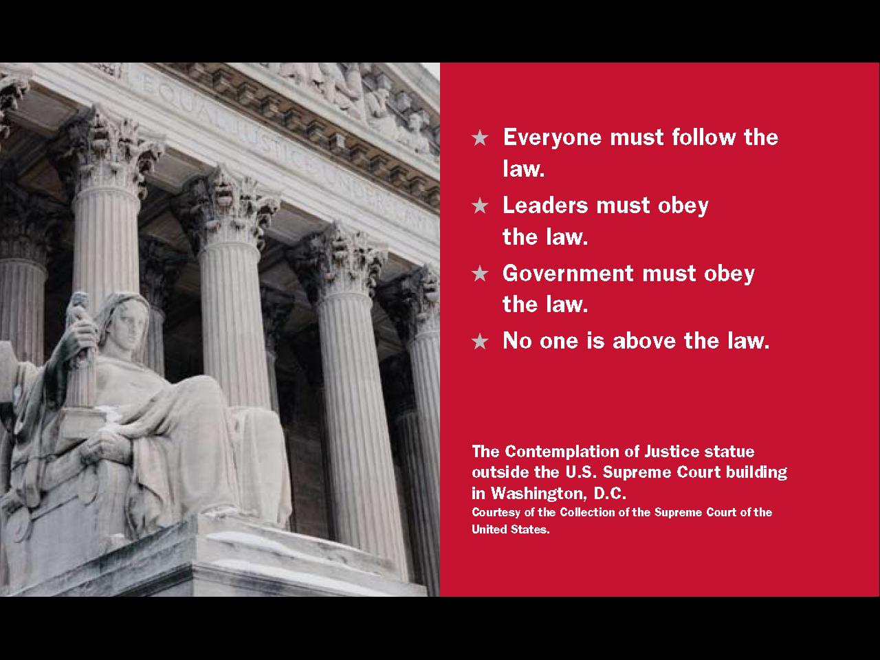
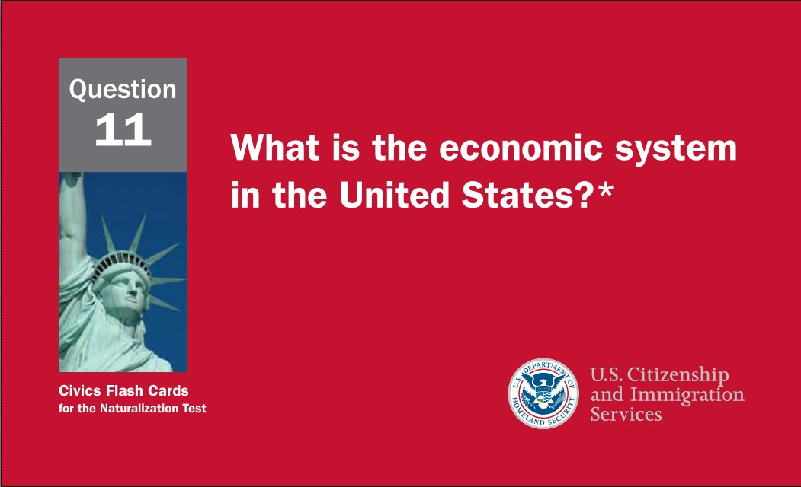
30
Notes:
Question 11. What is the economic system in the United States?

Slide 31

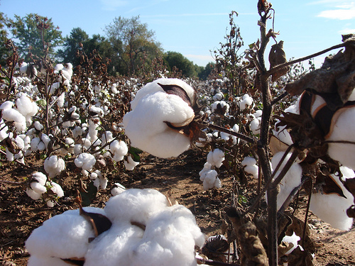

Question #11
31
Notes:
The economic system in the United States is capitalist with a market economy.

Slide 32
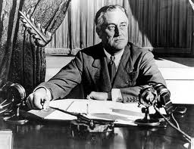
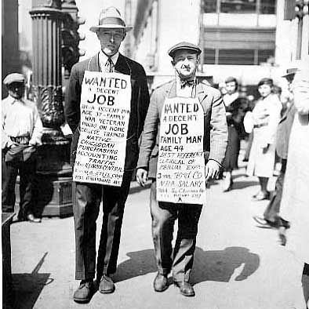
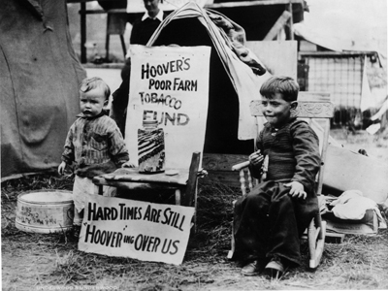
The Great Depression
32
Notes:
In October 1929, the U.S. stock market crashed and America went into economic depression. This period is called the Great Depression. The President in 1929, Herbert Hoover, was blamed and lost reelection in 1932 to Franklin Roosevelt. Franklin Roosevelt would go on to lead the U.S. through the Great Depression and most of World War II. He died at the beginning of his fourth term in 1945.

Slide 33
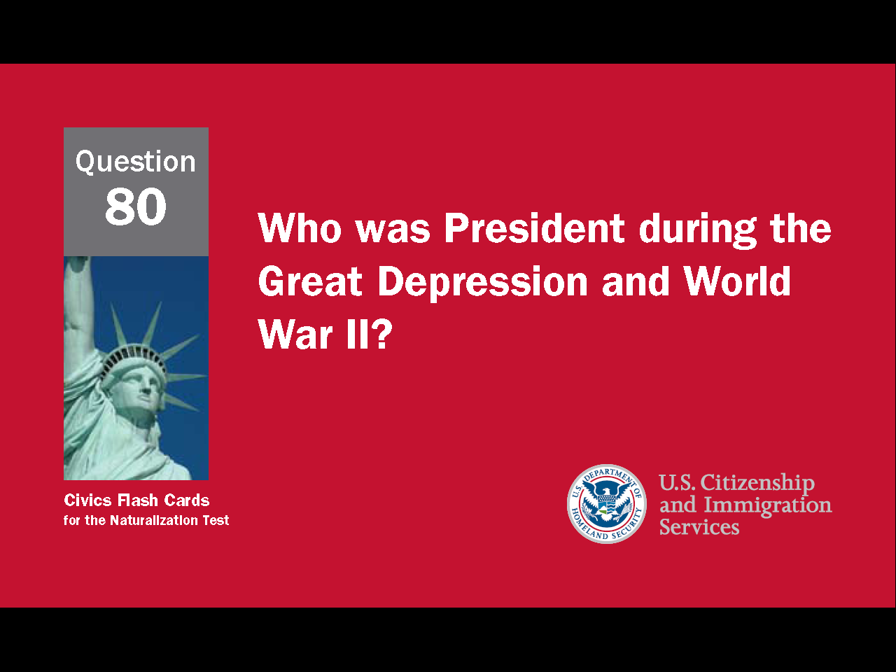
33
Notes:
Question 80. Who was President during the Great Depression and World War II?

Slide 34
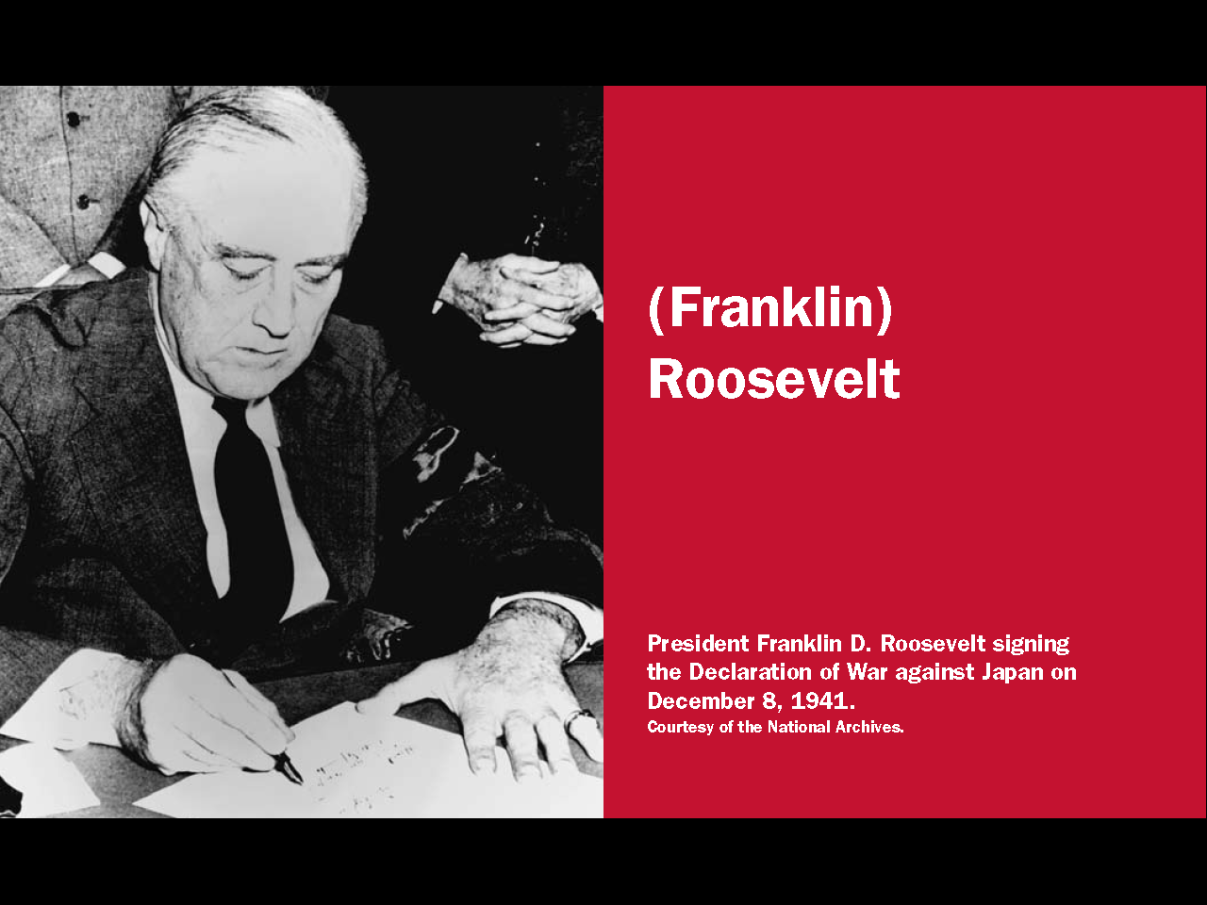
Question #80
34
Notes:
Franklin Roosevelt was president during the Great Depression and World War II.

Slide 35
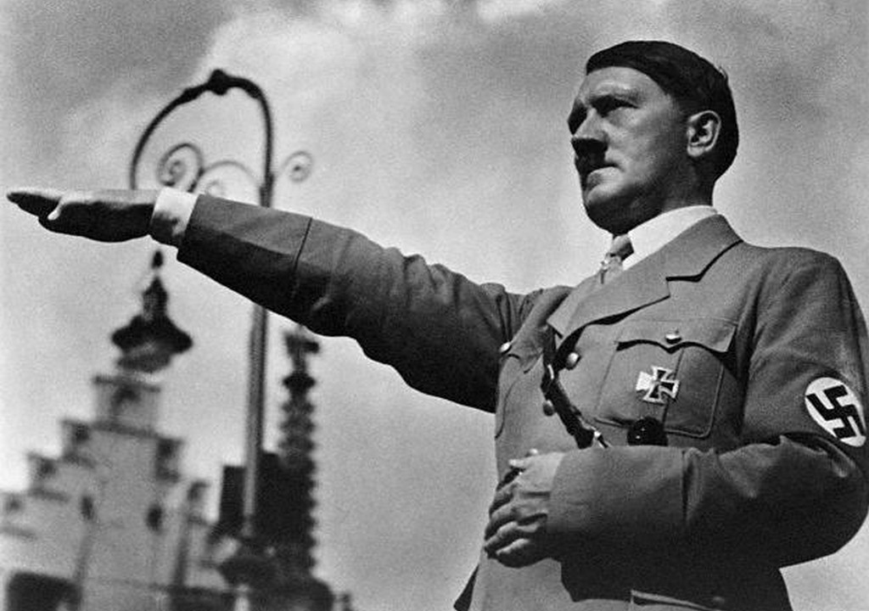
Hitler and Nazi Germany
35
Notes:
In Germany, economic problems, a weak government, and unhappiness over the treaty that ended World War I, helped a politician named Adolf Hitler become leader in 1934. Hitler quickly became a dictator and turned Germany into a totalitarian country like the Soviet Union. Hitler was also the leader of the Nazi party, a political party with a very nationalistic and racist ideology. Nazis believed Germans were the purest race and therefore deserved to conquer all of Europe and the Soviet Union.

Slide 36
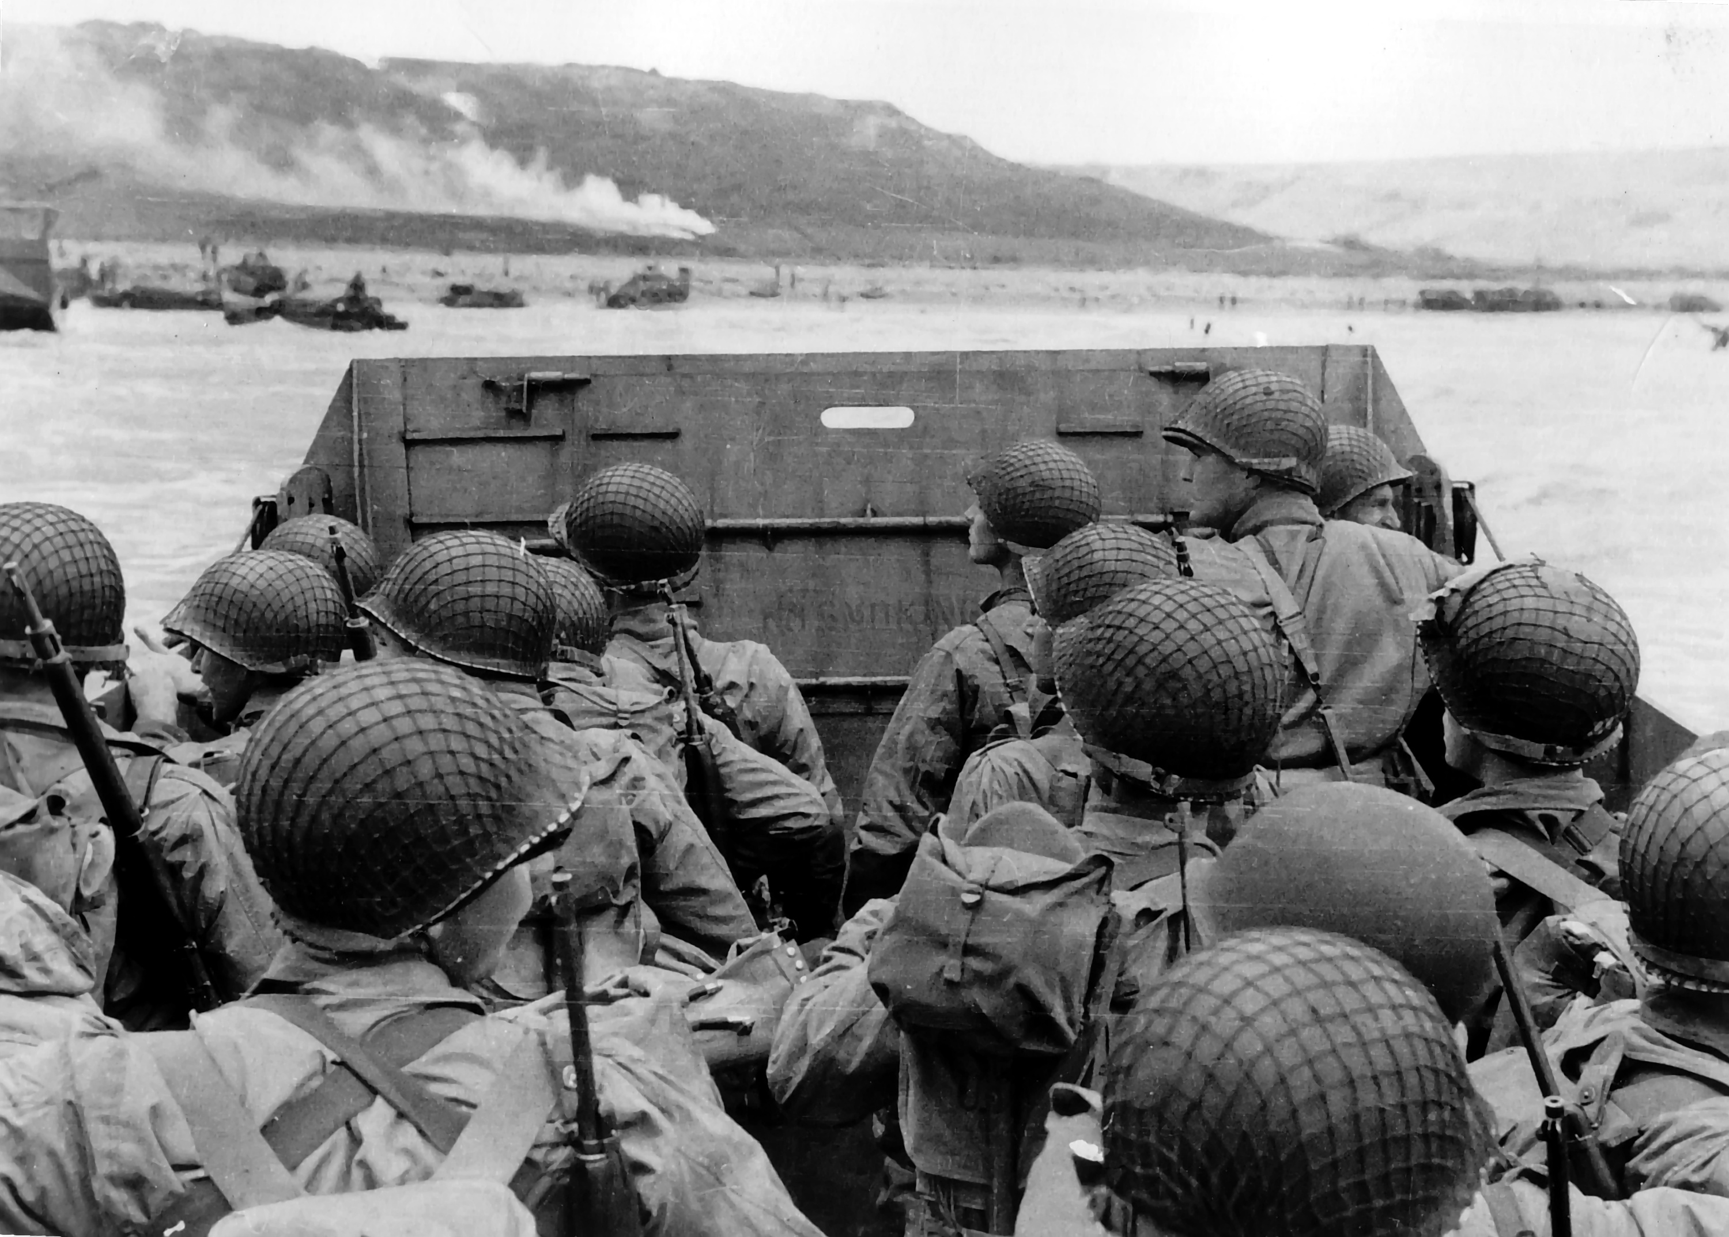
World War II (1939-1945)
36
Notes:
World War II was a true world war and the most destructive war in history. It was fought throughout Europe and Asia. The war began in 1939 when Germany invaded Poland. Britain and France then immediately declared war on Germany. France was invaded and defeated the following year. Afterwards, the U.S. assisted Great Britain, but was not in direct conflict with Germany. Instead, as a global power with a large navy, the U.S. was in competition with Japan. Japan wanted to create an empire in Asia, but the U.S., Britain, France, and Holland all had colonies there. However, by 1941, only America could resist Japan, so Japan decided to attack the United States. On December 7, 1941, Japan bombed the American fleet at Pearl Harbor, Hawaii. America declared war on Japan, and shortly after, Germany declared war on the U.S.

Slide 37
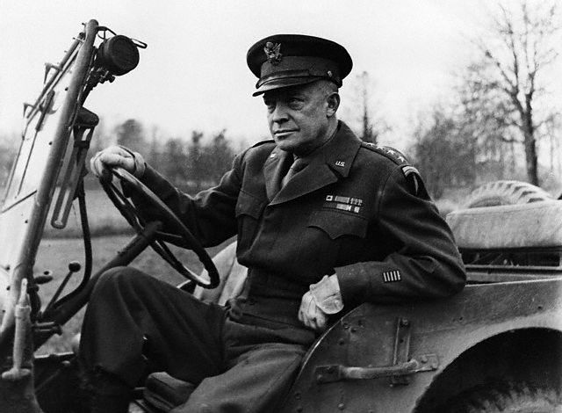
General Dwight D. Eisenhower
37
Notes:
During the war, the British and American needed a supreme commander. Because the U.S. was contributing the most men and material, it was decided an American should be commander. General Dwight D. Eisenhower was chosen because he was diplomatic and understood the political challenges of wartime leadership. After the war, Eisenhower retired and was later elected President.

Slide 38
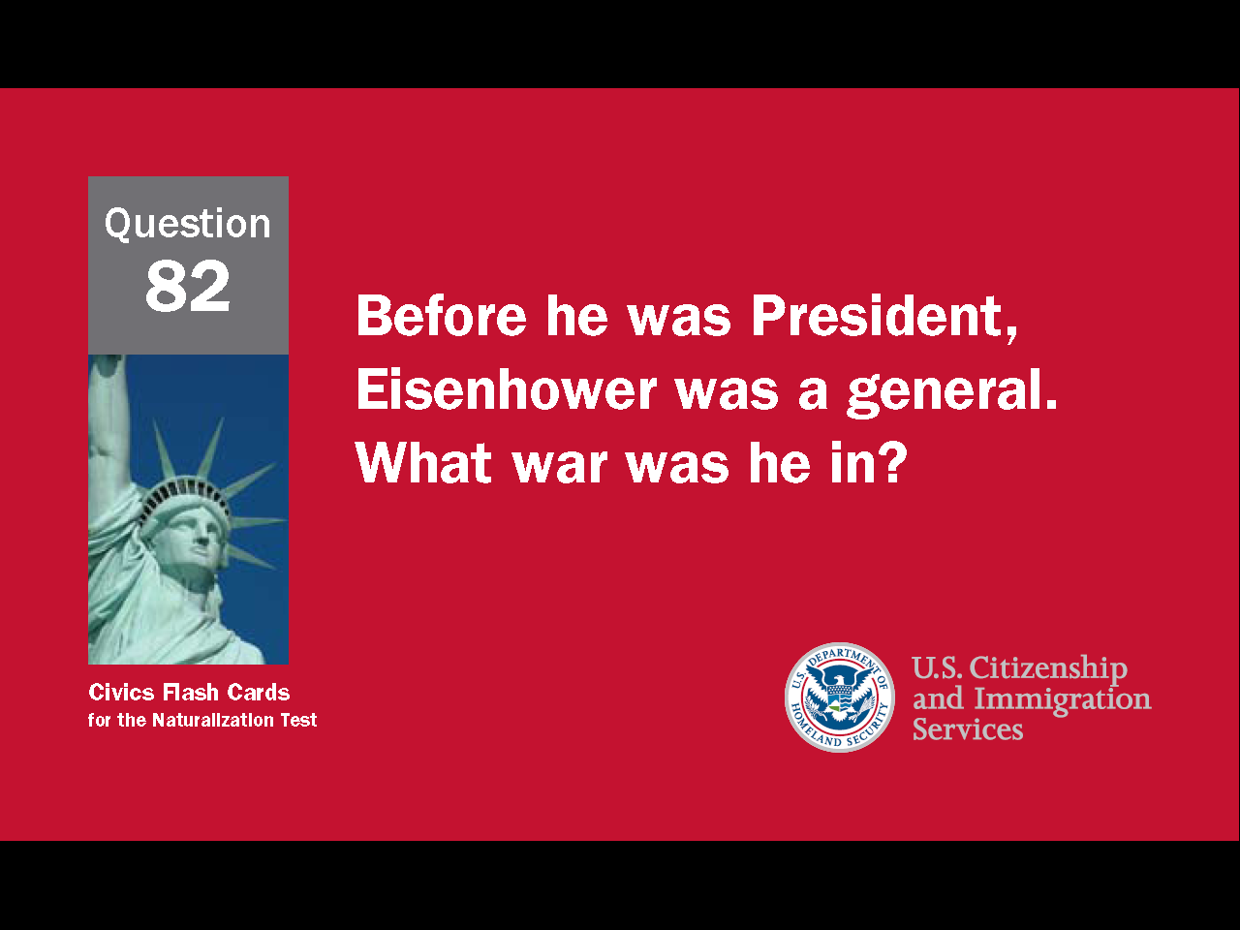
38
Notes:
Question 82. Before he was President, Eisenhower was a general. What war was he in?

Slide 39
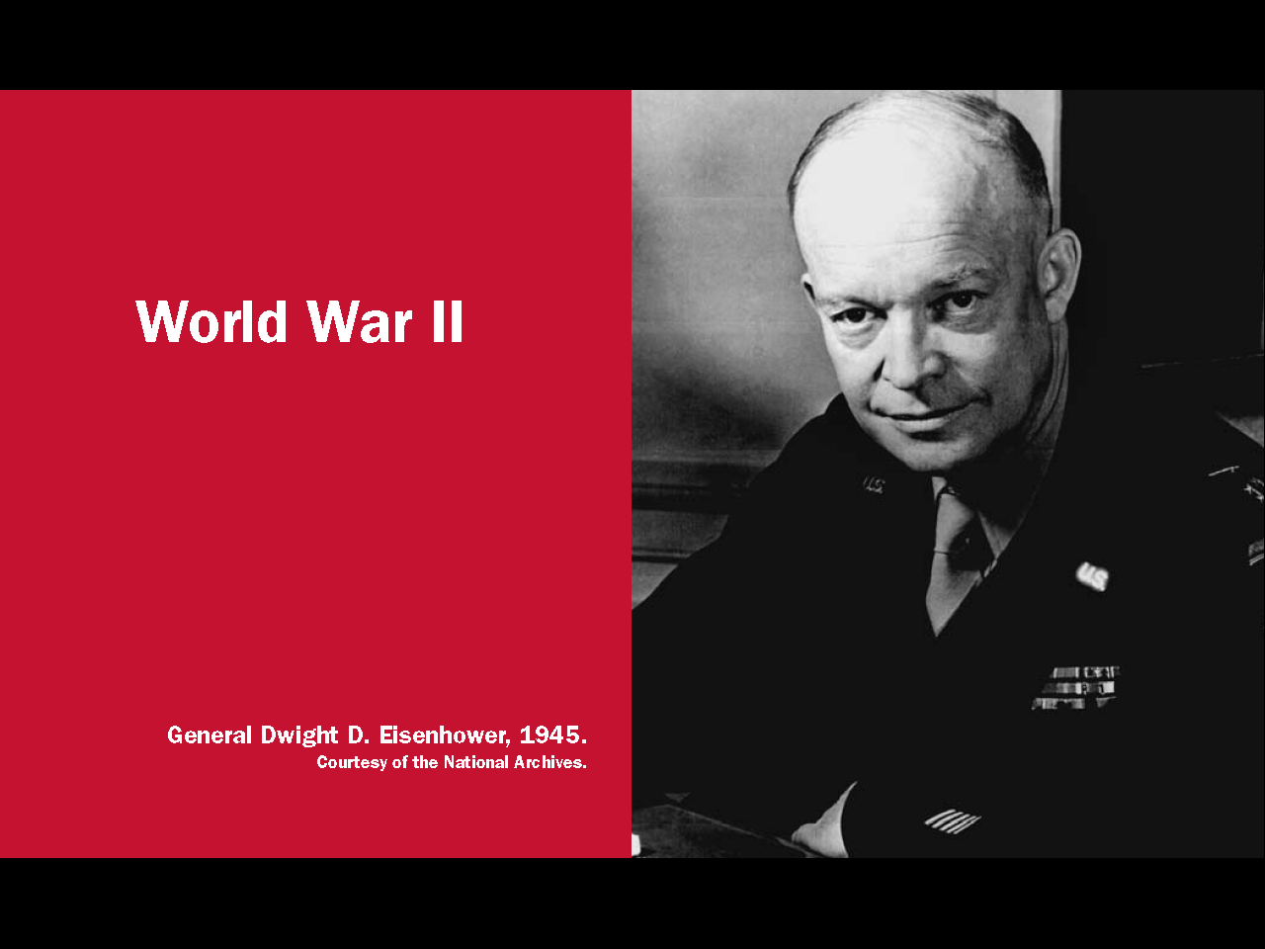
Question #82
39
Notes:
President Eisenhower was a general in World War II before he was president.

Slide 40
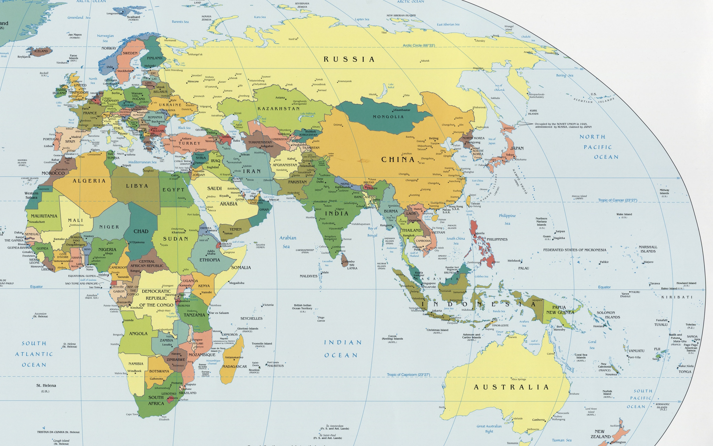
40
Notes:
In World War II, the United States, Britain, Russia and France fought against Germany, Japan and Italy. Battles took place in Europe, Russia, North Africa, and throughout much of Asia and the Pacific. Italy was defeated in 1943, but Germany and Japan didn't surrender until 1945.

Slide 41
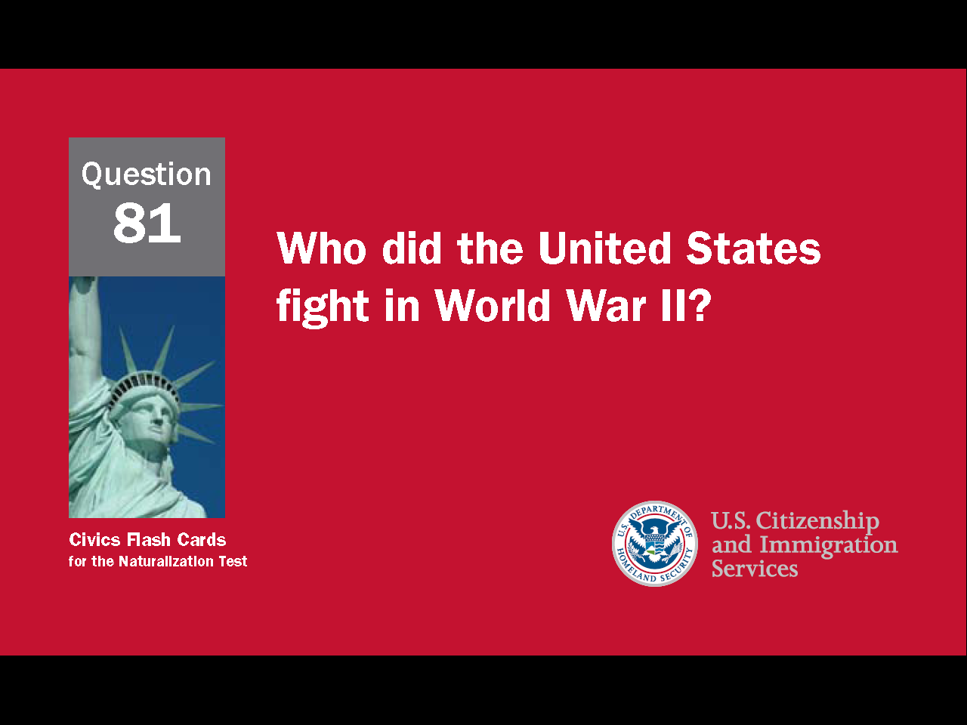
41
Notes:
Question 81. Who did the United States fight in World War II?

Slide 42
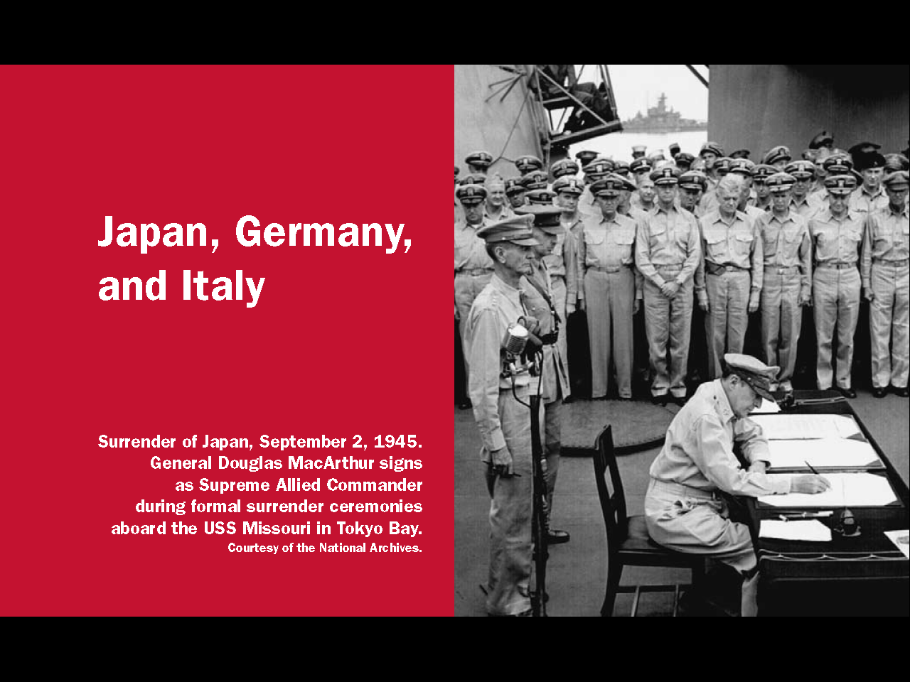
Question #81
42
Notes:
The United States fought Japan, Germany, and Italy in World War II.

Slide 43
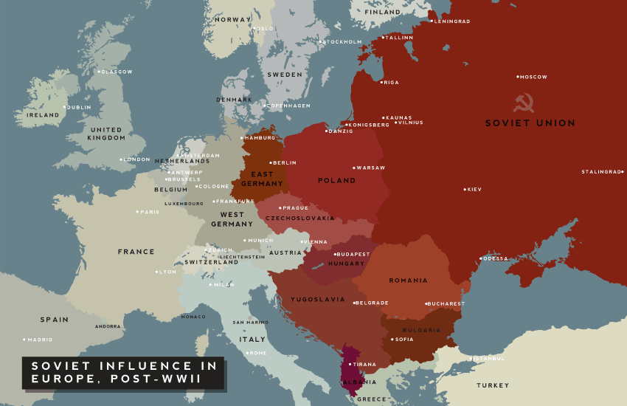
Communist Countries
43
Notes:
After the Russian Revolution in 1917, the U.S. and the Soviet Union became rivals because their economic systems were so different. During World War II, the two countries became allies, but when the war ended, the Soviet Union set up communist governments in the countries they freed from the Germans. This concerned the U.S. and marked the beginning of the Cold War, the time when communism was the main concern of the United States. The Cold War though was not a real war. The U.S. and Soviet Union never directly fought each other. Instead, they competed for global influence. On the map, the countries in red are the communist nations. The other countries are the western democracies. In 1949, China also became communist.

Slide 44
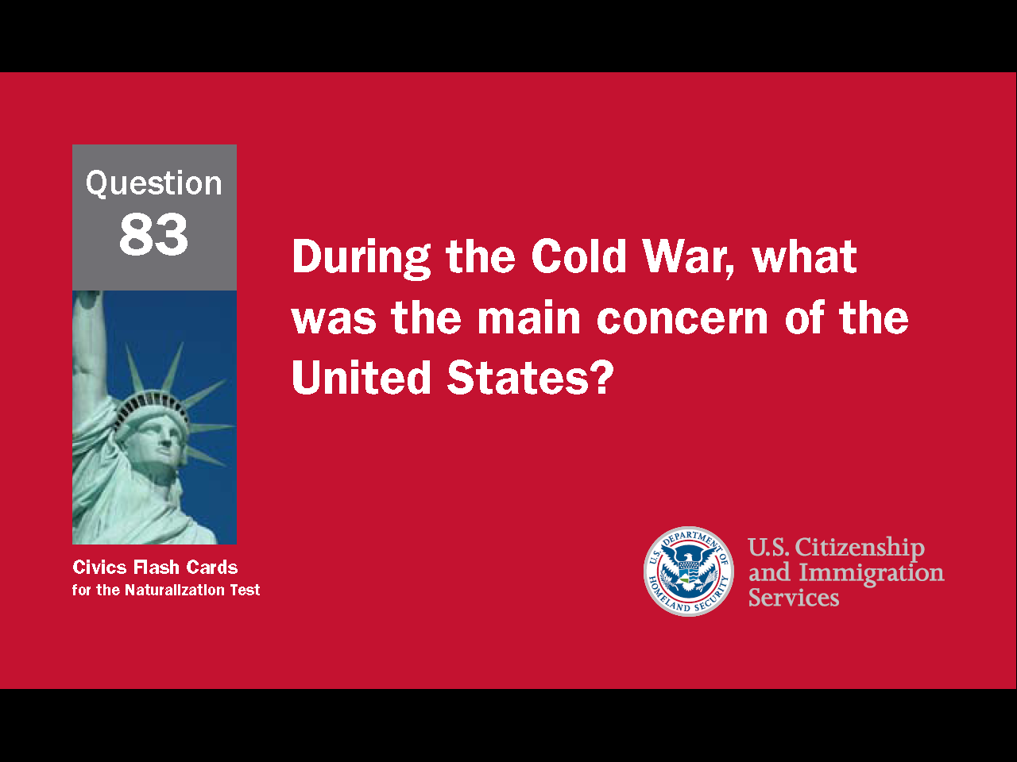
44
Notes:
Question 83. During the Cold War, what was the main concern of the United States?

Slide 45
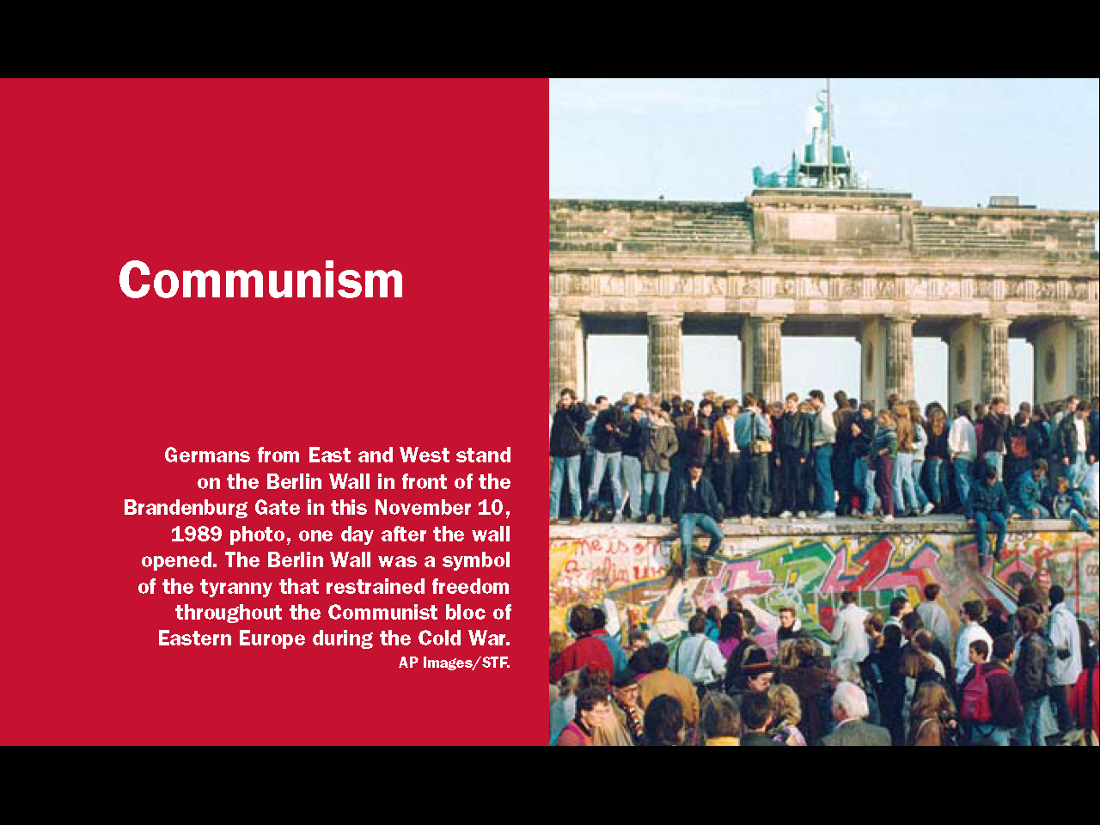
Question #83
45
Notes:
Communism was the main concern of the United States during the Cold War.

Slide 46
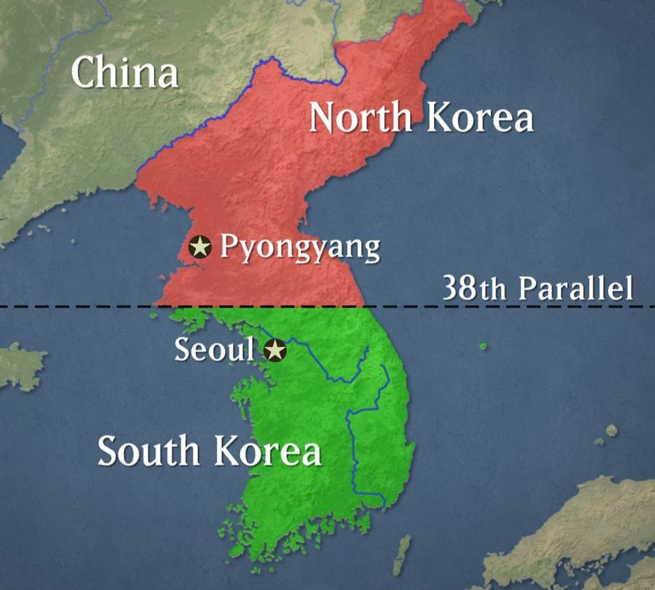
Korean War (1950-1953)
46
Notes:
While the U.S. and the Soviet Union never fought each other during the Cold War, the United States fought two major wars to try to stop other countries from becoming communist. The Korean War was the first major war to come out of the Cold War. Before World War II, Korea had been a colony of Japan. In 1945, Korea was divided along the 38th parallel into a communist north allied with China and Russia and a southern half allied with the United States. Elections were planned for the whole country, after which Korea would be reunified. However, the north refused to allow elections because the communists knew they would lose. The country remained divided and in June 1950 North Korea invaded the south. The United States and 20 other countries from the United Nations provided troops and other assistance to South Korea. When the U.N. forces drove the North Korean army to the Chinese border, China attacked. By June 1951 the two sides were in a stalemate around the 38th parallel. The war continued for another two years while peace talks slowly progressed and in July 1953 an armistice was finally signed. However, the armistice only ended the fighting, not the war. Therefore, North and South Korea are still technically at war and the country remains divided at the 38th parallel.

Slide 47

The Domino Theory
47
Notes:
The greatest conflict to come out of the Cold War was the Vietnam War. Vietnam was a French colony for 70 years. Shortly after the Second World War, communist fighters in the north of the country began fighting the French. The Korean War had ended in a stalemate, so when the Vietnamese communists defeated the French in 1954, the American government was very concerned. President Eisenhower spoke about a "Domino Theory" in which one country would become communist, then another, and another, until communism controlled the world.

Slide 48

Another Domino
Another Domino
China
Laos
Cambodia
48
Notes:
As part of the peace agreement with the French, Vietnam was divided at the 17th parallel into a communist north and U.S.-backed south. As with Korea, elections were planned, after which the country would be reunified. However, this time, the U.S. and South Vietnam refused to hold elections because they worried they would lose. Vietnam remained divided and a communist insurgency soon began in the south.

Slide 49

Vietnam War (1955-1975)
49
Notes:
After the French left, The United States sent some military advisors to South Vietnam from 1956 until 1965, when the first American combat troops arrived. By the end of that year, there were 200,000 American soldiers in Vietnam. By 1968, there were over 500,000. The United States fought in Vietnam until 1973 with little success. American troops were removed that year and two years later South Vietnam was defeated by communist North Vietnam.

Slide 50

The Cold War (1945-1991)
50
Notes:
The greatest conflict to come out of the Cold War was the Vietnam War. Vietnam was a French colony for 70 years. Shortly after the Second World War, communist fighters in the north of the country began fighting the French. The Korean War had ended in a stalemate, so when the Vietnamese communists defeated the French in 1954, the American government was very concerned. President Eisenhower spoke about a "Domino Theory" in which one country would become communist, then another, and another, until communism controlled the world.

Slide 51

(Persian) Gulf War (1991)
51
Notes:
During the Cold War, the U.S. was also concerned about oil and the middle east, and that region became more of a focus after the Cold War. The U.S. fought its first war in the middle east in 1991 after Iraq invaded and annexed Kuwait. Iraq claimed it annexed Kuwait for two reasons. First, after World War I Britain created Kuwait from the remains of the Ottoman Empire, but Iraq argued that Kuwait had always been part of their country. Second, Iraq and Kuwait belonged to a group of oil producing countries called OPEC. OPEC set oil production quotas to maintain the price of oil. Iraq accused Kuwait of producing more oil than allowed and of drilling across the border into Iraq's oil fields. When Iraq demanded $10 billion in damages from Kuwait, Kuwait offered $9 billion and Iraq announced it would invade.

Slide 52

(Persian) Gulf War
52
Notes:
On August 2, 1990, Iraq invaded and occupied Kuwait. The U.S. was concerned Iraq would invade Saudi Arabia afterwards. That would have seriously threatened the world’s oil supply. The United Nations condemned Iraq and the United States formed a coalition of nations willing to support an attack on the country. On December 17, 1990, the United Nations ordered Iraq leave Kuwait by January 15, 1991. Iraq refused, and two days later a U.S.-led bombing campaign against Iraq began. A month later, on February 23, the coalition army invaded and liberated Kuwait in one hundred hours.

Slide 53

53
Notes:
Question 78. Name one war fought by the United States in the 1900s.

Slide 54

Question #78
54
Notes:
The United States fought several wars in the 1900s. Five of them are
World War I
World War II
Korean War
Vietnam War
and the Persian Gulf War

Slide 55

The U.S. and the Middle East
55
Notes:
At the end of the Gulf War, the United States kept some troops in Saudi Arabia and the United Nations imposed sanctions on Iraq. The sanctions were intended to prevent the country from rebuilding its army or making weapons of mass destruction. Some Muslims in the Middle East did not like the idea of American troops staying there. For many years, there had also been many complaints about America's support for Israel. Together, these two policies made the United States an enemy in the eyes of many ordinary Muslims and terrorist groups.

Slide 56

World Trade Center Bombing (1993)
56
Notes:
In 1993, a truck bomb exploded under the North Tower of the World Trade Center in New York City. Six people were killed and 1,000 injured. The terrorists responsible said they wanted the United States to leave the Middle East and stop all support for Israel. A few years later, Osama bin Laden, the leader of a terrorist group called al-Qaeda, called on Muslims to join a holy war against America. bin Laden also said he was opposed to U.S. troops in Saudi Arabia, America's support of Israel, and the U.N. sanctions against Iraq.

Slide 57

September 11, 2001
57
Notes:
Al-Qaeda then decided to attempt a very big attack on the U.S. Planning took several years and on September 11, 2001, 19 terrorists from al-Qaeda hijacked four commercial airliners. Their plan was to fly the airplanes into the World Trade Center, Pentagon, and another building in Washington, D.C. Three planes hit their targets, the fourth one crashed in Pennsylvania when passengers attacked the hijackers. This attack led to the American invasion of Afghanistan, and later, the invasion of Iraq.

Slide 58

58
Notes:
Question 86. What major event happened on September 11, 2001, in the United States?

Slide 59

Question #86
59
Notes:
On September 11, 2001 terrorists attacked the United States.

