Slide 1
Lesson 6 American Government
Rights and Responsibilities
Questions: 4, 7, 54, 48, 6, 10, 51, 49, 56, 50, 52, 53, 55, 45, 57
1
Notes:
Lesson 6. American Government: Rights and Responsibilities.
This lesson is about your rights and responsibilities as an American citizen. Understanding your rights and civic responsibilities will allow you to better participate in American society and its political process.

Slide 2
The 27 Constitutional Amendments
1st - 10th Amendments: The Bill of Rights, 1791.
11th Amendment: Grants states immunity from outside lawsuits, 1795.
12th Amendment: Requires distinct votes for President and Vice President, 1804.
13th Amendment: Abolished slavery, 1865.
14th Amendment: Defines citizenship; includes clauses on due process and equal protection, 1868.
15th Amendment: Grants voting rights to male citizens of all races, 1870.
16th Amendment: Authorizes a federal income tax, 1913.
17th Amendment: Allows direct Senatorial elections by a state, 1913.
18th Amendment: Enacted prohibition, 1919.
19th Amendment: Grants voting rights to women (i.e. all citizens), 1920.
20th Amendment: "Lame Duck Amendment;" reduces time between elections and the service of
elected officials, 1933.
21st Amendment: Repealed the 18th Amendment, 1933.
22nd Amendment: Creates the presidential term limit, 1951.
23rd Amendment: Grants the District of Columbia electoral votes, 1961.
24th Amendment: Prohibits poll taxes, 1964.
25th Amendment: Clarifies procedures regarding succession of President and Vice President upon
death or inability to serve, 1967.
26th Amendment: Establishes 18 as the minimum legal voting age, 1971.
27th Amendment: Allows changes in Congressional salary only after a general election (originally
submitted in 1789) 1992.
2
Notes:
The Constitution includes procedures allowing changes or additions to be made to it. These are called amendments. So far, 27 amendments have been added to the Constitution. Four of the amendments are about voting.

Slide 3
3
Notes:
Question 4. What is an amendment?

Slide 4
Question #4
Notes:
An amendment is a change or addition to the Constitution.

Slide 5
5
Notes:
Question 7. How many amendments does the Constitution have?

Slide 6
Question #7
6
Notes:
27. Twenty-seven amendments have been added to the Constitution so far.

Slide 7
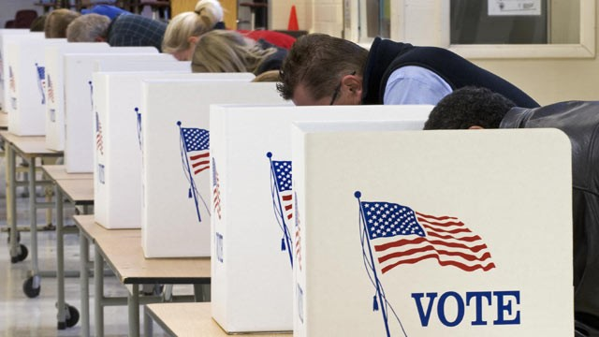
Amendments and Voting Rights
7
Notes:
The United States has always been a democracy, but, originally, only white male land owners could vote. The Constitution also allowed states to make their own voting rules. Today, any citizen who is 18 years old or older may vote. These equal voting rights were achieved only after years of struggle and four amendments to the Constitution. The first amendment gives the vote to all males, regardless of their race. Another amendment outlaws poll taxes. The third amendment gives women the right to vote, and the last allows any citizen who is 18 or older to vote.

Slide 8
The 27 Constitutional Amendments
1st - 10th Amendments: The Bill of Rights, 1791.
11th Amendment: Grants states immunity from outside lawsuits, 1795.
12th Amendment: Requires distinct votes for President and Vice President, 1804.
13th Amendment: Abolished slavery, 1865.
14th Amendment: Defines citizenship; includes clauses on due process and equal protection, 1868.
15th Amendment: Grants voting rights to male citizens of all races, 1870.
16th Amendment: Authorizes a federal income tax, 1913.
17th Amendment: Allows direct Senatorial elections by a state, 1913.
18th Amendment: Enacted prohibition, 1919.
19th Amendment: Grants voting rights to women (i.e. all citizens), 1920.
20th Amendment: "Lame Duck Amendment;" reduces time between elections and the service of
elected officials, 1933.
21st Amendment: Repealed the 18th Amendment, 1933.
22nd Amendment: Creates the presidential term limit, 1951.
23rd Amendment: Grants the District of Columbia electoral votes, 1961.
24th Amendment: Prohibits poll taxes, 1964.
25th Amendment: Clarifies procedures regarding succession of President and Vice President upon
death or inability to serve, 1967.
26th Amendment: Establishes 18 as the minimum legal voting age, 1971.
27th Amendment: Allows changes in Congressional salary only after a general election (originally
submitted in 1789) 1992.
8
Notes:
The first amendment gives the right to vote to all males, regardless of their race. The next amendment gives women the right to vote. The third amendment outlaws poll taxes, and the last one allows any citizen who is 18 or older to vote.

Slide 9
9
Notes:
Question 54. How old do citizens have to be to vote for President?

Slide 10
Question #54
10
Notes:
Eighteen. Citizens have to be 18 or older to vote for President, or in any other federal, state or local election.

Slide 11
11
Notes:
Question 48. There are four amendments to the Constitution about who can vote. Describe one of them.

Slide 12
Question #48
12
Notes:
There are four amendments to the Constitution about voters' rights. One amendment grants voting rights to any citizen who is eighteen or older. Another outlaws poll taxes. A third amendment allows both men and women to vote, and the last one allows a male citizen of any race to vote.

Slide 13
The First Amendment
freedom of speech
freedom of assembly
freedom to petition the government
freedom of worship / religion
freedom of the press
13
Notes:
Everyone living in the United States, not just citizens, has certain basic rights. Five of these rights are from the First Amendment. They are freedom of speech, freedom of assembly, freedom to petition the government, freedom of worship, and freedom of the press. Freedom of speech means a person may say or otherwise express any idea they wish. Freedom of assembly is the freedom to gather in a group. Freedom to petition the government means a citizen can make a complaint or request to the government. Freedom of worship is also called freedom of religion. Freedom of religion means you can practice any religion you want, or not practice a religion. Freedom of the press allows anyone to publish whatever they want, including criticism of the government and its leaders.

Slide 14
14
Notes:
Question 6. What is one right or freedom from the First Amendment?

Slide 15
Question #6
15
Notes:
The First Amendment allows for freedom of speech, freedom of religion, freedom of assembly, freedom of the press, and freedom to petition the government.

Slide 16
16
Notes:
Question 10. What is freedom of religion?

Slide 17
Question #10
Notes:
Freedom of religion means you can practice any religion you want, or not practice a religion.

Slide 18
Basic Rights of Everyone in the U.S.
freedom of expression
freedom of speech
freedom of assembly
freedom to petition the government
freedom of worship
*******************************************************************************************************************************
the right to bear arms
18
Notes:
As previously mentioned, everyone living in the United States has certain basic rights. All but the last right on this list are from the First Amendment. The First Amendment can be simply summarized as freedom of expression. Freedom of expression includes freedom of speech, freedom of assembly, freedom to petition the government, and freedom of worship. (Although not on this list, it also includes freedom of the press.) The last right, the right to bear arms, is from the 2nd Amendment.

Slide 19
19
Notes:
Question 51. What are two rights of everyone living in the United States?

Slide 20
Question #51
20
Notes:
Some rights everyone living in the United States has are
freedom of expression
freedom of speech
freedom of assembly
freedom to petition the government
freedom of worship
and the right to bear arms

Slide 21
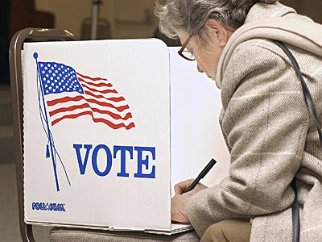
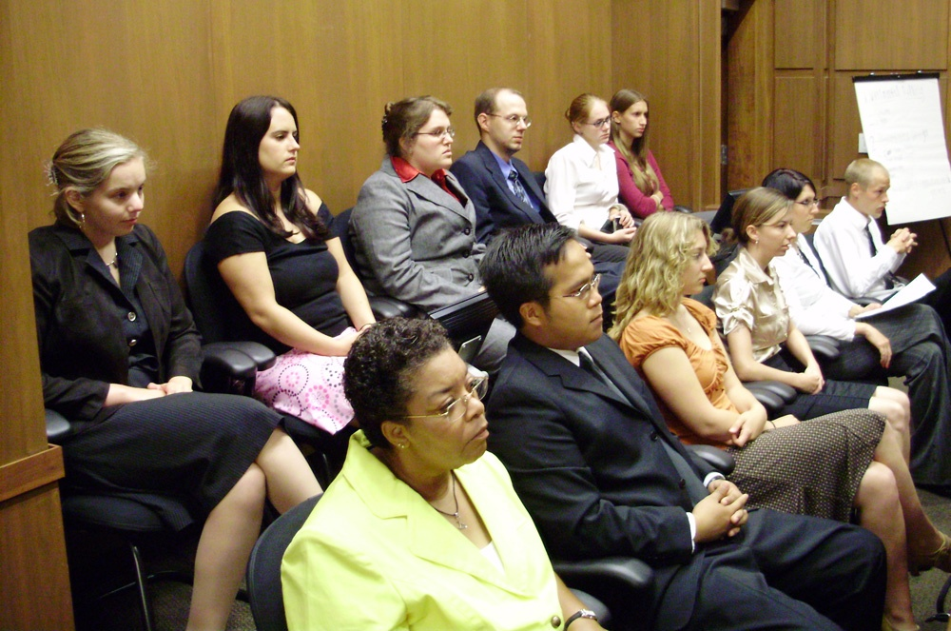
Civic Responsibilities
Serve on
a jury
Vote in
a federal election
21
Notes:
As a citizen, you must serve on a jury and vote in federal elections. The Constitution allows citizens the right to a trial by jury. A jury is a group of between 6 and 12 citizens who are chosen to listen to a court case and then decide if a person is guilty or innocent. When deciding, jury verdicts must be unanimous. If you receive a letter for jury duty, you are required to serve because jury duty is a legal responsibility. Voting, on the other hand, is a civic responsibility. You do not have to vote. However, it is important that all citizens participate in the democratic process and help choose leaders that represent their ideas and interests.
21

Slide 22
22
Notes:
Question 49. What is one responsibility that is only for United States citizens?

Slide 23
Question #49
23
Notes:
Two responsibilities of a U.S. citizen are serving on a jury and voting in a federal election.

Slide 24
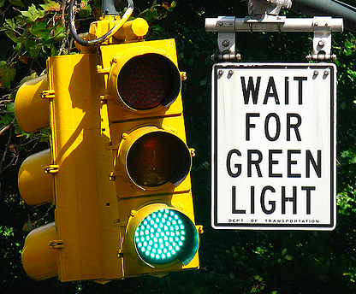
Other Responsibilities
April 15
24
Notes:
Other responsibilities of a U.S. citizen include obeying the law, paying taxes, and knowing about current issues. However, even if you aren't a citizen, you must still obey all laws and pay your taxes. Anyone who works in the United States has to pay federal income tax and usually state income tax and property tax as well. During your naturalization exam you will be asked if you owe any taxes, so it is important to pay your taxes. Every year, April 15 is the last day you can send in your federal and state income tax forms.
24

Slide 25
25
Notes:
Question 56. When is the last day you can send in federal income tax forms?

Slide 26
Question #56
26
Notes:
April 15. April 15 is the last day you can send in your federal income tax forms.

Slide 27
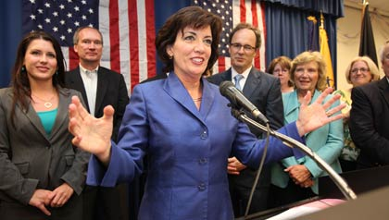
Two Rights Only for Citizens
Vote in
a federal election
Run for federal
office
27
Notes:
While you don’t have to be a citizen to have some of the same rights as Americans, citizenship gives you two very important rights – the ability to vote in a federal election and to run for federal office.

Slide 28
28
Notes:
Question 50. Name one right only for United States citizens.

Slide 29
Question #50
29
Notes:
Two rights that are only for U.S. citizens are voting in a federal election and running for federal office.

Slide 30
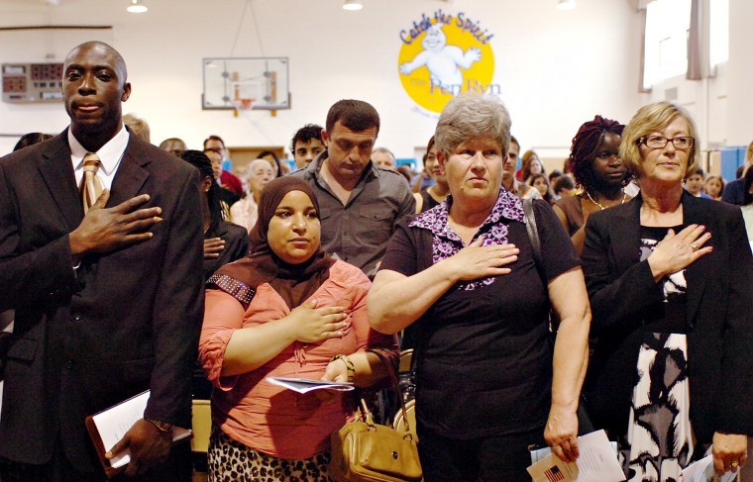
The Pledge of Allegiance
I pledge allegiance to the flag of the United States of America, and to the republic for which it stands, one nation under God, indivisible, with liberty and justice for all.
30
Notes:
When you become naturalized, you will be required to say the Pledge of Allegiance. When you say the Pledge of Allegiance you show your loyalty to the United States and to its flag. The words to the Pledge of Allegiance are:
I pledge allegiance to the flag of the United States of America, and to the republic for which it stands, one nation under God, indivisible, with liberty and justice for all.
The original pledge was written in 1892 by Francis Bellamy, but was not written for the United States. Bellamy wrote a pledge to be used by citizens of any country. In the 1920s, the phrase "the flag of the United States of America" was added. Then, in 1954, Congress added the words "under God." That last change created the pledge we say today. When saying the pledge, you should stand facing the flag with your right hand over your heart. If you are wearing a military uniform, you should salute instead of putting your hand over your heart.
30

Slide 31
31
Notes:
Question 52. What do we show loyalty to when we say the Pledge of Allegiance?

Slide 32
Question #52
32
Notes:
When we say the Pledge of Allegiance we show our loyalty to the United States and the country's flag.

Slide 33
Promises When You Become a Citizen
give up loyalty to other countries
33
Notes:
The Pledge of Allegiance means you give up loyalty to other countries. When you become a citizen you also promise to defend the Constitution and laws of the United States, obey the laws of the United States, serve in the U.S. military if needed, serve or do important work for the nation if needed, and be loyal to the United States.

Slide 34
Promises When You Become a Citizen
give up loyalty to other countries
defend the Constitution and laws of the United States
34
Notes:
The Pledge of Allegiance means you give up loyalty to other countries. When you become a citizen you also promise to defend the Constitution and laws of the United States, obey the laws of the United States, serve in the U.S. military if needed, serve or do important work for the nation if needed, and be loyal to the United States.

Slide 35
Promises When You Become a Citizen
give up loyalty to other countries
defend the Constitution and laws of the United States
obey the laws of the United States
35
Notes:
The Pledge of Allegiance means you give up loyalty to other countries. When you become a citizen you also promise to defend the Constitution and laws of the United States, obey the laws of the United States, serve in the U.S. military if needed, serve or do important work for the nation if needed, and be loyal to the United States.

Slide 36
Promises When You Become a Citizen
give up loyalty to other countries
defend the Constitution and laws of the United States
obey the laws of the United States
be loyal to the United States
36
Notes:
The Pledge of Allegiance means you give up loyalty to other countries. When you become a citizen you also promise to defend the Constitution and laws of the United States, obey the laws of the United States, serve in the U.S. military if needed, serve or do important work for the nation if needed, and be loyal to the United States.

Slide 37
Promises When You Become a Citizen
give up loyalty to other countries
defend the Constitution and laws of the United States
obey the laws of the United States
be loyal to the United States
serve or do important work for the nation if needed
37
Notes:
The Pledge of Allegiance means you give up loyalty to other countries. When you become a citizen you also promise to defend the Constitution and laws of the United States, obey the laws of the United States, serve in the U.S. military if needed, serve or do important work for the nation if needed, and be loyal to the United States.

Slide 38
Promises When You Become a Citizen
give up loyalty to other countries
defend the Constitution and laws of the United States
obey the laws of the United States
be loyal to the United States
serve or do important work for the nation if needed
and serve in the U.S. military if necessary
38
Notes:
The Pledge of Allegiance means you give up loyalty to other countries. When you become a citizen you also promise to defend the Constitution and laws of the United States, obey the laws of the United States, serve in the U.S. military if needed, serve or do important work for the nation if needed, and be loyal to the United States.

Slide 39
39
Notes:
Question 53. What is one promise you make when you become a United States citizen?

Slide 40
Question #53
40
Notes:
There are several promises you make when you become a U.S. citizen. Some of them are:
give up loyalty to other countries
defend the Constitution and laws of the United States
obey the laws of the United States
serve in the U.S. military if necessary
serve or do important work for the nation if needed
and be loyal to the United States

Slide 41
Ways to Participate in Our Democracy
vote
join a political party
help with a campaign
join a civic group
join a community group
give an elected official your opinion on an issue
call Senators and Representatives
publicly support or oppose an issue or policy
run for office
write to a newspaper
41
Notes:
There are many ways a citizen can become involved in their democracy. This participation is so important that many of the activities are protected by the Constitution. Some ways to participate include:
voting
joining a political party, community group, or civic group
helping with a campaign
giving an elected official your opinion on an issue
calling Senators and Representatives
publicly supporting or opposing an issue or policy
running for office
and writing to a newspaper

Slide 42
42
Notes:
Question 55. What are two ways that Americans can participate in their democracy?

Slide 43
Question #55
43
Notes:
There are many ways Americans can participate in their democracy including voting, joining various types of groups, helping with a campaign, publicly sharing opinions, and running for office. Even if you are not a citizen, you can do all of these activities except vote or run for office.

Slide 44
AND
PARTY MEMBERSHIP
44
Notes:
You do not have to be a member of a political party to vote. Nor do you have to vote for your party if you are a member. One advantage to belonging to a political party is you can vote in primary elections. Connecticut has closed primaries, which requires you to belong to the political party to vote. However, other states have open primaries, which allows any voter to vote in a primary, whether they belong to a political party or not.

Slide 45
Third Parties Bring New Ideas
45
Notes:
For most of its history, the United States has had two major political parties, although the parties and policies have differed over time. Third parties are usually more successful in local elections, but very important in bringing new ideas into national politics. Women's voting rights, child labor laws, the 40-hour work week, and Social Security are all ideas originally promoted by third parties. Currently, the largest third parties in the U.S. are the Libertarian Party, Green Party, and Constitution Party. The Libertarian Party believes in very limited federal government. The most radical form would be a government that only provides police, prisons, courts, and a military. The Green Party promotes grass roots democracy, social justice, non-violence, and environmentalism. The Constitution Party wants greater power given to the states and a federal government guided by a strict interpretation of the Constitution.

Slide 46
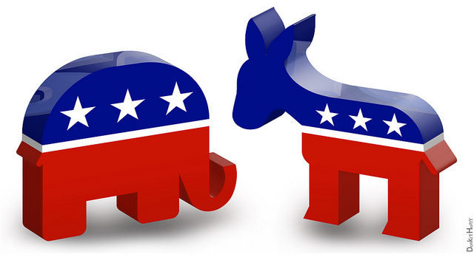
The Two Major Political Parties
Republican Democratic
46
Notes:
The two major political parties in the United States are the Democratic party and the Republican party. The elephant is the symbol of the Republican Party and the donkey represents the Democratic Party. While less common, a politician may also be an independent, which means he or she doesn't belong to a political party. Currently, there are two independent senators and several independent representatives in Congress. Both of Connecticut's senators and all five representatives are Democrats.

Slide 47
47
Notes:
Question 45. What are the two major political parties in the United States?

Slide 48
Question #45
48
Notes:
The two major political parties in the United States are the Democratic and Republican parties.

Slide 49
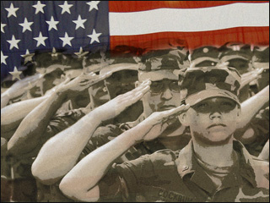
Selective Service
49
Notes:
When citizens are ordered to join a nation's armed forces, that is called a draft. The United States used a draft in the Civil War, World Wars I and II, the Korean War and the Vietnam War. Today, the United States military is all volunteer. Men and women can choose to serve in the U.S. Armed Forces, but are not required to. However, men between the ages of 18 and 26 must still register for military service. This system is called Selective Service and will be used should a new draft be necessary.

Slide 50
50
Notes:
Question 57. When must all men register for the Selective Service?

Slide 51
Question #57
51
Notes:
All men must register for Selective Service at the age of 18 or between the ages of 18 and 26.

