Slide 1
Lesson 7 American Government
System of Government:
The Legislative Branch
Questions: 2, 13, 14, 17, 25, 21, 22, 23, 18, 19, 20, 24, 16, 33, 34, 45, 31, 47
1
Notes:
Lesson 7. American Government: The Legislative Branch.
This lesson explains the structure and function of the first branch of American government, the legislative branch.

Slide 2
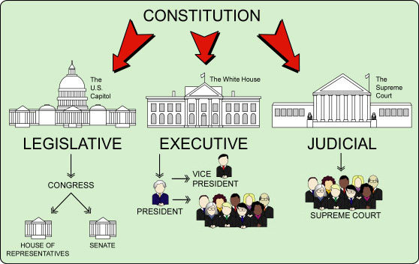
The Three Branches of Government
|
COURTS OF APPEAL
|
DISTRICT COURTS
CABINET
2
Notes:
The Constitution sets up a government with three branches: a legislative, an executive, and a judicial. The legislative branch is usually called Congress and consists of the House of Representatives and the Senate. The executive branch is also referred to as the president. The executive consists of the president, vice president and cabinet. The judicial branch refers to the courts. The highest court in the nation is the Supreme Court.

Slide 3
3
Notes:
Question 2. What does the Constitution do?

Slide 4
Question #2
4
Notes:
The Constitution
sets up the government
defines the government
and protects the basic rights of Americans

Slide 5
5
Notes:
Question 13. Name one branch or part of the government.

Slide 6
Question #13
6
Notes:
The three parts of the U.S. government are:
Congress, or the legislative branch
the President, or the executive branch
the courts, or the judicial branch

Slide 7
Separation of Powers /
Checks and Balances
PRESIDENT
(Executive Branch)
Can veto a bill
Can declare an executive
action unconstitutional
Can reject a treaty
signed by the president
Appoints federal judges
Can declare a law
unconstitutional
CONGRESS
(Legislative Branch)
THE COURTS
(Judicial Branch)
Approves federal judges
7
Notes:
To stop one branch of the government from becoming too powerful, the Founding Fathers gave each branch separate powers. This is called separation of powers. The Constitution also includes a system of checks and balances which allows one part of the government to "check" another. For example, Congress can reject a treaty signed by the president and the president can veto a bill from Congress. The President appoints federal judges, but Congress must approve them. Lastly, the Supreme Court can declare a law or executive action to be unconstitutional. In these ways, separate powers and checks and balances work to limit the power of government and to protect individual rights.
7

Slide 8
8
Notes:
Question 14. What stops one branch of government from becoming too powerful?

Slide 9
Question #14
9
Notes:
The separation of powers and system of checks and balances keeps one branch of government from becoming too powerful.

Slide 10
The Legislative Branch
U.S. Capitol Building, Washington, D.C.
10
Notes:
The Constitution gives the legislative branch a wide range of powers. The powers include making federal laws, creating taxes, maintaining the armed forces, and declaring war. However, to protect states' rights and individual rights, the Constitution says that any powers not expressly given to the federal government are reserved for the states.

Slide 11
11
Notes:
Another name for the legislative branch is Congress. Congress consists of two houses, sometimes called the lower house and upper house. The House of Representatives is the lower house. The Senate is the upper house. Like the three branches of government, the two houses of Congress have different powers and the ability to check one another. For instance, only the House of Representatives can propose new taxes, and only the Senate can approve Presidential appointments such as cabinet officials, federal judges, and ambassadors. However, the House of Representatives can impeach members of the government, even the President and Vice President, but the Senate decides whether to remove them from office.

Slide 12
12
Notes:
Question 17. What are the two parts of the U.S. Congress?

Slide 13
Question #17
House of Representatives
Senate
13
Notes:
The Senate and House of Representatives are the two parts of the U.S. Congress.

Slide 14
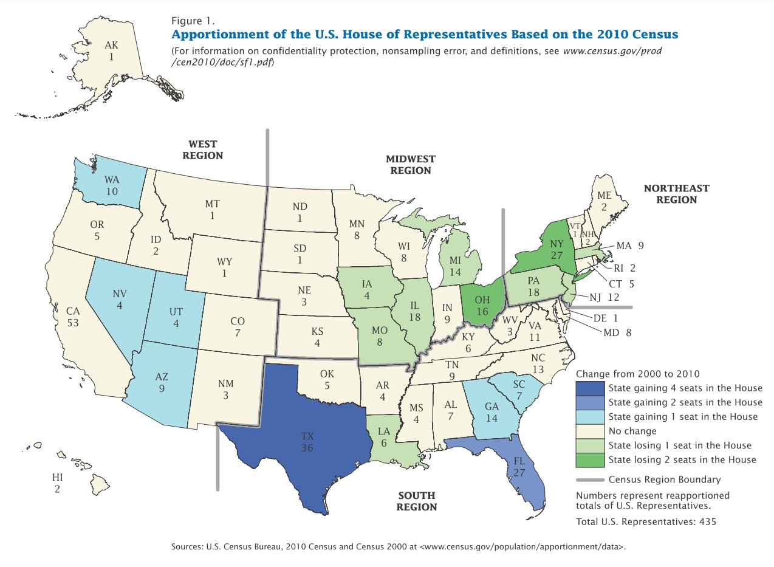
1 Representative
5 Representatives
14
Notes:
The House of Representatives consists of 435 voting members. Representatives are distributed among the states according to population; states with more people get more representatives. For example, Connecticut has five representatives while Alaska, the largest state in the country, has only one because it has a much smaller population. The distribution of the 435 representatives is adjusted every ten years after the national census. So representatives can better reflect the opinions of the people, each one is responsible for a specific district and serves two-year terms. There is no limit on the number of terms, and anyone over the age of 25 who has been a citizen for seven years may be a representative.

Slide 15
15
Notes:
Question 25. Why do some states have more Representatives than other states?

Slide 16
Question #25
16
Notes:
Some states have more Representatives
(because) of the state’s population
(because) they have more people
(because) some states have more people

Slide 17
Notes:
Question 21. The House of Representatives has how many voting members?

Slide 18
Question #21
18
Notes:
The House of Representatives has 435 voting members plus five non-voting members representing the District of Columbia, American Samoa, Guam, Puerto Rico, and the U.S. Virgin Islands.

Slide 19
19
Notes:
Question 22. We elect a U.S. Representative for how many years?

Slide 20
Question #22
20
Notes:
A U.S. Representative is elected for two years. The short term makes representatives more accountable and responsive to the people.

Slide 21
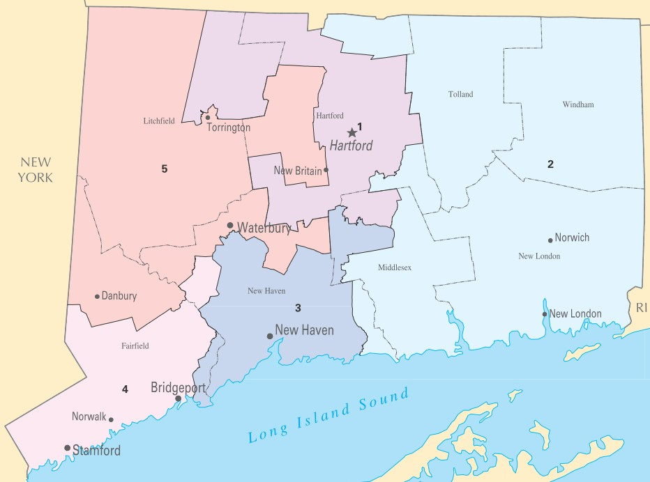
1
5
2
3
4
21
Notes:
The House of Representatives consists of 435 voting members. Representatives are distributed among the states according to population; states with more people get more representatives. For example, Connecticut has five representatives while Alaska, the largest state in the country, has only one because it has a much smaller population. The distribution of the 435 representatives is adjusted every ten years after the national census. So representatives can better reflect the opinions of the people, each one is responsible for a specific district and serves two-year terms. There is no limit on the number of terms, and anyone over the age of 25 who has been a citizen for seven years may be a representative.

Slide 22
22
Notes:
Question 23. Name your U.S. Representative.

Slide 23
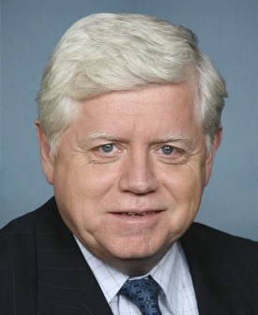
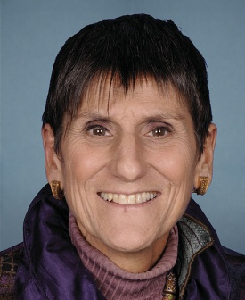
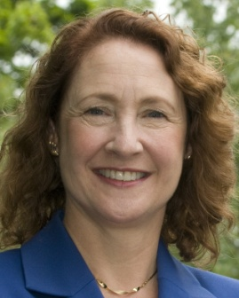
John Larson (1) Joe Courtney (2) Rosa DeLauro (3) Jim Himes (4) Elizabeth Esty (5)
23
Notes:
Answers to this question will vary. Who your U.S. Representative is depends upon the town you live in. Use the map above to find your district, or look up your town in the lists on the next two pages to find your representative.

Slide 24
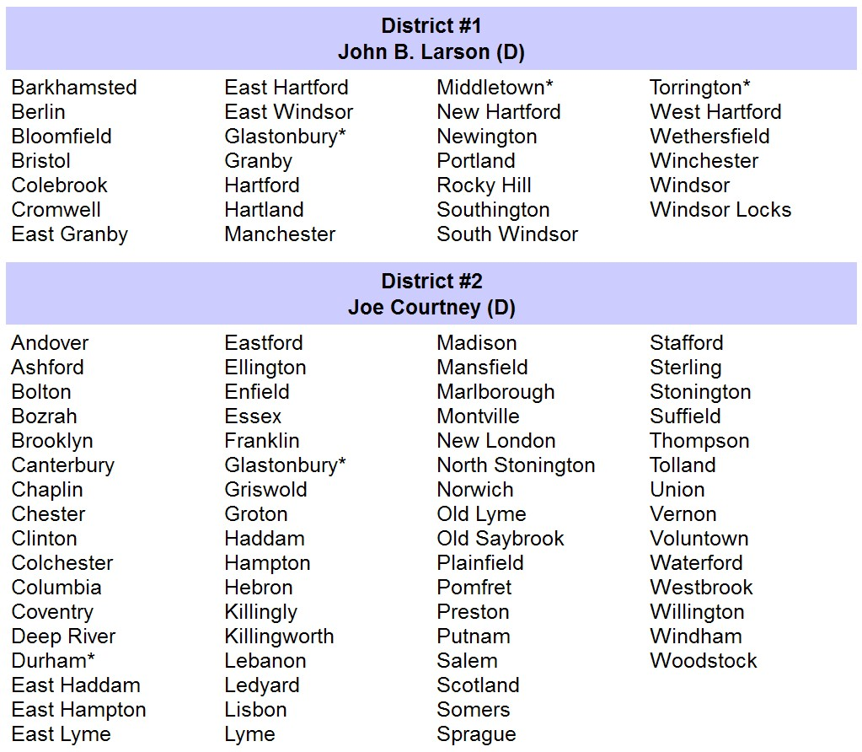
24
Notes:
This page lists the towns in districts 1 and 2. Almost every town has only one district. However, Glastonbury, Durham, Middletown, Waterbury, and Torrington have two districts. If you live in one of those towns, check your town map to determine which district you live in.

Slide 25
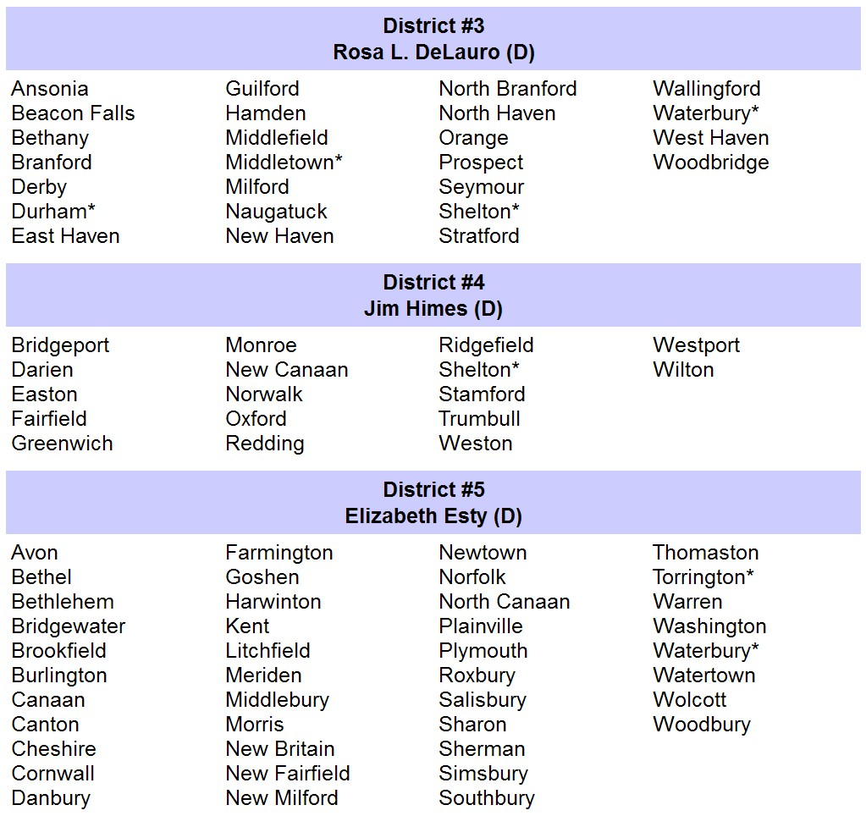
25
Notes:
This page lists the towns in districts 3, 4, and 5.

Slide 26
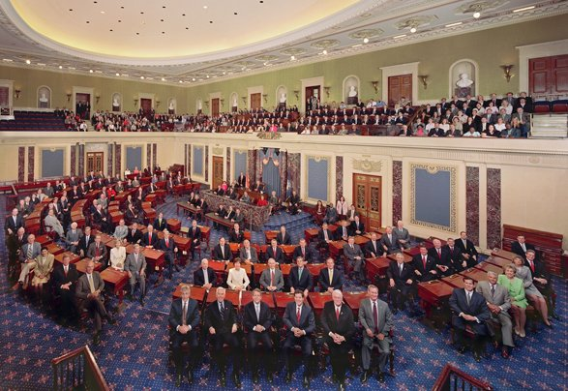
100 Senators
26
Notes:
There are 100 U.S. senators. Unlike the House of Representatives, each state has equal representation in the Senate because each state has two senators. Also, senators do not serve a district, but all the people of their state. The Founding Fathers gave senators six-year terms because they want the Senate to be less influenced by public opinion. Every two years, along with the House elections, approximately 33 senate seats have elections. Like a representative, a senator has no term limit, although to become a senator one must be over 30 years old and have been a citizen for nine years.

Slide 27
Connecticut's Two Senators
Connecticut's Two Senators
(Christopher) Murphy
(Richard) Blumenthal
27
Notes:
Connecticut's newest senator is Christopher Murphy. He was elected in 2012. The second senator is Richard Blumenthal. He was elected in 2010.

Slide 28
28
Notes:
Question 18. How many U.S. Senators are there?

Slide 29
Question #18
29
Notes:
One hundred. Each of the 50 states has two senators, making for a total of 100 senators.

Slide 30
30
Notes:
Question 19. We elect a U.S. Senator for how many years?

Slide 31
Question #19
31
Notes:
Six. We elect senators for six years.

Slide 32
32
Notes:
Question 20. Who is one of your state’s U.S. Senators now?

Slide 33
Question #20
(Christopher) Murphy
(Richard) Blumenthal
33
Notes:
Murphy. Connecticut's two senators are Richard Blumenthal and Christopher Murphy.

Slide 34
34
Notes:
Question 24. Who does a U.S. Senator represent?

Slide 35
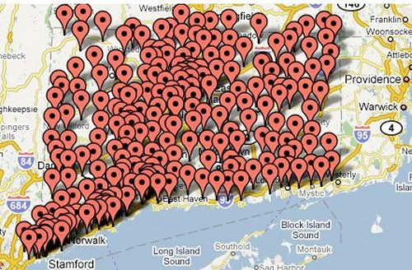
Question #24
all the people of the state
35
Notes:
A senator represents all the people of the state. They do not serve a particular district like representatives do.

Slide 36
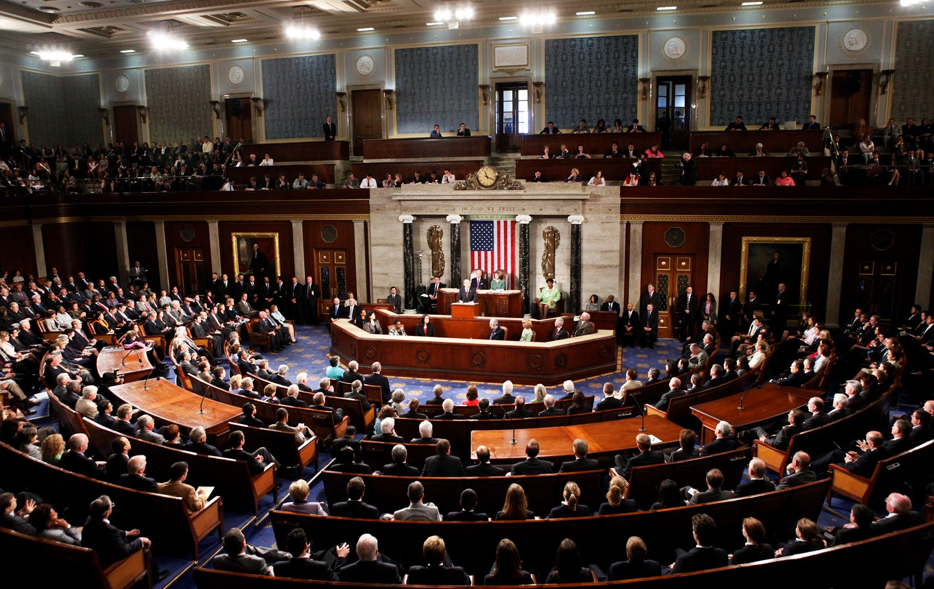
36
Notes:
The U.S. Congress is the only branch of the government that makes federal laws. Both parts of Congress share this power. When the legislature proposes a new law, it must go through a system of checks and balances in Congress and with the executive branch. Every year more than 5000 bills are introduced, but only about 150 become law.

Slide 37
How a Law is Made
CONGRESS
Bill introduced in House of
Representatives
Bill introduced in Senate
House-Senate committee writes
final bill
House makes their own version of bill
Both houses vote on final bill; Bill is sent to President
Senate makes their own version of bill
PRESIDENT
Senate debates and votes on bill
House debates and votes on bill
President signs bill into law or vetoes it
37
Notes:
A new law first starts as an idea. Since the First Amendment gives people the right to petition the government, the idea can come from almost any person, group or organization - a citizen, the president, a lobbyist, even a state legislature. If the idea is accepted by a U.S. Representative, the proposed law is introduced to both the House of Representatives and the Senate. Such a proposal is called a bill. Both houses of Congress then make their own version of the bill. Once each house has accepted its own version, Congress works together to make a final version. This final bill is sent to the President to either sign into law or veto. A veto means the President has rejected the bill. If a bill is vetoed, the President must explain why and send the bill back to Congress. Congress can then change the bill and send it back to the President or try to vote the bill into law with a two-thirds majority in both houses of Congress.

Slide 38
38
Notes:
Question 16. Who makes federal laws?

Slide 39
Question #16
39
Notes:
Congress makes federal laws.
The Senate and House of Representatives makes federal laws.
The U.S. legislature makes federal laws.

Slide 40
Notes:
Question 33. Who signs bills to become laws?

Slide 41
Question #33
41
Notes:
The President must sign a bill for it to become law.

Slide 42
42
Notes:
Question 34. Who vetoes bills?

Slide 43
Question #34
43
Notes:
The President is the only person who can veto legislative bills.

Slide 44
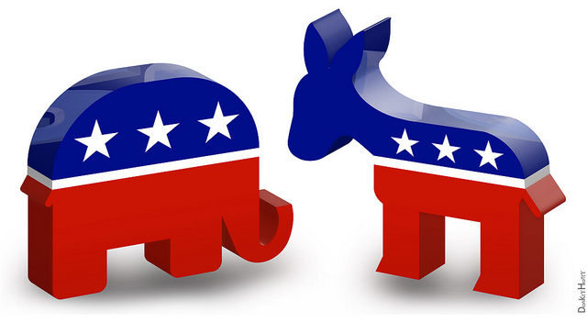
The Two Major Political Parties
Republican Democratic
44
Notes:
The two major political parties in the United States are the Democratic party and the Republican party. The elephant is the symbol of the Republican Party and the donkey represents the Democratic Party. While less common, a politician may also be an independent, which means he or she doesn't belong to a political party. Currently, there are two independent senators and several independent representatives in Congress. Both of Connecticut's senators and all five representatives are Democrats.

Slide 45
45
Notes:
Question 45. What are the two major political parties in the United States?

Slide 46
Question #45
46
Notes:
The two major political parties in the United States are the Democratic Party and Republican Party.

Slide 47
Third Parties Bring New Ideas
47
Notes:
For most of its history, the United States has had two major political parties, although the parties and policies have differed over time. Third parties are usually more successful in local elections, but very important in bringing new ideas into national politics. Women's voting rights, child labor laws, the 40-hour work week, and Social Security are all ideas originally promoted by third parties. Currently, the largest third parties in the U.S. are the Libertarian Party, Green Party, and Constitution Party. The Libertarian Party believes in very limited federal government. The most radical form would be a government that only provides police, prisons, courts, and a military. The Green Party promotes grass roots democracy, social justice, non-violence, and environmentalism. The Constitution Party wants greater power given to the states and a federal government guided by a strict interpretation of the Constitution.

Slide 48
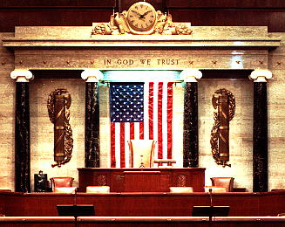
48
Notes:
The political party that has the most members in the House of Representatives chooses the Speaker of the House. The Speaker is a very powerful position. The Speaker decides what bills will be considered, assigns representatives to committees, and controls the floor debates. In addition, if both the President and Vice President can no longer serve, the Speaker of the House becomes President.

Slide 49
49
Notes:
Question 31. If both the President and the Vice President can no longer serve, who becomes President?

Slide 50
Question #31
50
Notes:
If both the President and Vice President can no longer serve, the Speaker of the House becomes President.

Slide 51
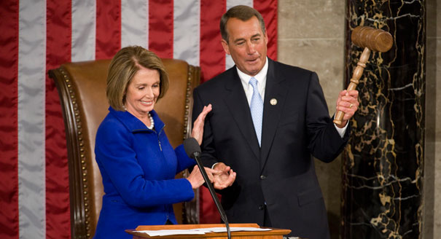
Speaker of the House of Representatives
Outgoing Speaker Nancy Pelosi hands the speaker's gavel to John Boehner in 2011.
51
Notes:
Since Representatives serve only two years, in the middle of each presidential term there are midterm elections. When President Barack Obama was elected in 2008, the Democrats also won a majority in the House of Representatives. Nancy Pelosi, a Democrat from California, was chosen as the Speaker of the House. In the 2010 midterm elections, the Republican Party won back control of the House and chose John Boehner, a Republican from Ohio, as Speaker. Boehner remained Speaker after the 2012 elections and resigned in 2015. Republican Paul Ryan was then made Speaker.

Slide 52
Speaker of the House of Representatives
Paul Ryan
52
Notes:
Since Representatives serve only two years, in the middle of each presidential term there are midterm elections. When President Barack Obama was elected in 2008, the Democrats also won a majority in the House of Representatives. Nancy Pelosi, a Democrat from California, was chosen as the Speaker of the House. In the 2010 midterm elections, the Republican Party won back control of the House and chose John Boehner, a Republican from Ohio, as Speaker. Boehner remained Speaker after the 2012 elections and resigned in 2015. Republican Paul Ryan was then made Speaker.

Slide 53
53
Notes:
Question 47. What is the name of the Speaker of the House of Representatives now?

Slide 54
Question #47
(Paul D.) Ryan
Paul Ryan, Speaker of the U.S. House of Representatives.
54

