Slide 1
Lesson 8
American Government
System of Government:
The Executive Branch
Questions: 2, 13, 14, 15, 28, 32, 33, 34, 35, 36, 29, 30, 45, 46, 26, 27, 54, 70, 31, 47
1
Notes:
Lesson 8. American Government: The Executive Branch.
This lesson explains the structure and function of the second branch of American government, the executive branch. This lesson covers civics questions 2, 13, 14, 15, 26, 27, 28, 29, 30, 31, 32, 33, 34, 35, 36, 45, 46, 47 and 54.

Slide 2
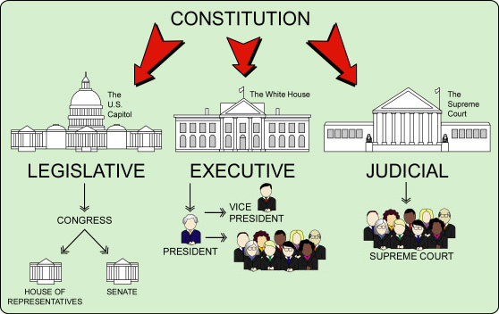
The Three Branches of Government
|
COURTS OF APPEAL
|
DISTRICT COURTS
CABINET
2
Notes:
The Constitution sets up a government with three branches: a legislative, an executive, and a judicial. The legislative branch is usually called Congress and consists of the House of Representatives and the Senate. The executive branch is also referred to as the president. The executive consists of the president, vice president and cabinet. The judicial branch refers to the courts. The highest court in the nation is the Supreme Court.

Slide 3
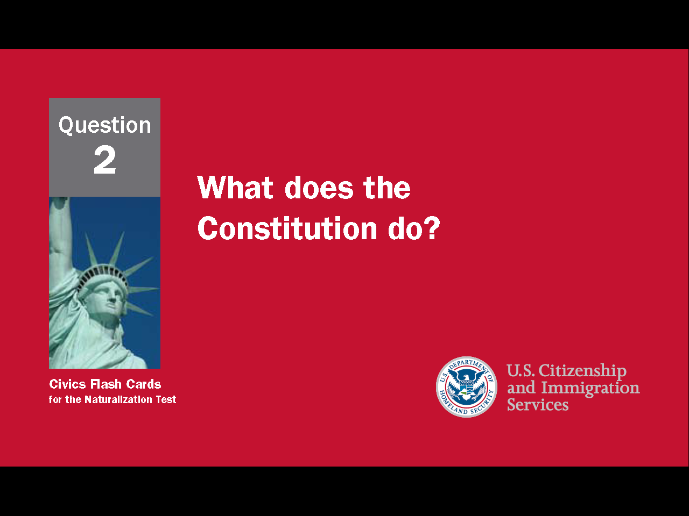
3
Notes:
Question 2. What does the Constitution do?

Slide 4
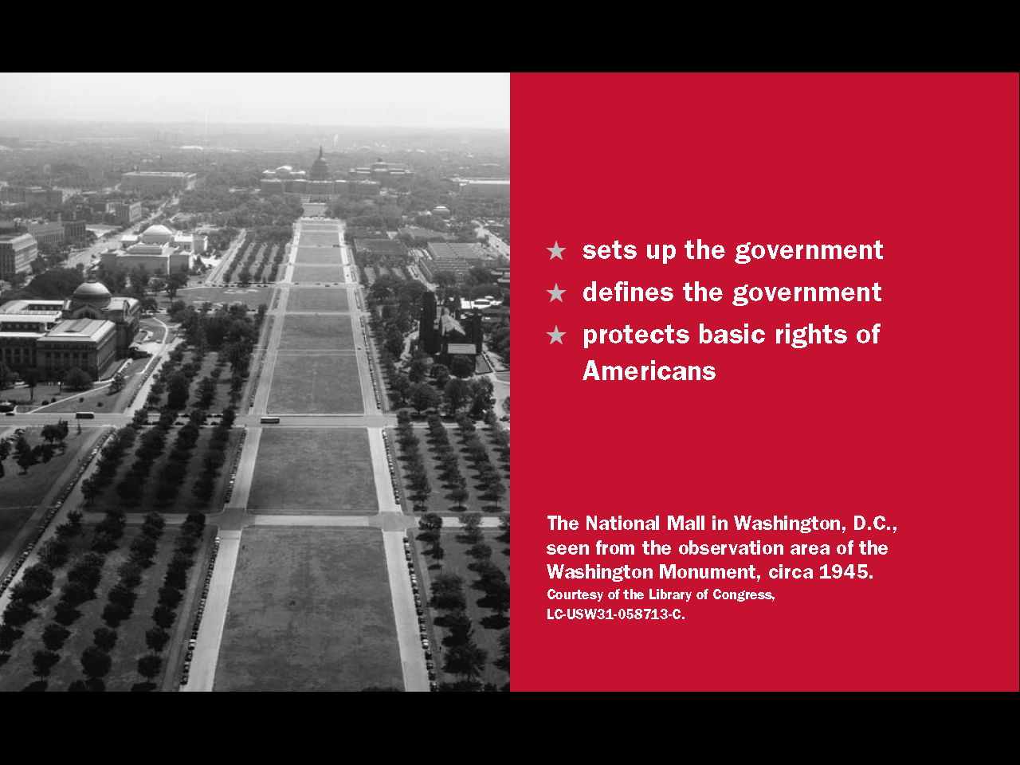
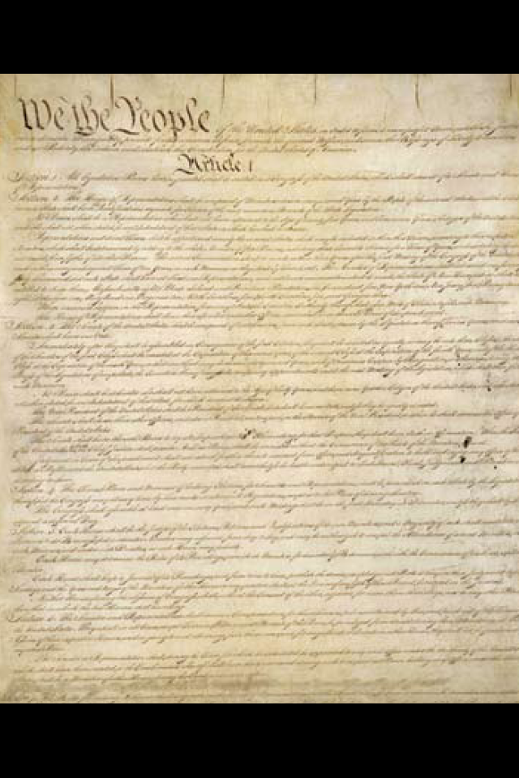
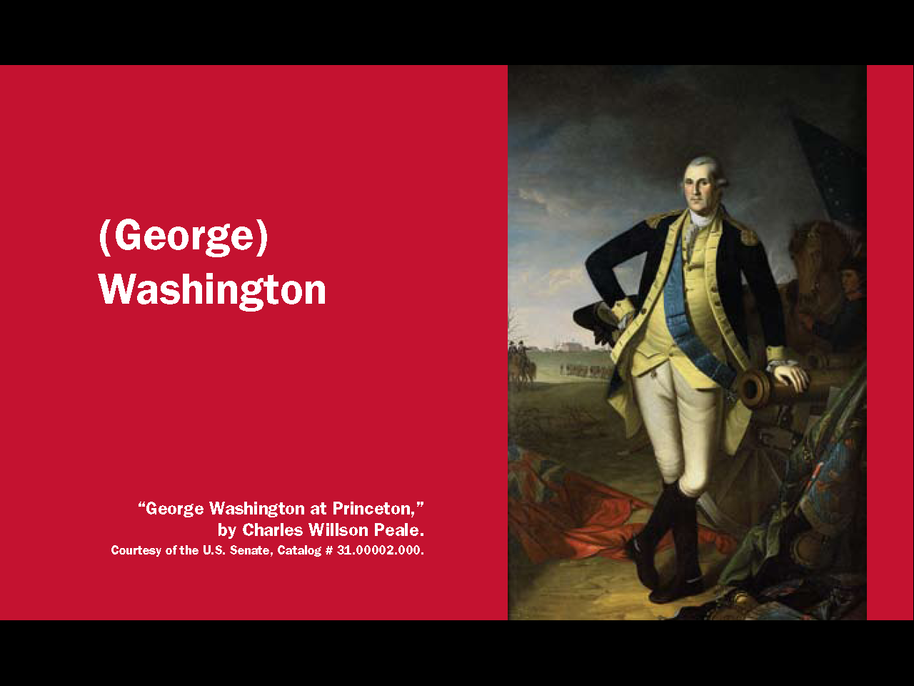
Question #2
4
Notes:
The Constitution
sets up the government
defines the government
and protects the basic rights of Americans

Slide 5
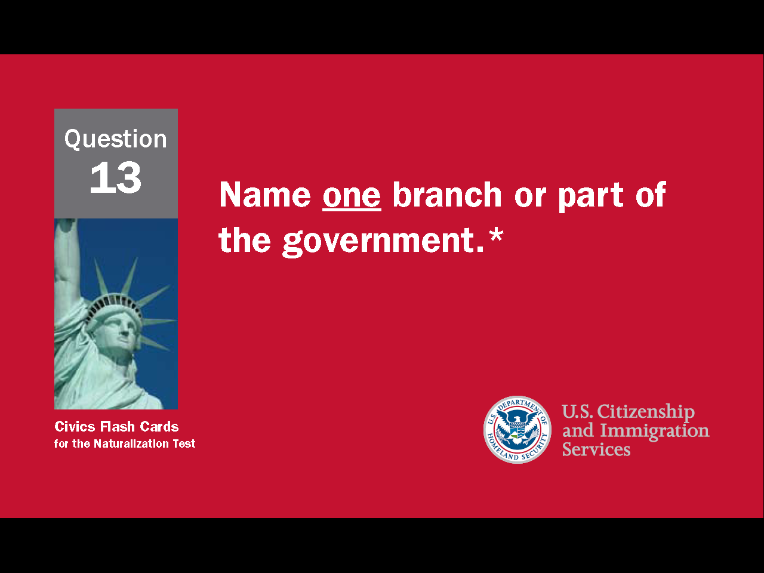
5
Notes:
Question 13. Name one branch or part of the government.

Slide 6
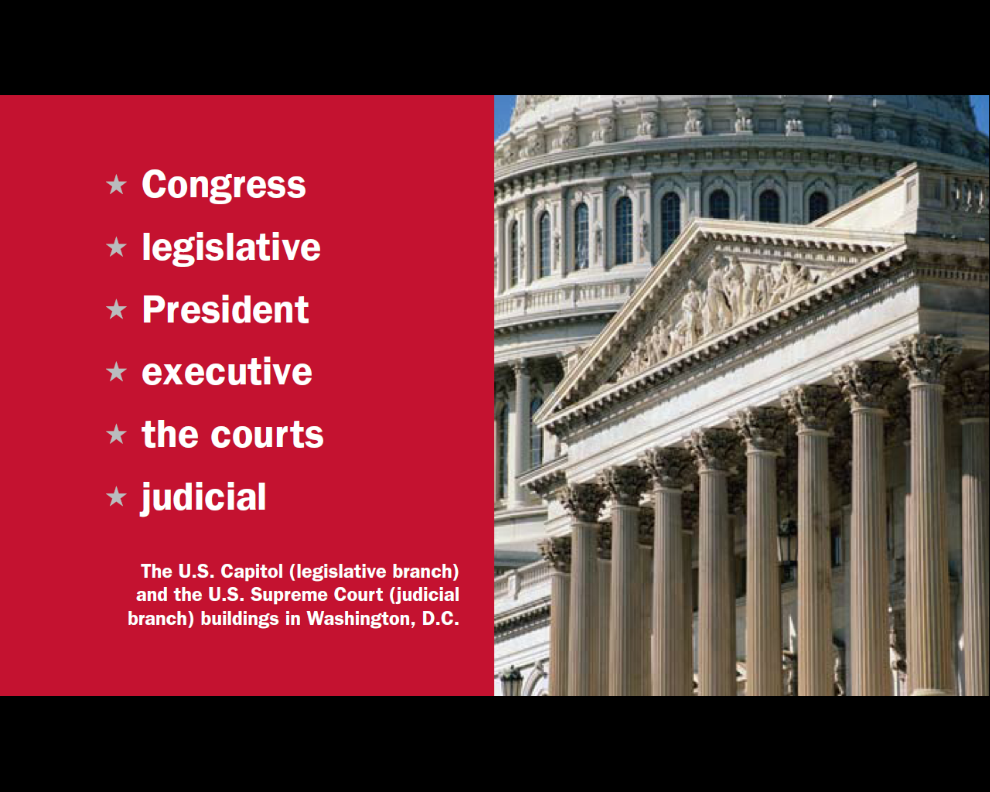
Question #13
6
Notes:
The three parts of the U.S. government are:
Congress, or the legislative branch
the President, or the executive branch
the courts, or the judicial branch

Slide 7
Separation of Powers /
Checks and Balances
PRESIDENT
(Executive Branch)
Can veto a bill
Can declare an executive
action unconstitutional
Can reject a treaty
signed by the president
Appoints federal judges
Can declare a law
unconstitutional
CONGRESS
(Legislative Branch)
THE COURTS
(Judicial Branch)
Approves federal judges
7
Notes:
To stop one branch of the government from becoming too powerful, the Founding Fathers gave each branch separate powers. This is called separation of powers. The Constitution also includes a system of checks and balances which allows one part of the government to "check" another. For example, Congress can reject a treaty signed by the president and the president can veto a bill from Congress. The President appoints federal judges, but Congress must approve them. Lastly, the Supreme Court can declare a law or executive action to be unconstitutional. In these ways, separate powers and checks and balances work to limit the power of government and to protect individual rights.
7

Slide 8
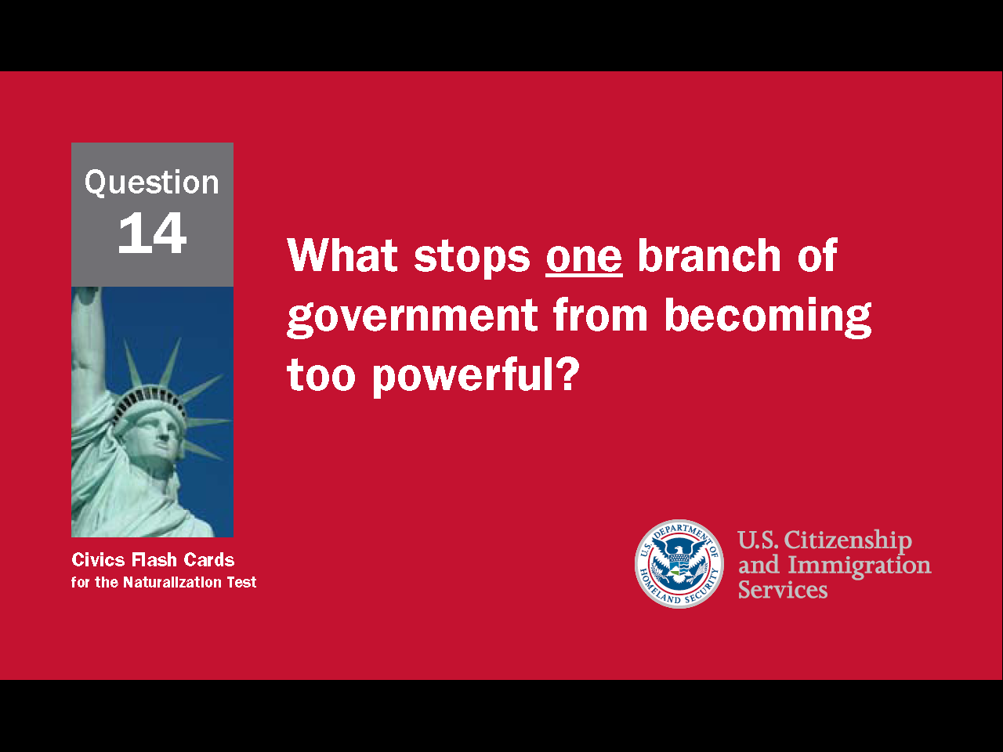
8
Notes:
Question 14. What stops one branch of government from becoming too powerful?

Slide 9
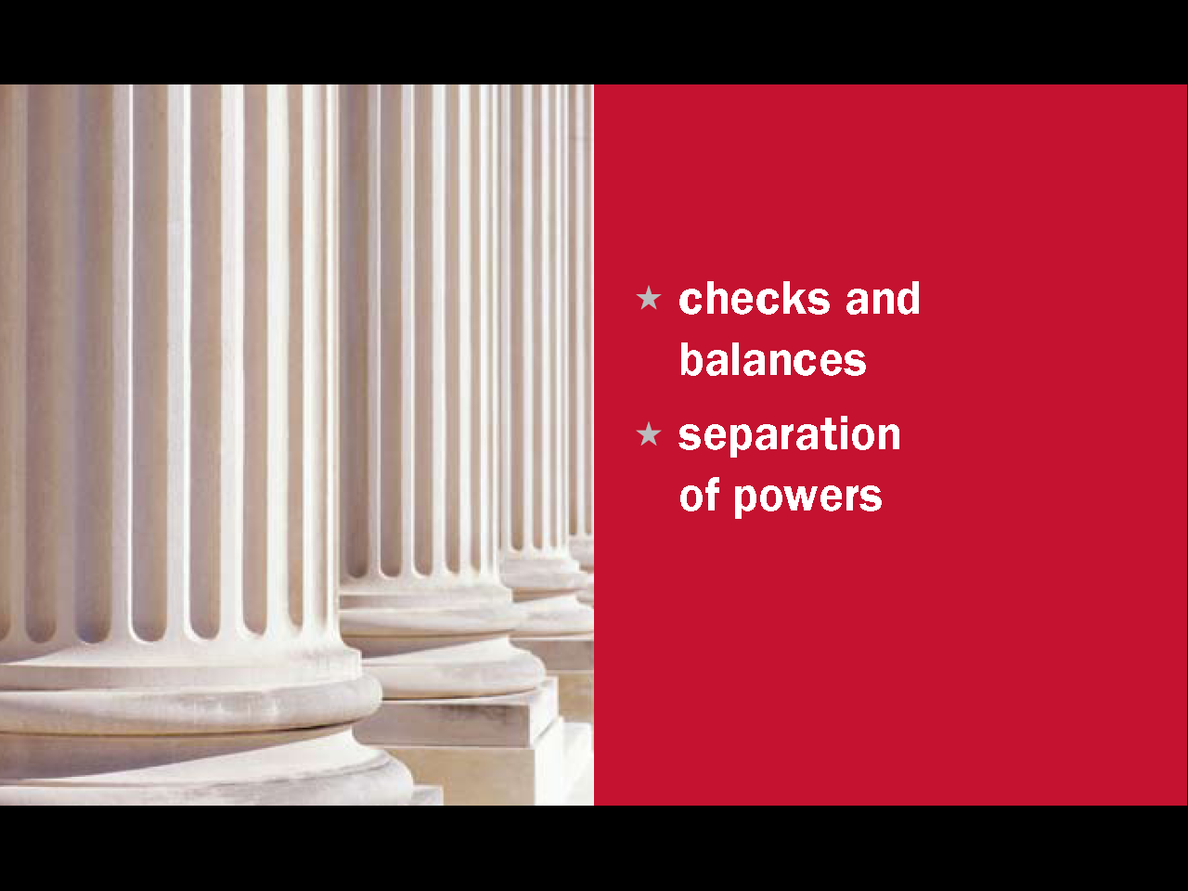
Question #14
9
Notes:
The separation of powers and system of checks and balances keeps one branch of government from becoming too powerful.

Slide 10
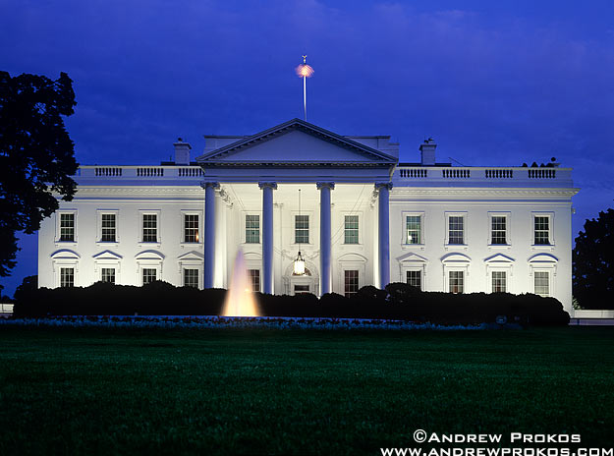
The Executive Branch
The White House, Washington, D.C.
10
Notes:
The executive branch is comprised of the President and the cabinet. The Constitution states the executive's job is to carry out and enforce the nation's laws, and "preserve, protect and defend the Constitution."

Slide 11
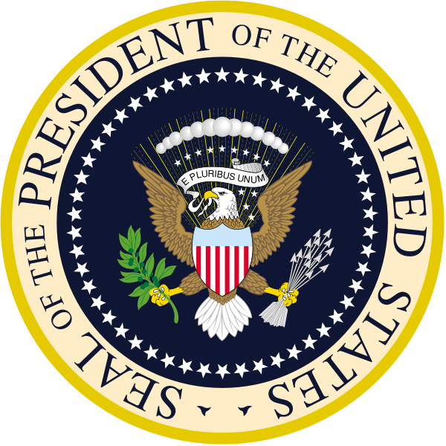
11
Notes:
The President is both the head of state and the head of the government. As the head of state, the President is the symbolic face of the nation and government and its top diplomat. As the head of the government, the President is in charge of the executive branch, Commander in Chief of the military, sets national policy, proposes legislation to Congress, and nominates Supreme Court justices and federal judges.

Slide 12
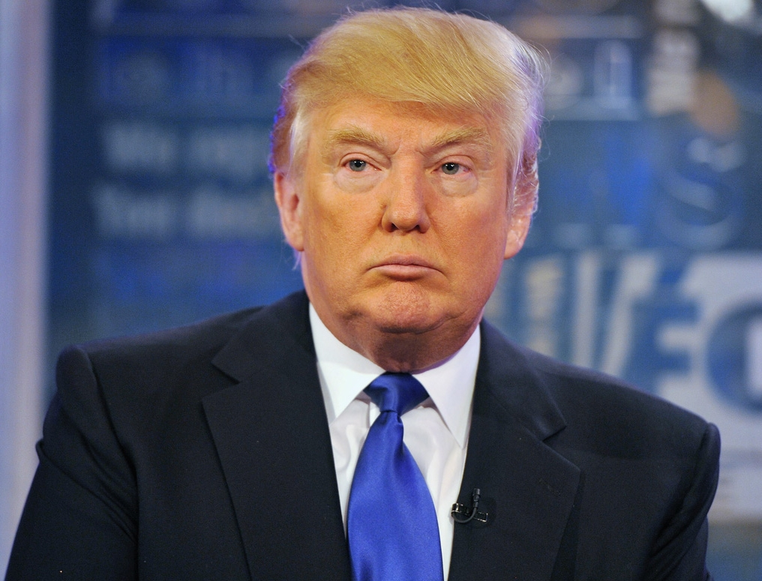
President Donald Trump
12
Notes:
The current president is Donald Trump. He was elected in 2016.

Slide 13
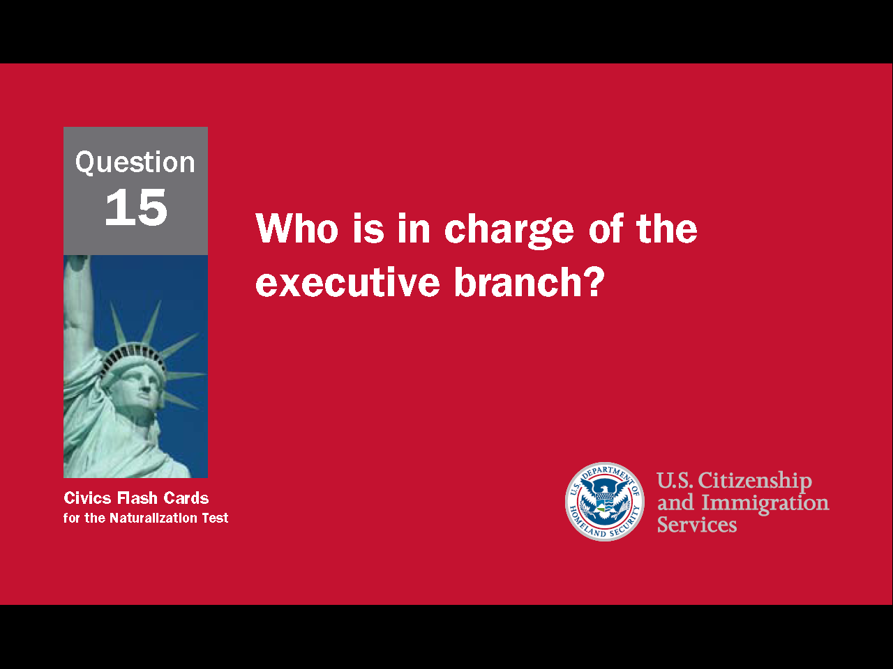
13
Notes:
Question 15. Who is in charge of the executive branch?

Slide 14
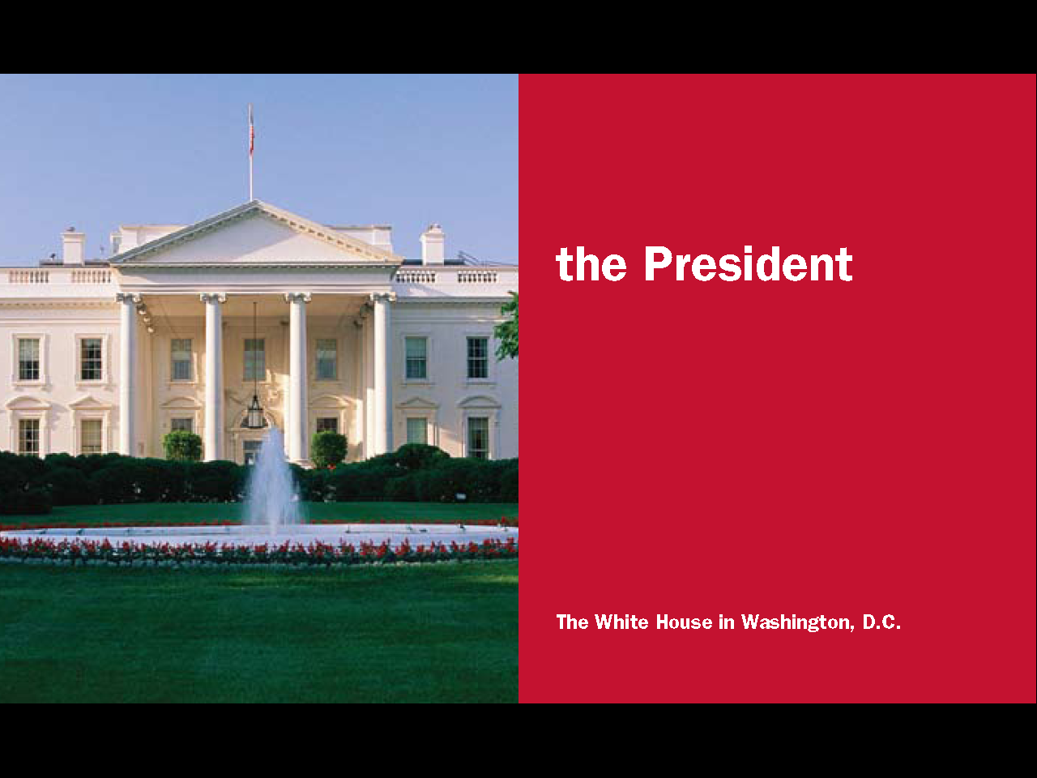
Question #15
14
Notes:
The President is in charge of the executive branch.

Slide 15
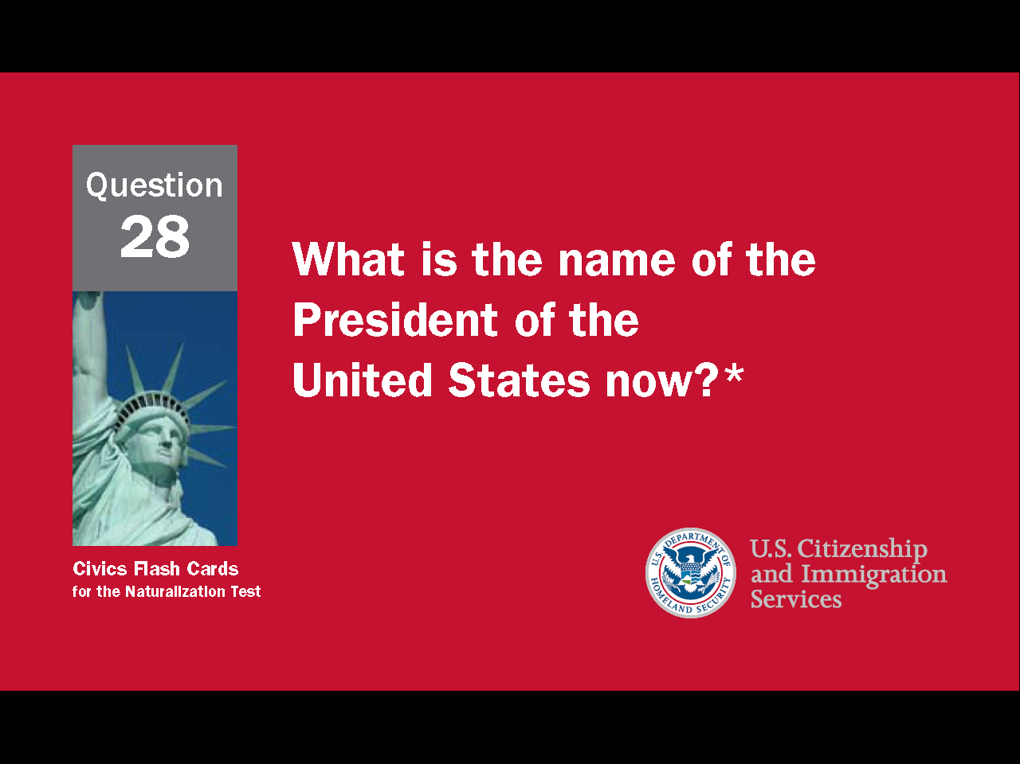
15
Notes:
Question 28. What is the name of the President of the United States now?

Slide 16
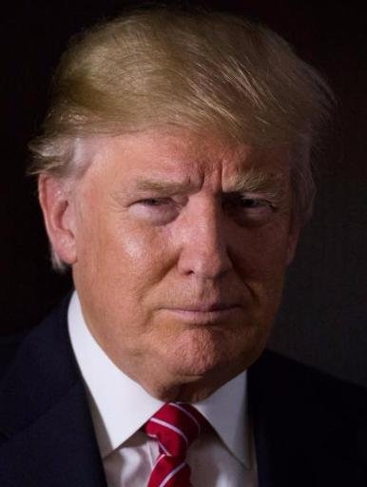
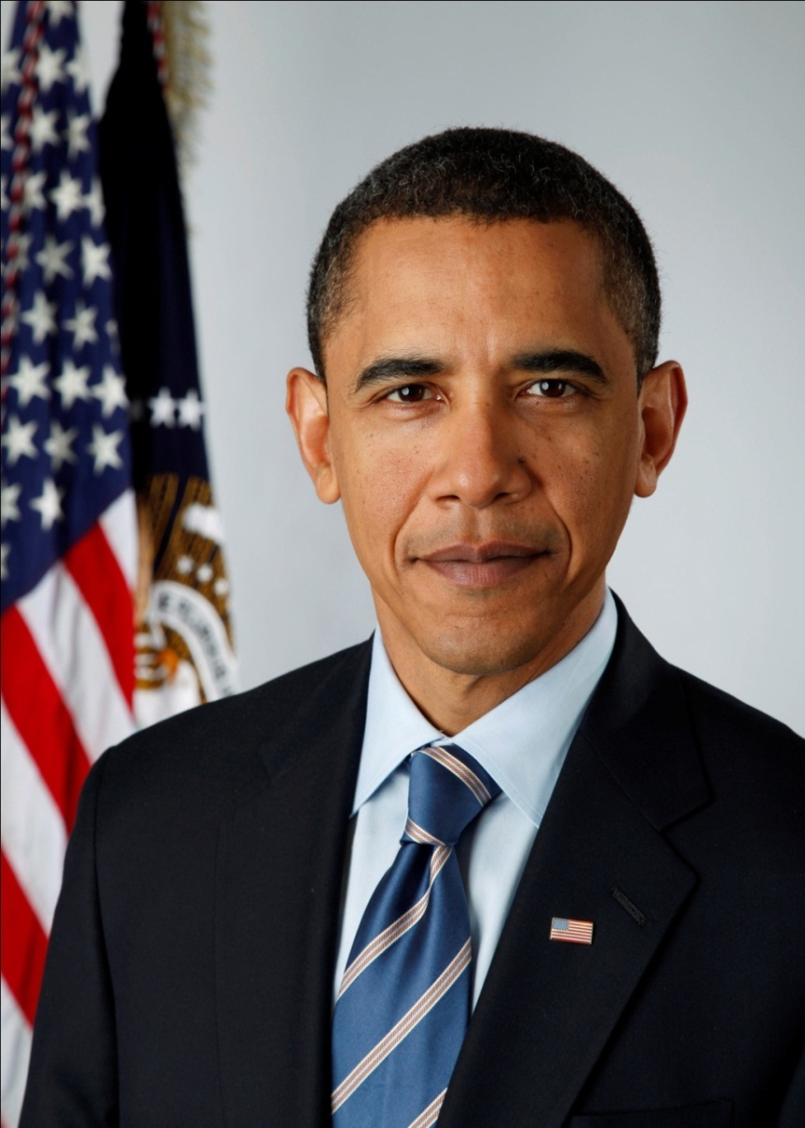
Question #28
President
Donald Trump
President
Barack Obama
16
Notes:
Barack Obama is the President of the United States now.

Slide 17
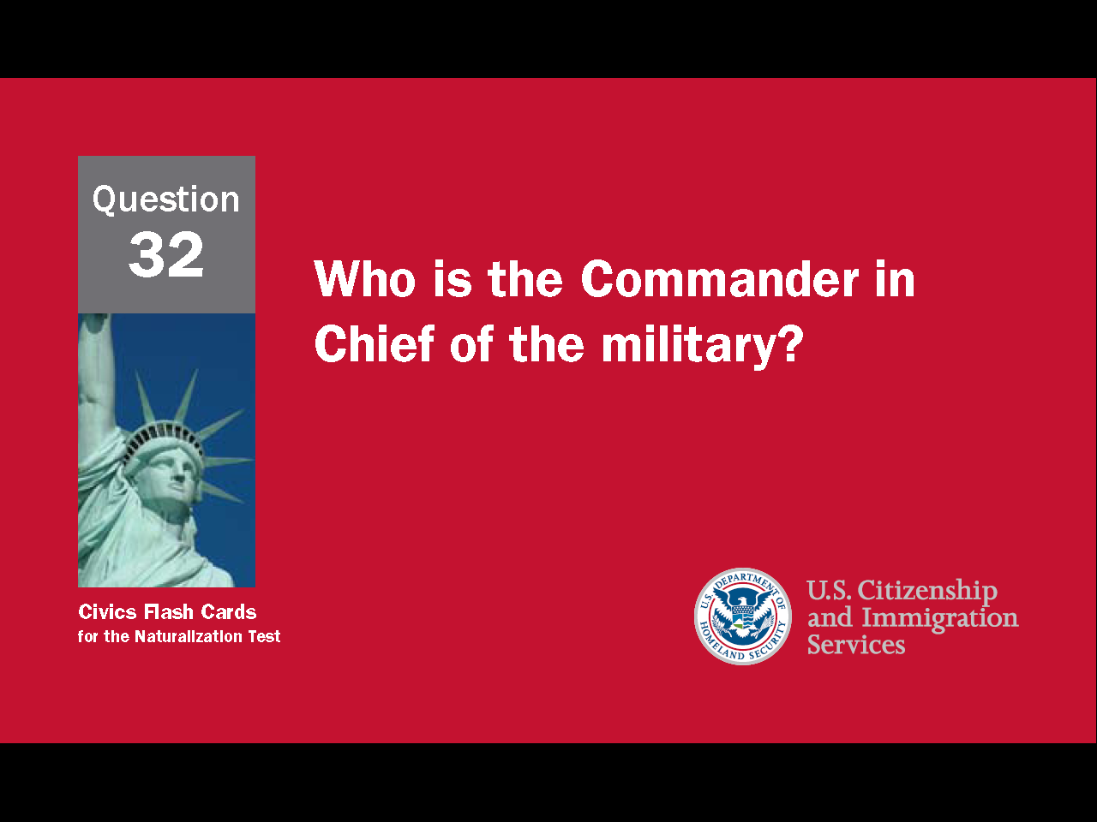
17
Notes:
Question 32. Who is the Commander in Chief of the military?

Slide 18
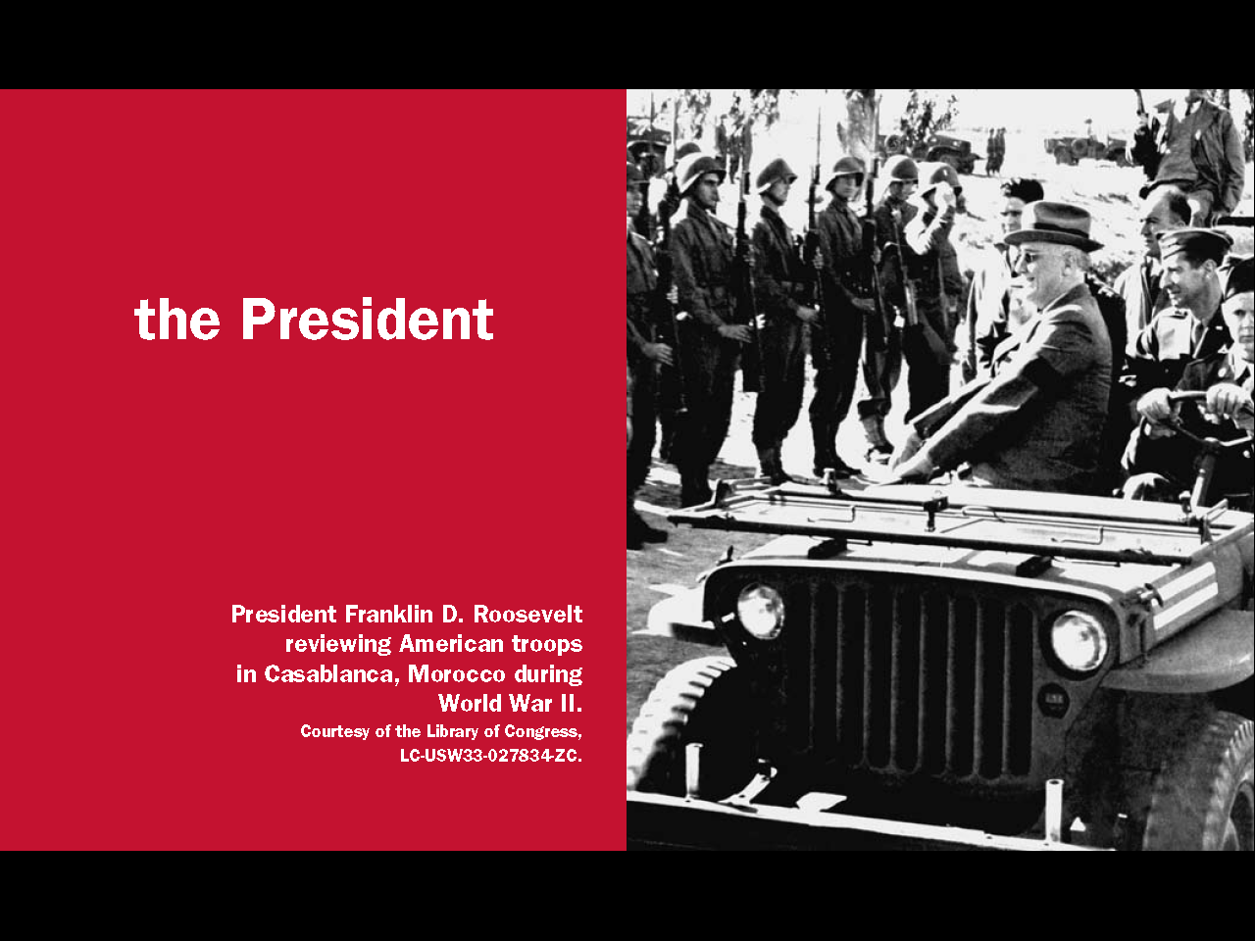
Question #32
18
Notes:
The President is Commander in Chief of the military. The military consists of the Army, Navy, Air Force, Marines, Coast Guard, and National Guard.

Slide 19
How a Law is Made
CONGRESS
Bill introduced in House of
Representatives
Bill introduced in Senate
House-Senate committee writes
final bill
House makes their own version of bill
Both houses vote on final bill; Bill is sent to President
Senate makes their own version of bill
PRESIDENT
Senate debates and votes on bill
House debates and votes on bill
President signs bill into law or vetoes it
19
Notes:
A new law first starts as an idea. Since the First Amendment gives people the right to petition the government, the idea can come from almost any person, group or organization - a citizen, the president, a lobbyist, even a state legislature. If the idea is accepted by a U.S. Representative, the proposed law is introduced to both the House of Representatives and the Senate. Such a proposal is called a bill. Both houses of Congress then make their own version of the bill. Once each house has accepted its own version, Congress works together to make a final version. This final bill is sent to the President to either sign into law or veto. A veto means the President has rejected the bill. If a bill is vetoed, the President must explain why and send the bill back to Congress. Congress can then change the bill and send it back to the President or try to vote the bill into law with a two-thirds majority in both houses of Congress.

Slide 20
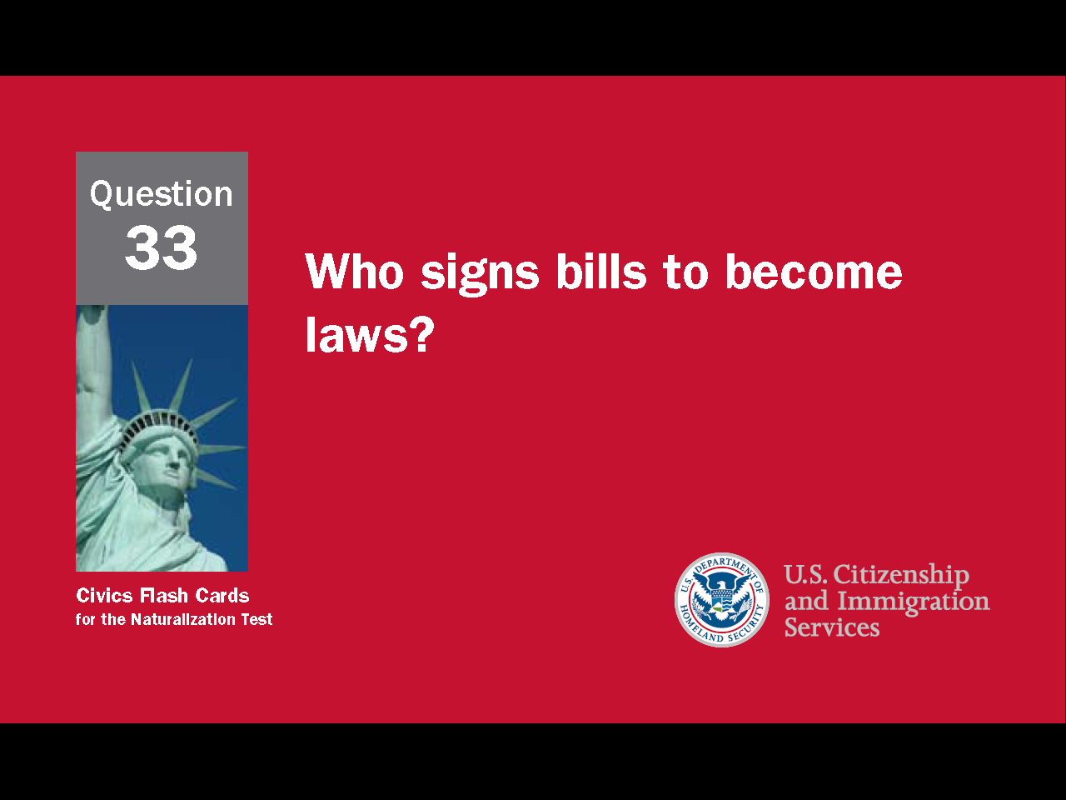
20
Notes:
Question 33. Who signs bills to become laws?

Slide 21
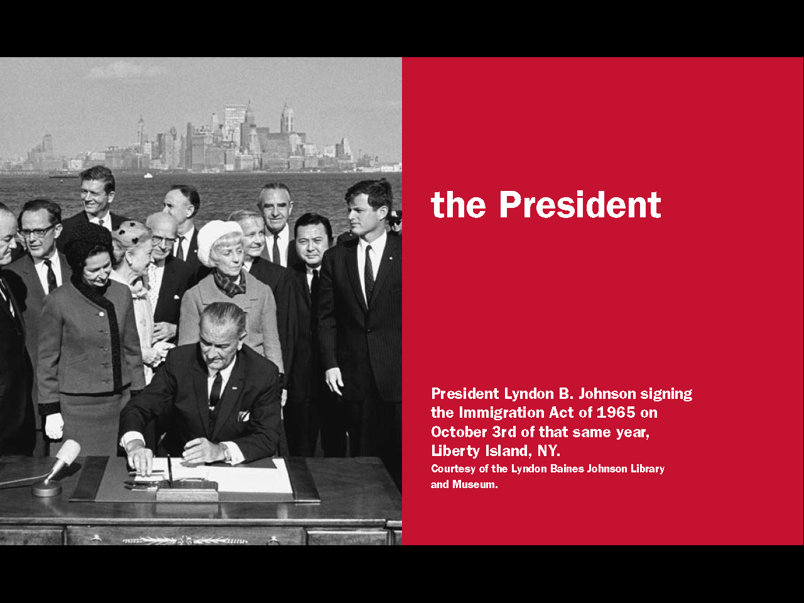
Question #33
21
Notes:
The President must sign a bill for it to become law.

Slide 22
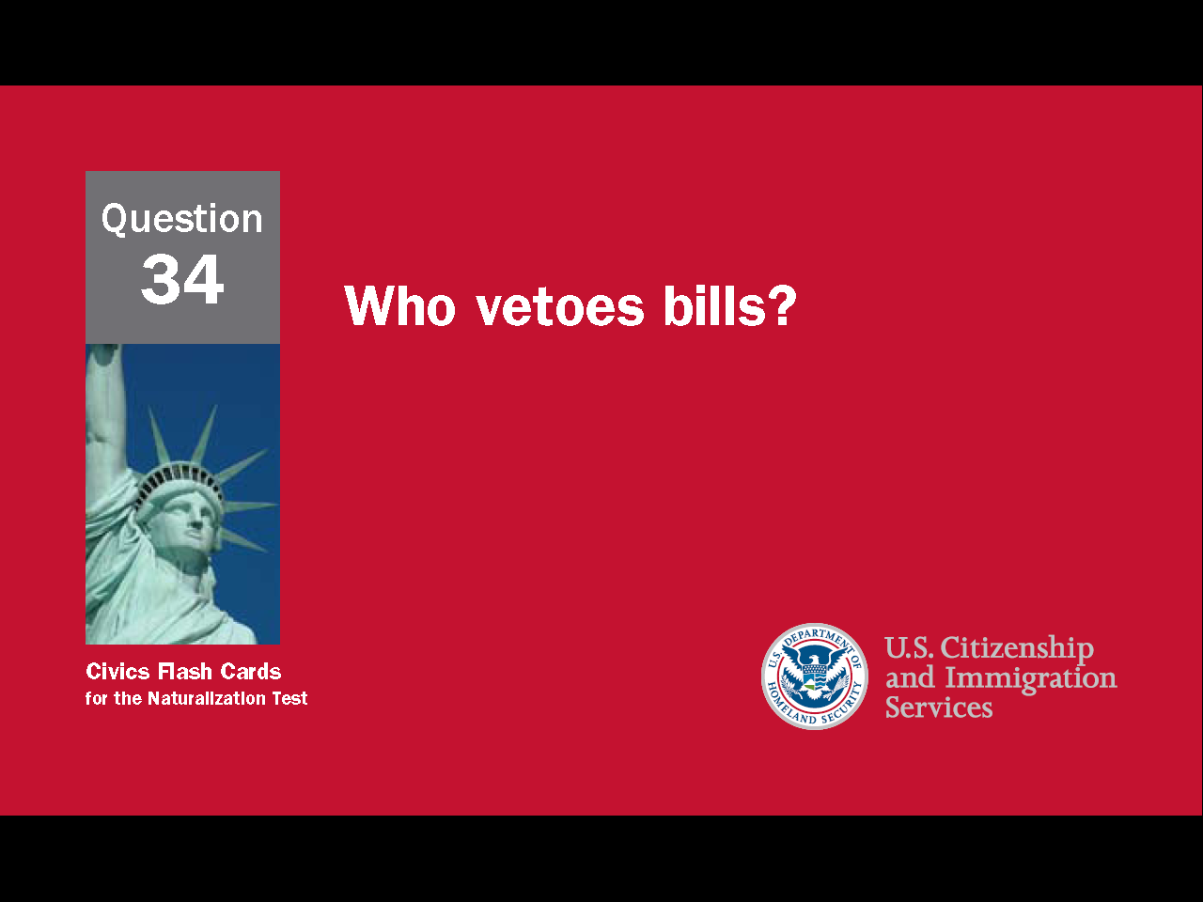
22
Notes:
Question 34. Who vetoes bills?

Slide 23
Question #34
23
Notes:
The President is the only person who can veto legislative bills.

Slide 24















The Cabinet
24
Notes:
The purpose of the Presidents' cabinet is to advise the president. The cabinet consists of the Vice President and the heads of the 15 executive departments. Departments are specialized parts of the executive branch responsible for specific public services. For example, the U.S. Treasury prints money and collects taxes, the Department of Defense is responsible for national security and the military, and the Department of Homeland Security works to prevent terrorist attacks and responds to natural and man-made disasters. Most of the department heads are called secretaries. In another example of checks and balances, the President nominates the cabinet members, but the Senate can accept or reject the person.

Slide 25
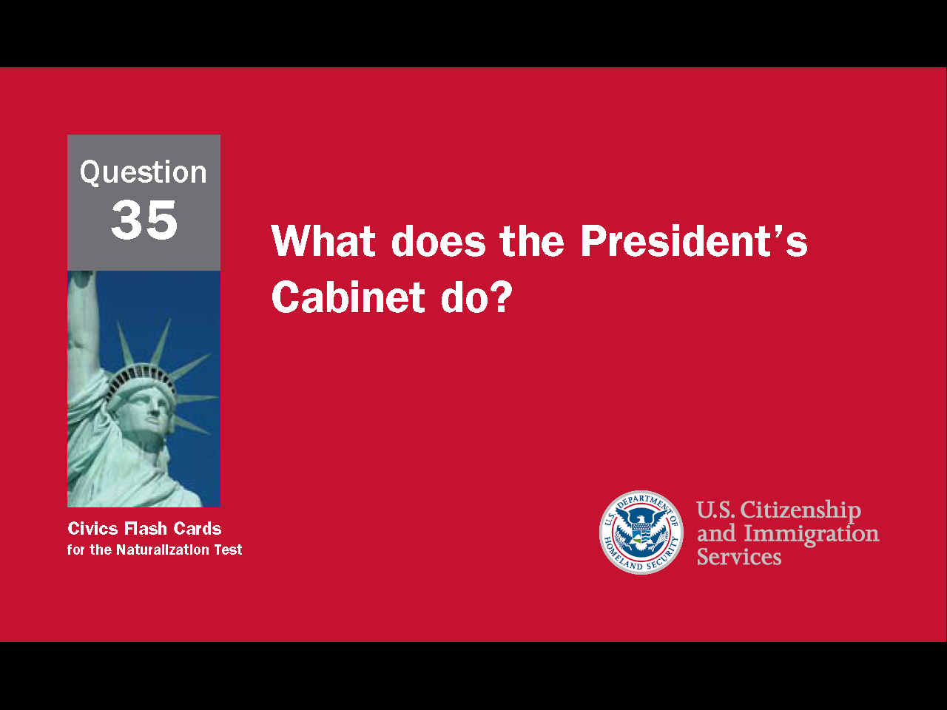
25
Notes:
Question 35. What does the President’s Cabinet do?

Slide 26
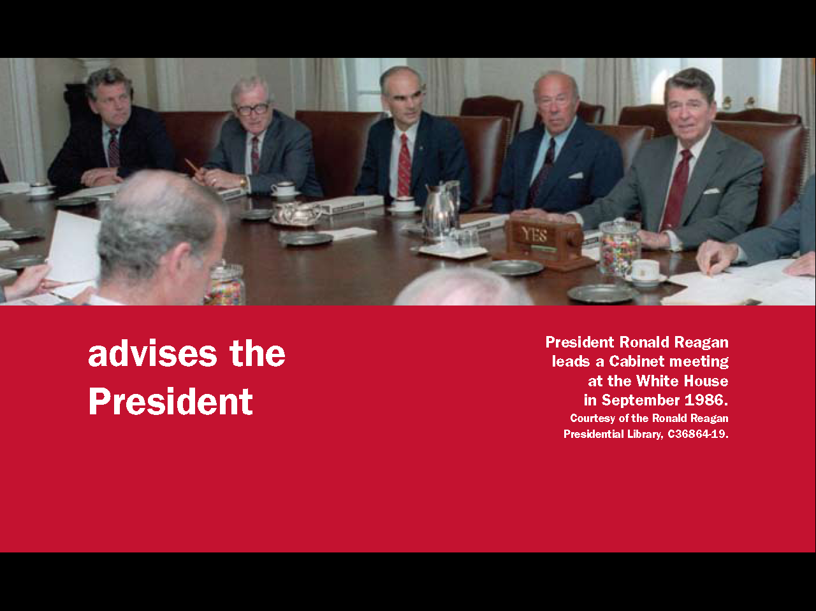
Question #35
26
Notes:
The President's Cabinet advises the President.

Slide 27
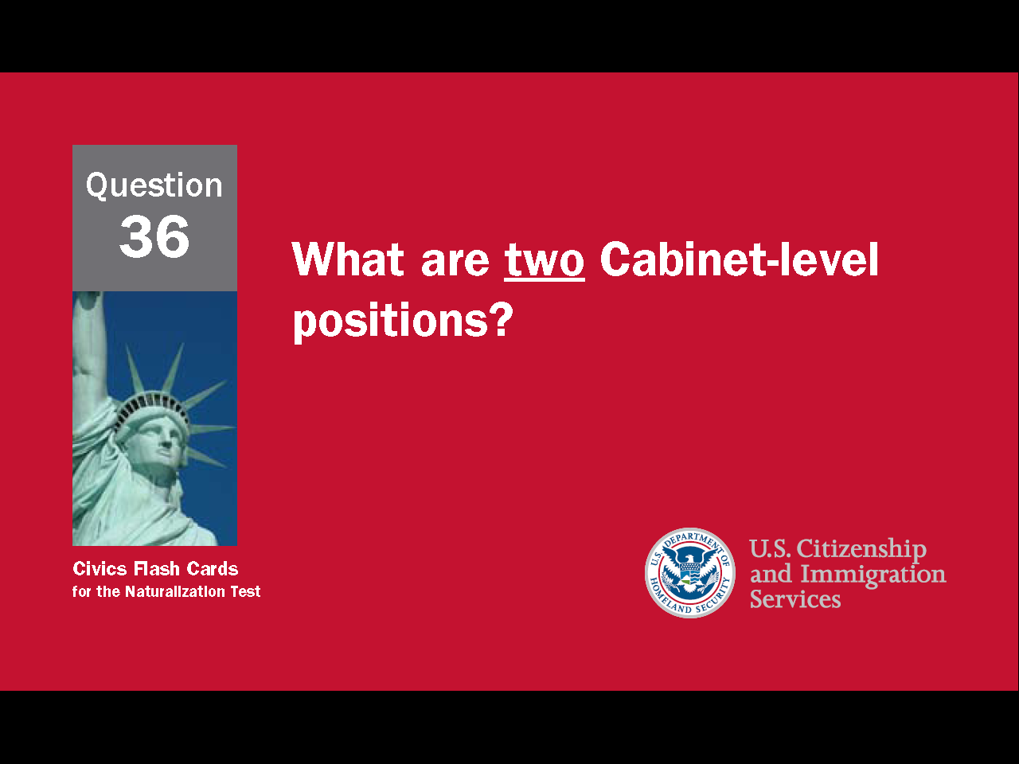
27
Notes:
Question 36. What are two Cabinet-level positions?

Slide 28
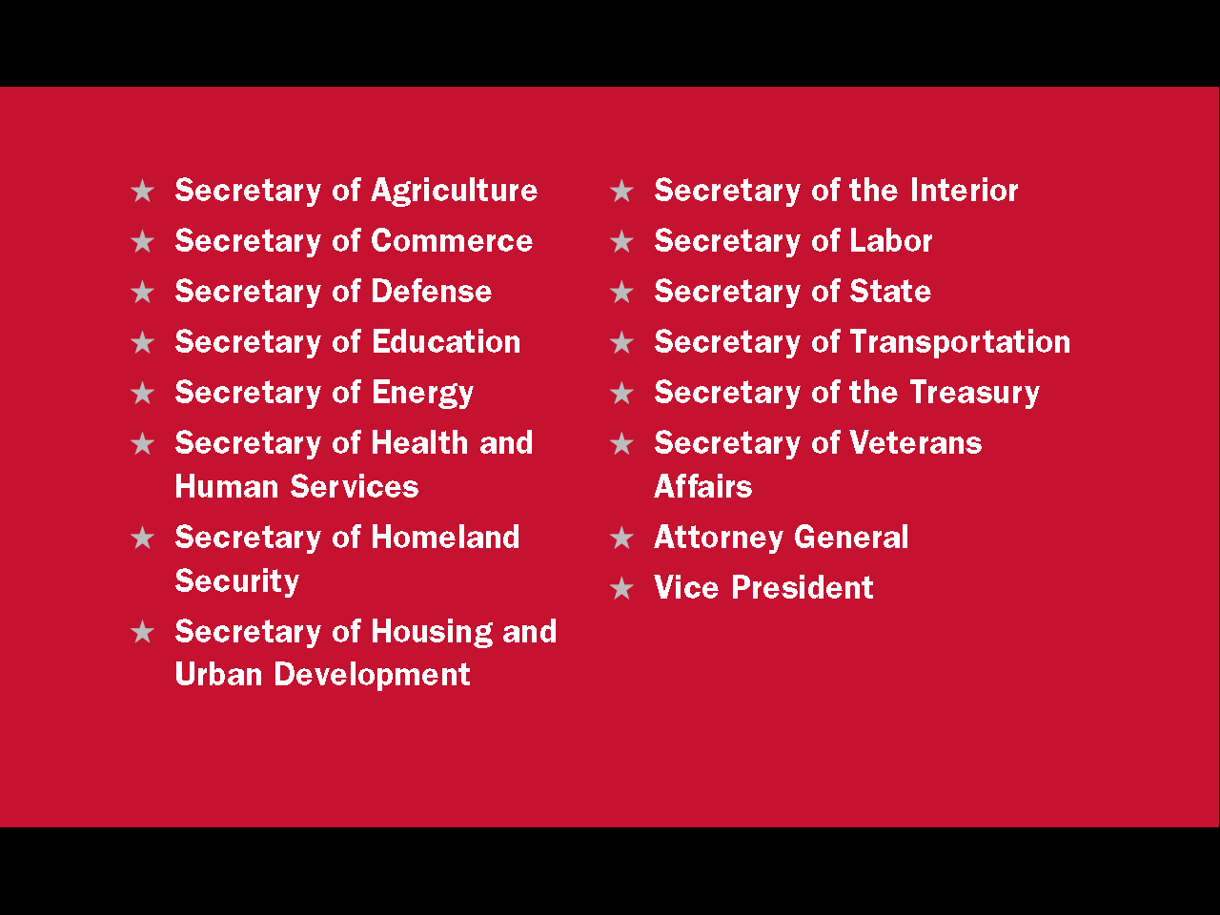
Question #36
28
Notes:
There are currently 16 Cabinet-level positions. Two are Attorney General and Vice President. The other 14 positions are secretaries of different executive departments, such as the Secretary of Labor, the Secretary of Education, and the Secretary of State.

Slide 29
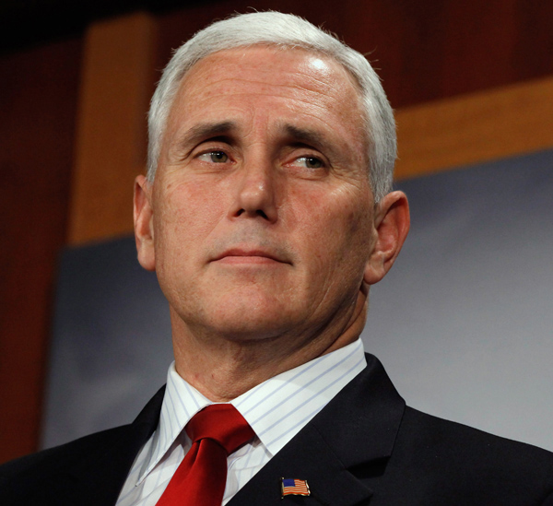
Vice President Mike Pence
29
Notes:
As a member of the cabinet, the Vice President helps advise the president, but performs other duties as well. For instance, the Vice President performs ceremonial duties when the President is busy, casts tie-breaking votes in the Senate, and most importantly, becomes President should the President be no longer able to serve. The current Vice President is Mike Pence.

Slide 30
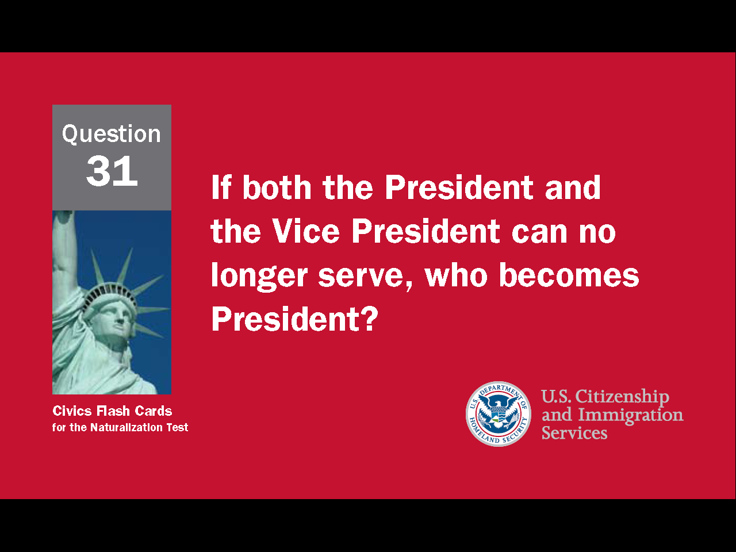
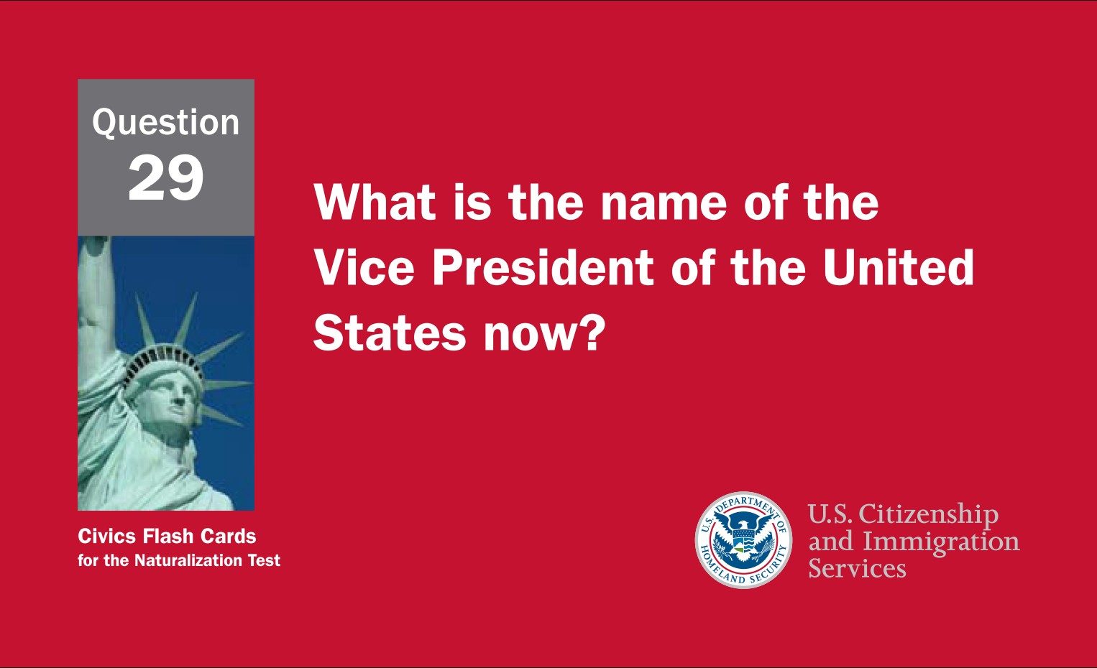
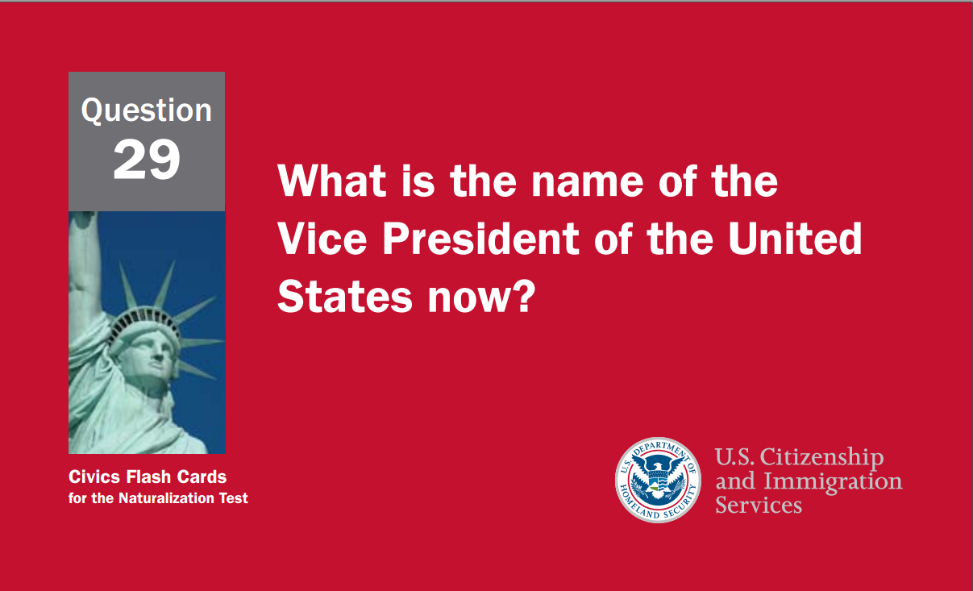
30
Notes:
Question 29. What is the name of the Vice President of the United States now?

Slide 31
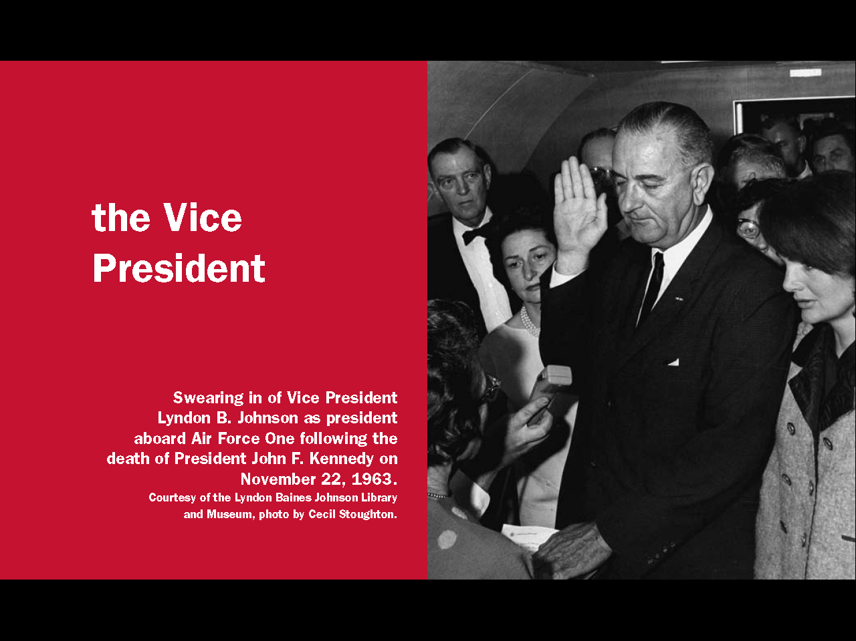
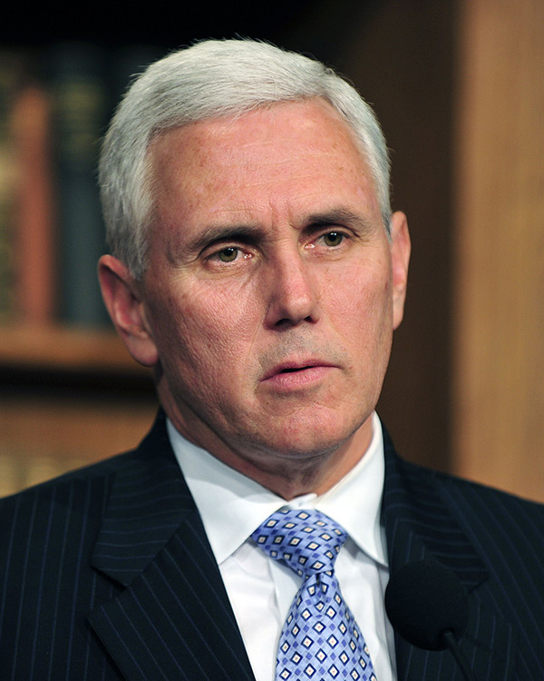
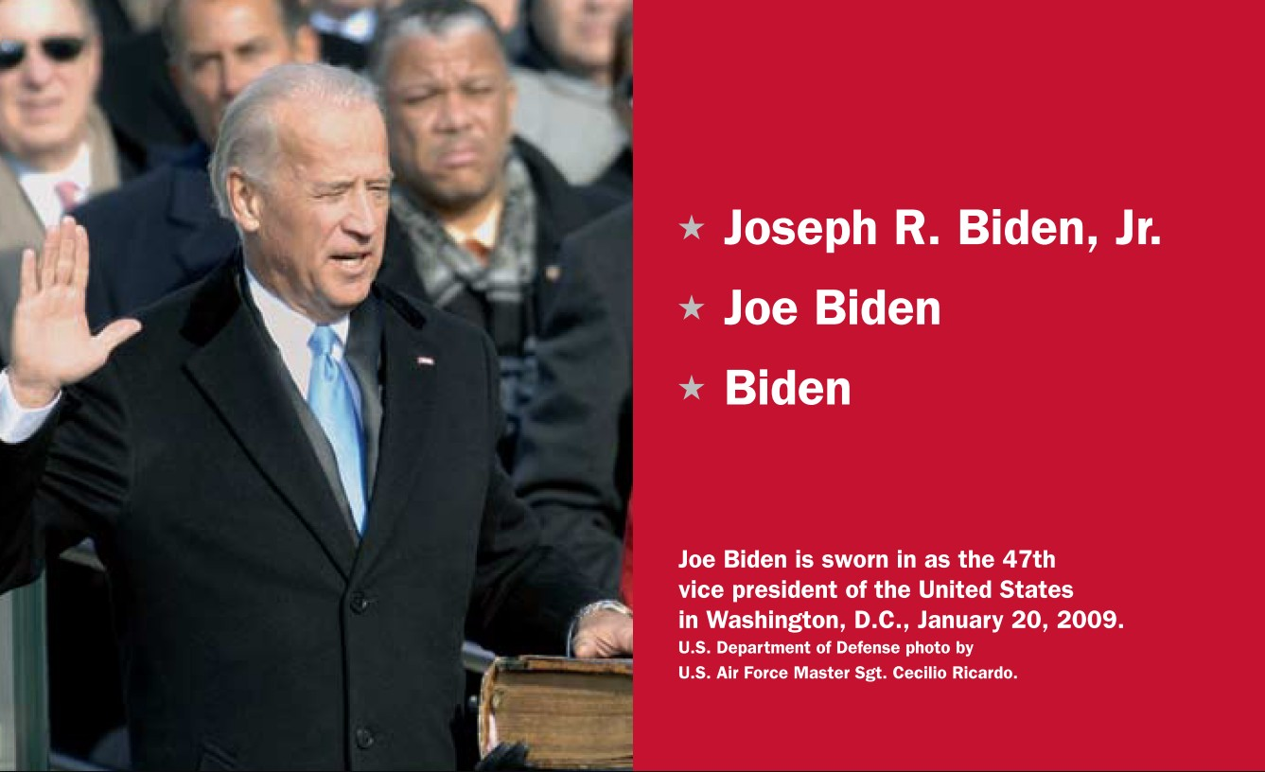
Question #29
* Michael Richard Pence
* Mike Pence
* Pence
31
Notes:
Pence. The current Vice President of the United States is Mike Pence.

Slide 32
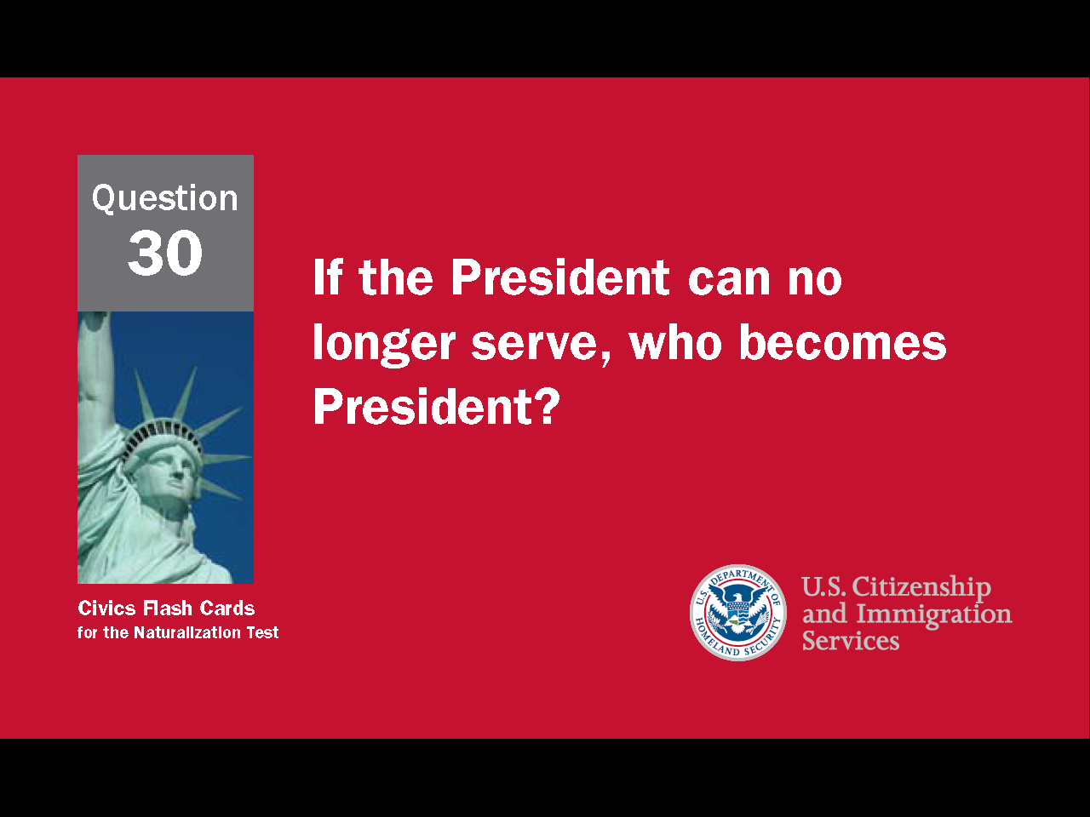
32
Notes:
Question 30. If the President can no longer serve, who becomes President?

Slide 33
Question #30
33
Notes:
If the President can no longer serve, the Vice President becomes President.

Slide 34
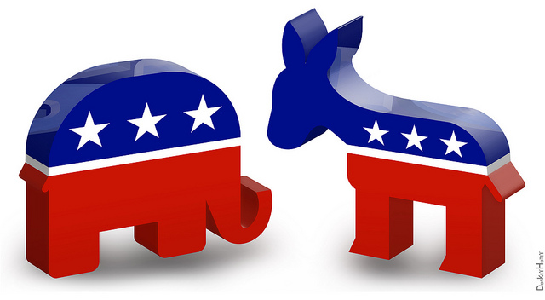
The Two Major Political Parties
Republican Democratic
34
Notes:
The two major political parties in the United States are the Democratic party and the Republican party. The elephant is the symbol of the Republican Party and the donkey represents the Democratic Party. While less common, a politician may also be an independent, which means he or she doesn't belong to a political party. Currently, there are two independent senators and several independent representatives in Congress. Both of Connecticut's senators and all five representatives are Democrats.

Slide 35
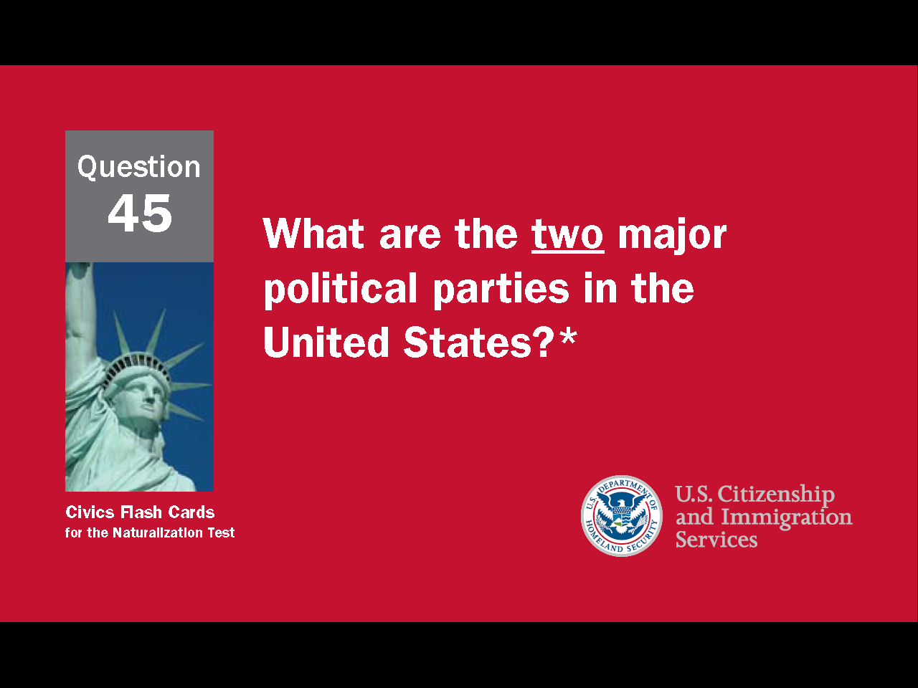
35
Notes:
Question 45. What are the two major political parties in the United States?

Slide 36
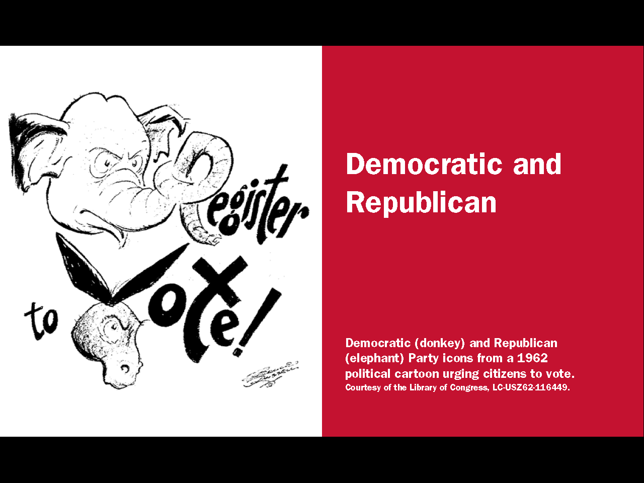
Question #45
36
Notes:
The two major political parties in the United States are the Democratic and Republican parties.

Slide 37
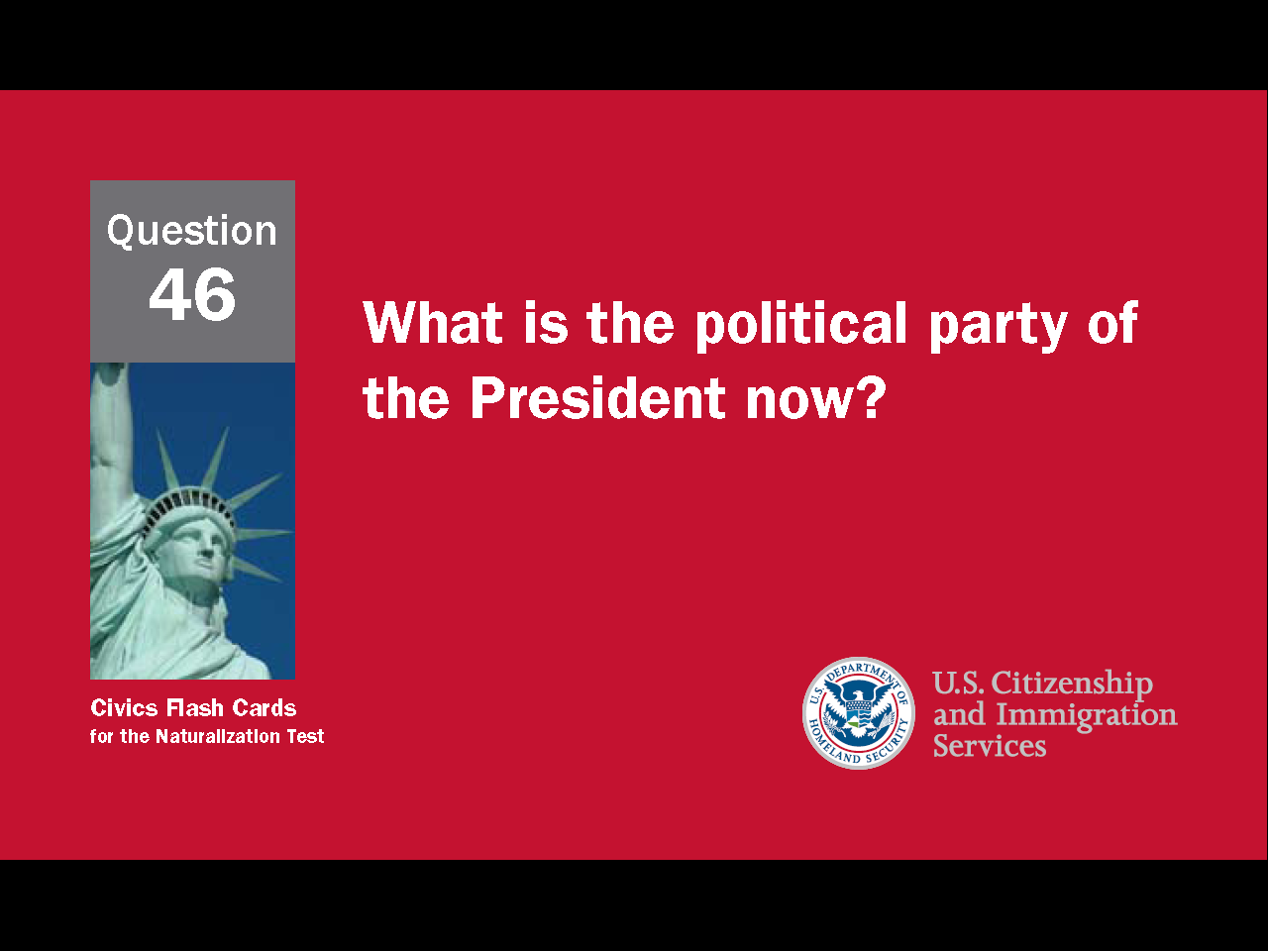
37
Notes:
Question 46. What is the party of the President now?

Slide 38
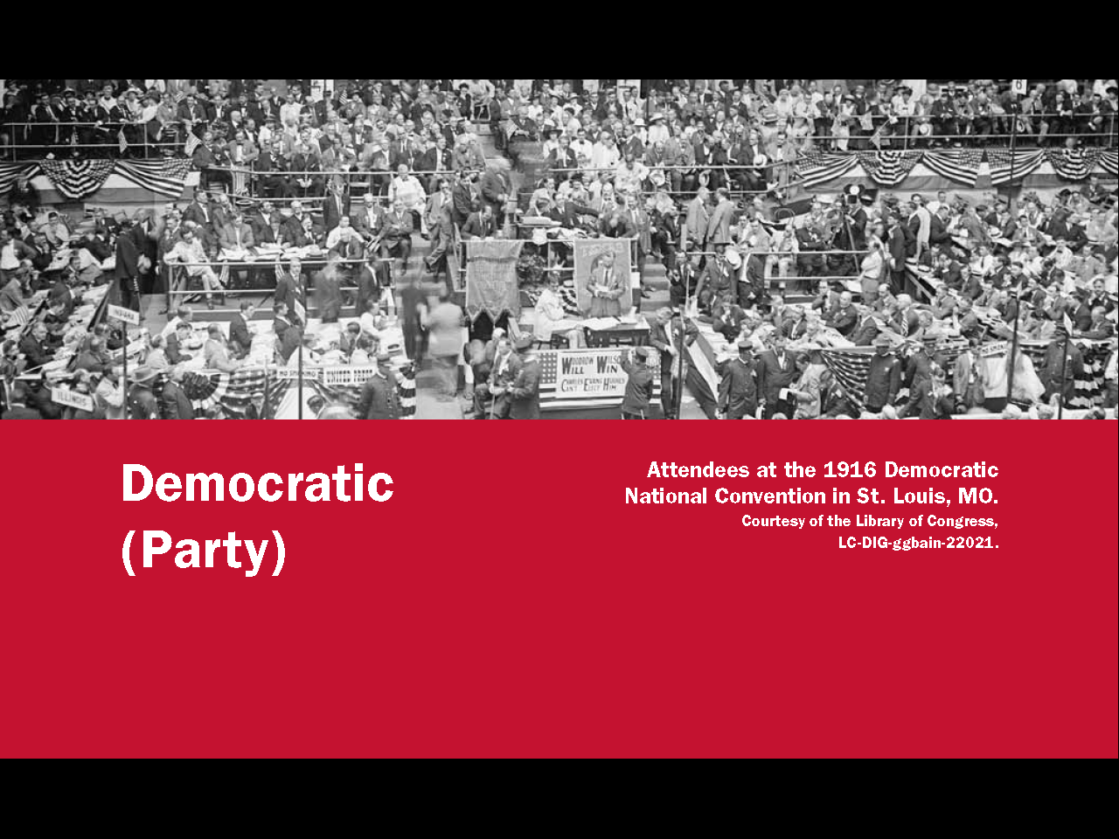
Question #46
Republican
(Party)
38
Notes:
The Democratic Party. The current President belongs to the Democratic Party.

Slide 39


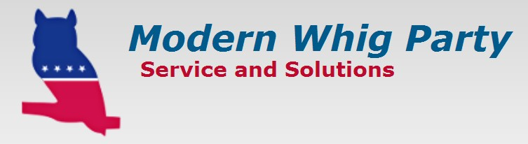








Third Parties Bring New Ideas
39
Notes:
For most of its history, the United States has had two major political parties, although the parties and policies have differed over time. Third parties are usually more successful in local elections, but very important in bringing new ideas into national politics. Women's voting rights, child labor laws, the 40-hour work week, and Social Security are all ideas originally promoted by third parties. Currently, the largest third parties in the U.S. are the Libertarian Party, Green Party, and Constitution Party. The Libertarian Party believes in very limited federal government. The most radical form would be a government that only provides police, prisons, courts, and a military. The Green Party promotes grass roots democracy, social justice, non-violence, and environmentalism. The Constitution Party wants greater power given to the states and a federal government guided by a strict interpretation of the Constitution.

Slide 40
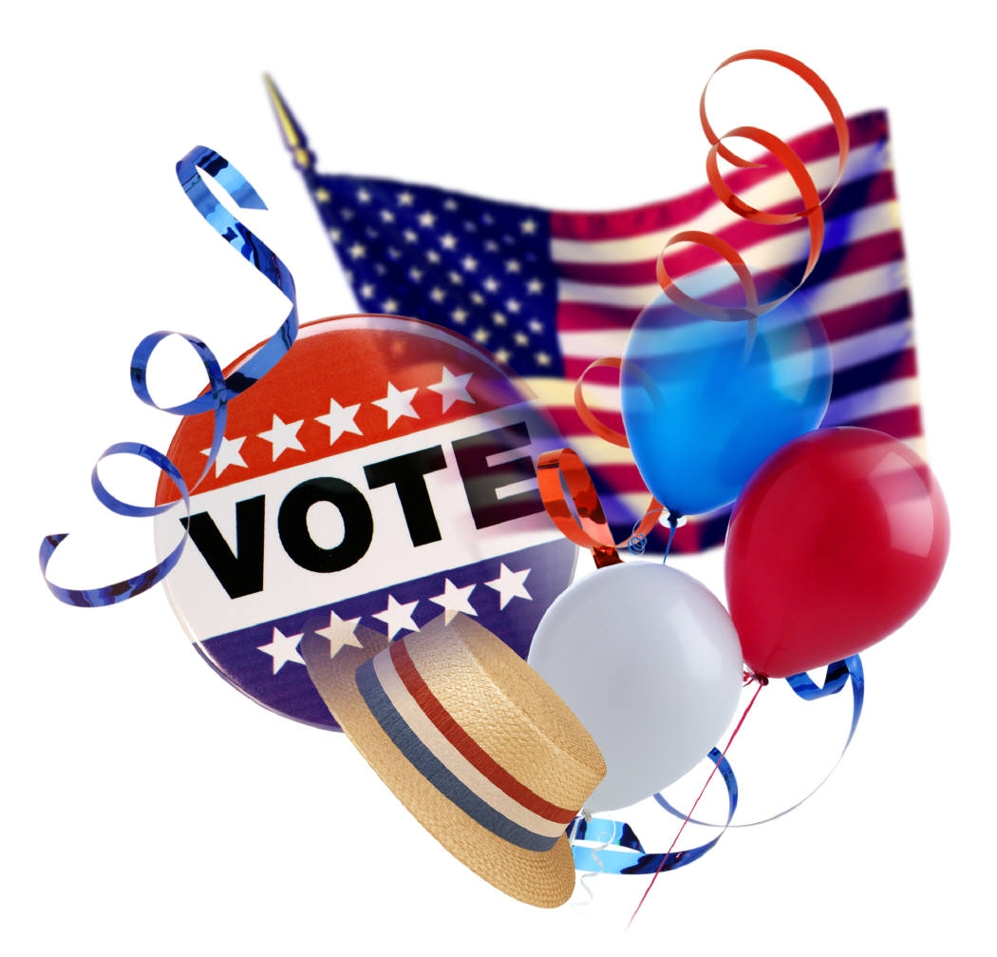
November is Coming!
2004
2008
2012
2016
2020
2024
2028
2032
Be sure to vote!
40
Notes:
Presidential elections are held every four years in November. All citizens over the age of 18 can vote for president. Although he could have served longer, the first president, George Washington, set a precedent by serving only two terms. Franklin Roosevelt is the only president to have served more than two terms. He died in 1945 at the beginning of his fourth term. In 1951, the 22nd Amendment was passed. The amendment limits presidents to two terms.

Slide 41
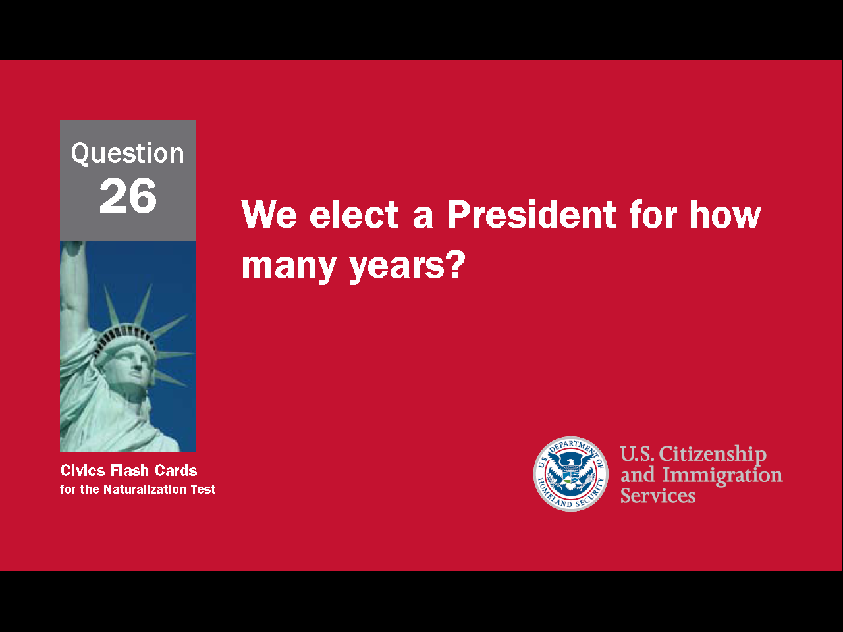
41
Notes:
Question 26. We elect a President for how many years?

Slide 42
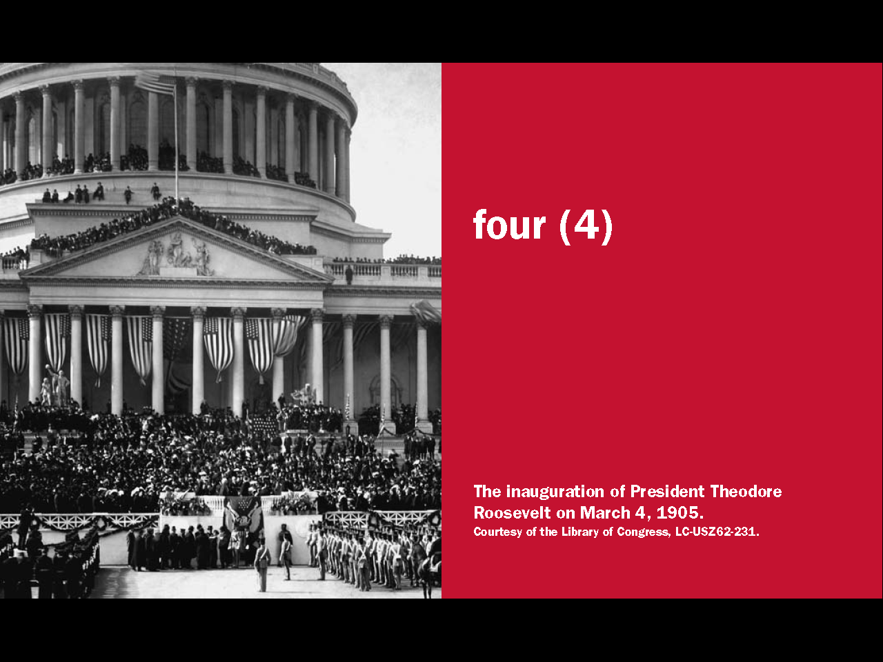
Question #26
42
Notes:
A president is elected for four years and may serve only two four-year terms.

Slide 43
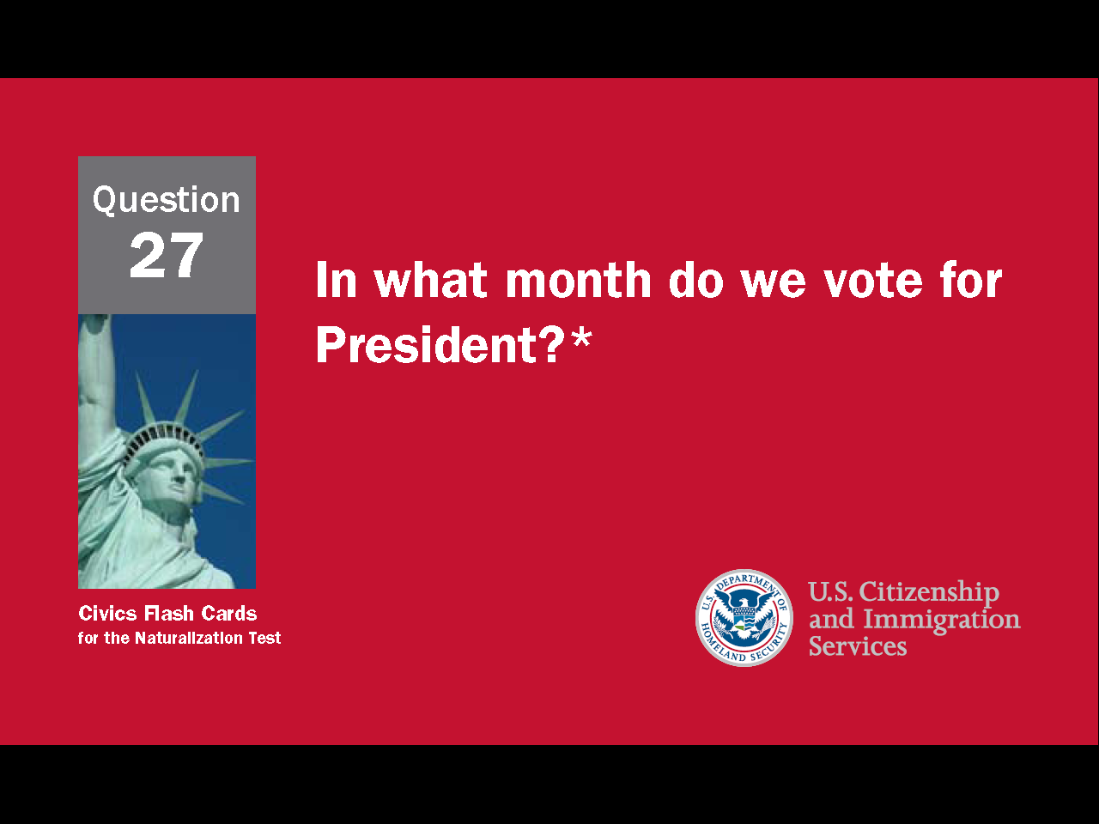
43
Notes:
Question 27. In what month do we vote for President?

Slide 44
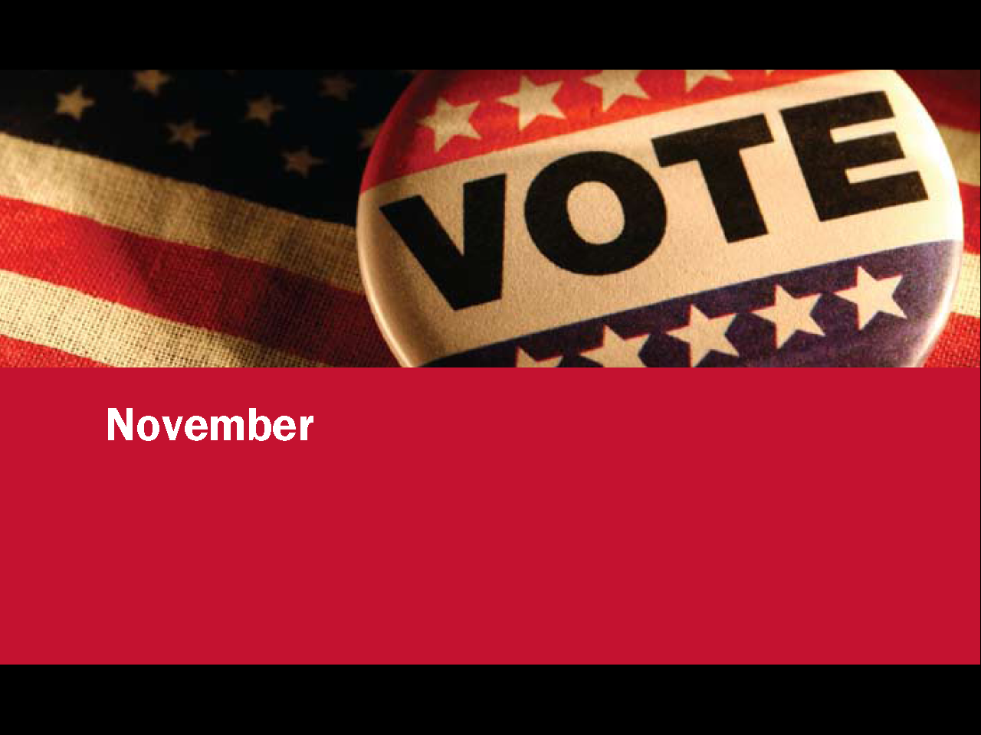
Question #27
44
Notes:
We vote for President in November. Election day is always the Tuesday after the first Monday in November.

Slide 45
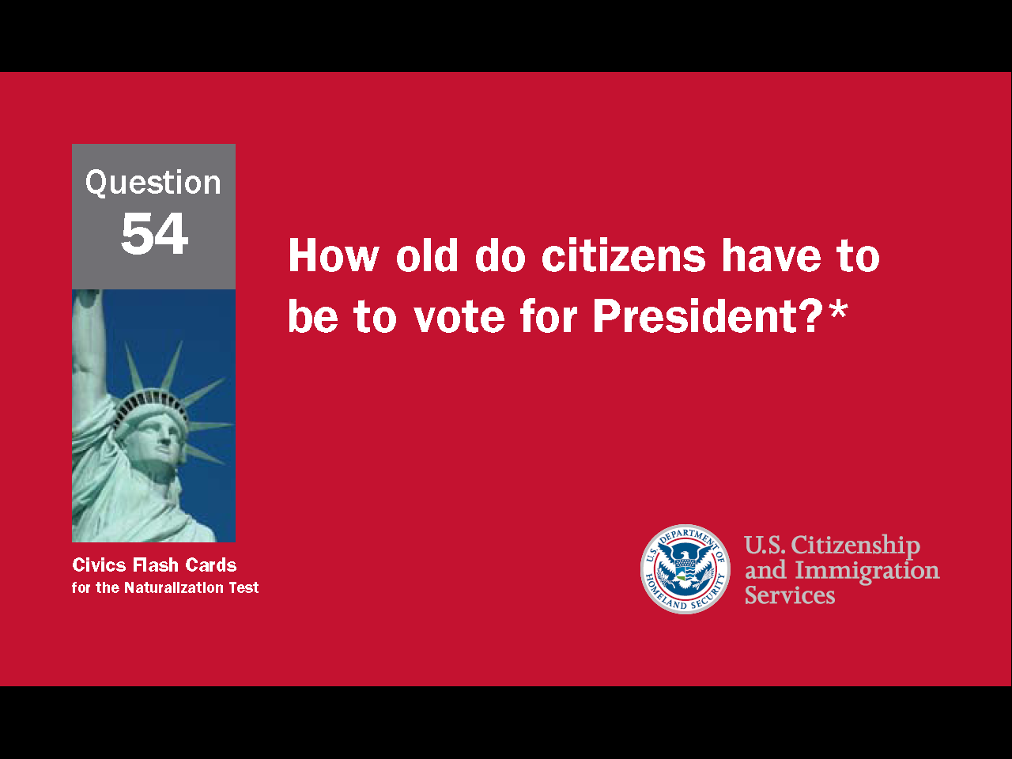
45
Notes:
Question 54. How old do citizens have to be to vote for President?

Slide 46

Question #54
46
Notes:
Eighteen. Citizens have to be eighteen or older to vote for President, or in any other federal, state or local election.

Slide 47
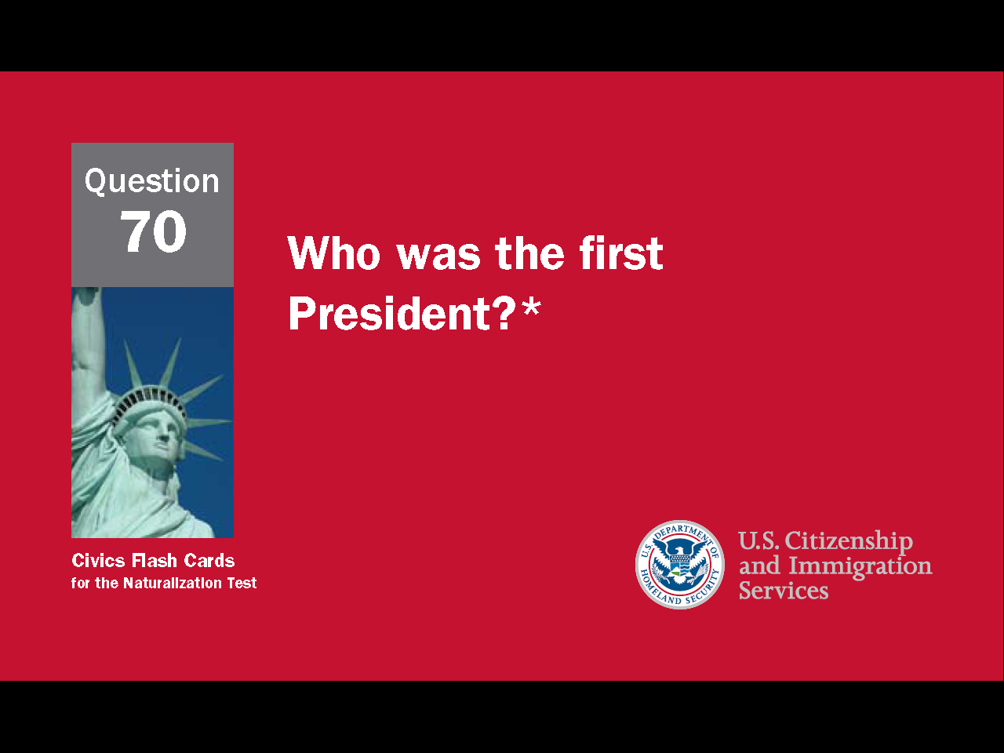
47
Notes:
Question 70. Who was the first President?

Slide 48
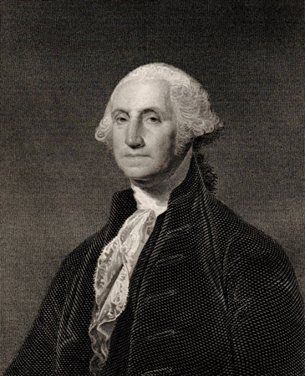
Question #70
48
Notes:
George Washington was the first president of the United States and considered "the father of our country."

Slide 49
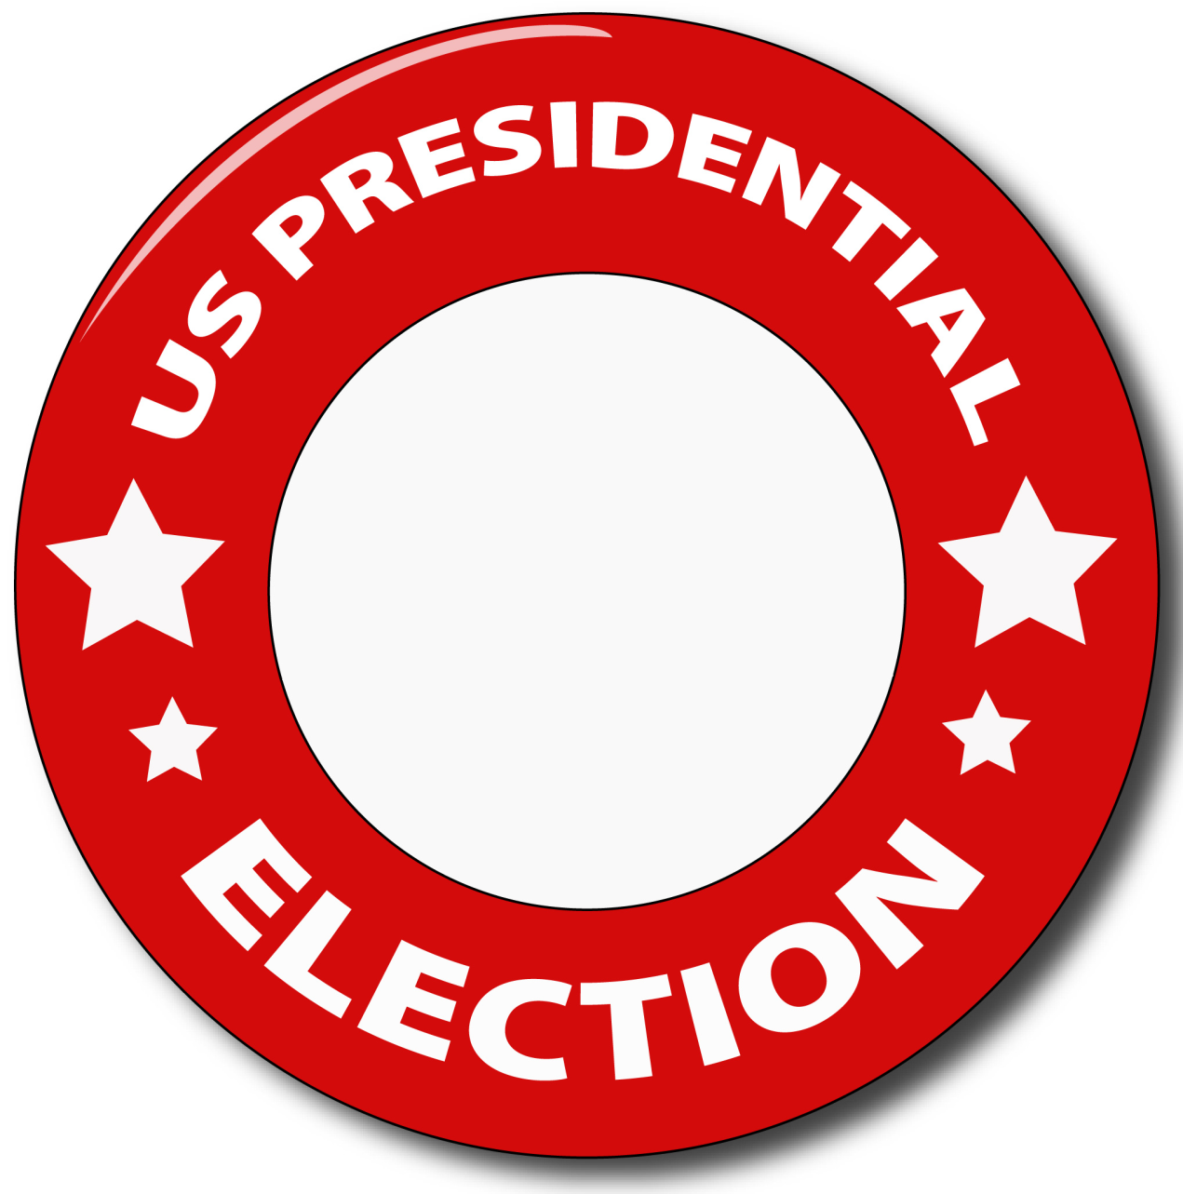
How a President is Elected
Vote
49
Notes:
Presidential elections have two stages. Primary elections are the first stage. Primary elections are held when two or more candidates from the same party compete for the same position. Usually, when a sitting president runs for a second term, no member of the President's party competes with the President. However, when a president's second term is ending, there are two main sets of primary elections, one for Democrats and another for Republicans. For instance, in the 2008 Presidential election, there were nine Republican candidates and eight Democratic candidates. Barack Obama won the Democratic primary and John McCain won the Republican primary. They then ran against each other - and an independent candidate and three third party candidates - in the Presidential election.

Slide 50
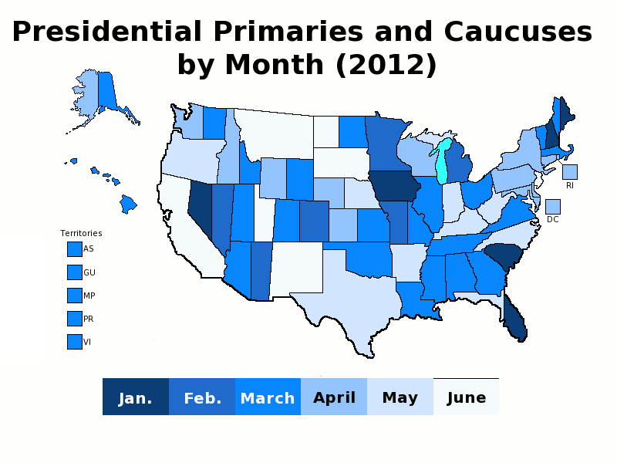
States with two colors have different dates for the Democratic and Republican primaries.
Source: http://frontloading.blogspot.com/p/2012-presidential-primary-calendar.html
50
Notes:
Presidential primaries are long and complicated. From January to June, candidates campaign from state to state as each state votes for its preferred nominee. As the campaigning and voting progresses, some candidates quit. Sometimes there is only one candidate remaining before the last primary in June. The final candidate from each party is then selected at a national convention and the final candidate from each party competes in the Presidential election in November. Connecticut, like most states, has closed primaries. That means you must be a member of the political party to vote in their primary election. Around 20 states have open Presidential primaries which allow any registered voter to vote. In that way, they are just like state and national elections. You do not have to be a member of a political party to vote in the primary.

Slide 51

Representatives + Senators = Electors
51
Notes:
All federal, state and local elections - except one - are direct elections. That means the candidate who receives the most votes wins. However, U.S. presidential elections are indirect elections and so the candidate with the greatest number of votes is not always the winner. Instead, a body called the electoral college determines who becomes president. In the electoral college, each state has a number of electors equal to its total number of U.S. Representatives and Senators. For example, Connecticut has five Representatives and two Senators, so has seven electors. During a presidential election, the candidate who receives the most votes in Connecticut gets all seven votes. At the end of the presidential election the candidate with the most electoral votes becomes President. There are a few reasons why the electoral college was created. One is it protects against "tyranny of the majority" and gives smaller states more influence. In The Federalist Papers, James Madison describes the electoral college as another aspect of federalism. He argues that the House of Representatives is population-based and the Senate state-based. In the same way, the general election is population-based and the electoral college is state-based. The electoral college was also necessary because of slavery. Slaves couldn't vote, and because there were so many slaves in the south, the northern states would have always held a majority in a direct election. The slave states would have lost every election.

Slide 52

Notes:
So far, the electoral college has chosen the candidate with fewer popular votes four times: in 1876, 1888, 2000 and 2016.

Slide 53



Presidential Order of Succession
President
Vice
President
Speaker of
the House
53
Notes:
The Constitution sets up rules in case the President, for whatever reason, can no longer serve. When that happens, the Vice President becomes President. If both the President and Vice President cannot perform their duties, the Speaker of the House of Representatives becomes President. So far, eight U.S. Presidents have died while in office and one has resigned.

Slide 54

Speaker of the House of Representatives
Paul Ryan
54
Notes:
Since Representatives serve only two years, in the middle of each presidential term there are midterm elections. When President Barack Obama was elected in 2008, the Democrats also won a majority in the House of Representatives. Nancy Pelosi, a Democrat from California, was chosen as the Speaker of the House. In the 2010 midterm elections, the Republican Party won back control of the House and chose John Boehner, a Republican from Ohio, as Speaker. Boehner remained Speaker after the 2012 elections and resigned in 2015. Republican Paul Ryan was then made Speaker. He remained speaker after the 2016 Presidential election.

Slide 55


55
Notes:
Question 31. If both the President and the Vice President can no longer serve, who becomes President?

Slide 56

Question #31
56
Notes:
If both the President and Vice President can no longer serve, the Speaker of the House becomes President. However, that has never happened in U.S. history.

Slide 57
57
Notes:
Question 47. What is the name of the Speaker of the House of Representatives now?

Slide 58



Question #47
(Paul D.) Ryan
Paul Ryan, Speaker of the U.S. House of Representatives.
58
Notes:
Paul Ryan. The current Speaker of the House is Paul Ryan.

