Slide 1
Lesson 9
American Government
System of Government
The Judicial Branch
Questions: 2, 13, 14, 37, 38, 39, 40, 12
1
Notes:
Lesson 9. American Government: The Judicial Branch.
This lesson explains the structure and function of the third branch of American government, the judicial branch. This lesson covers civics questions 2, 12, 13, 14, 37, 38, 39, and 40.

Slide 2
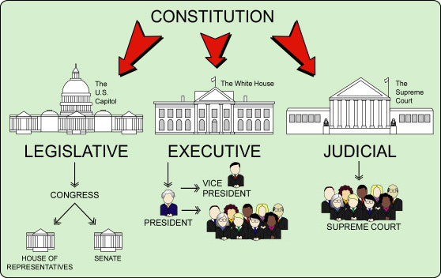
The Three Branches of Government
|
COURTS OF APPEAL
|
DISTRICT COURTS
CABINET
2
Notes:
The Constitution sets up a government with three branches: a legislative, an executive, and a judicial. The legislative branch is usually called Congress and consists of the House of Representatives and the Senate. The executive branch is also referred to as the president. The executive consists of the president, vice president and cabinet. The judicial branch refers to the courts. The highest court in the nation is the Supreme Court.

Slide 3
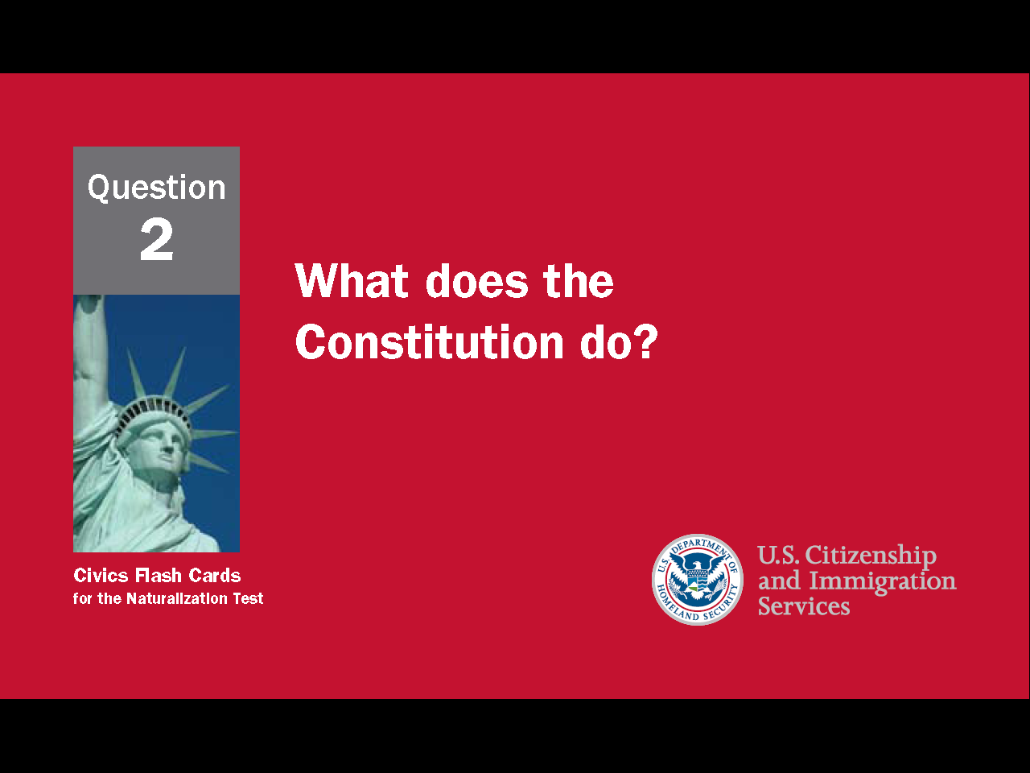
3
Notes:
Question 2. What does the Constitution do?

Slide 4
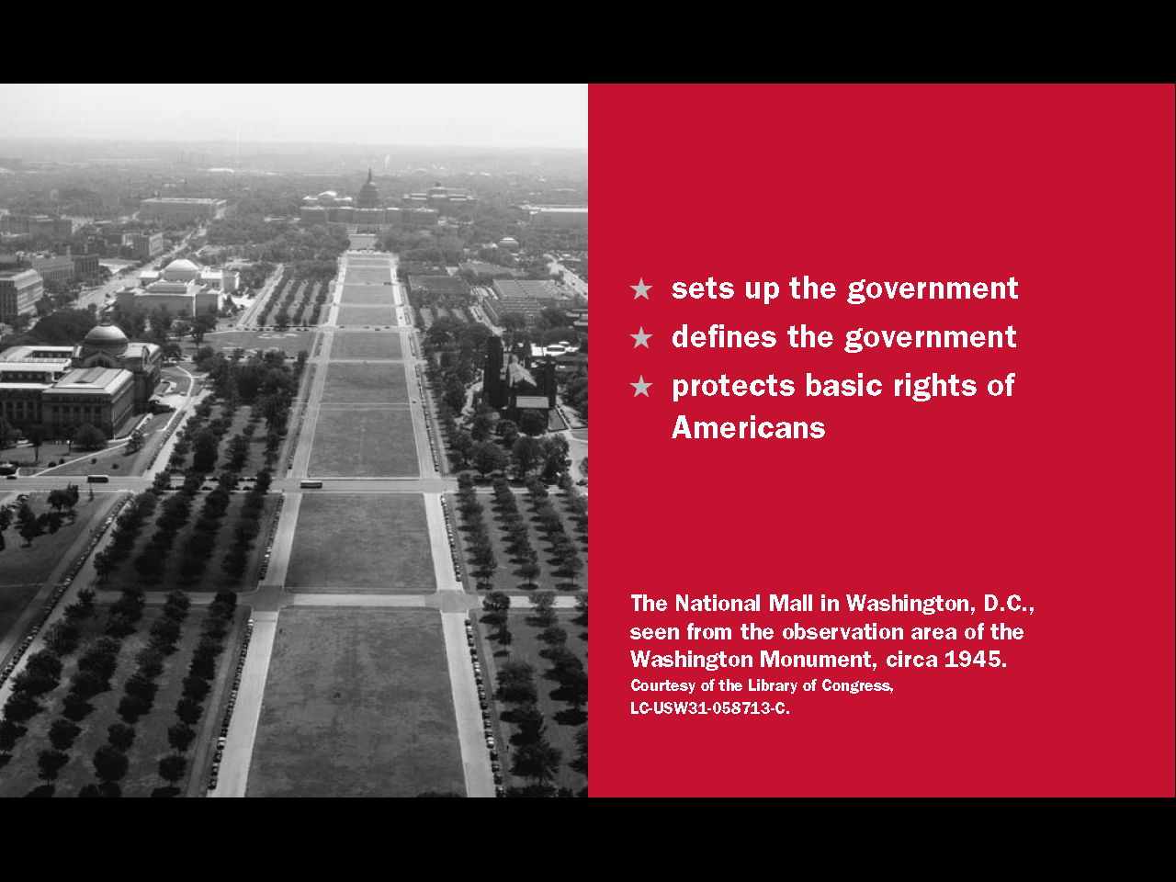
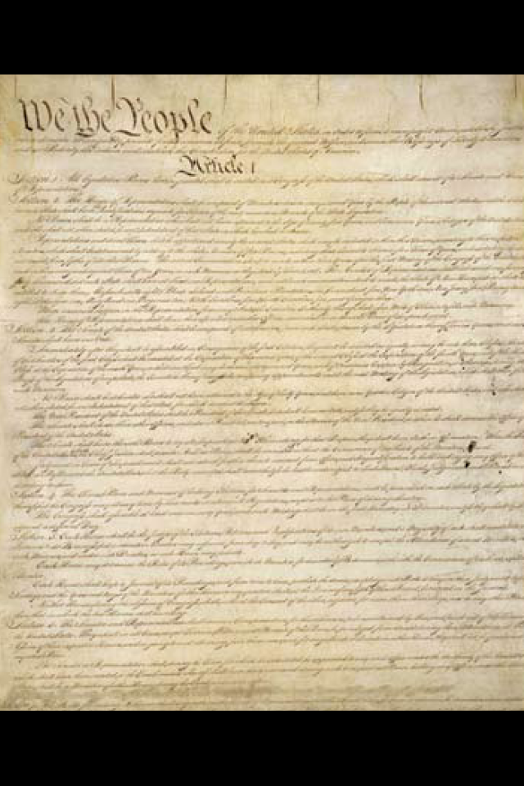
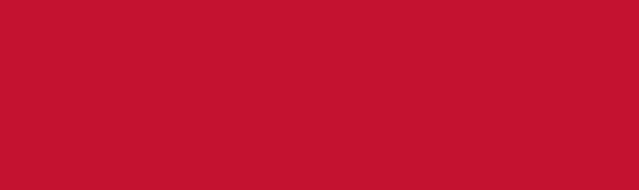
Question #2
4
Notes:
The Constitution
sets up the government
defines the government
and protects the basic rights of Americans

Slide 5
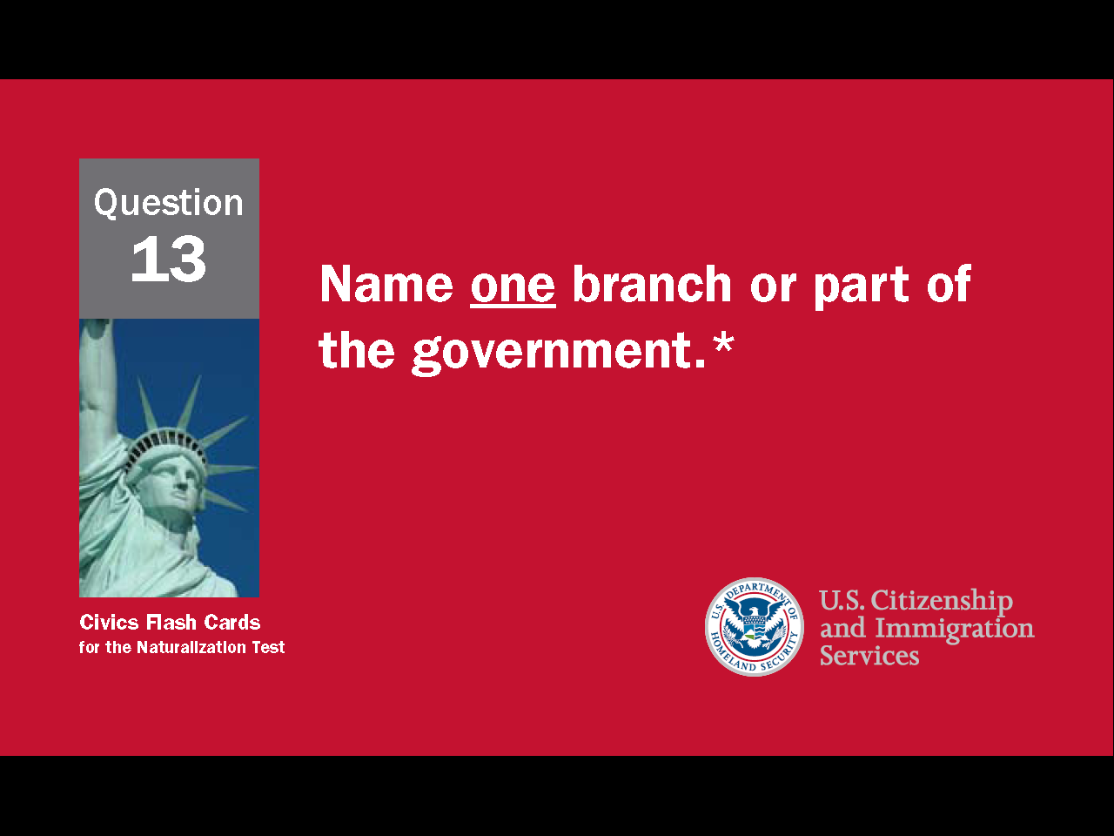
5
Notes:
Question 13. Name one branch or part of the government.

Slide 6
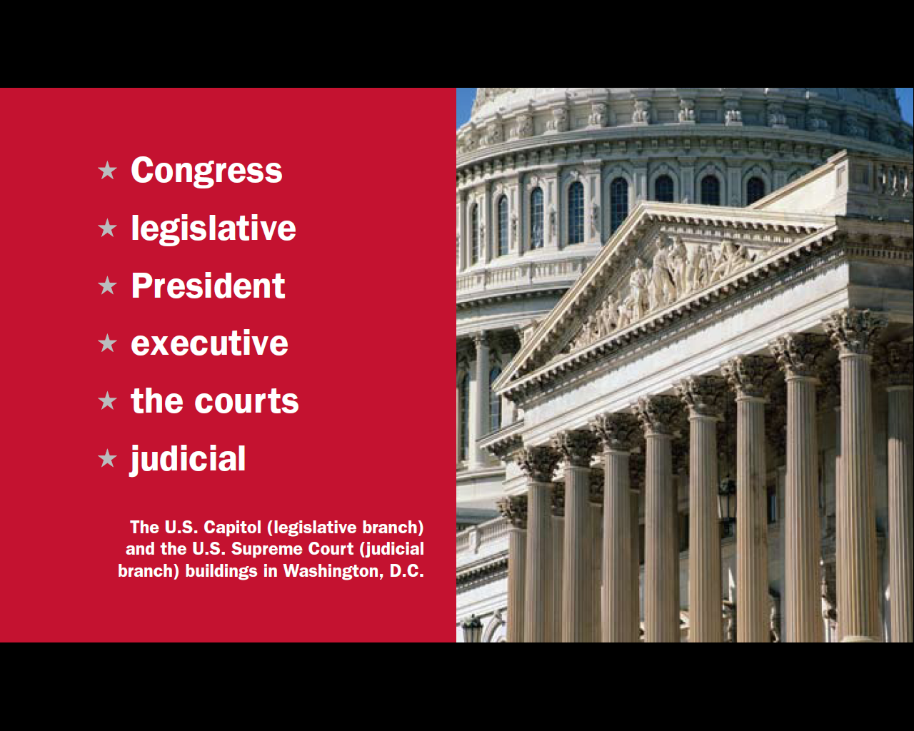
Question #13
6
Notes:
The three parts of the U.S. government are:
Congress, or the legislative branch
the President, or the executive branch
the courts, or the judicial branch

Slide 7
Separation of Powers /
Checks and Balances
PRESIDENT
(Executive Branch)
Can veto a bill
Can declare an executive
action unconstitutional
Can reject a treaty
signed by the president
Appoints federal judges
Can declare a law
unconstitutional
CONGRESS
(Legislative Branch)
THE COURTS
(Judicial Branch)
Approves federal judges
7
Notes:
To stop one branch of the government from becoming too powerful, the Founding Fathers gave each branch separate powers. This is called separation of powers. The Constitution also includes a system of checks and balances which allows one part of the government to "check" another. For example, Congress can reject a treaty signed by the president and the president can veto a bill from Congress. The President appoints federal judges, but Congress must approve them. Lastly, the Supreme Court can declare a law or executive action to be unconstitutional. In these ways, separate powers and checks and balances work to limit the power of government and to protect individual rights.
7

Slide 8
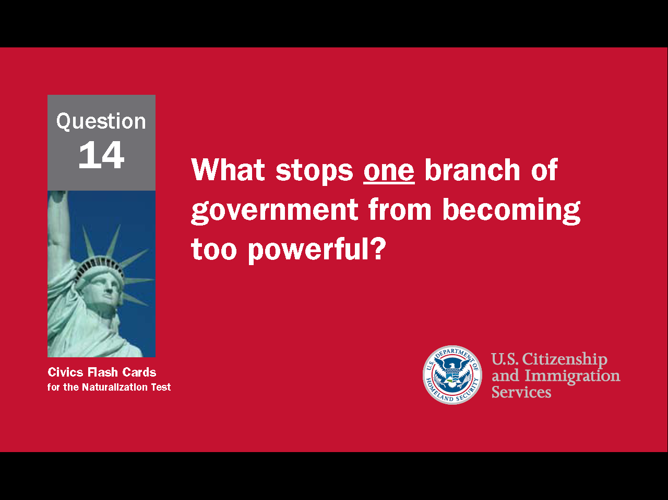
8
Notes:
Question 14. What stops one branch of government from becoming too powerful?

Slide 9
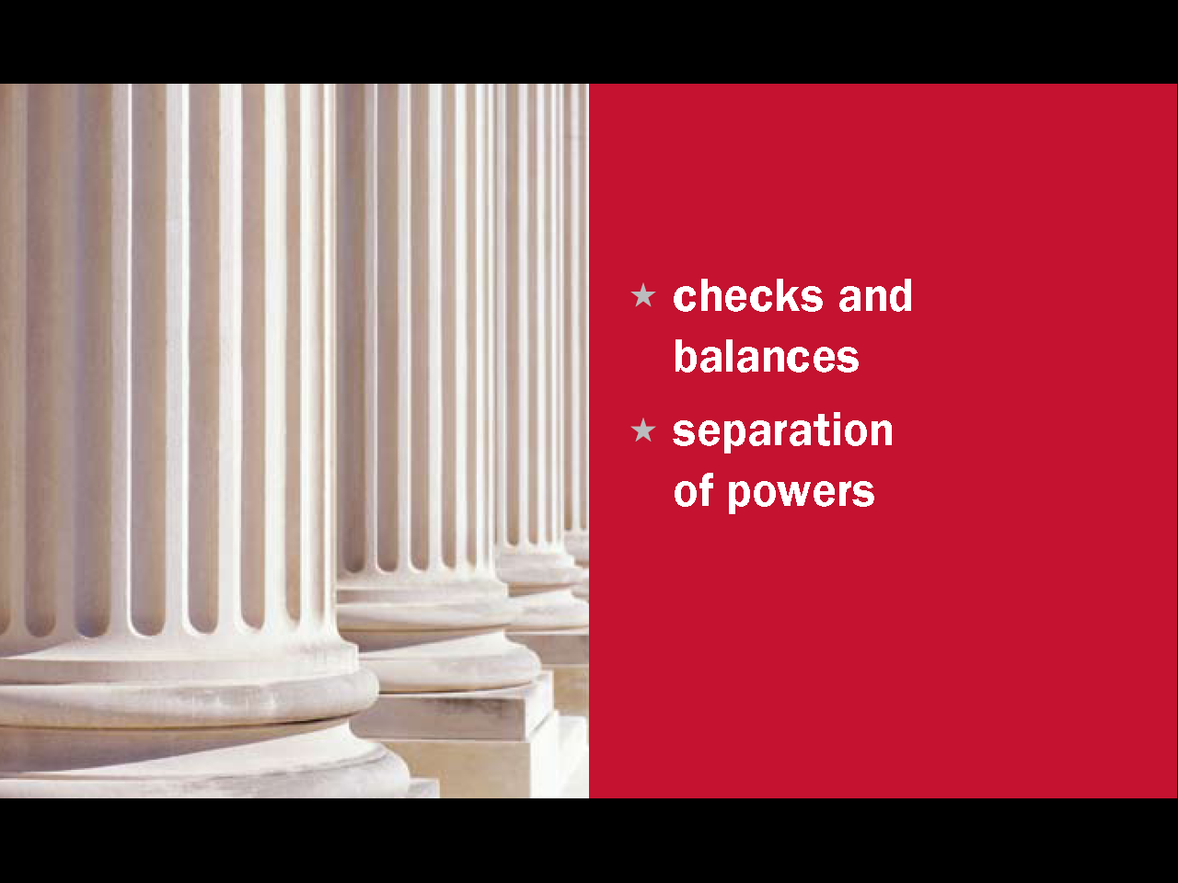
Question #14
9
Notes:
The separation of powers and system of checks and balances keep one branch of government from becoming too powerful.

Slide 10
What does the Judicial Branch do?
The Judicial Branch:
  reviews laws
  explains laws
  resolves disputes (disagreements)
  decides if a law goes against the Constitution
10
Notes:
The job of the judicial branch is to review and explain laws, resolve disagreements, and decide whether a law goes against the Constitution.

Slide 11
The Federal Court System
Supreme
Court
Courts of Appeal (11)
District Courts (94)
11
Notes:
The Constitution set up the judicial branch with the Supreme Court only. As the country grew, Congress established additional lower federal courts. Now the federal court system has three levels. At the bottom are 94 district courts. Every state and territory has at least one district court. Above them are 11 courts of appeal that serve a specific region of the country. At the top is the U.S. Supreme Court. This is the highest court in the nation and it alone resolves disputes between states and determines whether a law goes against the Constitution.

Slide 12
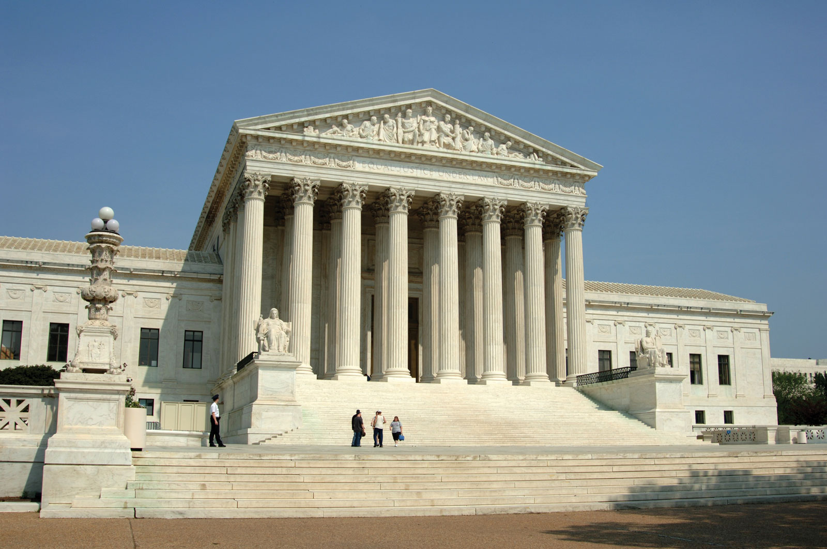
The U.S. Supreme Court
12
Notes:
This is a picture of the U.S. Supreme Court in Washington D.C. Every year about 6000 petitions are made to the U.S. Supreme Court. Of those, only about 60 are chosen to be heard by the court. Two factors that help the court decide whether to hear a case are whether the issues raised are of national importance and if the lower courts are split in their decisions on the case.

Slide 13
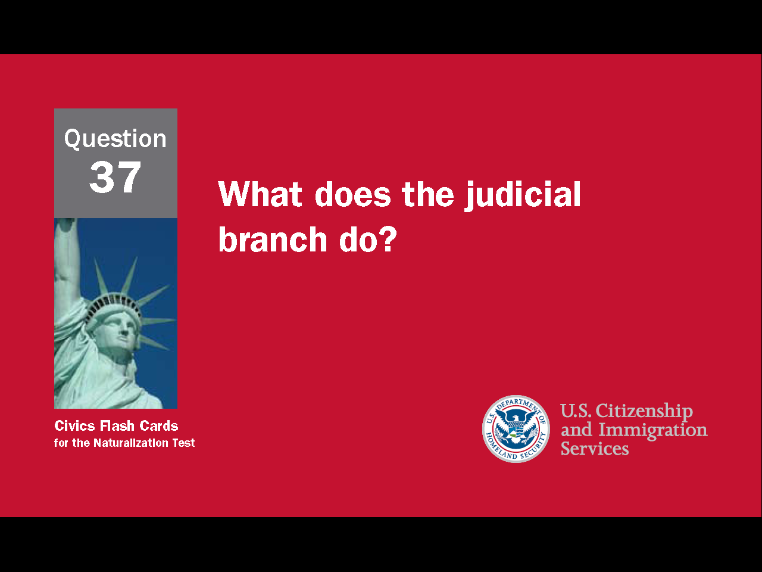
13
Notes:
Question 37. What does the judicial branch do?

Slide 14
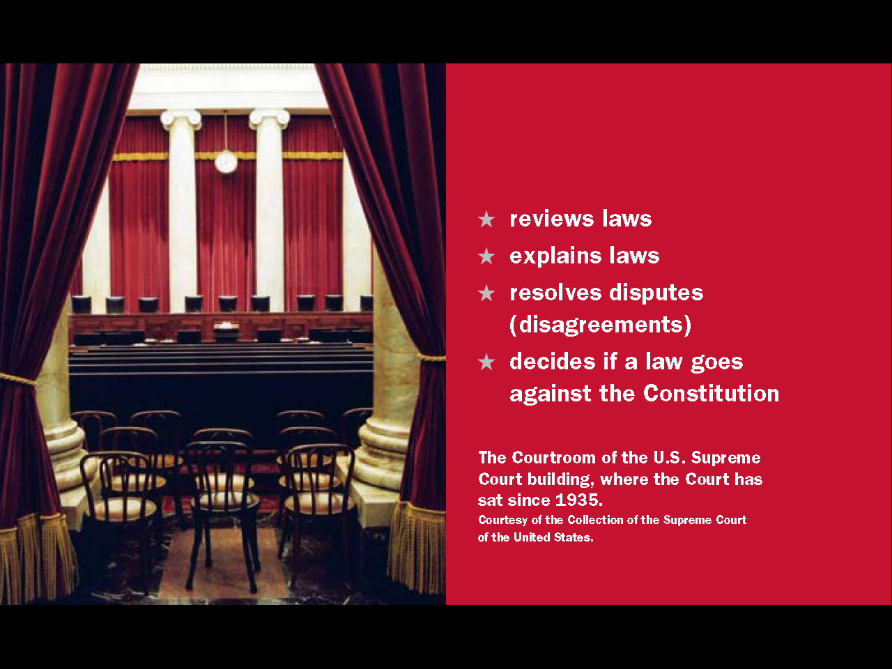
Question #37
14
Notes:
Question 37. What does the judicial branch do?
reviews laws
explains laws
resolves disputes (disagreements)
decides if a law goes against the Constitution

Slide 15
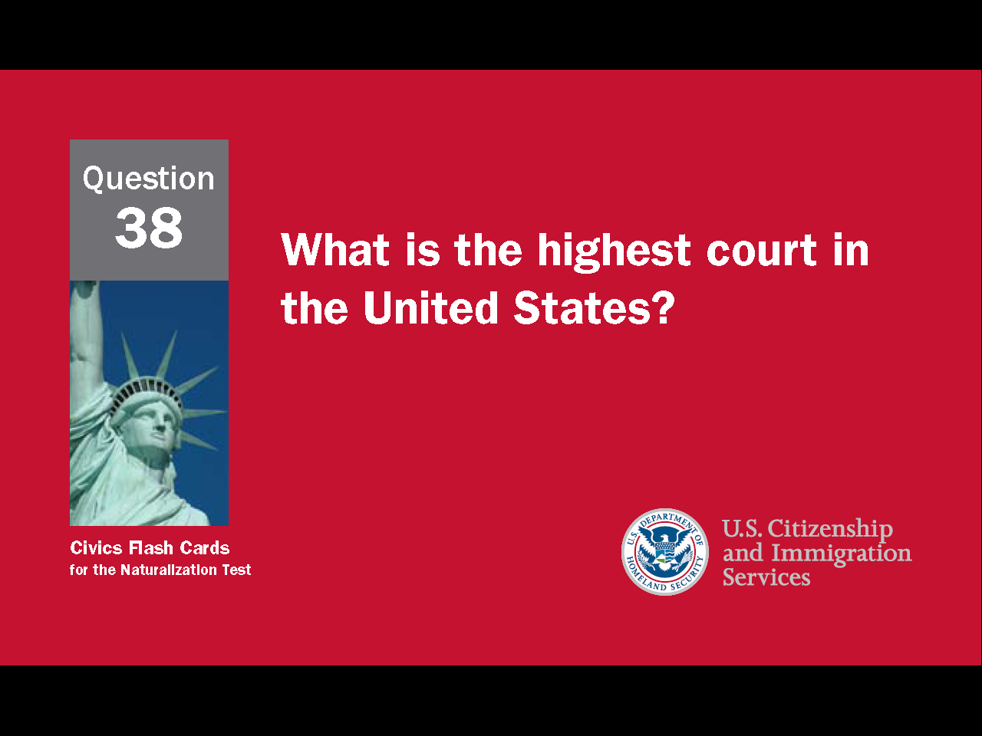
15
Notes:
Question 38. What is the highest court in the United States?

Slide 16
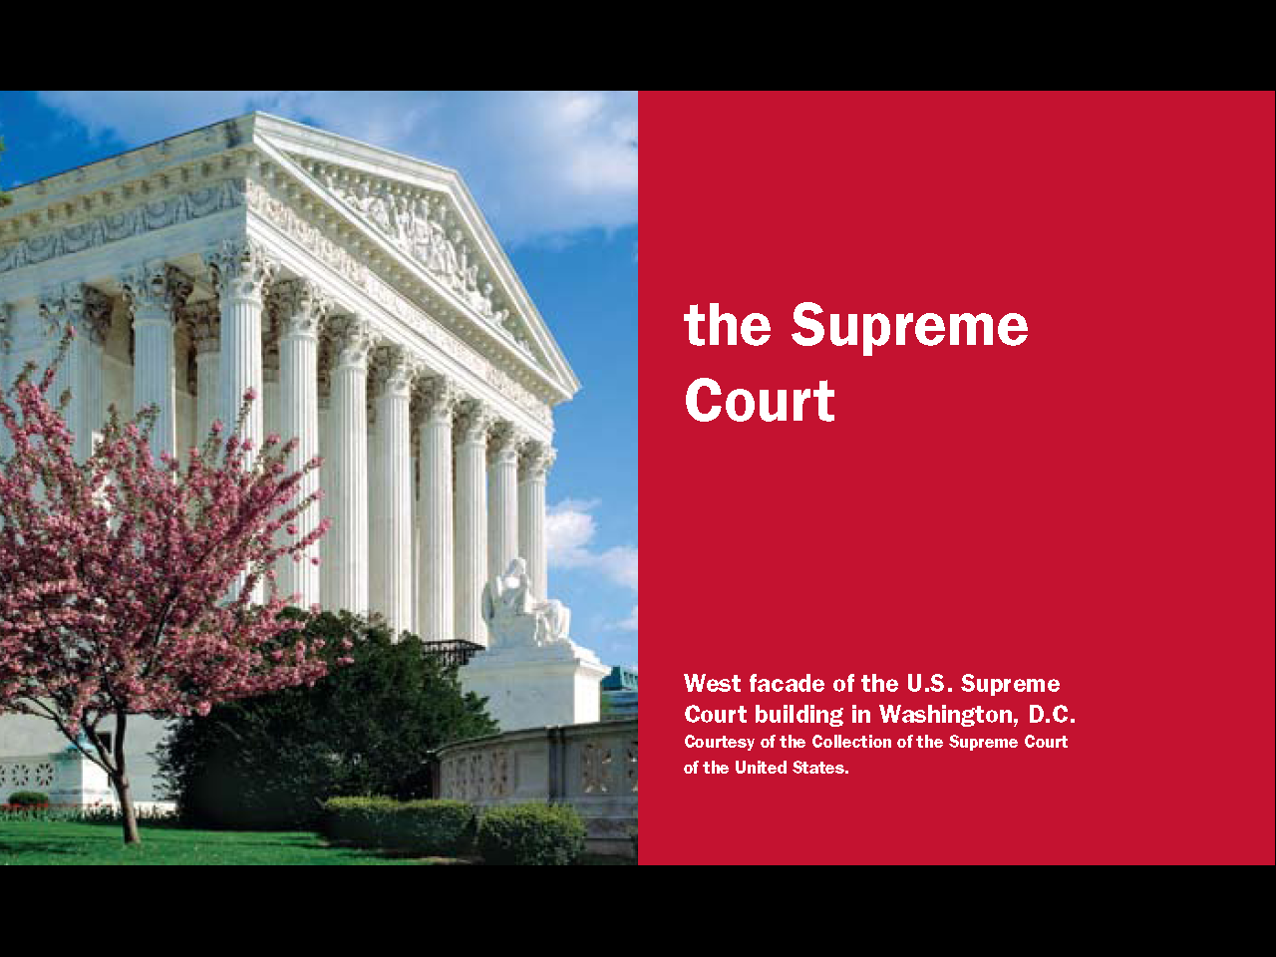
Question #38
16
Notes:
The Supreme Court is the highest court in the United States. As such, it is the "court of last resort."

Slide 17
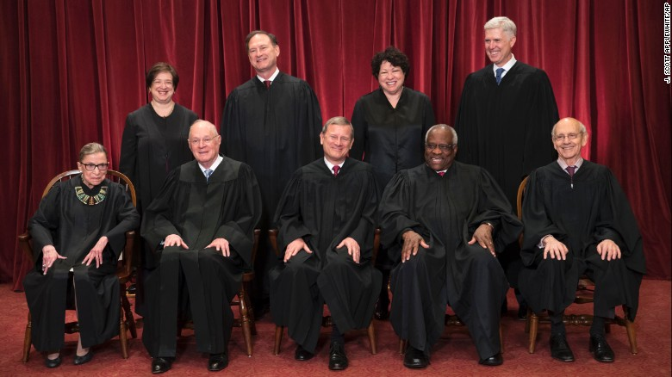
The 9 Supreme Court Justices
Sonia Sotomayor Samuel Alito Elena Kagan Neil Gorsuch
Ruth Bader Anthony Kennedy John Roberts Clarence Thomas Stephen Breyer
Ginsburg (Chief Justice)
17
Notes:
There is a total of nine justices on the Supreme Court - one Chief Justice and eight associate justices. Nine judges means that when the court votes there is always a definite decision. Justices are appointed by the President, approved by Congress, and serve for life. The Chief Justice is the head of the federal judiciary and the Supreme Court. In the Supreme Court, the Chief Justice sets the court's agenda, and leads the court when it is in session. The Chief Justice also administers the oath of office to all new Presidents and, in the case of an impeachment of the President, oversees the trial in the Senate. The current Chief Justice is John Roberts Jr.

Slide 18
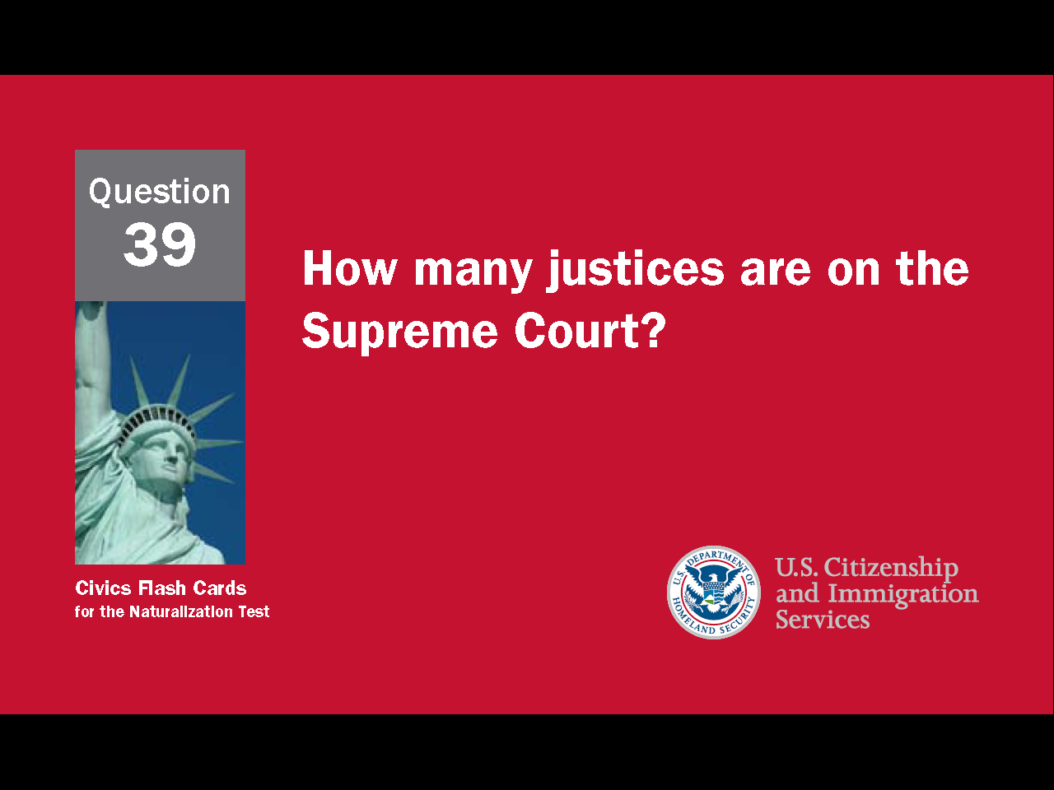
18
Notes:
Question 39. How many justices are on the Supreme Court?

Slide 19
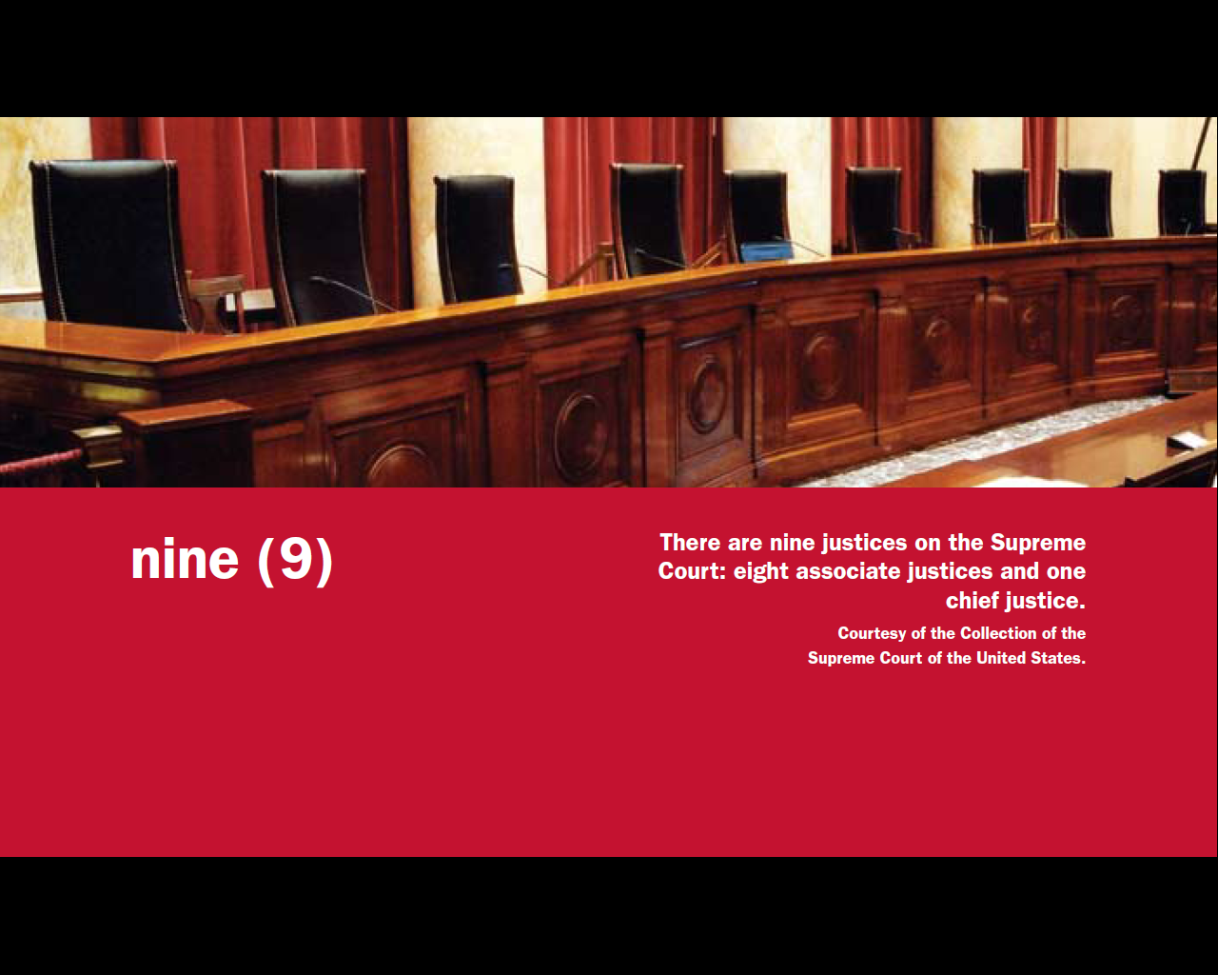
Question #39
19
Notes:
Nine. There are nine justices on the Supreme Court.

Slide 20
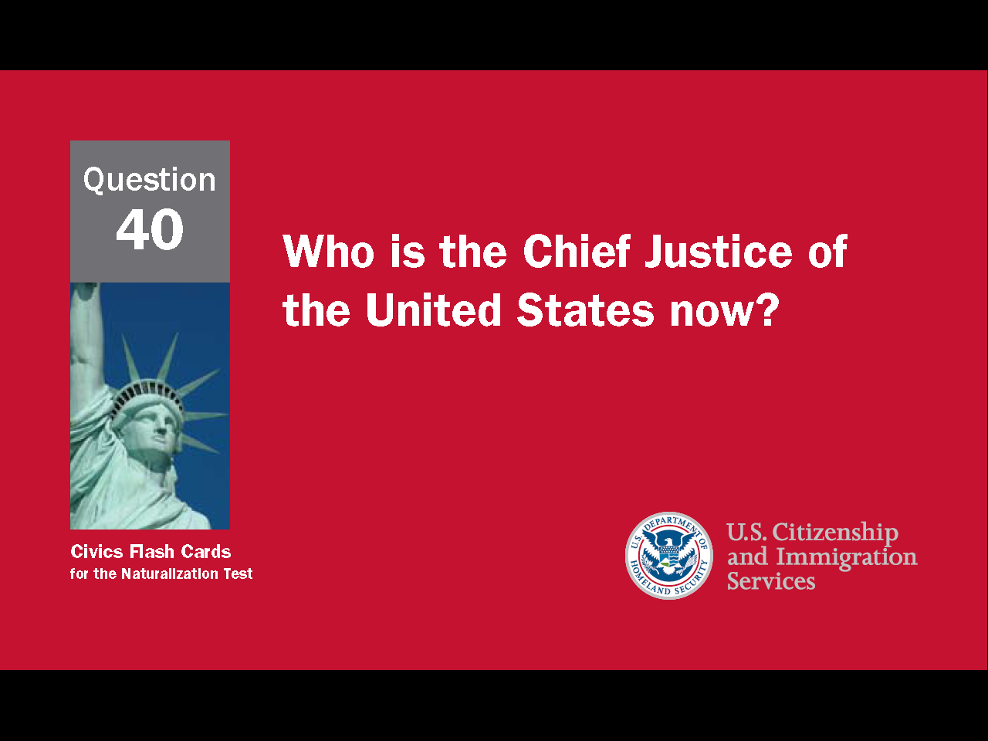
20
Notes:
Question 40. Who is the Chief Justice of the United States now?

Slide 21
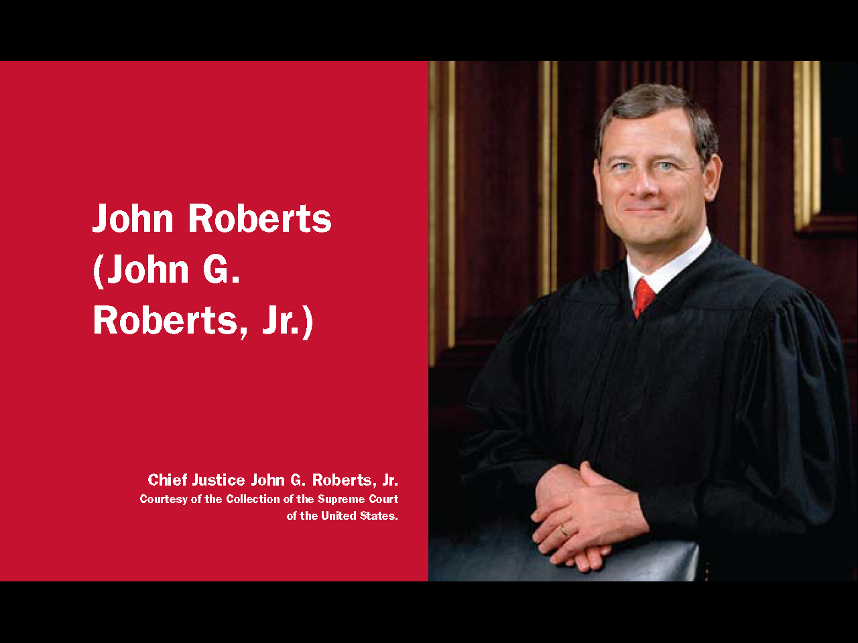
Question #40
21
Notes:
John Roberts Jr. is the Chief Justice of the Supreme court now.

Slide 22
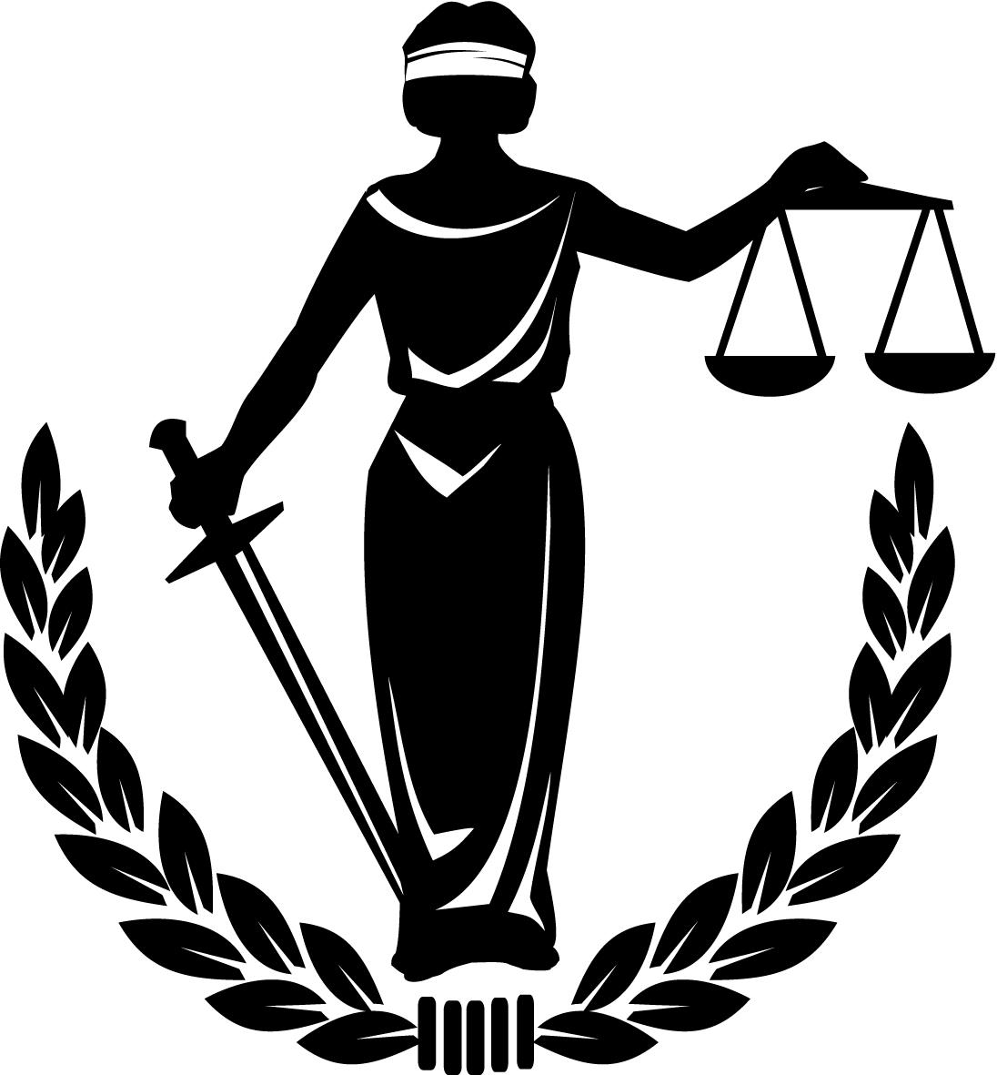
The
Rule
of
Law
22
Notes:
By ignoring the Supreme Court, Governor Faubus was going against a basic principle behind the Constitution - the rule of law. The rule of law means everyone must obey the law, even leaders and the government.

Slide 23
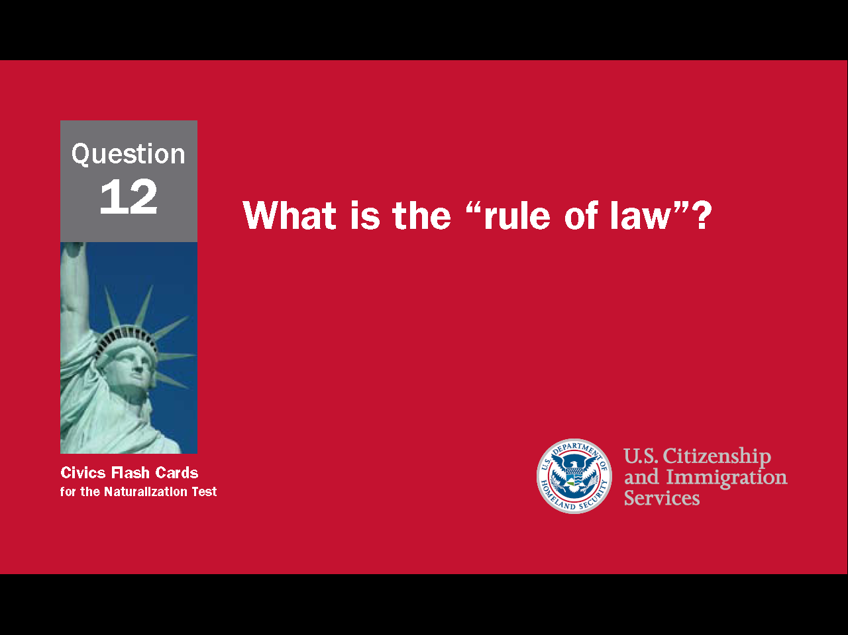
23
Notes:
Question 12. What is the “rule of law”?

Slide 24
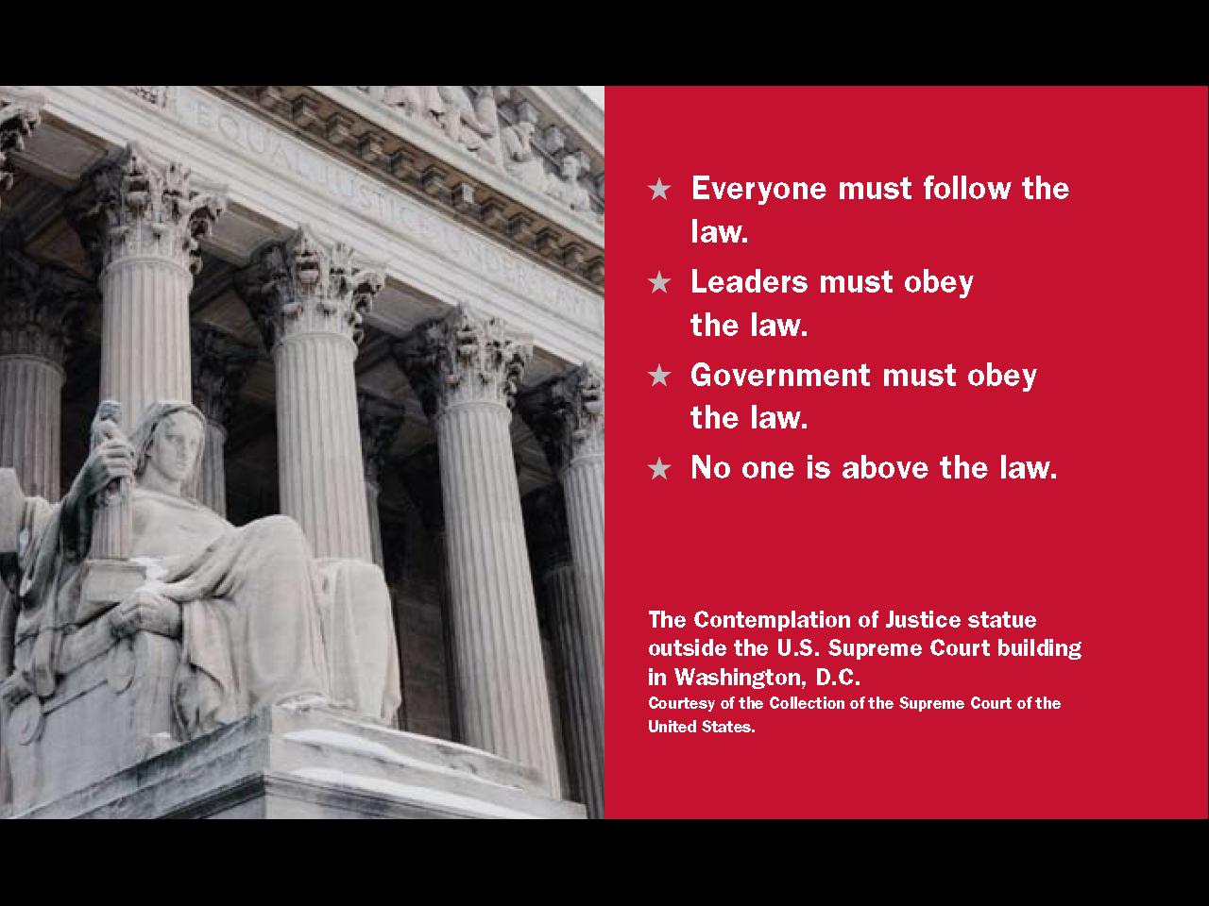
Question #12
24
Notes:
The rule of law means:
Everyone must follow the law.
Leaders must obey the law.
The government must obey the law.
No one is above the law.

Slide 25
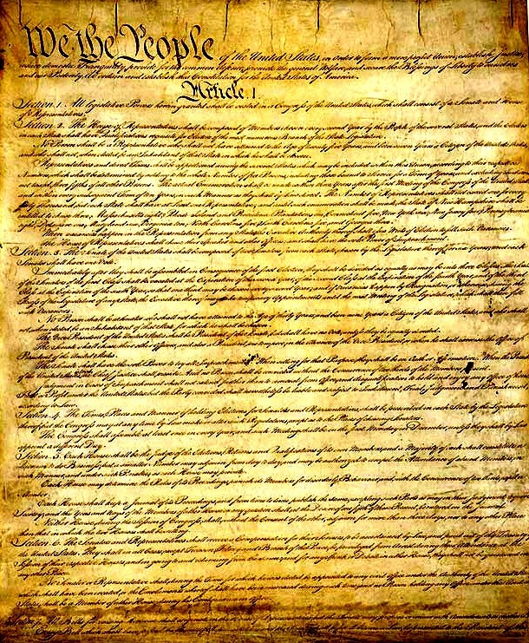
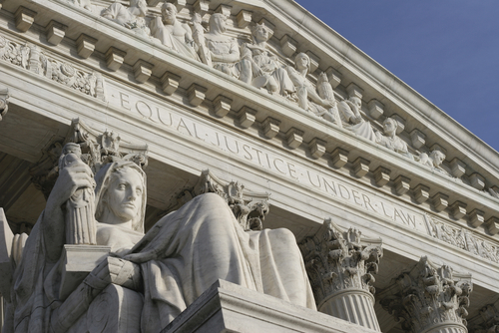
The Supreme Court
Interprets and Upholds the Constitution
25
Notes:
Using the Constitution as its guide, the Supreme Court has played an important role in the evolution of American democracy and civil rights. Some of its most important decisions have helped define the powers of the three branches of government, end segregation, and protect the basics freedoms of Americans. As the highest court in the land, Supreme Court decisions are final and apply to everyone in the United States. Because of its authority, the court's decisions can be very controversial.

Slide 26

Texas v. Johnson (1989)
26
Notes:
One controversial ruling is Texas versus Johnson. Gregory Johnson was arrested for burning a U.S. flag during the 1984 Republican Convention. At that time, 48 states had laws protecting the American flag. Johnson was sentenced to a year in prison and fined $2,000. He appealed his conviction and in 1989 the Supreme Court voted 5-4 that the burning of an American flag is a form of free speech.

Slide 27
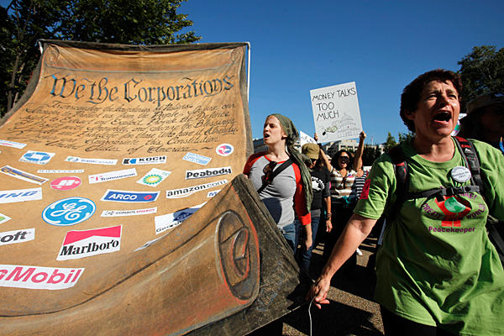
Citizens United v. FEC (2010)
Citizens United v. FEC (2010)
27
Notes:
A more recent ruling is from the Citizens United v. Federal Election Commission case of 2010. At that time, corporations and unions could not make direct contributions to political parties or federal candidates. There were also restrictions on when these organizations could pay for political advertisements. In the Citizens United case, the Supreme Court ruled that these restrictions were a violation of free speech. This is a controversial decision because many people believe corporate spending is harmful to the democratic system. For example, in 2012, the presidential and congressional candidates spent $6 billion on their campaigns and most of the money came from corporations and unions.

