Slide 1
Lesson 10
Integrated Civics
A: Geography
B: Symbols
C: Holidays

Slide 3
Question # 71

Slide 5
Question # 88

Slide 7
Question # 89

Slide 9
Question # 90

Slide 11
Question # 91

Slide 13
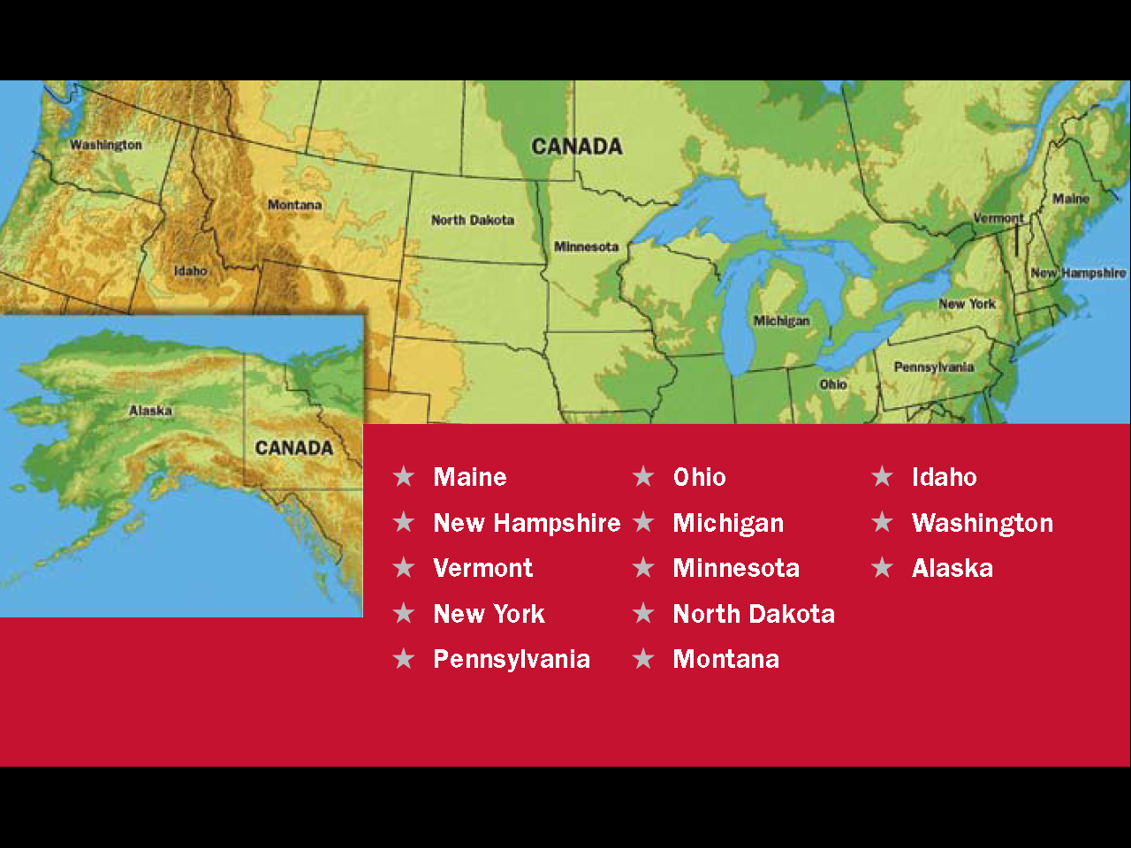
Question # 92

Slide 15
Question # 93

Slide 17
Question # 94

Slide 19
Question # 95

Slide 21
Question # 96

Slide 23
Question # 97

Slide 25
Question # 98

Slide 27
Question # 99
Question # 99

Slide 29
Question # 100

