Slide 1
Lesson 3 American Government
A: Principles of American Democracy
Questions: 1, 3, 2, 66, 67, 5, 4, 7, 6, 10
1

Slide 2
Question # 1

Slide 3
Question # 66

Slide 4
Question # 3

Slide 5
Question # 2

Slide 6
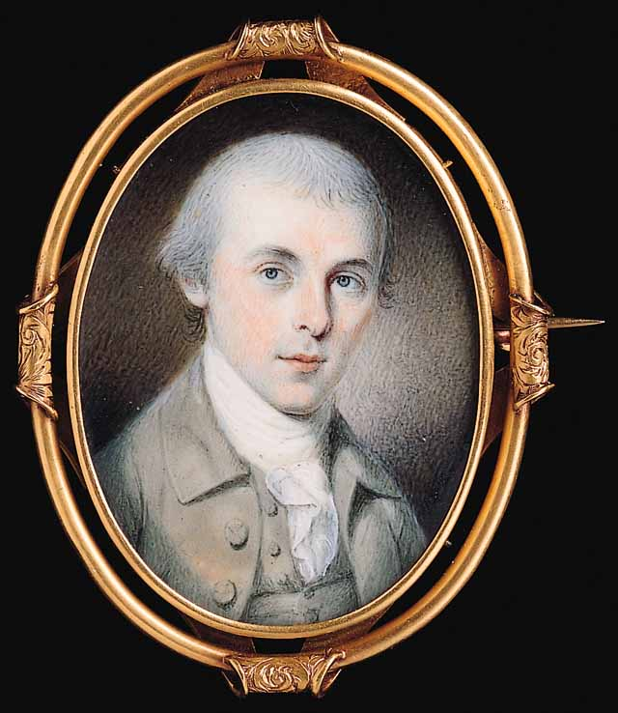
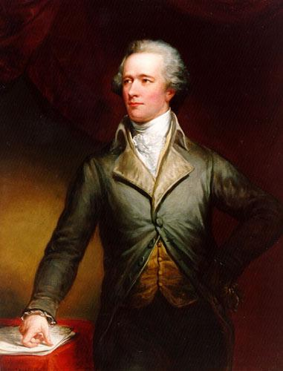
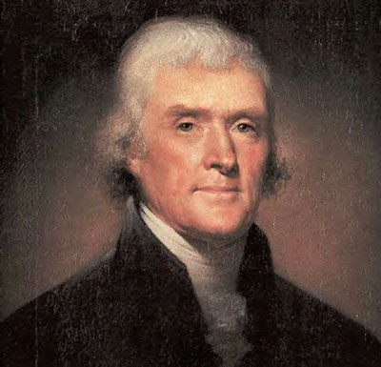
James Madison
Thomas Jefferson

Slide 7
Federalists

Slide 8
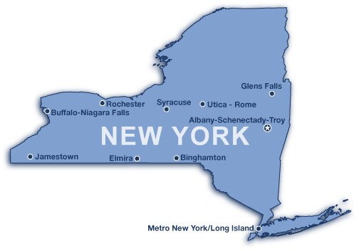
The Federalist Papers

Slide 9
Question # 67

Slide 10
Question # 5

Slide 11
Question # 4

Slide 12
Question # 7

Slide 13
Question # 6

Slide 14
Question # 10

