Slide 1
Lesson 5 American History
C: Recent American History & Other Important Historical Information
Section: Civil Rights
Questions: 4, 48, 77, 38, 12, 84, 85, 51, 28

Slide 2
Voting Rights

Slide 3
Question # 4

Slide 4
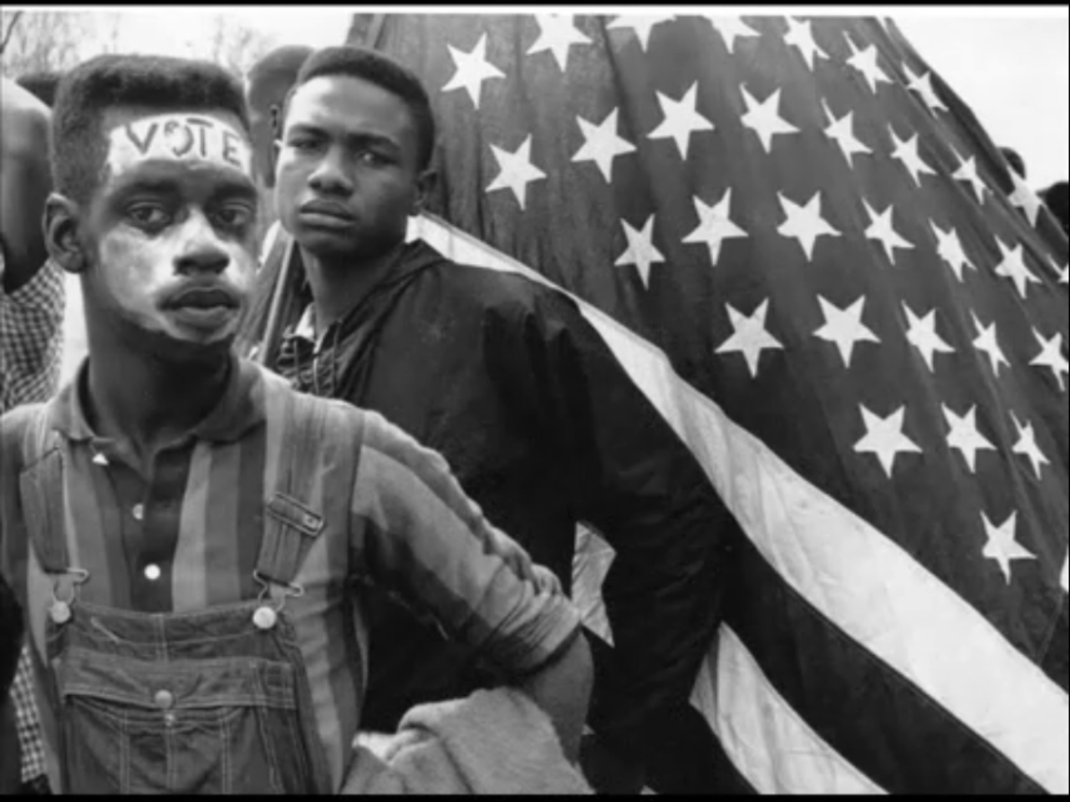

Slide 5
Question # 48

Slide 6
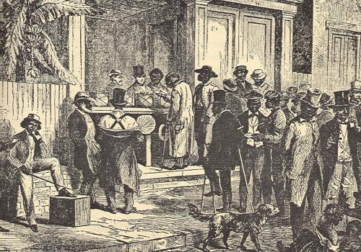
Voter Discrimination, Literacy Tests, Poll Taxes

Slide 7
Question # 48

Slide 8
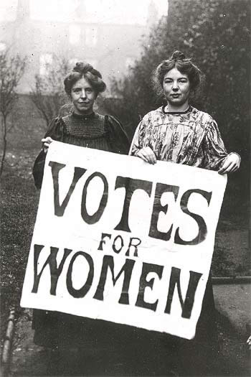

Slide 9
Question # 77

Slide 10
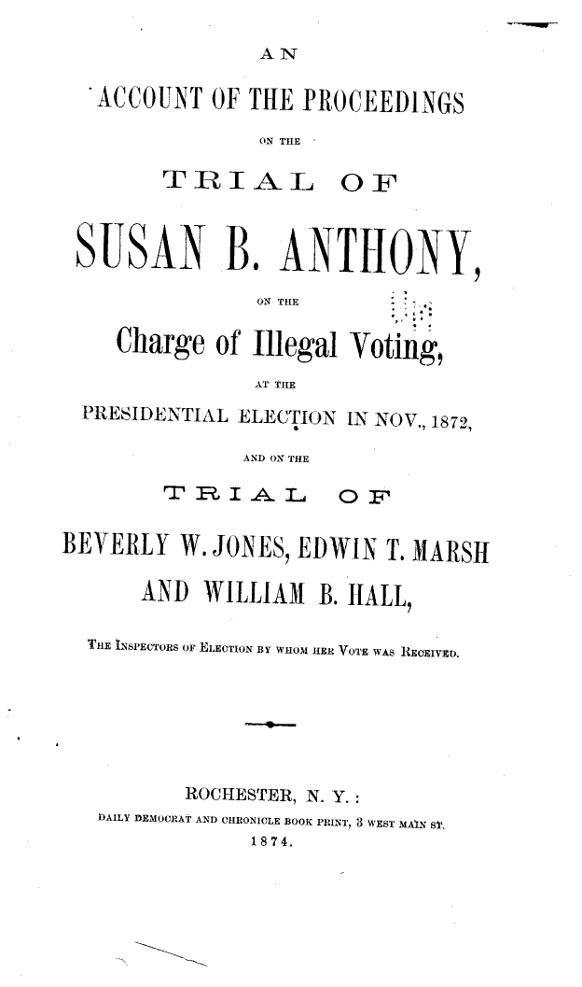
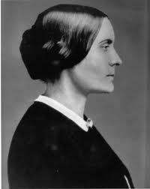

Slide 11
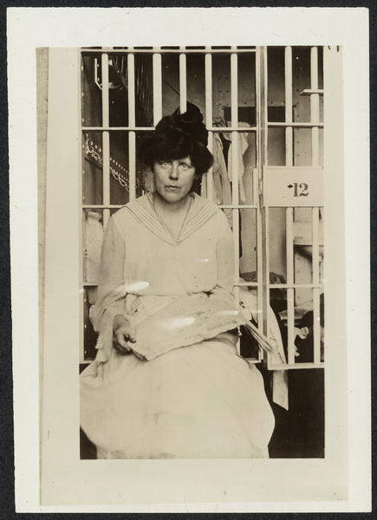
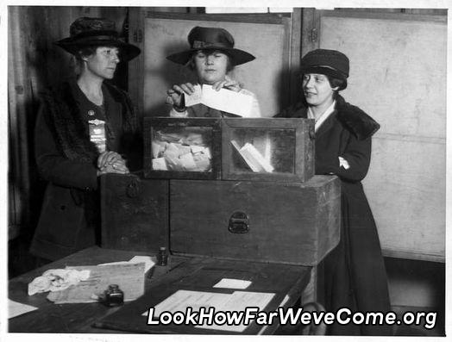
1920

Slide 12
Question # 48
Question # 48

Slide 13
American History
The Civil Rights Movement

Slide 14
Question # 84

Slide 15
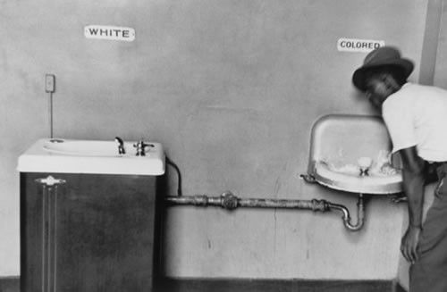
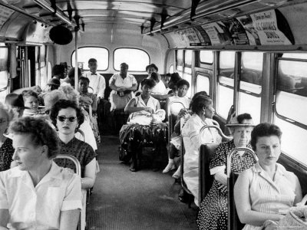
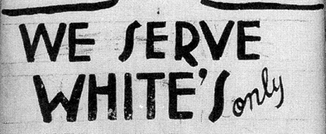
Segregation = Separation
Discrimination

Slide 16
Question # 38

Slide 17
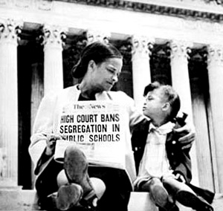
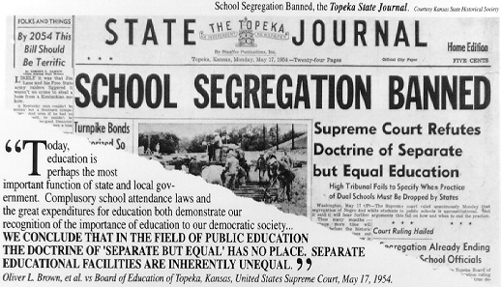
The Supreme Court’s decision to end segregation in schools - 1954

Slide 18
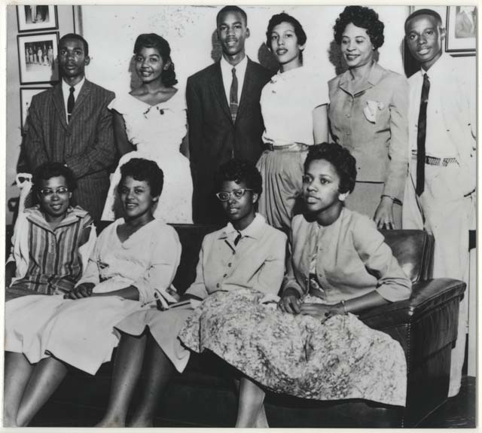
The Little Rock Nine

Slide 19
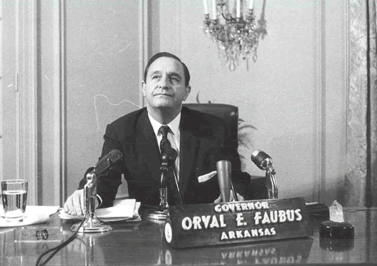
Governor of Arkansas

Slide 20
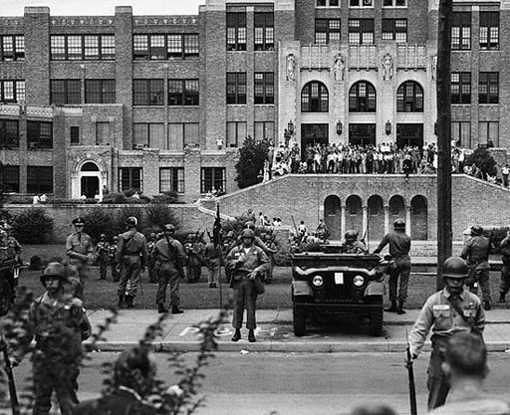
Little Rock High School, Arkansas

Slide 21
Question # 12

Slide 22
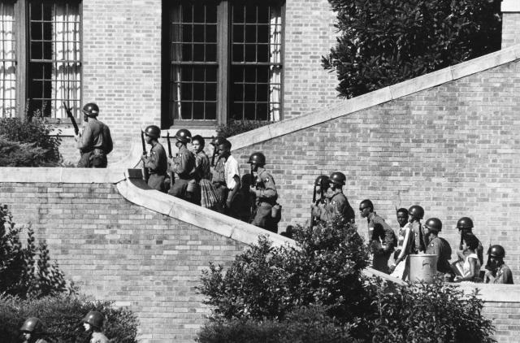
The President Sends The Federal Army

Slide 23
Question # 85

Slide 24
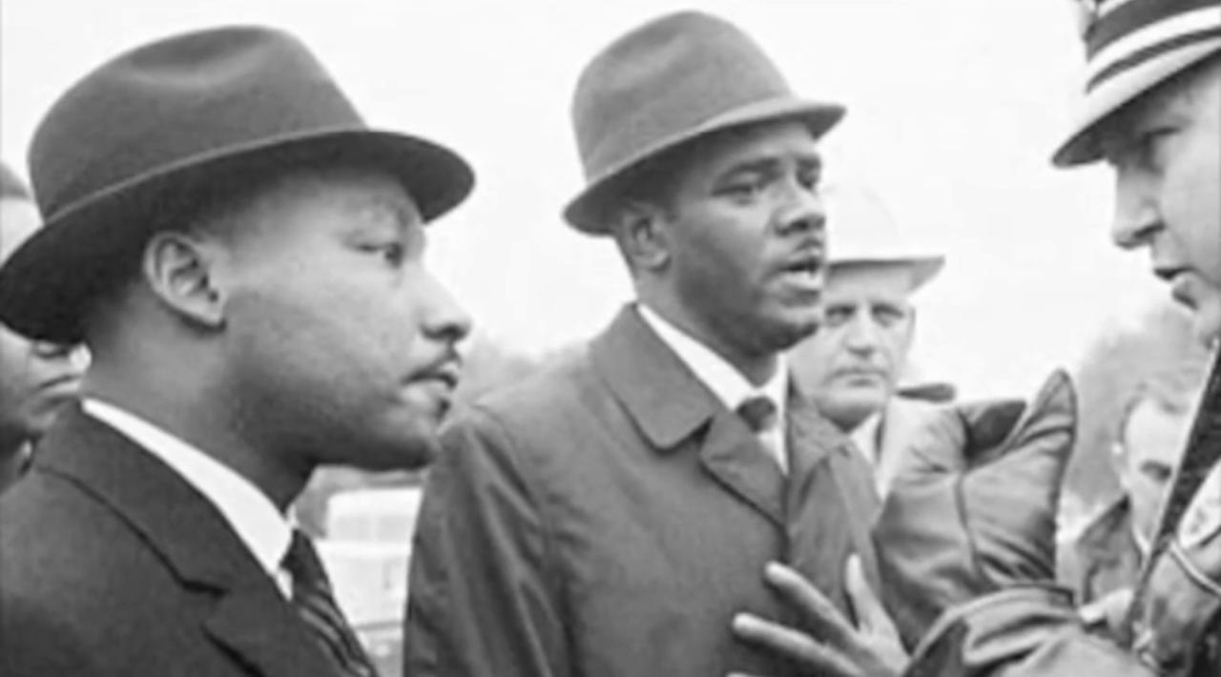
March Birmingham, Alabama - 1963

Slide 25
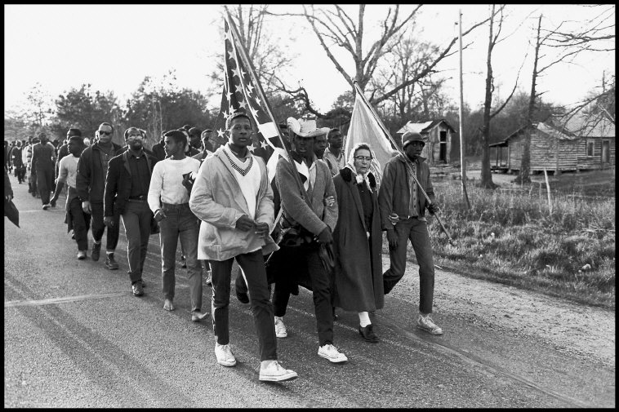
March to Birmingham

Slide 26
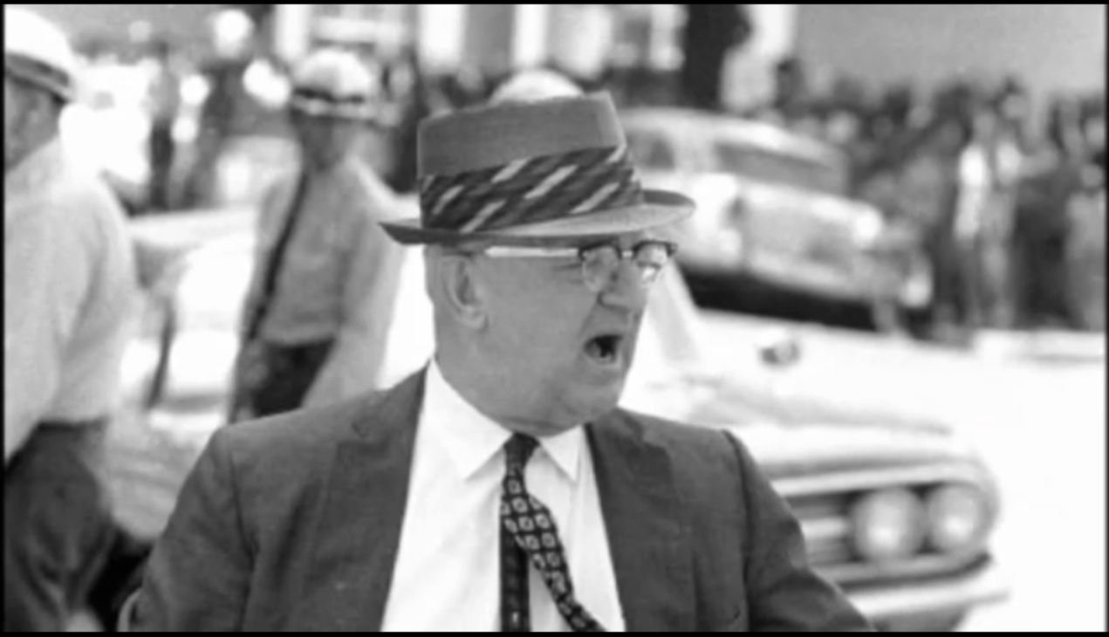

Slide 27
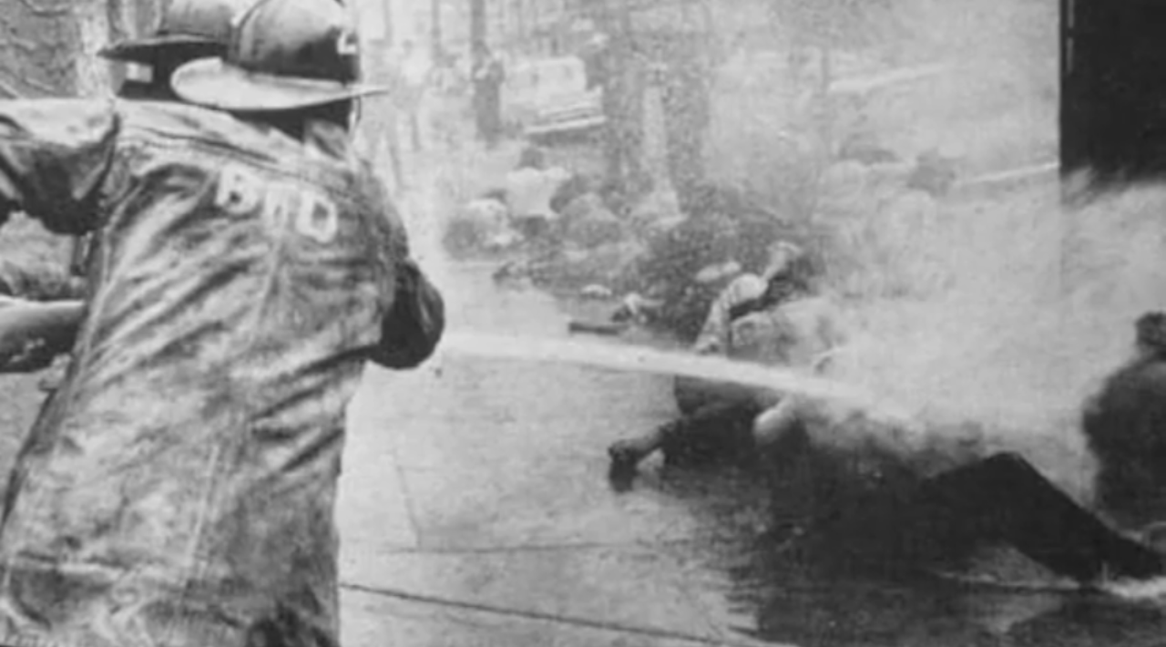

Slide 28
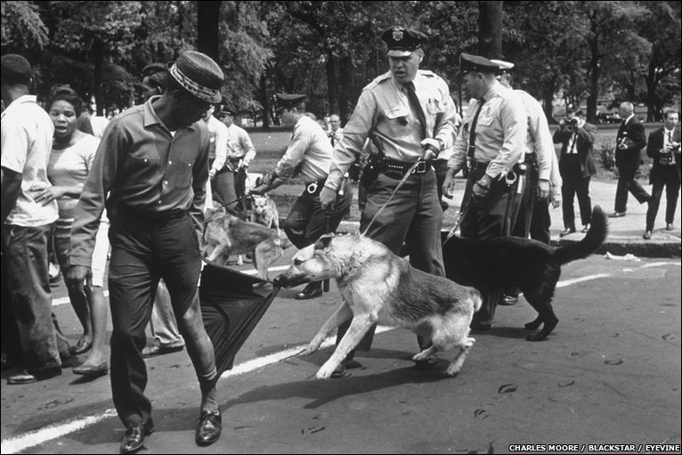
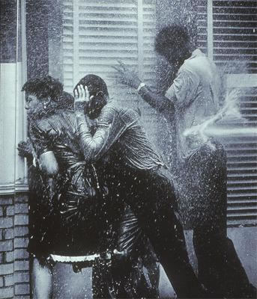

Slide 29
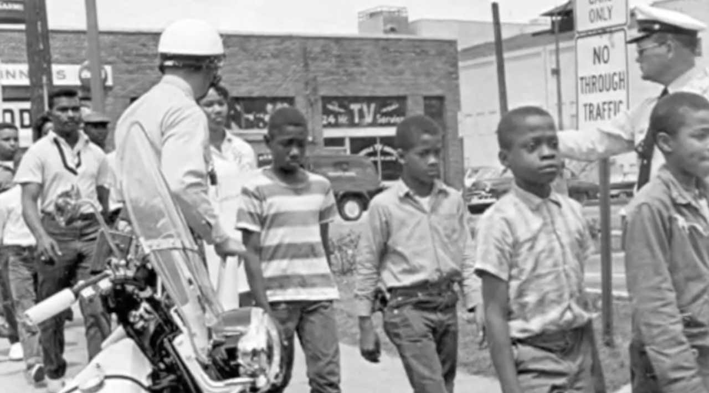

Slide 31
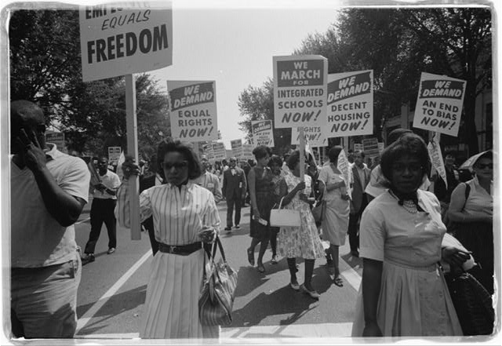
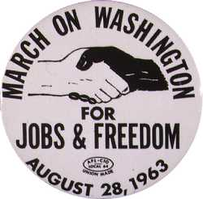
March to Washington D.C.

Slide 32
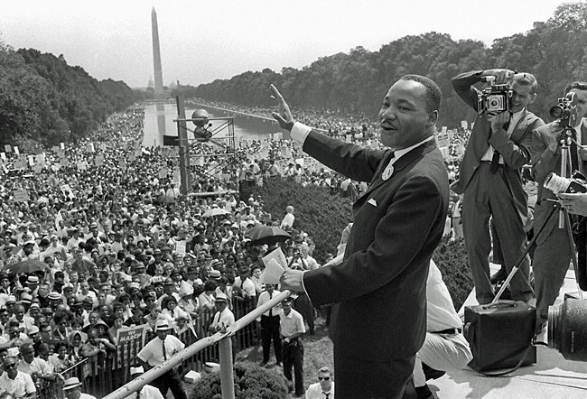
250,000 protesters

Slide 33
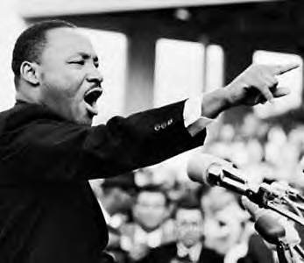
I Have A Dream Speech

Slide 34
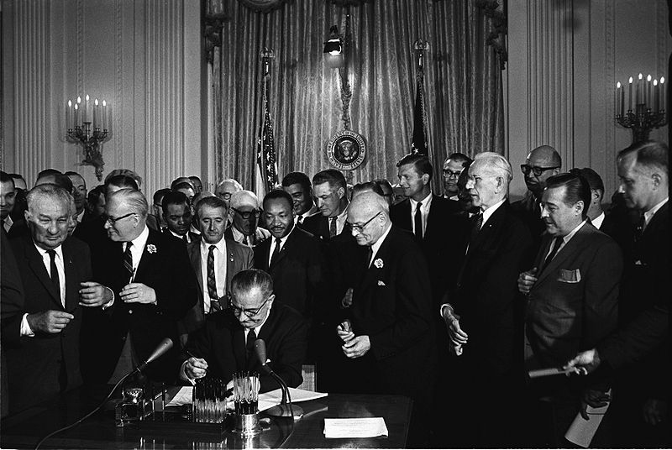
Civil Rights Act - 1964

