Slide 1
Hartford Public Library
Citizenship Class
Welcome to Lesson 1
An Overview of the Naturalization Process

Slide 4
What are the requirements to become a US citizen?

Slide 5
You must be at least 18 years old at the time of filing
Form N-400, Application for Naturalization.

Slide 6
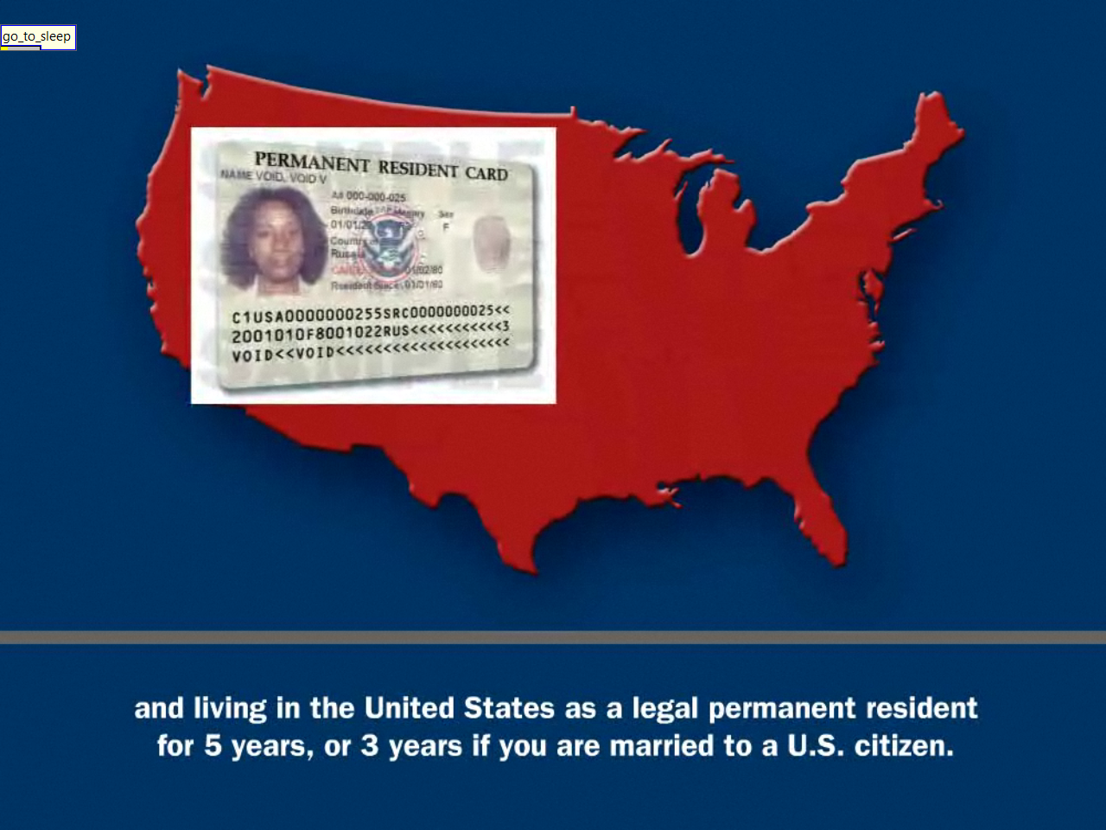
You must be in the United States as a legal permanent resident
For five years (or 3 years, if you are married to a US citizen)

Slide 7
You must maintain continuous residence in the U.S.
Continuous residence means that you actually have lived in the US
As a permanent resident without going on a long trip outside of the US
You must not go on a trip that lasts longer than six months.

Slide 9
Maintain Physical Presence in the U.S.

Slide 10
You must file an application for naturalization

Slide 19
You must have a basic understanding of
U.S. history and government (civics).

Slide 20
Becoming a U.S. Citizen: An Overview of the Naturalization Process
http://www.hplct.org/tap/Citizenship/ApplyForCitizenship.shtml
A Promise of Freedom (English captions)
http://www.hplct.org/tap/Citizenship/E-Learning.shtml

