Slide 1
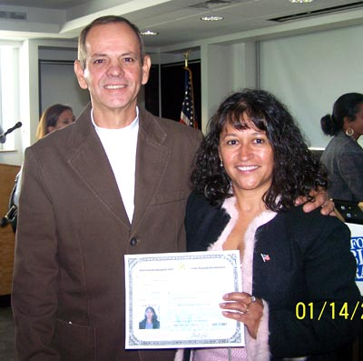
The American Place Hartford Public Library
Notes:
Greetings everyone and thank you for joining us. The American Place is Hartford Public Library’s program for immigrants and refugees. It offers a broad range of services but for the purpose of todays presentation we’ll only focus on our Citizenship Preparation services which has been funded in large part by USCIS and IMLS.

Slide 2
Core Values of Libraries
Trust: Libraries respect user privacy and confidentiality.
Professionalism: Library services are provided by qualified information specialists.
Access/Democracy: Libraries offer a neutral setting with free and equal access to information for all people.
Diversity: Libraries value our nation's diversity and strive to reflect that diversity by providing a full spectrum of resources and services.

Slide 3
The American Place
Citizenship
Application support
Education
ESL
Workforce Readiness
Servsafe
Patient Care Assistant
Teens4Citizenship
After-School English Club
ABE/High School Completion
Coalition Building
Community Dialogues
Bridging Cultures Book Groups
Instruction
We Belong Campaign
Building Relationships of Trust
Cultural Navigator Volunteers
American Job Center

Slide 4
Effective Cultural Navigators
Listen and draw out their mentees
Interact with cultural sensitivity
Are nurturers of possibilities
Serve as “guides on the side”
Tap their own established networks
Show up

Slide 5
YouTube: Voices of Asylum Hill

